Slide 1
EE 152 Real-time embedded systems
Tufts University
Instructor: Joel Grodstein
joel.grodstein@tufts.edu
Day #1

Slide 2
What is this course, anyway?
Name of the course: Real-time Embedded Systems
What is an embedded system?
Something that computes but isn’t a computer
One example: anti-lock brakes
Any other examples?

Slide 3
Real-time embedded systems
OK, now we know what “embedded” means ☺
Real-time means that it analyzes data immediately, with stringent constraints on response time
What real-time embedded devices can you think of?
Automotive (anti-lock brakes, traction control, …)
Medical (pacemaker, defibrillator, surgical robots, handheld ultrasound, …)
For each one: what is the input signal? The output? The processing in between?

Slide 4
Goals for the course
Now we know what “real-time embedded system” means
Goals for the course
Learn the issues (HW, SW, debug) that make this hard
Note: “debug” is sometimes the hardest!
Build a real-time embedded medical device

Slide 5
How I spent summer vacation
How do you think I spent my summer?
at the beach
researching Important Stuff
trying to understand enough about embedded systems to teach this course
Most eye-opening part for me: infrastructure wars

Slide 6
So many infrastructures…
How many embedded-programming environments can you think of?
Arduino, Raspberry Pi, MicroPython, CircuitPython, mbed
STM CMSIS, LL, HAL
Infineon PDL, HAL
C vs. C++ vs. assembly
Can anyone make a quick case for pros and cons of some of these?
We’ll learn how to choose the right tool for the job
Notes:
Time to start answering this question!

Slide 7
Agenda for today
What is this course about?
Course web page, course format & workload
Industry survey

Slide 8
Class web page
https://www.ece.tufts.edu/ee/152RTE
Syllabus, class calendar, all lecture slides
All labs, as well as the lab turn-in

Slide 9
Class format
Divided up into groups of ≈3 people
Try to have different skill sets in each group (SW, HW)
All labs are done by group (just turn in one report)
Can switch groups halfway through the course
Roughly half lectures, half labs (see class calendar)

Slide 10
Workload
No tests (so far)
Labs take up about half the course (including prep, reports)
Maybe a homework or two (also by group)

Slide 11
Physical labs
Measure your own ECG (heartbeat signal)
Equipment:
Small pre-amp, scope
STM32L432 Nucleo board
Recording your own signals is optional
It is confidential medical data
Turn in one data set per group (or turn in mine)
None of us are clinically qualified to diagnose from an ECG
Any abnormalities you see may well be artifacts of our cheap equipment See a licensed doctor if you have concerns

Slide 12
People
Me: Joel Grodstein
TAs: ??

Slide 13
Agenda for today
What is this course about?
Course web page, course format & workload
Industry survey

Slide 14
2023 Embedded Market survey
Performed by Aspencore
https://www.embedded.com/embedded-survey/
655 respondents
52% software people, 47% HW/SW integration, 38% HW
Current project is new = 45%, incremental update 55%
Survey + talking to industry people drove course decisions
Real goal for this course: make you look good on a job interview

Slide 15
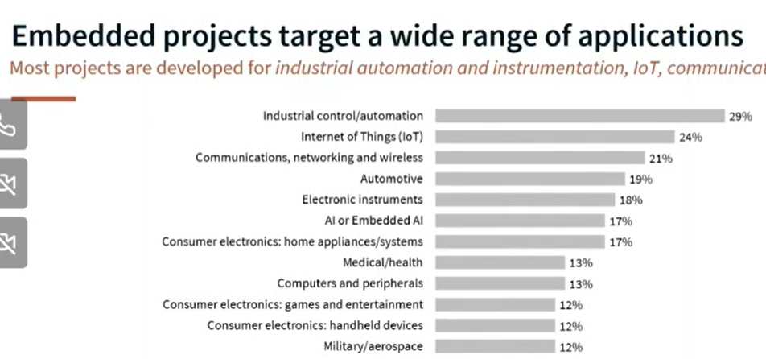
Survey question: “For what types of applications are your projects developed?”
Message: there’s a broad range of applications
Notes:
What do these numbers mean? Of the 650+ survey respondents, 29% said that the project they’re currently working on is targeted at industrial control.
The survey question is the “For what types…”

Slide 16
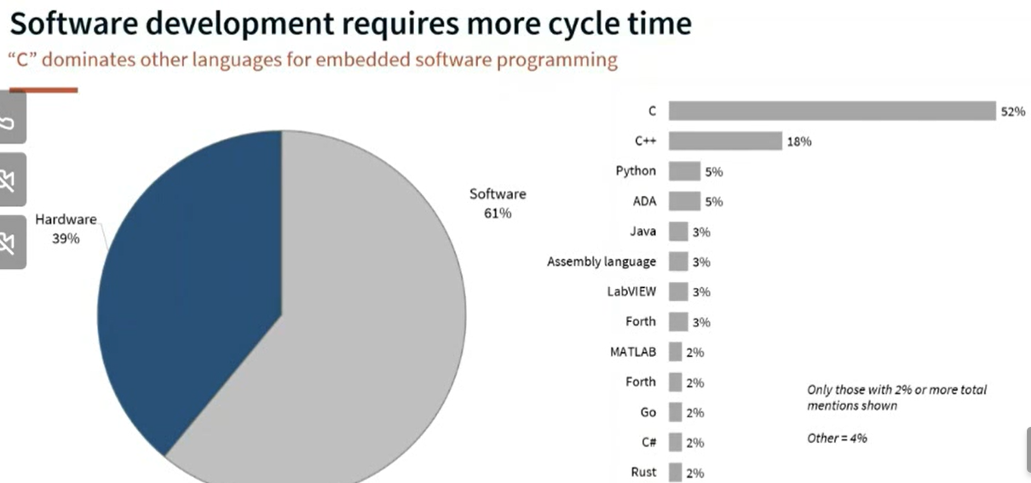
Ratio of total resources ($, time, people) on HW vs. SW?
Current project is programmed mostly in ?
Notes:
So, yes, C and C++ rule the embedded world. I’m surprised Python is as high as it is! And, really, ADA?
And almost nobody is using Rust yet.
Also, I don’t take this to mean you should *only* learn about SW. Learn both – they mesh. And remember: 47% of respondents worked on integration.
I originally wanted to target this course to microPython – but it would have resulted in unhappy job interviews.

Slide 17
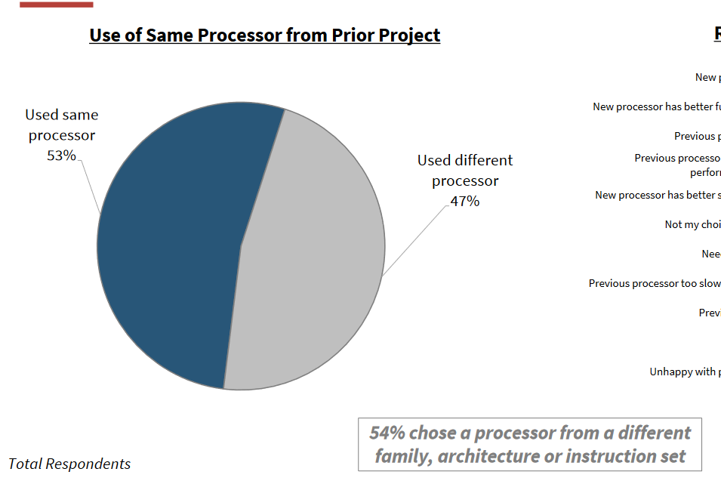
Remember this when we talk about programming APIs
Notes:
Why is a new CPU a big deal? Because each new CPU family comes with its own API ☹

Slide 18
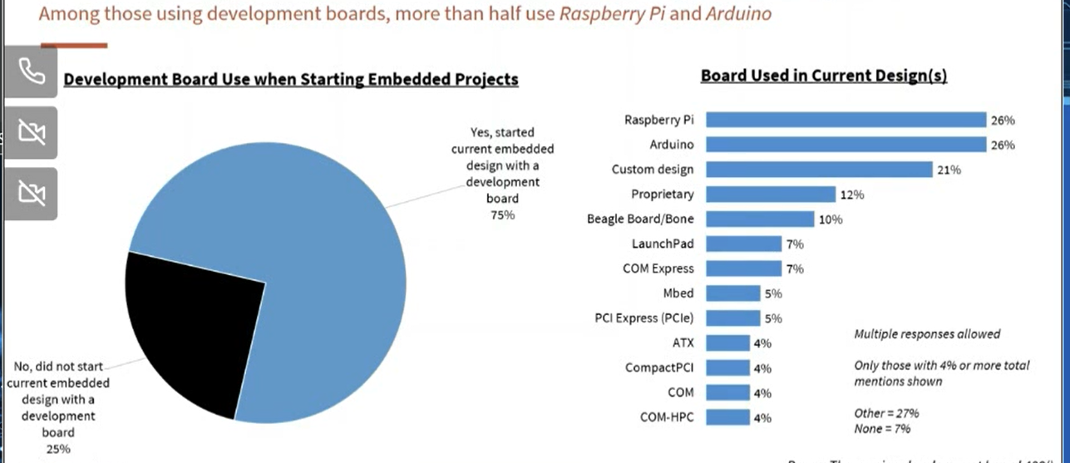
Did you start your current design with a development board? If so, which?
Notes:
Arduino surprises me, but just a bit. Raspberry Pi is a total surprise.
Arduino is the “one API to rule them all.” But it’s a slow, weak API. So people use it to develop the slow version of their new algorithms while they learn the new API for their new chip.

Slide 19
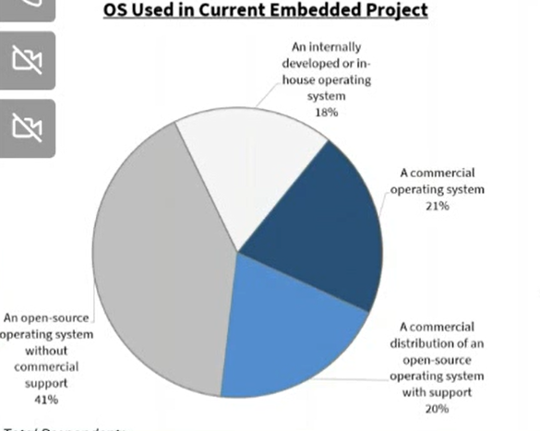
Do you use an O/S? What kind?
Notes:
And some stats that I didn’t show say that the fraction of people using an open-source O/S is growing, not shrinking.

Slide 20
Which O/S(s) are you currently using or considering?
Notes:
So almost nobody uses Keil’s RTX. And I’ve never even heard of Embedded Linux.

Slide 21
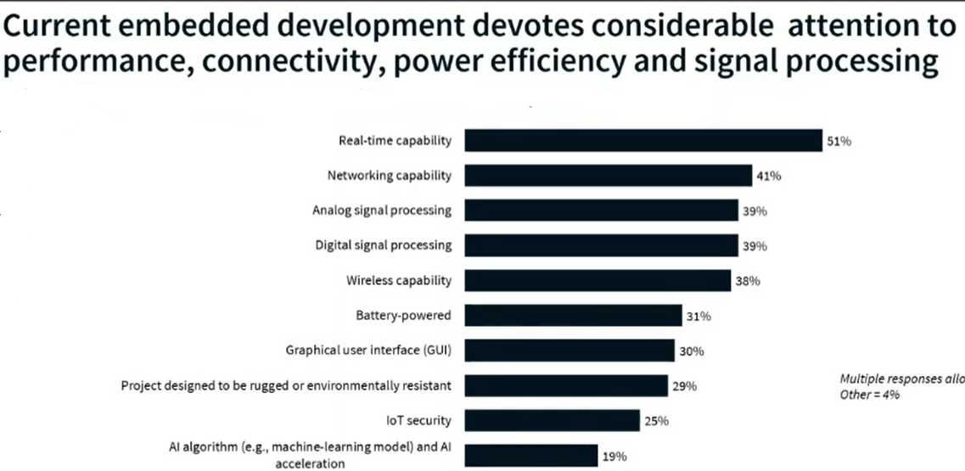
Us
EE153
EE/ME 125
EE153
Which of the following capabilities does your current project include?
Notes:
Multiple responses allowed.

Slide 22
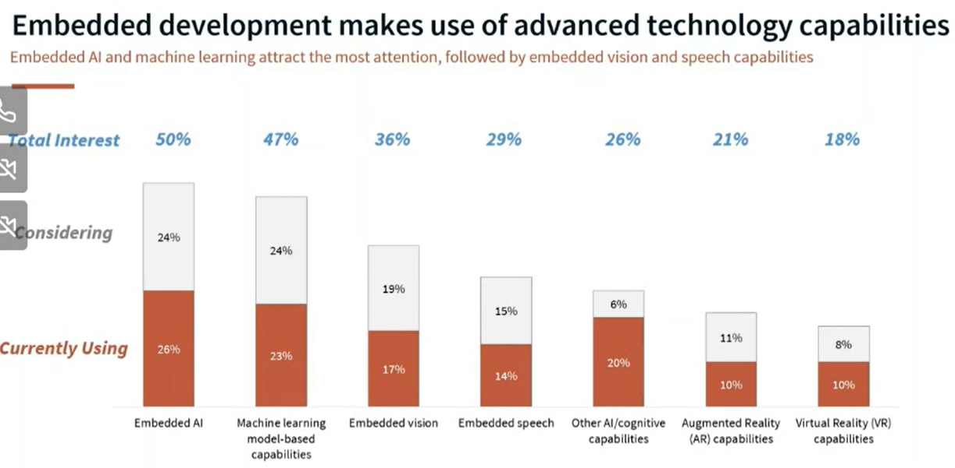
Which of these technologies are you (a) using in your current project, and (b) considering for the next?
Notes:
So AI is becoming common – even on small, cheap processors. And there are *multiple* ML courses at Tufts.

Slide 23
Which processor families are you using or considering?
Notes:
OK, neither Raspberry Pi nor Arduino are a processor family! So this data is a bit confusing.
Any

Slide 24
Follow the money
Most companies have their own software infrastructures (free for universities ☺)
And we get free demo boards too ☺
Why do you think that is?
Notes:
They’re trying to get you comfortable with their tools now, so you buy their chips later on.

Slide 25
How many projects did you work on in the past year; how many are you working on now?
Notes:
Yes, life is hard! And everyone is multi-tasking ☹. Actually, this was already a challenging fact of life when I left Intel in 2014.

Slide 26
Poll
Programming background
Comfortable in C? Other languages?
Used VSCode?
Embedded background
Used Arduino, Raspberry Pi, other?
How much?
DSP background?

