Slide 1
EE 152 – Real-time embedded systems
Tufts University
Instructor: Joel Grodstein
joel.grodstein@tufts.edu
Prep for lab 1

Slide 2
Prep for lab #1
Main topics:
No keyboard and monitor ☹
Cross compilers
SRAM, DRAM and flash
Tie-it-together demo
All about GPIO
Using CubeMX

Slide 3
A day in the life: SW engineer
We all program with a keyboard, monitor, mouse & hard drive
Notes:
The picture on the left is just for fun. Really, there’s a big monitor. And a keyboard.

Slide 4
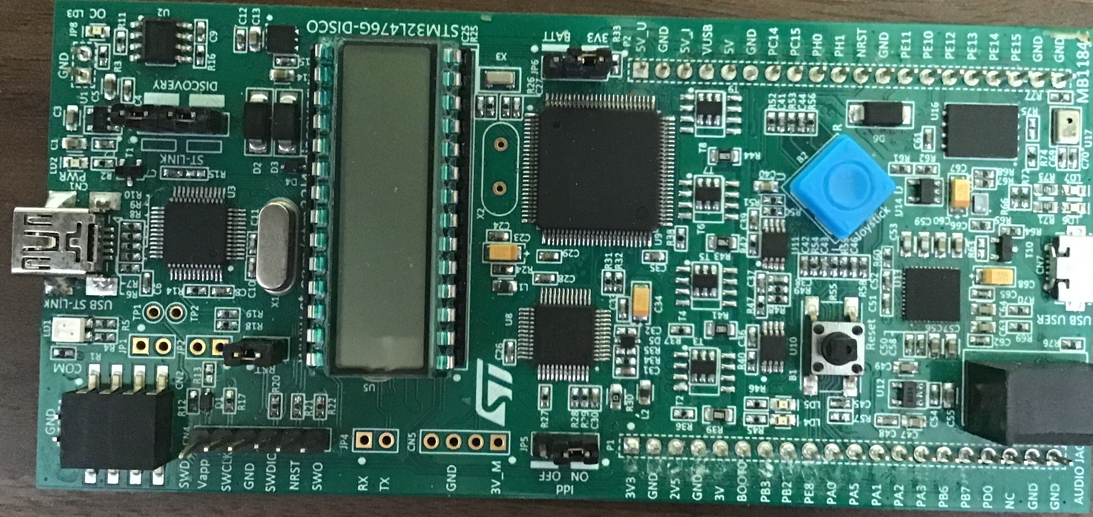
A day in the life: SW engineer
embedded
What’s missing in this picture?
No keyboard, or display
At least there are a few LEDs & a 7-seg LCD ☺
How are you going to debug?
Notes:
At least he still has his coffee ☺

Slide 5
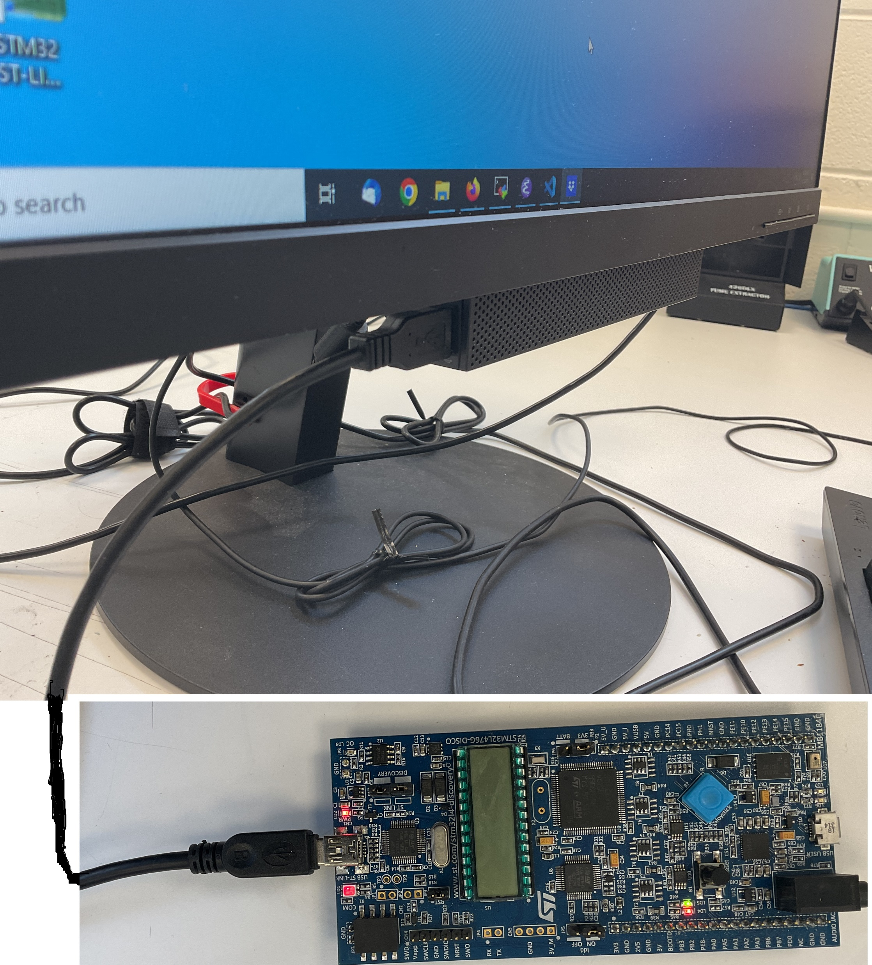
DITL: embedded systems
Answer – you can’t
Notes:
DITL = Day In The Life

Slide 6
Coding is on the host
Debugging is cooperative
Untether it later
show them a demo of the program that flashes a different color LED depending on your keystrokes (my UART program)
Notes:
DITL = Day In The Life

Slide 7
Today’s lecture
Main topics:
No keyboard and monitor ☹
Cross compilers
SRAM, DRAM and flash
Tie-it-together demo

Slide 8
Minor technical issue
Who remembers what a compiler is?
We usually program in a high-level language (e.g., C)
Our laptop probably runs x86 code
A C compiler translates C ⇒ (e.g.,) x86

Slide 9
Programming for your laptop
Your C program
runs on laptop
is x86 code
compiler
x86 code
The C compiler is a program written in C/C++; somebody compiled it to x86 to run on your laptop
It spits out x86 code to run on your laptop
What if you have an Apple laptop?
Notes:
Apple laptops use their own custom silicon, which run the ARM instruction set. So just change x86 to ARM.

Slide 10
Programming for Disco Kit
Your C program
front end
back end
runs on laptop
is x86 code
compiler
ARM code
Can this run on a Disco kit?
x86 code
The Disco kit is ARM based, and cannot run x86 code. Solution?
A cross compiler
Most embedded work is done with cross compilers
Notes:
You don’t always need a cross compiler. We’ll see later that Raspberry Pi is an exception.

Slide 11
Today’s lecture
Main topics:
No keyboard and monitor ☹
Cross compilers
SRAM, DRAM and flash
Tie-it-together demo

Slide 12
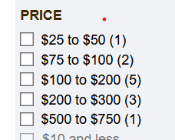
Where does the data live?
My laptop has a 500GB SSD
How much does an SSD cost nowadays?
From microcenter.com, search for SSD
So the sweet spot is $100-$200 (remember, this is probably aimed at PCs)

Slide 13
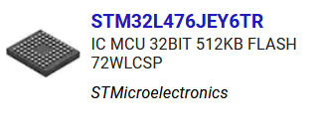
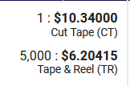
Price breakdown
From digikey.com
Any issues here?
Spending $100-200 for a SSD with a $6 CPU seems unlikely to result in good market success

Slide 14
Price breakdown
Enter the alphabet soup: SRAM, DRAM, NAND/NOR flash, EPROM, SSD & and SD card
Has everybody heard of most of these?
Quick summaries of the differences between them?

Slide 15
All about memory
Three common basic memory types: SRAM, DRAM, NAND flash
A ton of other types, including next-generation memories, but these are the most common
Notes:
Why is SRAM reliable? The major reliability issue with SRAM and DRAM is alpha strikes & cosmic radiation. An SRAM cell is reasonably large, so you need a large strike to disrupt it.

Slide 16
SRAM
Static Random Access Memory
Static = holds memory “forever”
but it’s volatile: data is lost at power down
Random Acc = can access any location at any time
Most common memory type inside of CPUs (caches, regfiles)
Fastest: SRAM cell access is just a few gate delays (routing data to/from one location in a large array can be much slower)
Highly reliable (as long as power is up)
Least dense

Slide 17
DRAM
Dynamic Random Access Memory
Dynamic = data value eventually leaks away DRAM needs a controller that refreshes it “occasionally”
Random Acc = can access any location at any time
Cell is smaller than SRAM ⇒ denser, cheaper, slower, more vulnerable to particle strikes
Volatile, just like SRAM
Most common use: main memory for your laptop
Less common in the embedded world

Slide 18
NAND flash
One technology with many applications
USB thumb drive, SD card, SSD (solid-state drive) all use NAND flash
How can that be?
The quality and speed of the electronics around the flash can differ vastly
Nonvolatile: data lasts after power is removed (10+ years)
Not random access – can only erase an entire sector. Works best for accessing contiguous blocks of memory
Only about 500-50K writes/sector before it dies. Then what?
USB thumb drives: mostly just die (would that be OK for med. equip?)
SSD: spare memory banks, swap them in, + sophisticated remapping so there aren’t “hot spots”
Flash on our board = typically in between
Notes:
There’s also NOR flash, but it isn’t used much nowadays.
Replacing an implanted medical device when the memory stick dies would require surgery ☹

Slide 19
Pros/cons
 | Speed | Errors | Random | Lifetime | Density
SRAM | Best | Best | Yes | Volatile | Worst
DRAM | OK | Good | Yes | Volatile | Better
Good flash | Slower | Good | No | 5-10 years | Still better
Cheap flash | Slowest | Bad | No | Don’t ask | Best
What are good uses of each?
Notes:
Cheap flash is slower than good flash because there’s lots of delay in the cheap electronics around the memory cells themselves (e.g., slow/narrow busses).
Similar for errors: good flash and DRAM have lots of ECC & spare banks.
Cheap flash is the densest because they don’t worry about EEC & spare banks ☺.

Slide 20
Today’s lecture
Main topics:
No keyboard and monitor ☹
Cross compilers
SRAM, DRAM and flash
Tie-it-together demo

Slide 21
Nucleo board
STM32L432
Laptop
ARM core
128KB SRAM
Intel CPU
16 GB DRAM
1MB flash
USB
500 GB SSD
Lots of peripherals…
A few peripherals
Big battery
Initial programming: use the host interface
Cross-compiler on the host
Send executable to Disco flash over USB
Runs on the Nucleo (can use USB for debug, or not)
Small + cheap ⇒ drives some “weird” decisions
Notes:
The Disco kit is a small, cheap system that is very limited. This will drive many seemingly-weird decisions.

Slide 22
Disco kit
STM32L432
Laptop
ARM core
128KB SRAM
Intel CPU
16 GB DRAM
1MB flash
USB
500 GB SSD
Lots of peripherals…
A few peripherals
Little battery
Big battery
When you’re done with debug, disconnect USB
Nucleo board is now standalone
But it got power from host over USB!
Notes:
The Disco kit is a small, cheap system that is very limited. This will drive many seemingly-weird decisions.

Slide 23
Detailed demo
Show the UART demo again. This time, at each stage (build, flash, run) show what’s traveling over USB and what’s stored in 432 flash
Then disconnect the board to see it die (no power!)

Slide 24
GPIO

Slide 25
References
RM0394 Chapter 8 (the GPIO chapter)
Zhu video at https://www.youtube.com/watch?v=zHHwbRdstoQ

Slide 26
What is GPIO?
General Purpose Input/Output pins
Each GPIO pin that can be programmed to be a digital input or an output
Often, there are “alternate functions” also (UART output, I2C, …)
As a digital output: can drive an LED or a stepper motor
As a digital input: can listen to a pushbutton and read on vs. off

Slide 27
GPIO organization
Microcontrollers have many GPIO pins
STM32L432 chip has 26
Organized into ports; each port has up to 16 pins
16 pins ⇒ programming with 32-bit registers is easy
STM32L432 has PA0-15, PB0-7 (but no PB2!), PC14-15, PH3 (!)
Notes:
Why is the choice of GPIO pins so weird? I have no idea. Perhaps some compatibility issue with other chips.

Slide 28
Big picture on CSR programming
The chip is organized into many units: GPIO, DAC, …
Each unit is programmed via multiple CSRs (Control/Status Register)
Typically you must turn on a unit’s clock before programming it (any idea why?)
Header file stm32l432xx.h has macros
Notes:
The “why” is that clock gating is a huge power savings.

Slide 29
Chip clocking
On most any chip, nothing happens without clocks
external crystal
main clock generator
main clock(s)
external clock
unit clocks
internal clock
unit enables
Programming of the main clocks is given to you
turning on the clock network
selecting the clock frequency
clock_setup_16MHz(void), clock_setup_80MHz(void)

Slide 30
Turning on the GPIO clocks
Clock control is in the RCC (Reset and Clock Control) unit
RCC unit’s AHB2ENR register (section 6.4.16)
Turn on the clocks for GPIO port B with
RCC->AHB2ENR |= RCC_AHB2ENR_GPIOBEN

Slide 31
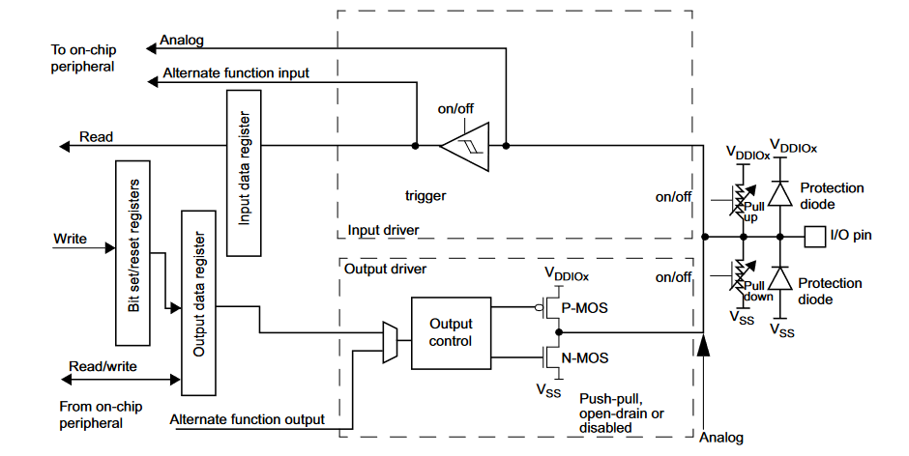
GPIO unit
See reference manual chapter 8

Slide 32
As an output
Data reg holds the 16 data values; PMOS & NMOS transistors pull the output high/low

Slide 33
As an input
Any idea what pull-up/pull-down resistors are for?
Input data register holds the 16-bit input value
Notes:
The pullup/pulldown resistors work with the PMOS & NMOS devices to implement multi-driver busses

Slide 34
Pick input vs. output
GPIOx_MODER (x is A, B, …)
One CSR = 16 pins, 2 bits/pin
00=input, 01=output, 10=alternate function, 11=analog
Set GPIO pin B3 to an output with
GPIOB->MODER &= ~(0x3<<6)
GPIOB->MODER |= (0x1<<6)

Slide 35
Output programming
We have to program all the stuff in red

Slide 36
GPIOx_ODR
Output Data Register: 1 bit/pin
Whatever data you write here goes to the GPIO pins
Program all 16 pins with one CSR write

Slide 37
GPIOx_OTYPER
One CSR = 16 pins, 1 bit/pin
1 = push-pull, 0=open-drain
Push-pull is usually what we want
Notes:
The most common reason for open-drain is busses. You could drive an LED that way if you want (but you won’t be able to hook up a scope probe).

Slide 38
GPIOx_OSPEEDR
One CSR = 16 pins, 2 bits/pin
00=slow, 01=faster, 10=even faster, 11=fastest
But why wouldn’t you set them all to “fastest?”
Notes:
“Faster” pulls in bigger PMOS and NMOS drivers. And bigger drivers means more power, which may or may not be needed. Plus it can cause bus ringing.

Slide 39
As an input
Again, we must program the stuff in red

Slide 40
GPIOx_IDR
Input-data register
One CSR = 16 pins, 1 bits/pin
Just reads the current input state

Slide 41
GPIOx_PUPDR
One CSR = 16 pins, 2 bits/pin
00=neither, 01=pullup, 10=pulldown, 11=reserved

Slide 42
What else?
That’s mostly all we need to drive a GPIO pin
Missing pieces
the header files
map from chip pin names to Nucleo/Uno pin names

Slide 43
Nucleo/Uno pin names
STM Nucleo-32 boards
various boards, with various STM32L* μcontrollers
all share the same Arduino Uno form factor
D0-D13 = digital-only pins
A0-A6 = analog or digital pins
some of these are reserved for other usages
See UM1956 for details

Slide 44
CubeMX demo
Do a short demo here, for GPIO programming
Show the HAL output

