Slide 1
EE 152 – Real-time embedded systems
Tufts University
Instructor: Joel Grodstein
joel.grodstein@tufts.edu
Lab 2 prep

Slide 2
Lab 2 prep
Main topics:
What is an O/S and why is it useful?
Living with no O/S: bare metal
Raspberry Pi
RTOS overview
FreeRTOS details
FreeRTOS debug instrumentation

Slide 3
Operating systems
Our first in-your-face issue with embedded systems: no keyboard or monitor
Our second one: “what about the O/S?”
Who can roughly define the term “operating system?” Name a few desktop or phone O/S?
Which do you think run on most embedded systems?
Often none!
Huh? But an O/S is kind of useful, isn’t it?
Notes:
A few popular O/Ss: Linux, Unix, Windows, IOS, Android, …

Slide 4
What does an O/S really do?
Who remembers what kinds of things an O/S does?
manage multiple users/threads. Tricks them into each thinking they own the machine
files; paging/VM
attach your keyboard/screen to a window(s)

Slide 5
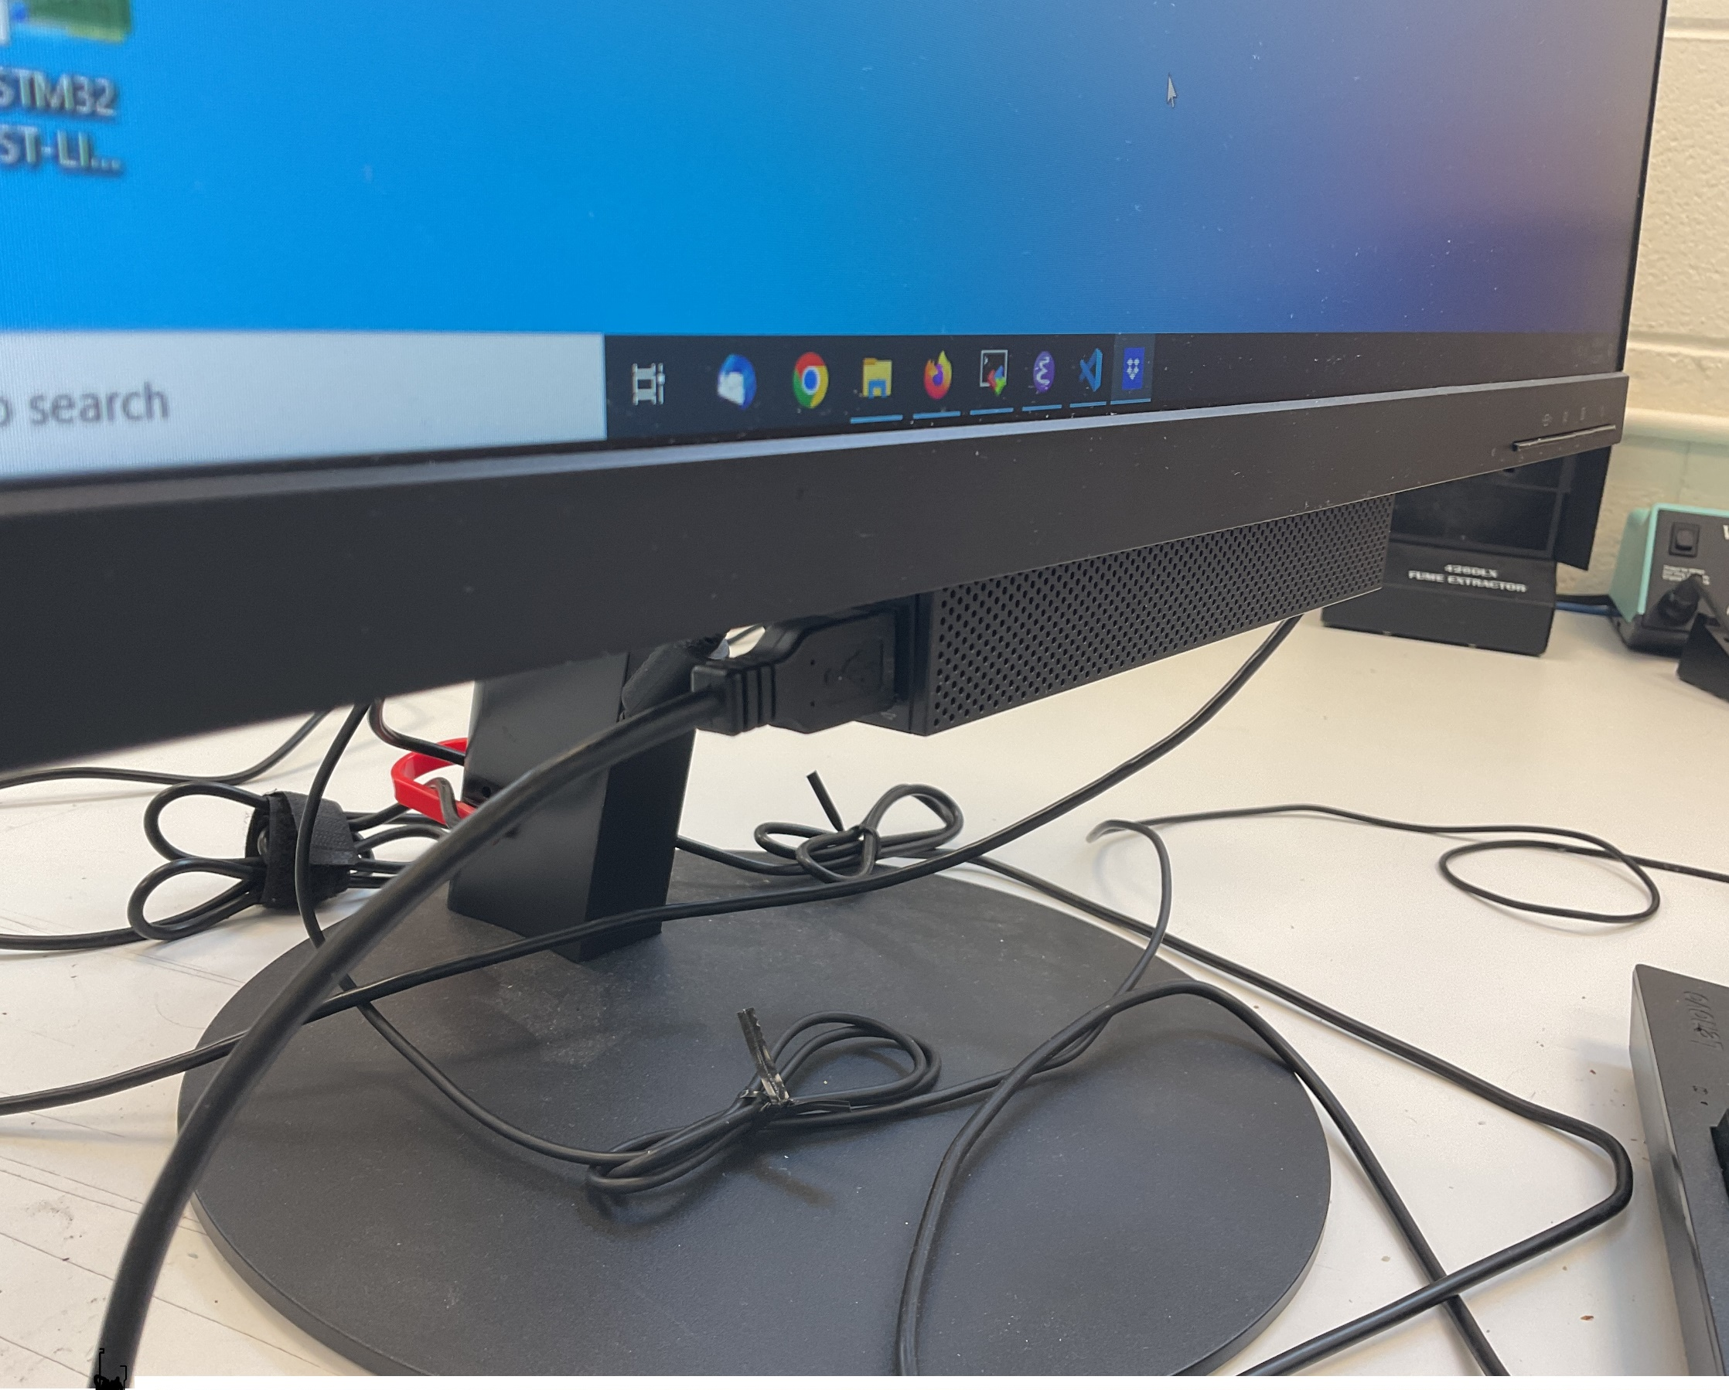
What an O/S does
manage multiple users/threads Tricks them into each thinking they own the machine
files; paging/VM
attach your keyboard/screen to a window(s)
Which of those functions do we need on the Nucleo?
Do we really need an O/S?

Slide 6
What we’ll cover & how
Main topics:
What is an O/S and why is it useful?
Living with no O/S: bare metal
Raspberry Pi
RTOS overview
FreeRTOS details (prep for lab 2)

Slide 7
Bare metal
Bare metal is ≈ 26% market share
it means no O/S at all!
Host
USB
Cross-compile on the host → ARM binary
Download binary → Nucleo flash
Disconnect the board
Ship to customer. Turn it on → runs from flash

Slide 8
Bare metal
Bare metal = board boots to your program
What do you think are pros and cons?
An O/S takes up flash space, so no O/S is cheap
Files are useful (but our program can write/read flash)
Multiple threads may be useful (more on that later)
We have no “boot to a shell, where you can run any program you want” – but our embedded system only runs one program, anyway

Slide 9
Linux?
What about Linux (or Windows)?
Mainstream Linux needs 10GB hard drive and virtual memory
STM32L432 has 256KB on-die flash
Microcontrollers rarely support virtual memory
So no mainstream Linux (or Windows!)
“Tiny” versions can be down to 500KB
Notes:
So even a tiny Linux won’t fit our flash. And we’ll do a comparison to FreeRTOS soon – which takes only about 7KB.

Slide 10
Virtual memory
Virtual memory lets two users use the same hardware
Compile your C program
extern a = 5
a = a + 1
Compiler gives you, e.g.,
mem[1000] = mem[1000] + 1
What if two users run this program at the same time?
Do they each see a wind up as 7?
How about three users?
It actually works fine – because of virtual memory
Notes:
OK, most assembly languages won’t let you add 1 directory to memory. But I’m just keeping it simple

Slide 11
Virtual memory
Virtual memory maps
address in your program
your user ID
Memory manager
actual address
virtual address | user # | physical address
1000 | 0 | 10000
1000 | 1 | 20000
1000 | 2 | 30000
Can’t really do a multi-user system without VM
Most microcontrollers don’t support VM
Notes:
In fact, some might say that the definition of a microcontroller (as opposed to a microprocessor) is that it doesn’t support VM

Slide 12
What we’ll cover & how
Main topics:
What is an O/S and why is it useful?
Living with no O/S: bare metal
Raspberry Pi
RTOS overview
FreeRTOS details (prep for lab 2)

Slide 13
RTOS
RTOS = Real-time O/S
The most popular one is called FreeRTOS
Any guesses why it’s the most popular? ☺
Open source
“Owned” by Amazon Web Services
Can pay for support, and for FDA-friendly version

Slide 14
RTOS
Pared-down bare-bones O/S
No file system, VM → about 7KB!
FreeRTOS gives you threads + inter-thread comms
gives you alloc(), free() (but see later…)
gives you real-time “guarantees”
Why do we care about threads?
About ¼ of projects are bare metal and ¾ are RTOS
Multiple threads are good (labs will show us why)
Lets you put different functionality in different threads, making your code more modular

Slide 15
RTOS superpower
RTOS can work in real time
Why does this matter? What embedded systems might need real-time response?
Pacemaker, neural prosthetic, anti-lock brakes, …
A few definitions
soft RTOS ⇒ almost always meet a deadline
hard RTOS ⇒ meet a deadline deterministically
Notes:
What does “deterministic” mean in this context? You yourself can write bad code that results in deadlines not being met. But at least the RTOS is deterministic, and good code on your part can work. The main thing that would cause an RTOS to not be deterministic is garbage collection.

Slide 16
Slightly interesting opinions
https://www.embedded.com/are-all-rtoses-equivalent
https://www.embedded.com/why-a-bare-metal-developer-moved-to-operating-systems
https://www.embedded.com/how-to-select-your-embedded-systems-operating-system-selection-guidelines

Slide 17
So many infrastructures…
How many embedded-programming environments can you think of?
Arduino, Raspberry Pi, MicroPython, CircuitPython
STM CMSIS, LL, HAL
Infineon PDL, HAL
C vs. C++ vs. assembly
Remember this?
Which of these counts as an O/S?
Notes:
Hopefully this is an easy question to answer

Slide 18
What we’ll cover & how
Main topics:
What is an O/S and why is it useful?
Living with no O/S: bare metal
Raspberry Pi
RTOS overview
FreeRTOS details (prep for lab 2)

Slide 19
Tour of FreeRTOS
Next up: enough FreeRTOS details to get you through labs #2, #3

Slide 20
FreeRTOS tasks
Concept #1: tasks
A task is (roughly)
the basic thing that runs in FreeRTOS
what the scheduler schedules
others call it a thread (or, wrongly, a process)
Three tasks in lab #2
green LED blinker
red LED blinker
UART
Any guess what the green-LED-blinker task does?

Slide 21
UART
UART = Universal Asynchronous Receiver and Transmitter
UART in 432
Host
USB
serial to USB
1b series
1B parallel
UART
Notes:
UART takes 1B all at once and ships out 1b at a time (or vice versa).
USB changes from the simple UART format to the very complex USB format.
There’s a host-side USB chip too.

Slide 22
UART for output
We write 1B to the UART
it sends out 1b at a time to Nucleo USB
Nucleo USB sends out 1b at a time to host USB
serial term (Moba or other) on host prints
Nucleo
432
serial to USB
UART
Look at serial_write() and UART_write_byte() in lib_UART.c
they takes multiple bytes and do spin-waits

Slide 23
UART for input
Host terminal waits for keyboard input (one char)
Sends one char over USB to Nucleo
Nucleo USB chip receives 1B, serializes it
UART on 432 reassembles it as 1B
Look at USART_read()
mostly just a big spin-wait loop
can wait a long time for a keystroke!

Slide 24
FreeRTOS and UARTs
Why are we talking about UARTs in the FreeRTOS slides?
Sending text to a screen helps us debug
the sooner we learn that the better!
More tasks equals more fun on lab 2 ☺
UART will be a third task
Lots of spin waits in UART drivers
FreeRTOS can help us multitask while we wait

Slide 25
Create a FreeRTOS task
TaskHandle_t task_handle_red = NULL;
BaseType_t red_status = xTaskCreate (
task_blink_red, // name of the task function
"Blink Red LED", // for debugging
100, // stack size in words
NULL, // parameter passed into task
tskIDLE_PRIORITY, // priority
&task_handle_red);
if (red_status != pdPASS) …
Notes:
The task handle is typically unused, but could be used to edit the task properties.

Slide 26
More “what is a task?”
We haven’t really said exactly what a task is yet!
We said “tasks are the things FreeRTOS schedules”
FreeRTOS makes it look like all these tasks are happening at the same time
Of course they’re not
We only have one core; only one thing can run at a time
But we switch back-and-forth really fast

Slide 27
Multitasking & the scheduler
Any examples of multi-tasking in your daily life?
Daydreaming while listening to a boring lecture?
Listening to music while studying?
Every multi-user OS does that
A real time OS gives us more control on the switching
Let’s talk about how that works
Notes:
I can’t really listen to music and concentrate any more… not even when driving

Slide 28
Scheduler in a nutshell
The heart of an RTOS is a scheduler
The scheduler…
has a list of all tasks that want to run
picks the highest priority one
What if there are several tasks ready to run at the same priority?
Take turns (round robin)
xTaskCreate (task_blink_red, …,
tskIDLE_PRIORITY,
…);

Slide 29
Can FreeRTOS hang?
Problem: who runs the scheduler?
Is it that a task runs the scheduler when it wants to play nice & share the MCU?
If one task wants to run and run and run, and never calls the scheduler, will it succeed?
Will other tasks never execute?

Slide 30
Who runs the scheduler
That scenario cannot happen
Two ways the scheduler gets control
FreeRTOS has a tick (1ms for us). Hardware timer ticks every 1ms; interrupts whoever is running and runs the scheduler instead. The scheduler then does its thing to pick who goes next
A task says I’m stuck until (say) 10ms from now. E.g., vTaskDelay(10) ⇒ pause me for 10 ticks
Note it’s in ticks (and for us, 1 tick = 1ms)

Slide 31
Blinky and π
Two tasks:
Low-priority background computes digits of π forever
High-priority task blinks LED
0 1 2 3 4
Blinky
π
Blinky starts running (it’s the high-priority task)
Flips the GPIO pin
Calls vTaskDelay(2) long before tick #1 occurs
Will sleep 2 ticks (so, until tick #2)
Notes:
Because we switch to the scheduler with an interrupt, we can return to the interrupted task. It takes a bit of doing (since usually we unroll the stack in LIFO order and the scheduler can instead do what it wants).
Also be sure to show the difference between preemption and cooperation.

Slide 32
Blinky and π
Two tasks:
Low-priority background computes digits of π forever
High-priority task blinks LED
0 1 2 3 4
Blinky
π
vTaskDelay(2) calls the scheduler
Control passes to π, which computes happily along

Slide 33
Blinky and π
Two tasks:
Low-priority background computes digits of π forever
High-priority task blinks LED
0 1 2 3 4
Blinky
π
Next tick interrupt happens (tick #1)
Blinky is blocked until tick #2, so π can keep running

Slide 34
Blinky and π
Two tasks:
Low-priority background computes digits of π forever
High-priority task blinks LED
0 1 2 3 4
Blinky
π
Next tick interrupt happens (tick #2)
Blinky is now unblocked
π is pre-empted, Blinky runs again

Slide 35
Blinky and π
Two tasks:
Low-priority background computes digits of π forever
High-priority task blinks LED
0 1 2 3 4
Blinky
π
Blinky flips the GPIO pins
Blinky calls VTaskDelay(2), sleeps until tick #4
VTaskDelay(2) calls scheduler, returns control to π

Slide 36
Blinky and π
Two tasks:
Low-priority background computes digits of π forever
High-priority task blinks LED
0 1 2 3 4
Blinky
π
And the beat goes on…

Slide 37
Blinky and π
Two tasks:
Low-priority background computes digits of π forever
High-priority task blinks LED
0 1 2 3 4
Blinky
π
Every tick, the scheduler picks the highest-priority unblocked task
Calls to vTaskDelay() and other FreeRTOS kernel functions can re-schedule mid-tick

Slide 38
Blinky and π
Two tasks:
Low-priority background computes digits of π forever
High-priority task blinks LED
0 1 2 3 4
Blinky
π
Thought questions: how would this diagram have changed if Blinky and π had equal priority?

Slide 39
RTOS vs Linux
The whole point of an RTOS
you pick the timer tick
you assign priorities
(you pick the heap algorithm)
Result: you can guarantee mission-critical tasks happen on time
Do ps on a Linux system; so many weird tasks!

Slide 40
Ready for lab #2!

Slide 41
Instrumentation
I think I got the last few slides right ☺
But how do you debug this stuff? Processes are switching at 1000 times/second
FreeRTOS allows you to instrument the scheduler
FreeRTOS manual section 11.6, Trace Hook Macros
https://www.freertos.org/rtos-trace-macros.html

Slide 42
How to use instrumentation
Trace-hook macros get called at, e.g.,
every tick interrupt
every task switch
lots of other point if you want
You have to get that information from the code to your eyes
Macros can toggle GPIO or change DAC voltages
Macros can build data structures you look at later

Slide 43
Blinky-π demo
Class exercise: look at the code & the output: does it make sense, and are the last few slides correct?
FreeRTOSconfig.h (at the end of the file)
declares array g_debug_notes[] to save real-time debug info for printing later
defines trace hook macros so task switch & tick interrupt save info into g_debug_notes
configUSE_APPLICATION_TASK_TAG lets us put a small integer into each task as its “note”
demo_blinky_pi_main.c
allocates g_debug_notes[]
after π is computed, prints them out

Slide 44
Problem of the day
How do two units talk to each other reliably without needing a ton of wires?

Slide 45
Keep it simple
Simplest method: one wire, on/off
Transmitter
one wire
LED
Assume you receive 1s on, 1s ff, 1s on. Is that binary 101?
Hard to say without a clock
It could also be 110011 or 111000111
Having a clock is really useful!

Slide 46
Add a clock
Transmitter
data clk
Receiver
clk
data
1
1
0
0
1
1
Lecture done?
UART gets away with one wire, not two!
Transmits 8-bit data, not one bit
We’ll learn a bit about I²C, SPI too

Slide 47
8-bit wide data
Transmitter
clk
data0
data1
data2
…
data7
Receiver
This would be one way to implement 8 bits of data
but it’s not what UART does

Slide 48
Shift register
P3
P2
P1
P0
ser_out
D Q
CK
D Q
CK
D Q
CK
D Q
CK
clk
Parallel-in, serial-out shift register
Lives inside the transmitter
And the receiver has a serial-in, parallel-out version

Slide 49
The problems
We want 8-bit data but only use one data wire
Parallel-to-serial shift register in the transmitter, serial-to-parallel in the receiver
What did we trade away to get this?
Transmitter
data clk
Receiver
USRT
clk
data
1
1
0
0
1
1

Slide 50
Getting rid of the clock wire
Transmitter
data clk
Receiver
USRT
Can we remove the clock wire?
Yes, UART does it. But how?
Tx and Rx must agree on the data speed
e.g., 9600 baud = 9600 bits/second
Is that good enough?
Notes:
That’s not good enough. The two frequencies will always drift apart.

Slide 51
Clock drift
Tx clk
data
Rx clk
1
1
0
0
1
1
Works fine if Tx and Rx clocks are identical
But they’re never quite the same frequency
Or quite perfectly aligned, even at the same freq
How do we build a practical UART?

Slide 52
Start and stop bits
Every packet has
start bit = 0
5-8 data bits
optional parity bit
stop bit = 1
Stop + start = guaranteed rising data transitions at known locations
Rx clock continually adjusts itself!
any downside to this scheme?
Notes:
The downside is we need two extra bits for each packet, and extra complexity in the Rx clock generation.

Slide 53
UARTs in the Nucleo board
432
ST-LINK
USART2
Tx
Rx
USB to host
USART1
Tx Rx Clk
USART1 Tx=PA9, PB6; Rx=PA10, PB7
Choose via CSR programming

Slide 54
Ready for lab #3!

Slide 55
SPI
Similar to synchronous UART
Clk wire is required, driven by the “master”
Full-duplex transmission via MISO and MOSI
Bonus
Supports multiple slaves (but just one master)
Master drives a select line to each slave
Fully-synchronous operation can reach 20 MB/s

Slide 56
I2C
Only two wires – SCL (clock) and SDA (data)
Single duplex
Any unit can be master or slave!
Complex protocol
Each unit has a 7-16 bit address
SDA can contain commands and/or unit address
The current master always drives SCL
Up to 3.4Mb/sec
Why do you think it’s slower than SPI?
Notes:
Clock switching is ugly, and data bandwidth is stolen for control. Both these slow it down.

Slide 57
What we didn’t cover
USB
Much more complex, multi-layer protocol
Many versions
But lots faster, and the newer versions are parallel

Slide 58
Exceptions
Anyone know a cheap-ish hobbyist Linux-ish board?
Raspberry Pi
But how do they do it?

Slide 59
What we’ll cover & how
Main topics:
What is an O/S and why is it useful?
Living with no O/S: bare metal
Raspberry Pi
RTOS overview
FreeRTOS details (prep for lab 2)

Slide 60
Raspberry Pi use model
Remember our use model
Host
USB
Raspberry Pi is very different

Slide 61
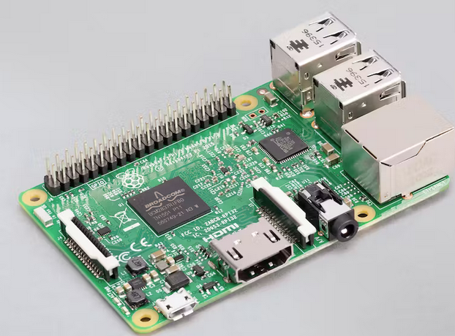
Raspberry Pi hardware
4x USB
LAN
SD card (holds O/S)
HDMI monitor
Power
This is a single-board computer
Uses SD card instead of flash (the “hard drive”)

Slide 62
Raspberry Pi O/S
Raspberry Pi O/S is Linux
Variant of Debian Linux
All of the bells and whistles of Linux
Class exercise: what are the consequences of that?

Slide 63
How can a Pi run “Linux?”
 | Bits | Cores | MHz | On-chip flash | VM | Peripherals
STM32L476 | 32 | 1 | 80 | 1MB | No | tons
Broadcom BCM2837 | 64 | 4 | 1200 | ??? | Yes | few
Way more powerful CPU
But to avoid going over budget, few peripherals
No analog GPIO pins; timers are few and simple
Fine for hobbyists; they buy shields
Hobbyist volumes can afford a few extra bucks, space
Requires ≥16GB SD card
Notes:
The Pi specs are for a Raspberry Pi 3b (the 3b+ is1.4GHz rather than 1.2GHz)

Slide 64
Raspberry Pi pros/cons
Pros
fast, “cheap” ($35 for Pi 3b) computer
can program it in your favorite language with your favorite editor
fast enough to run Python easily
Cons
STM32 = $1 to $10 or so
standalone use without monitor or keyboard is hard (but can SSH in via ethernet or wireless)
not a lot of peripherals (you need shields)
bigger form factor than you may need (esp. w/shields)
Needs ≥16GB SD card
It’s not an RTOS (what???)

Slide 65
Serial vs. parallel. We can always send 8 bits as one bit/cycle x 8 cycles or 8 bits/cycle * 1 cycles (or anything else). We could have done that with our 1-bit LED datum (sending 8 datum/cycle).
The obvious tradeoff? More wires vs. higher speed. Any examples of different busses that are narrow vs. wide? (USB-C is 24 pins wide).

Slide 66
Mutexes and queues
Do an example of multiple tasks filling an array
Show the problem, and how a mutex helps
Next, avoid the problem by using a queue
Show them lab 3: two different ways to use a queue for two UART writers. But don’t tell them the solution.

