Slide 1
EE 152 Embedded Medical Devices
Tufts University
Instructor: Joel Grodstein
joel.grodstein@tufts.edu
Lab 6 prep: the human heart

Slide 2
Table of contents
Cool cardiac facts & why we care
Cardiac basic operation
Electrocardiograms
Arrhythmias
Backup-system engineering
2 to 3 billion cells; they break and die all the time

Slide 3
Why do we care?
The next few labs will be measuring our ECG
Heart disease is the #1 killer in the U.S.
The mammalian heart is a super cool, well-engineered system

Slide 4
Deaths/year in U.S.
2.8M deaths/year total (.9 / 100 people)
Heart disease = 650K
Cancer = 600K
Coronavirus = 188K (9/6/2020)
Accidents = 170K
Chronic lower respiratory diseases: 160K
Stroke = 150K
Alzheimer’s = 120K
Diabetes = 80K
Mostly heart attacks
(from https://www.cdc.gov/nchs/products/databriefs/db328.htm)
Notes:
“Heart disease” actually includes all cardiovascular diseases.
But “stroke” is counted as a cerebrovascular disease, so it’s separate from heart disease!

Slide 5
Heart attack = blocked artery starves heart muscle
Plumbing problem
Heart dies over hours to weeks
Cardiac arrest = heart stops beating
Electrical problem
Lose consciousness in seconds; die in minutes
530K cases/year; 8% survival rate
CPR, AED save lives
PSA – learn how to use one!
one cause

Slide 6
A miracle of engineering
The heart contains 2-3 billion independent cells
Cells have high variability
Cells are quite failure prone
They somehow link together
to produce a coordinated, durable, and adaptable whole!
The heart is really really really robust – a miracle of fail-safe engineering
Multiple backup subsystems
It’s really robust! Keeps beating and never stops
Except for the 99 varieties of heart disease…

Slide 7
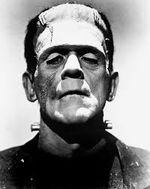
Galen of Pergamum, 130-200AD
extracted heart keeps beating for a long period
nobody knew why
Question: does your heartbeat originate in the brain and get sent to the heart via neurons?
Keith and Flack (1907)
sinoatrial node initiates the heartbeat
Notes:
From Galen’s experiment, we conclude that the brain is not the source of the heartbeat – if it were, the heart would stop beating as soon as we removed it from the body
Keith and Flack first found the SA node on a mole

Slide 8
Table of contents – this unit
Cool cardiac facts & why we care
Cardiac basic operation
Electrocardiograms
Arrhythmias
Backup-system engineering

Slide 9
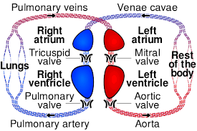
Plumbing – the big picture
Two separate two-chambered pumps
Red = oxygenated
Blue = not
Two chambers = more efficient

Slide 10
What does electricity do?
Electricity drives the muscles
Muscles drive the plumbing
Similar to the rest of your body
Notes:
Of course, in this case the electrical signals are coming from an oscillator rather than from the brain
Note the timing – both atria contract at once, and both ventricles contract at once.

Slide 11
The pumps in operation
https://www.youtube.com/watch?v=CWFyxn0qDEU
Mayo Clinic
https://www.youtube.com/watch?v=-s5iCoCaofc
Suitable for younger than college age ☺

Slide 12
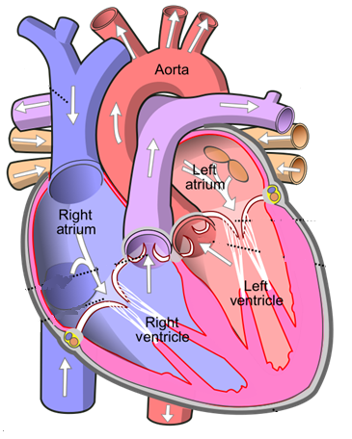
Atrial conduction
Sinoatrial (SA) node is the oscillator
Signal spreads over the atria at 1 m/s (100ms total)
Atrial muscles contract
SA
Notes:
Normal atrial conduction

Slide 13
Conduction on the highways
Through the AV node (slowly)
Zoom through the bundle of HIS, left/right bundle branches
SA
AV
Notes:
Normal atrial conduction

Slide 14
Conduction on the highways
Then the Purkinje fibers
SA
AV
Notes:
Normal atrial conduction

Slide 15
Ventricular conduction
Purkinje fibers have seeded the AP on much of the ventricular surface
Now it squeezes the entire muscle all at once
SA
AV
Notes:
Normal ventricular conduction

Slide 16
Table of contents
Cool cardiac facts & why we care
Cardiac basic operation
Electrocardiograms
Arrhythmias
Backup-system engineering

Slide 17
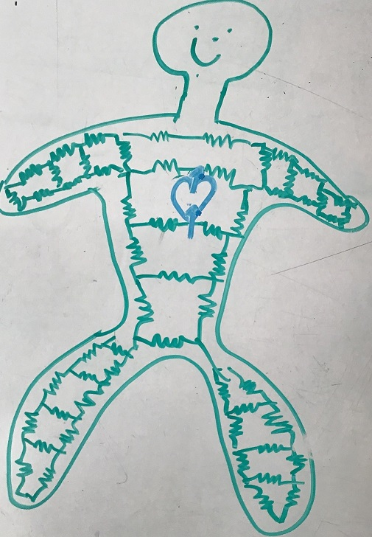
What is an ECG?
Measures the heart’s “summed” action potential
Each AP in the cardiac wave → small current travels through the body to the ECG electrodes
Different heart cells are oriented in different directions; vector dot products cause different results depending on where electrodes are attached

Slide 18
Atrial conduction
P wave = atrium firing
SA
AV
R
P
T
Q
S
Notes:
Normal atrial contraction

Slide 19
Ventricular conduction
Purkinje fibers have seeded the AP on much of the ventricular surface
Now it squeezes the entire muscle all at once
Why is QRS complex taller & skinnier than the P wave?
SA
AV
R
P
T
Q
S
Notes:
The tall & skinny contraction is because you have such a strong, well-synchronized set of APs throughout the entire (huge and strong) ventricles.
The reason for the synchronization is because the Purkinje fibers work so well.

Slide 20
Ventricular recovery
Ventricular recovery
It takes current to recover from firing, too
T wave
SA
AV
R
P
T
Q
S

Slide 21
Electrocardiogram
R
P
T
Q
S
Locate these
SA node firing
atrial firing
atrial recovery
ventricular firing
ventricular recovery
How can you read the heart rate?
Notes:
SA node firing is the beginning of P
atrial repolarization is hidden by QRS
time to traverse the atria + AV node = PR interval = start of P to start of QRS
delay through the
AV node = PR segment = end of P to start of QRS. Note the PR interval and segment are perhaps badly named; they end at Q, not at R.
The lab asks for the HR, PR interval and PR segment.

Slide 22
Table of contents – this unit
Cool cardiac facts & why we care
Cardiac basic operation
Electrocardiograms
Arrhythmias
so many things can go wrong ☹
Backup-system engineering

Slide 23
Bundle-branch block
What it is
delay or blockage in left or right BB
Symptoms
None (majority case)
Fainting, dizzyness
Causes
Prior heart attack, bacterial infection, high blood pressure, …
Genetic
Too much exercise
Consequences
often none (explanation shortly)
SA
AV

Slide 24
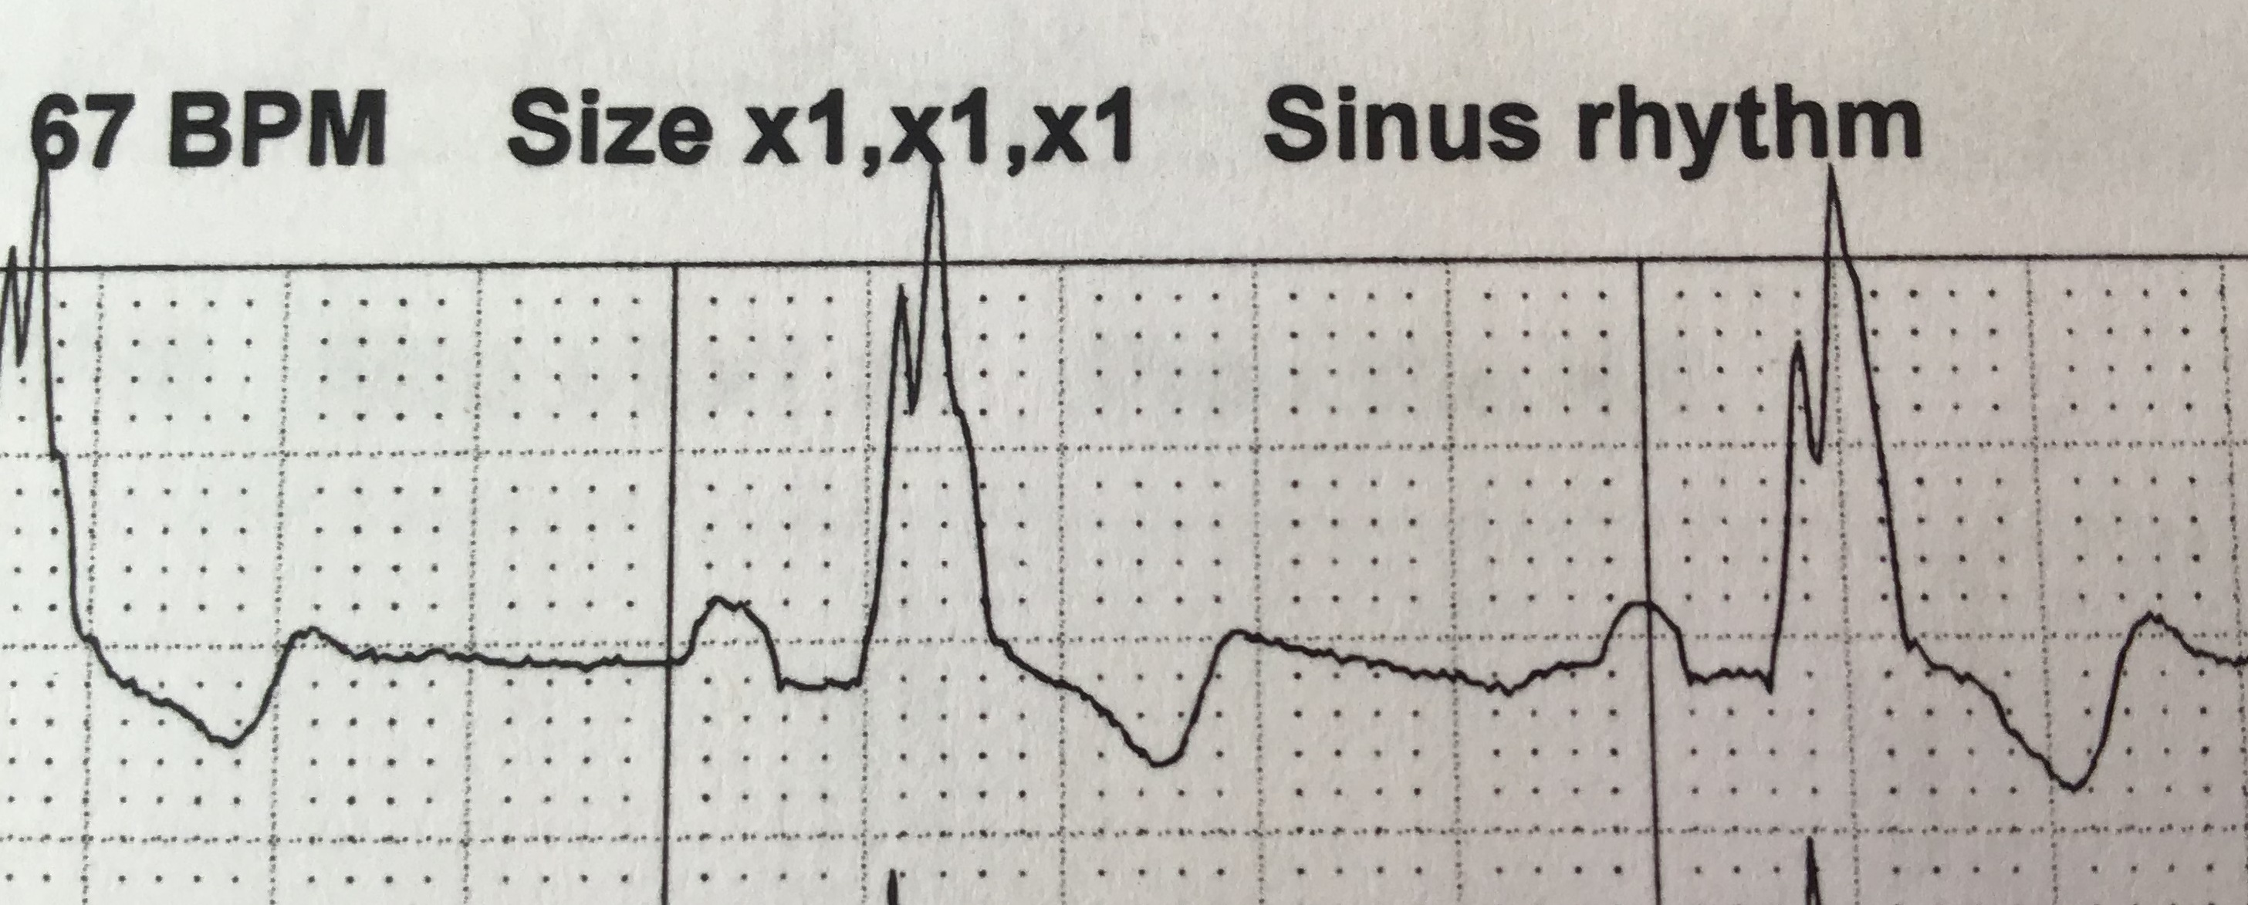
RBBB example
Diagnosis: wide QRS complex
.1-.12s → partial block (not uncommon, especially in endurance athletes)
>.12s → complete block (less common)
Is this ECG normal, partial RBBB or complete?
Notes:
Do the math – there are 5x5=25 squares per second, so each square is .04 sec.
So I would call this about .12s – right on the border between partial and full. However, note that it has been separately read at .144 sec.

Slide 25
RBBB – not a big problem
The RBBB is mine!
Any reason I’m still alive (and not overly concerned)?
Heart cells are quite interconnected
Left branch crosses over to drive the right side
Right side is “just” the lungs anyway ☺
SA
AV
Notes:
Normal atrial conduction

Slide 26
Group exercise
Why does RBBB cause wide QRS?
Would you expect a left BBB to be more dangerous than right, or less?
Notes:
The wide QRS is because you’re still hitting the left ventricle with a nice sharp early pulse. But you’re hitting the right ventricle with a delayed and much less-sharp pulse. Combine the two and you typically get a single wide pulse (or, as we see here, what looks like the summation of two different pulses).

Slide 27
Table of contents – this unit
Cool cardiac facts & why we care
Cardiac basic operation
Electrocardiograms
Arrhythmias
Backup-system engineering
STOP HERE
The rest of the material is covered in EE/BME 123

Slide 28
Entrainment
Sinoatrial node has ≈ 500K cells
Each one oscillates independently
Potentially a slightly different frequency, phase
How can your heart have a single unified beat?
Entrainment is the process of all the oscillators talking to each other and agreeing on a frequency
Now it has a name ☺
But how does it work?

Slide 29
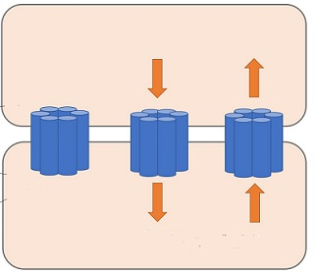
Gap junctions
A gap junction (GJ) is a little tube that connects two cells
GJs allow cells to talk to each other
Molecules can travel between the two cells
A resistor between two cells
Interesting tidbit – it’s a voltage-controlled conductance
Tie oscillators together → force them to sync up
+10mV
Na⁺
Cl⁻
-20mV
Na⁺
Cl⁻
Notes:
The GJs are drawn as six little tubes forming a big tube because, in fact, that’s more or less their anatomic structure.

Slide 30
Your heart, on AFib
Loop starts at an ectopic pacemaker
Goes round and round with no input from SA node
Called a reentrant arrhythmia
May take a slightly different path each time
Waves spread out from the loop, some go through AV node and trigger ventricles
SA
AV

Slide 31
Atrial conduction – review
Sinoatrial (SA) node is the oscillator
Signal spreads over the atria at 1 m/s (100ms total)
Atrial muscles contract
SA
AV
Notes:
Normal atrial conduction

Slide 32
Atrial fibrillation
R
P
T
Q
S
No P wave – why?
HR is irregular – why?
Frequency usually about 150 bpm
Ventricles pumping inefficiently but still pumping – why?
You can limp to the phone to call 911
Lookahead – we’ll talk about another backup system shortly

Slide 33
https://watchlearnlive.heart.org/index.php?moduleSelect=atrfib
Traditionally requires a one-way path
Notes:
The question of *why* it requires a one-way path will be on the quiz

Slide 34
Atrial fib causes
Causes:
Congenital heart disease of many types
Sedentary lifestyle (via diabetes, obesity, high blood pressure)
“Excessive” endurance exercise!
Exercise is a powerful drug, with a dose/response curve
Cures
Various drugs
Ablation
Rest, sleep or time

Slide 35
Ablation
Find the ectopic pacemaker
Surgically break the loop
SA
AV

Slide 36
Ablation
Find the ectopic pacemaker
Surgically break the loop
Either burn or freeze the relevant heart tissue
SA
AV

Slide 37
Ablation
Find the ectopic pacemaker
Surgically break the loop
Either burn or freeze the relevant heart tissue
Like any procedure, it’s not risk free
Atrial fib: surgery or not?
https://www.medscape.com/viewarticle/919228
https://www.drjohnm.org/2011/03/the-best-tool-for-treating-atrial-fibrillation
Anyone have an interesting story?
SA
AV

Slide 38
Why have fail-safe circuits?
Remember our intro?
Cardiac arrest = heart stops beating
Lose consciousness in seconds; die in minutes
Keeping the heart beating is job #1!
But success seems unlikely
Cells die all the time
We just discussed so many things that can go wrong
Biological cells are unreliable
So why are we alive?
A miracle of beautiful system-level design

Slide 39
Electrical system – review
Sinoatrial (SA) node is the oscillator
Signal spreads over the atria at 1 m/s (100ms total)
Atrial muscles contract
Atrioventricular (AV) node conducts slowly to ventricles (.01-.05 m/s, 80ms total)
Delay is on purpose
Bundle of HIS, left/right bundle branches
Purkinje fibers (2-4 m/s)
Electrical highway
ventricular muscles contract
SA
AV

Slide 40
Triple redundancy
The main operation is simple – SA node oscillates ≈ 60 bpm
But what if the upstream rhythm breaks?
Quick review: how can it break?
atria
SA
AV
ventricles

Slide 41
Triple redundancy
The main operation is simple – SA node oscillates ≈ 60 bpm
But what if the upstream rhythm breaks?
Quick review: how can it break?
The AV node can also oscillate!
Now we have a backup in case of atrial fib, AV blocks
AV-node cells have funny ion channels & are pacemakers
But what if the bundle of HIS, or LBB & RBB are both blocked?
atria
SA
AV
ventricles

Slide 42
Triple redundancy
The main operation is simple – SA node oscillates ≈ 60 bpm
But what if the upstream rhythm breaks?
Quick review: how can it break?
The AV node can also oscillate!
Now we have a backup in case of atrial fib, AV blocks
But what if the bundle of HIS, or LBB & RBB are both blocked?
The Purkinje fibers can also oscillate!
atria
SA
AV
ventricles

Slide 43
System-level coordination
Three oscillators; only one is needed
What happens if they all turn on at once?
chaos ☹
Can you devise a fail-safe system to control this?
Requirement: KISS principle (less is more)
Hint: SA node ≈ 60 bpm; AV node ≈ 40 bpm; Purkinje ≈ 20 bpm

Slide 44
Normal operation
SA oscillator (60bpm)
Travels through AV node…
AV-node action potentials

Slide 45
Normal operation
SA oscillator (60bpm)
So the ventricular rhythm gets driven by the SA node
Travels through AV node…
Here’s the next fire if input breaks (40 bpm)
AV-node action potentials
Notes:
Funny channels haven’t reached the trigger threshold yet, when the upstream AP comes in through GJs and does hit the threshold.
So the funny channels are nearly irrelevant.
Note the drawing shows upward slope of phase 0 in the AV-node cells being less than that in the SA-node cells, since they have fewer funny ion channels.

Slide 46
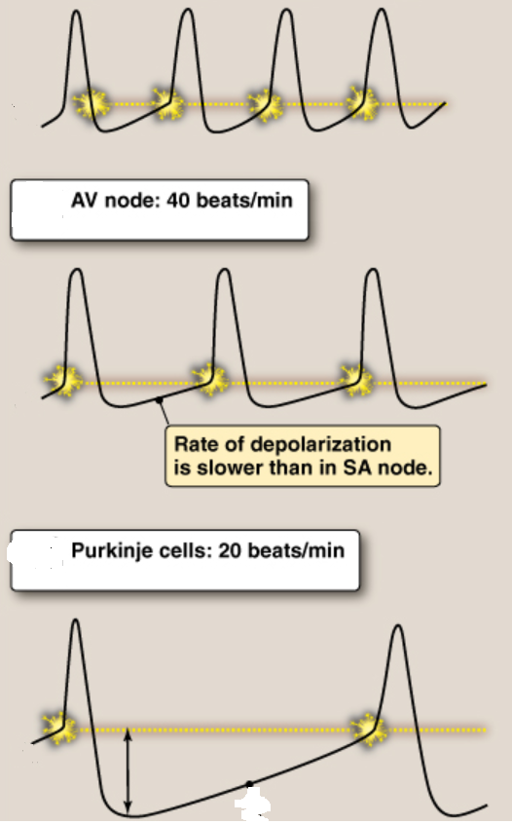
Lippincott, Fig 16.12
Each downstream oscillator is slower than the upstream one
Downstream ones never fire unless the upstream one is stopped
Upstream AP comes in before downstream funny channels would cause refiring
Funny channels are mostly irrelevant – for now
SA node: 60+ BPM

Slide 47
What can go wrong?
SA oscillator (60bpm)
Travels through AV node…
What could occur to break this coupling and cause the ventricles to fire from their own pacemaker?

Slide 48
If the SA node slows down…
SA oscillator (60bpm)
Travels through AV node…
AV oscillator (40bpm) all by itself

Slide 49
If the SA node slows down…
SA oscillator (38bpm)
Why doesn’t this fire the ventricles?
AV oscillator (40bpm) all by itself
Ventricles fire from AV pacemaker
Notes:
Why doesn’t the second SA pulse cause the ventricles to fire? Perhaps because they’re still refractory to their own second pulse (which has just fired). And if they’re refractory then they don’t fire on the SA depolarization – and if the SA repolarizes (and pulls the AV down) before the refractory period ends then the SA spike gets completely ignored.
The narration: AV pulse #2 does occur (running on the AV 40Hz clock), since the SA is running so slowly.
Then SA #2 doesn’t cause a new AV pulse (since AV is refractory as noted above).
But SA #3 probably does get through.
Note that this sequence has ventricular firing that looks almost exactly like a PVC (which is what we’ll look at next), though slow SA firing is typically

Slide 50
Design choices
Frequencies:
SA node ≈ 60+ bpm
AV node ≈ 40 bpm
Purkinje ≈ 20 bpm
Why did we get designed the way we did?
Pros/cons of
AV node ≈ 45 bpm, Purkinje ≈ 25 bpm?
AV node ≈ 35 bpm, Purkinje ≈ 15 bpm?
Notes:
If the 40 creeps up much higher, an athlete with 45bpm resting pulse will be in trouble.
If the 20 bpm goes much lower, it’s not enough to keep you alive.

Slide 51
PVCs
Doesn’t go anywhere (ventricles still refractory)
SA oscillator (50bpm)
Ventricular AP
Premature Ventricular Contraction (PVC) sounds like a “skipped” pulse
Ectopic* focus
A random firing in the ventricles
Ventricles not full; little blood pumped
*Ectopic=in the wrong place
Notes:
We’re (mistakenly) assuming zero delay from SA to ventricles to make the drawing simpler. In reality, the ventricular AP should be shifted to the right a bit.
And as usual, my artwork isn’t great – a real ventricular AP has a flatter top than what I’ve drawn.

Slide 52
PVCs
Ectopic* focus
could happen
SA oscillator (80 bpm)
SA oscillator (50 bpm)
Why are PVCs more likely with lots of endurance exercise and little sleep?
lots of exercise → HR lowers (well known)
lots of stress → more ectopic foci (hypothesized)
benign except if you overdo it for a long time
Notes:
The red zone is where an ectopic focus could cause a PVC. Really, the important thing is the ventricles and not the SA oscillator, but I drew it this way because it’s the SA oscillator that’s controlling the rhythm and thus setting the HR in the ventricles.

Slide 53
PVCs
Backup circuits are great – what if they break?
Yes, you have no backup. Or...
Backup circuit launches when it shouldn’t
one way to make an ectopic focus
Too much exercise = more PVCs?
More info:
https://www.drjohnm.org/2013/06/benign-pvcs-a-heart-rhythm-doctors-approach/
https://www.drjohnm.org/2015/08/on-pvcs-think-anew-but-think-slowly/

Slide 54
“The current record for number of dominoes toppled in one cascade is just shy of 4.5 million, a record set in the Netherlands on Domino Day 2009. It took a team of 89 builders 2 months to set up! Because a misplaced foot or finger could easily trigger the entire array, it had to be designed with breaks that were completed immediately before the competition began
Because the myocardium does not have such safety features, every cell in the heart has the potential to become the primary pacemaker should its membrane become unstable. “Ectopic” pacemakers are responsible for common mishaps leading to premature ventricular contractions, which are typically one-off events in young, healthy hearts. In aging hearts, ectopic pacemakers may become established, posing a constant and potentially lethal threat to cardiac function.”
Lippincott’s Physiology, 2nd edition, Chapter 16

Slide 55
Can you find the PVC?

Slide 56
Do you think that PVCs would get more or less frequent as HR rises?
More while you’re exercising?
Or while sleeping?
Notes:
This should be an easy question to answer; we just answered it about 4 slides ago!

Slide 57
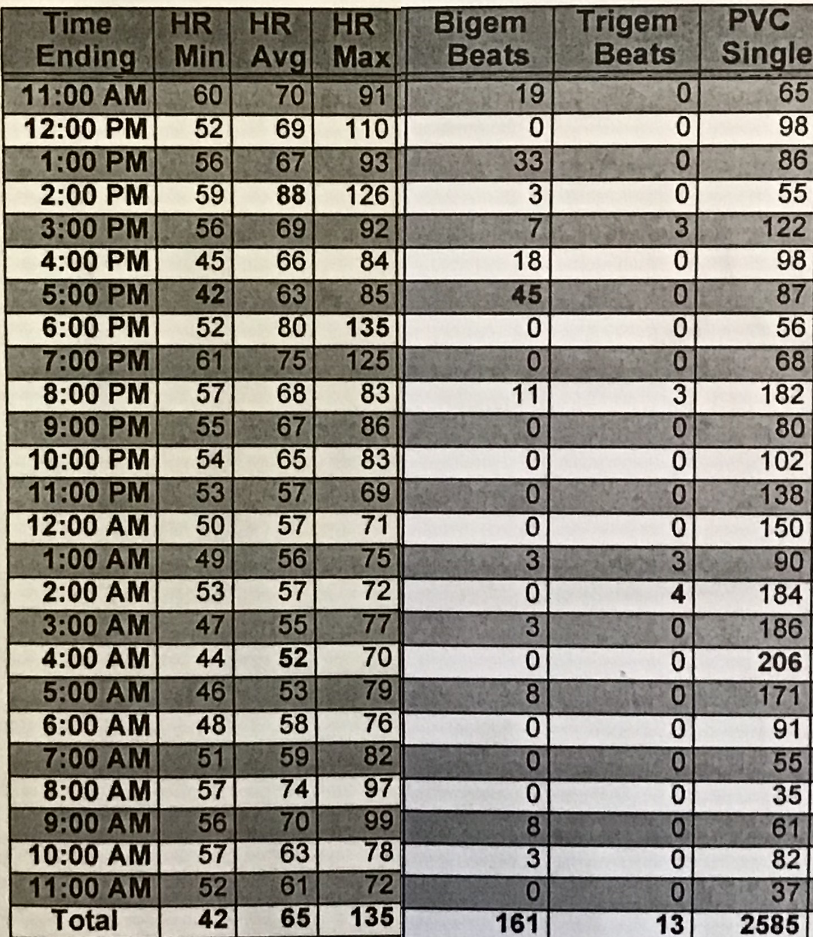
Bigeminy: 2 consecutive PVCs
Trigeminy: 3
Conclusions?
Notes:
And yes, the most PVCs (206) came at 4am, when the HR was lowest (44).
The bigeminy and trigeminy, interestingly, were not in that period; I’m not sure why. But they were in how-HR periods.

Slide 58
Electrical control of HR, BP
Sympathetic nervous system increases heart rate:
releases norepinephrine, which helps to open HCN channels and thus speed up phase 4
it also makes the AP triggering voltage more negative
Parasympathetic nervous system slows HR:
releases acetylcholine, which decreases [cAMP]
does the opposite of the above
Baroreceptors: arterial stretch receptors
detect changes in arterial pressure and communicate this to the medulla oblongata in the brainstem
… which then controls heart rate as described above, as well as changing circulatory muscle tone
End goal: feedback loop controlling blood pressure
Salt seems to affect it; nobody knows why
Your brain is the mysterious box controlling it all

Slide 59
CVRx
Barostim-NEO device
one in three high-blood-pressure patients is resistant to drugs
they are the target audience
Mechanism:
activate baroreflex; reduces sympathetic activity and increases parasympathetic activity
Results:
http://www.barostimtherapy.com/en-gb/node/86
FDA approval Aug 2019 (implantable device)
Medicare/Medicaid approval 2020
Also used for heart-failure patients
Often, too much sympathetic (too little para) activity causes pathological myocardial remodeling that worsens the condition

Slide 60
Mini quiz
Why is QRS tall and skinny?
What is AFib?
Describe the redundancy system

Slide 61
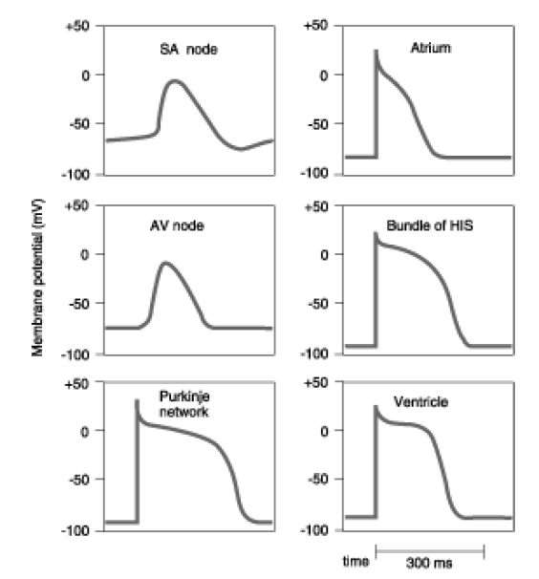
a

