Slide 1
MIMD
Multiple instruction,
multiple data
BY Michael Nuzzolo

Slide 2
Introduction
Multiple instruction streams
Multiple data streams
At any time, different processors may be executing different instructions on different pieces of data.
Not limited to executing a single instruction (SIMD)

Slide 3
Parallelism Architectures
 | Single Instruction | Multiple Instruction | Single Program | Multiple Program
Single Data | SISD | MISD | - | -
Multiple Data | SIMD | MIMD | SPMD | MPMD
Notes:
Flynn’s Taxonomy

Slide 4
Multiple Instruction, Multiple Data
Became popular in the 80s, when multiple processors became relatively inexpensive and easily accessible
^Made possible by progress in integrated circuit technology and the transputer
By the 90s, MIMD computers with hundreds of processors became available
(Sima, D., Fountain, T. J., Kacsuk, P.)
Notes:
Transputer was the first general purpose microprocessor designed specifically to be used in parallel computing systems

Slide 5
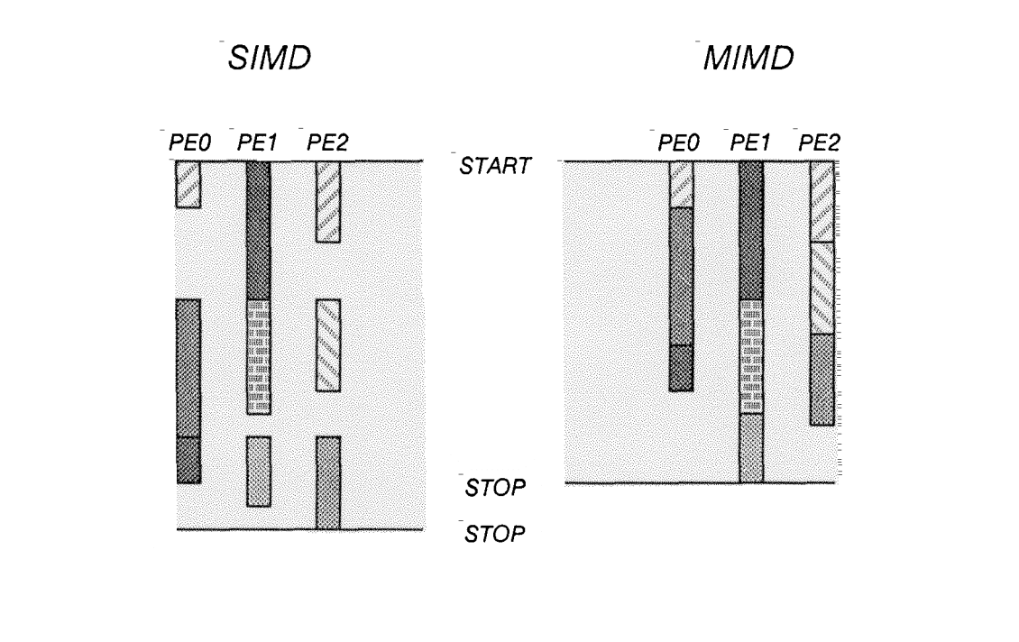
Example Program Execution
(Wojcik, 2014)
Notes:
Speed is dependent on the longest execution time of one processor in MMD

Slide 6
MIMD
Good at independent branching (if & else)
Poor at synchronization and communication
(SIMD has opposite problem)
MSIMD/MIMD systems solve this problem, but are expensive
(Baig, El-Ghazawi, and Alexandridis, p.460)
Notes:
Configured at run-time Multiple SIMD/ MIMD

Slide 7
MIMD
Allows for more efficient execution of conditional statements because each processor can independently follow either decision path
Generally more expensive and complex than SIMD
Multiple decoders (one for each processor)
(Kaur & Kaur, 2013)

Slide 8
Memory Architectures
Shared Memory
Distributed Memory

Slide 9
Shared Memory
Memory 1
Memory 2
Memory 3
Interconnection Network
Processor 1
Processor 2
Processor 3
(Choi, 2014)

Slide 10
Shared Memory
Advantages:
Can use single processor programming style
Efficient communication between processors
Disadvantages:
Need to synchronize access to the shared data
Memory contention limits scalability
(Choi, 2014)

Slide 11
Shared Memory Classes
NUMA
COMA
CC-NUMA
(Kaur & Kaur, 2013)
Notes:
COMA and CC-NUMA are used in newer generation of parallel computers

Slide 12
NUMA
(Non-uniform memory access)
Shared memory is divided into blocks, each block is attached with processor
(Kaur & Kaur, 2013)

Slide 13
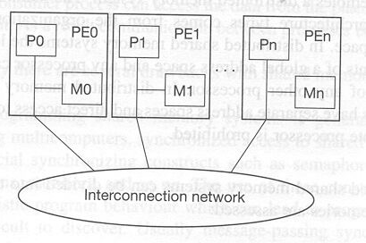
NUMA
(Choi, 2014)
Notes:
(PE - processing element)

Slide 14
COMA
(Cache only memory access)
Every memory block works as a cache memory
(Kaur & Kaur, 2013)

Slide 15
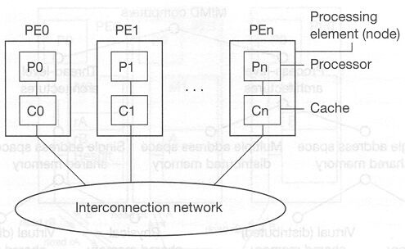
COMA
(Choi, 2014)

Slide 16
CC-NUMA
(Cache-coherent non-uniform memory access)
Cache memory and memory blocks are attached with a processor
Solves cache coherence problem
(Kaur & Kaur, 2013)

Slide 17
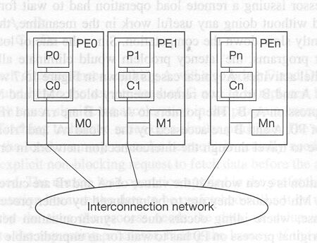
CC-NUMA
(Choi, 2014)

Slide 18
Memory Architectures
Shared Memory
Distributed Memory

Slide 19
Distributed Memory
PE 1
PE 2
PE 3
Memory 1
Memory 2
Memory 3
Processor 1
Processor 2
Processor 3
Interconnection Network
(Choi, 2014)

Slide 20
Distributed Memory
Each processor contains its own memory
Accessing remote memory can cause stalls
Messages are sent between processing elements by switch units (router)
May be a communication processor - organizes communication, packetizing & depacketizing
(Kaur & Kaur, 2013)

Slide 21
Distributed Memory
Advantages:
Scalable design
No synchronization problem
Disadvantages:
Load balancing problem
Message passing between processors causes deadlock
Shared data must be copied between processors
(Choi, 2014)

Slide 22
References
Kaur, Mandeep, Kaur, Rajdeep. (September, 2013) A Comparative Analysis of SIMD and MIMD Architectures. International Journal of Advanced Research in Computer Science and Software Engineering (1151-1156). http://www.ijarcsse.com/docs/papers/Volume_3/9_September2013/V3I9-0332.pdf
Choi, Ben. (2014) Introduction to MIMD Architectures http://www2.latech.edu/~choi/Bens/Teaching/Development/Hardware/
Wojcik, Vlad. (2013)Taxonomy of Supercomputers http://www.cosc.brocku.ca/Offerings/3P93/notes/2-Taxonomy.pdf
Sima, D., Fountain, T. J., Kacsuk, P.. Advanced Computer Architectures. Chaper 15 - Introduction to MIMD Architectures http://eclass.uoa.gr/modules/document/file.php/D36/%CE%A3%CE%B7%CE%BC%CE%B5%CE%B9%CF%8E%CF%83%CE%B5%CE%B9%CF%82%20%CE%93%CE%B9%CE%AC%CE%BD%CE%BD%CE%B7%20%CE%9A%CE%BF%CF%84%CF%81%CF%8E%CE%BD%CE%B7%29/chap15%20SIMA%20MIMD.pdf

