Slide 1
NVIDIA Tesla GPU
Zhuting Xue
EE126

Slide 2
GPU
Graphics Processing Unit
The "brain" of graphics, which determines the quality of performance of the graphics

Slide 3
NVIDIA Tesla
NVIDIA
is a company, which designs graphics chip and chipset-based semiconductor , also achieving a lot of breakthroughs in parallel processing.
Tesla
is a GPU produced by NVIDIA, which is designed for large-scale parallel computer;mostly work for science research in labs.

Slide 4
GPU & CPU
In NVIDIA’s design, the GPU cooperates with CPU to accelerate scientific and other applications.
Compute-Intensive Functions
5% of code
Rest of Sequential CPU Code
95% of code
GPU
Application Code
CPU

Slide 5
GPU Architecture
Dynamic Parallelism
All child launches must complete in order for the parent kernel to be seen as completed
Recursion, irregular loop structure or other structures that do not fit a flat, single-level parallelism can be more transparently expressed.
A
X
CPU
B
Y
C
Z

Slide 6
GPU Architecture
Host interface and Compute Work Distribution
Getting instructions and data from the host CPU and its main memory; also manage the threads of execution by assigning groups of threads to processor clusters and performing context switching;
TPC (texture/processor cluster)
A basic building block of Tesla architecture GPUs (a single GPU can have from one to eight TPCs);
SM (Streaming Multiprocessor)
A part of TPC, consisting of eight streaming processor cores, two special function units (for performing interpolation and approximate evaluation of trigonometric functions, logarithms, etc.), a multithreaded instruction fetch and issue unit, two caches and a pool of shared memory;
Texture unit
Each unit is shared by two SMs, the unit plays its part in graphics calculations and is equipped with L1 cache memory accessible from SPs; Level 2 Cache memory units are connected through fast network to TPCs.
Host CPU
Bridge
System Memory
Host Interface
GPU
Input Assembler
viewport/clip/setup/raster/zcull
Vertex Work
Distribution
Pixel Work
Distribution
Compute Work
Distribution
TPC
TPC
TPC
TPC
SM
SM
SM
SM
SM
SM
SM
SM
SP
SP
SP
SP
SP
SP
SP
SP
Shared
Memory
Shared
Memory
Shared
Memory
Shared
Memory
Shared
Memory
Shared
Memory
Shared
Memory
Shared
Memory
Text Unit
Text Unit
Text Unit
Text Unit
Interconnection Network
ROP
L2
ROP
L2
ROP
L2
DRAM
DRAM
DRAM

Slide 7
GPU Challenges
The GPU remains a specialized processor
Its performance in graphics computation belies a host of difficulties to perform true general-purpose computing.
The processors themselves require recompiling software they have rudimentary programming tools, as well as limits in programming languages and features.

Slide 8
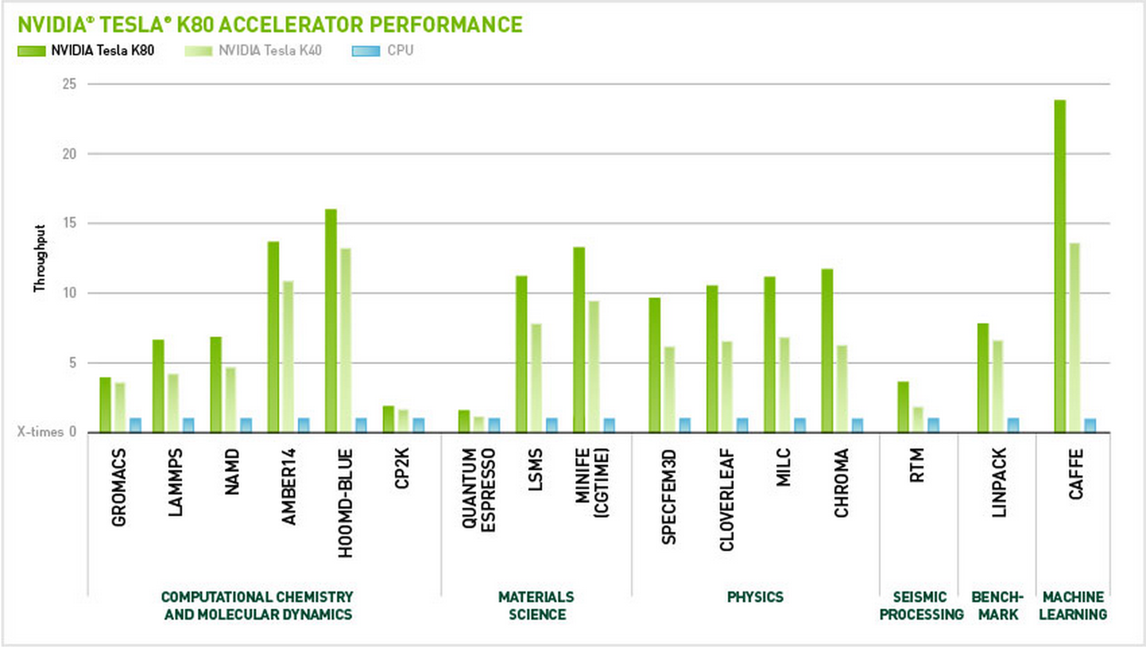
GPU VS CPU
CPU VS GPU

Slide 9
Conclusion
GPU still cooperates with CPU , which is supposed to be broken through so that the GPU can complete all work without the help of CPU.
The competition between CPU and GPU is positive, which leads to the development of both GPU and CPU.

Slide 10
Reference
[1]Maciol, Pawel, and Krzysztof Banas. "Testing tesla architecture for scientific computing: The performance of matrix-vector product." Computer Science and Information Technology, 2008. IMCSIT 2008. International Multiconference on. IEEE, 2008.
[2]Andreyev, A., A. Sitek, and A. Celler. "Acceleration of blob-based iterative reconstruction algorithm using Tesla GPU." Nuclear Science Symposium Conference Record (NSS/MIC), 2009 IEEE. IEEE, 2009.
[3]Lindholm, Erik, et al. "NVIDIA Tesla: A unified graphics and computing architecture." Ieee Micro 28.2 (2008): 39-55.
[4]Heinecke, Alexander. "Accelerators in scientific computing is it worth the effort?." High Performance Computing and Simulation (HPCS), 2013 International Conference on. IEEE, 2013.

