Slide 1
Memory testing methodologies
For embedded memory
Minghuan Zhao

Slide 2
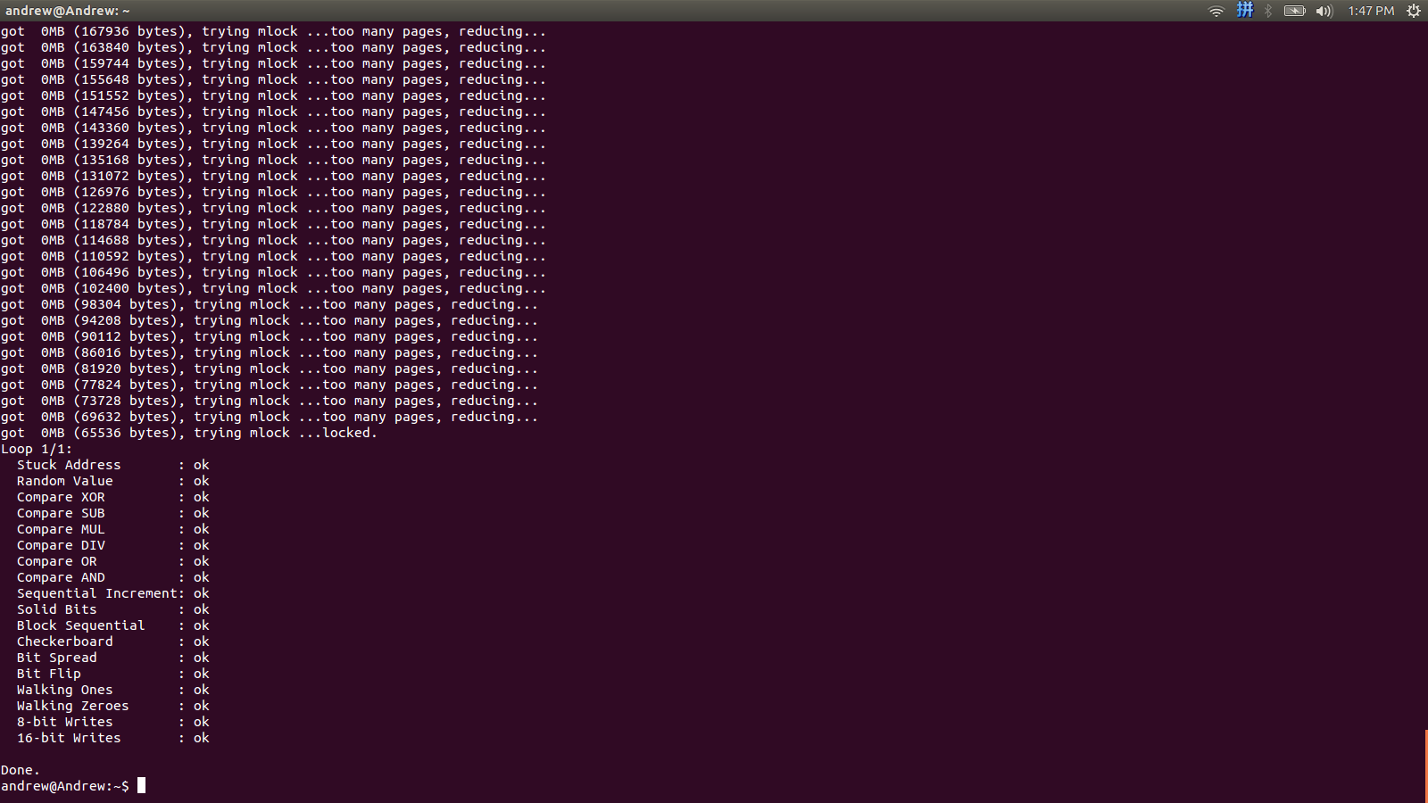

Slide 3
Fault Characteristics
Address-Decoder Fault (AF)
Stuck-At Fault (SAF)
Transition Fault (TF)
Coupling Fault (CF)
3

Slide 4
Traditional solution
Walking Pattern-Complexity 2N²
Sliding Pattern-Complexity 4N^{1.5}
Butterfly Pattern-Complexity 5NlogN
Means
Size | N | NlogN | N^{1.5} | N²
1G | 10.5sec | 5.3min | 4days | 366years
4

Slide 5
Embedded memory Characteristics
embedded memory’s address, data, and control signals are usually not directly accessible through the I/O pins.

Slide 6
Solution: March && Memory Built-In-Self Test
March Test typically has complexity: O(N)
Linear access to memory by a specific order
Memory Built-In-Self Test(Architecture)
Model select
Normal data in
Test clk
Self-test controller
Data generator
reset
Address Generator
RAM
Normal address
Normal data out
Reference
Data receiver
(Comparator)

Slide 7
March C-(evolved March C)
March C- is a classical algorithm which is the foundation of other algorithms
{(w0);(r0,w1);(r1,w0);(r0,w1); (r1,w0);  (r0)}
Complexity—5N=>O(N)
⇧ ascending order
⇩ descending order
r0:read 0
w1:write 1
March Element (w0): M0

Slide 8
{(w0);(r0,w1);(r1,w0);(r0,w1); (r1,w0); (r0)} M0 M1 M2 M3 M4 M5
Address Fault, Transition Fault: M2 and M3
Stuck-At Fault: overwrite 0’s and 1’s
M1
0 1
0 1
0 1
M2
1 0
1 0
1 0
M2
1 0
1 0
1 0

Slide 9
{(w0);(r0,w1);(r1,w0);(r0,w1); (r1,w0); (r0)} M0 M1 M2 M3 M4 M5
Coupling Fault (CF)
j< i, Cj affected by Ci
M1: Ci 1->0 falling behavior affect Cj
M2: Ci 0->1 raising behavior affect Cj
j> i, detected by M3 and M4
M1
1
0 1
0 1
M2
0
1 0
1 0
0(j)
1
2(i)

Slide 10
Other March algorithm
 | SAF | AF | TF | CF
MATS | ALL | Some
MATS++ | ALL | ALL
March X | ALL | ALL | ALL | Some
March C- | ALL | ALL | ALL | ALL
March A | ALL | ALL | ALL | Some
March B | ALL | ALL | ALL | Some
March Y | ALL | ALL | ALL | Some

Slide 11
Challenge
Silicon area overhead
Complexity can be less than O(N)
Faults coverage
Decrease test instructions and data
Model select
Normal data in
Test clk
Self-test controller
Data generator
reset
Address Generator
RAM
Normal address
Normal data out
Reference
Data receiver
(Comparator)

