Slide 1
Bioelectricity
Fall 2022
Tufts University
Instructor: Joel Grodstein
joel.grodstein@tufts.edu
Bioelectricity 1b – QSS and neurons

Slide 2
Big picture of the course
Where does bioelectricity come from?
Neurons and working with the nervous system
Cardiac bioelectricity
Worms

Slide 3
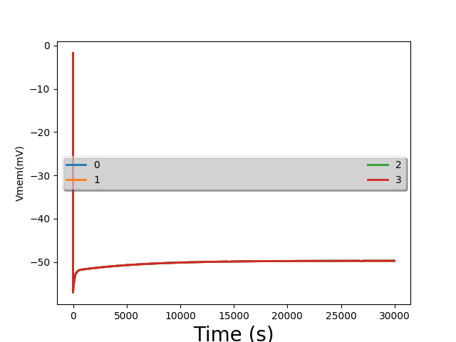
VLab #1, first plots

Slide 4
Problem for the day
We ran a bunch of simulations of cells
They created voltage. Cool!
“Minor” problem:
Our sims took several hours of simulated time to reach steady state
Our brains run on bioelectricity
Any problem there?

Slide 5
How can our brain be so fast?
We humans can think pretty fast
We can react pretty fast, too
Cannot work if each neuron takes hours to settle!
Result: humans evolved a new way to use bioelectricity
Operation at quasi-steady-state
It’s how neurons work
Levin-lab hypothesis
Steady-state bioelectricity is used to build body shape
We’re in the womb for 9 months
Our cuts & scrapes heal over days/weeks
But it’s not OK for brains ☹
Or for animorphs https://www.youtube.com/watch?v=jEKPDgjERt0&list=PL9AC274019AC09106&index=5
Notes:
At the “react fast” part, throw something!

Slide 6
What we will learn
How to use bioelectricity to compute really fast
This will be how neurons work
Hypothesis: cells communicated slowly via bioelectricity for eons…
And then evolution figured out a trick

Slide 7
How can neurons be so fast?
Can you put these facts together to figure out why?
Fun facts:
Cells are very small (C_{mem} is small)
Biology has built sensitive sensors – we need only move V_{mem} by 50mV
Inside and outside have very different concentrations from each other
Each has quite a lot of charge
So ∆V is also small. And q = CV, ∆q = C∆V
diffusion currents are high. ${flux}_{Na}=−D\frac{d\left[Na\right]}{dx}$
60mV
--- +++
Drift currents are quite high. Lots of ions packed densely, all moving even slowly → lots of cars passing/second
[K⁺]=20mM
[Na⁺]=440mM
[Cl⁻]=560mM
other⁺=110mM
[K⁺]=400mM
[Na⁺]=50mM
[Cl⁻]=52mM
Pr ⁻=408mM
3Na⁺
2K⁺
Notes:
Biological voltages are small: 50mV or so. Compare to your IPhone CPU >1V. This is partly why your brain is so power efficient!
And your house is 120V. This also gives your body a lot of safety margin against getting electrocuted if something goes wrong. You would not want to be electrocuted every time you catch a cold!

Slide 8
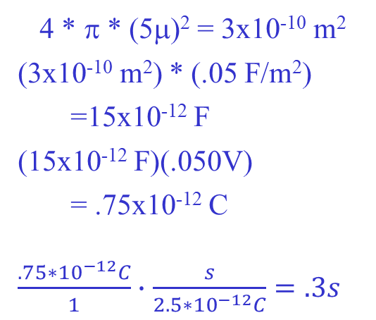
Back of the envelope speed
Quick electricity problem:
If the cell membrane is a capacitor C
How much charge Δq must enter the cell to change the voltage by ΔV?
Δq=CΔV
Typical planaria values:
Radius of a cell = 5μ
Capacitance of the cell membrane = .05 F/m²
ΔV = 50mV
What is Δq?
How long will it take to move V_{mem} by 50mV?
Current = 2.5*10⁻¹² C/s
Area of membr. =
C =
Δq = CΔV =
Time =
4 * π * (5μ)² = 3x10⁻¹⁰ m²
(3x10⁻¹⁰ m²) * (.05 F/m²)
=15x10⁻¹² F
(15x10⁻¹² F)(.050V)
= .75x10⁻¹² C
$\frac{.75∗{10}^{−12}C}{1}∙$ $\frac{s}{2.5{∗10}^{−12}C}=.3s$
Notes:
First convince them that Δq=CΔV is true by showing a few numbers: 10=2*5, and (10+2*3)=2*(5+3)
This works because the equation is linear

Slide 9
It only takes .3s to move V_{mem} around as much as needed!
That’s a planaria; humans are <1ms
More fun facts… anybody know why human nerves are so much faster than worms?
That’s a lot faster than hours! Nice, but…

Slide 10
So why was VLab #1 so slow?
--- +++ 60mV
3Na⁺
2K⁺
[K⁺]=20mM
[Na⁺]=440mM
[Cl⁻]=560mM
other⁺=110mM
[K⁺]=400mM
[Na⁺]=50mM
[Cl⁻]=52mM
other⁻=408mM
Blue arrows = diffusion
Green arrows = electric current
Red arrows = ion pump
Bioelectricity has another trick up its sleeve
Consider increasing G_{Na}
Lookahead… neurons work by quickly changing G_{Na} and G_{K}
Notes:
Assume we were in SS before we increased G_{Na}

Slide 11
So why was VLab #1 so slow?
50mV
--- +++ 60mV
3Na⁺
2K⁺
[K⁺]=20mM
[Na⁺]=440mM
[Cl⁻]=560mM
other⁺=110mM
[K⁺]=400mM
[Na⁺]=50mM
[Cl⁻]=52mM
other⁻=408mM
Blue arrows = diffusion
Green arrows = electric current
Red arrows = ion pump
If we increase G_{Na}
Na+ is flowing inwards from both diffusion and drift, and then being pumped out
Increasing G_{Na} will increase the inwards flow; and not affect the outwards flow
Analyzing only Na for now…
More [Na]_{int} → V_{mem} ↑
Higher V_{mem} pushes Na⁺ out again
This is negative feedback
V_{mem} rises → reduced drift balances increased diffusion
Concentrations barely change, so it’s fast
V_{mem} will get more positive (i.e., closer to 0)… fast or slow?
very fast
Are we done yet? At this new V_{mem}, is the flow of, say, Cl⁻ balanced?
Notes:
Assume we were in SS before we increased G_{Na}

Slide 12
We’re not at steady state
--- +++ 50mV
3Na⁺
2K⁺
[K⁺]=20mM
[Na⁺]=440mM
[Cl⁻]=560mM
other⁺=110mM
[K⁺]=400mM
[Na⁺]=50mM
[Cl⁻]=52mM
other⁻=408mM
Blue arrows = diffusion
Green arrows = electric current
Red arrows = ion pump
Cl⁻ has no pump. It’s only balanced when drift=diffusion. Are they balanced?
Cl⁻ diffusion is unchanged, but drift is changed…
Cl⁻ is not balanced
Ditto for K⁺, in fact
What must change for Cl⁻ to balance again at this new V_{mem}?
ICF [Cl] must change enough to make a new diffusion
But that is what takes hours and not ms.
Remember: unbalanced charge flow changes V_{mem} very fast, but [] changes slowly
So what’s going on? Why do we think we can compute fast?

Slide 13
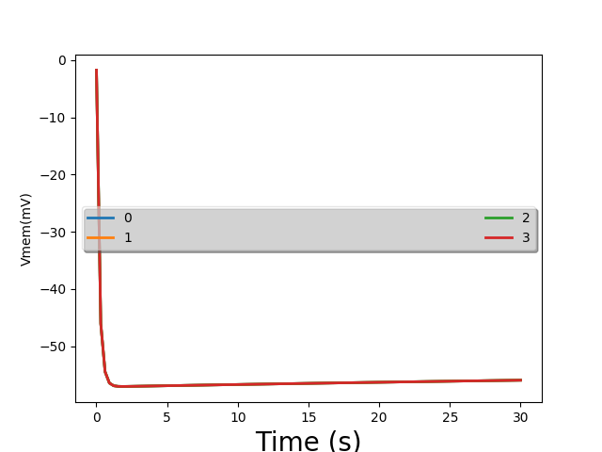
VLab #1 picture again
This time in more detail, from t=0 to t=30:
really fast change
really slow change
Notes:
We see one

Slide 14
50mV
--- +++ 60mV
3Na⁺
2K⁺
[K⁺]=5mM
[Na⁺]=145mM
[Cl⁻]=140mM
[K⁺]=400mM
[Na⁺]=50mM
[Cl⁻]=9mM
other⁻=408mM
Blue arrows = diffusion
Green arrows = electric current
Red arrows = ion pump
Big picture: if you make V_{mem} more positive
Diffusion and pump flows are unchanged
Drift currents push positive ions out, negative ions in

Slide 15
flux (mM/m²s) into cell
Na drift+diff
K pump
K drift+diff
-71 0 V_{mem} (mV)
Na pump
The situation at SS, -71mV before we changed G_{Na}:
Pump 3 Na out, 2 K in
Drift & diffusion must balance the pump
Now increase G_{Na}
Na drift and diffusion are both in → flux increases
Generally, more positive V_{mem} → pos. charges drift out
Any guesses how I drew the slope of these two lines?
Notes:
When we turn on more Na ion channels and increase Na drift & diff, the green dot moves up to reflect that.
So the moved green dot is really saying “this is the new drift+diffusion at -71mV.”
Now of course the unbalanced charge will quickly change Vmem – and the green “Na drift+diff vs Vmem” line is showing how a changed Vmem (which will be the natural result of newly-unbalanced charge) will affect drift+diff. “ That’s why the green line must pass through the moved green dot.
So the green line will show how Na drift+diff changes with Vmem with the newly-on ion channels.
How did we pick the slopes of the Na and K lines? The x intercepts are easy: at each ion’s Vnernst, drift+diff=0 (Vn,Na=+77mV; Vn,K=-89). Then we need one other point. For K, at -71mV drift+diff=pump. For Na, we have the fairly arbitrary place we moved the Na dot to.
Random note: we’ve moved to voltage (Vmem=-71mV) and concentration values (for Vnernst) that are more like human neurons, not giant squid.

Slide 16
flux (mM/m²s) into cell
Na drift+diff
K pump
K drift+diff
-71 0 V_{mem} (mV)
Na pump
Na has net flow in
so V_{mem} becomes more positive
But how much more positive?
We can pick a new V_{mem} to balance Na
but then K isn’t balanced
What is the right V_{mem}?

Slide 17
charge (C/m²s) into cell
flux (mM/m²s) into cell
Na drift+diff
K pump
K drift+diff
-71 0 V_{mem} (mV)
Na pump
Net + charge into cell
Net 0 charge into cell
Net - charge into cell
Add Cl to the picture
There is some increased V_{mem} with net zero charge into the cell!
Can you argue that this is where we settle to?
Can you argue that we settle here pretty quickly?
Notes:
Clearly if we raise Vmem positive enough, drift pulls huge net negative charge into the cell.
And if we move Vmem negative enough, drift pulls net positive charge into the cell.
Therefore there *must* be some intermediate Vmem where net charge flow into the cell is zero.
Note that the line for Cl is drawn with some random slope; no way to know what it is.

Slide 18
charge (C/m²s) into cell
flux (mM/m²s) into cell
Na drift+diff
K pump
K drift+diff
-71 0 V_{mem} (mV)
Na pump
Net + charge into cell
Net 0 charge into cell
Net - charge into cell
No individual ion is balanced
Non-zero charge flux into cell for each of Na, K, Cl
But they all cancel out!

Slide 19
VLab #1 picture again
This time in more detail, from t=0 to t=30:
really fast change
really slow change – QSS
no change – SS
Notes:
In the “really slow change” domain, we still have unbalanced flux of all ions. But it’s really slow, since (again) the ion channels

Slide 20
In-class exercise
In a few sentences, explain how neurons can operate so fast
If a cell is at some V_{mem} higher or lower than the net-charge-flux-equals-0 voltage, what is the mechanism to quickly fix this?
How is this a negative-feedback system?

Slide 21
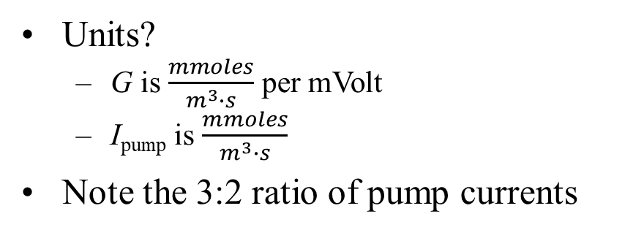
Circuit model computes V_{mem}
ICF
I_{Na}
I_{K}
.4
2.2
.4
60 40
$$V_{Na}^{N}$$
$$V_{K}^{N}$$
$$V_{Cl}^{N}$$
ECF
77mV
-89mV
-71mV
Units?
G is $\frac{mmoles}{m^{3}∙s}$ per mVolt
I_{pump} is $\frac{mmoles}{m^{3}∙s}$
Note the 3:2 ratio of pump currents
Notes:
In Bitsey, the units on Gth are (ions entering the cell/m2s) per Volt of Vmem; thus Gth tends to be negative for Na and K, and positive for Cl.
However, Bitsey then scales the resultant ion fluxes by each ion’s Z to get charge fluxes. If we’re restricted to Z=+1 and Z= -1, then we get the same effect by simply assuming that all G values are positive (which is what this slide does)

Slide 22
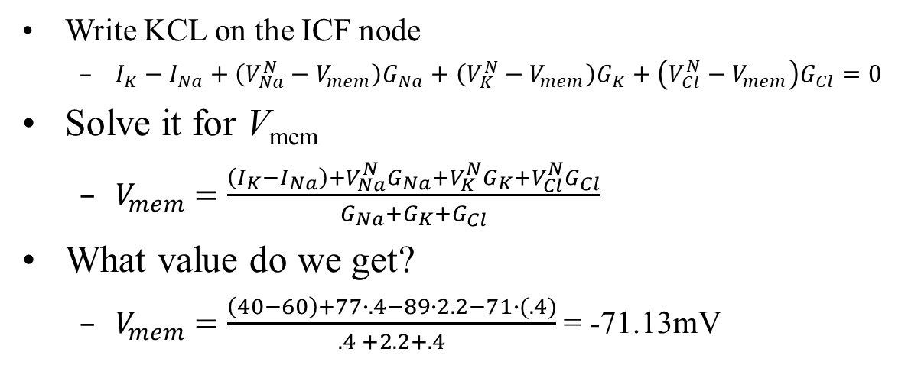
In-class exercise
ICF
I_{Na}
I_{K}
.4
2.2
.4
60 40
$$V_{Na}^{N}$$
$$V_{K}^{N}$$
$$V_{Cl}^{N}$$
ECF
77mV
-89mV
-71mV
Write KCL on the ICF node
$I_{K}−I_{Na}+\left(V_{Na}^{N}−V_{mem}\right)G_{Na}+\left(V_{K}^{N}−V_{mem}\right)G_{K}+\left(V_{Cl}^{N}−V_{mem}\right)G_{Cl}=0$
Solve it for V_{mem}
$V_{mem}=\frac{\left(I_{K}−I_{Na}\right)+V_{Na}^{N}G_{Na}+V_{K}^{N}G_{K}+V_{Cl}^{N}G_{Cl}}{G_{Na}+G_{K}+G_{Cl}}$
What value do we get?
$V_{mem}=\frac{\left(40−60\right)+77∙.4−89∙2.2−71∙(.4)}{.4 +2.2+.4}$ = -71.13mV
Notes:
In Bitsey, the units on Gth are (ions entering the cell/m2s) per Volt of Vmem; thus Gth tends to be negative for Na and K, and positive for Cl.
However, Bitsey then scales the resultant ion fluxes by each ion’s Z to get charge fluxes. If we’re restricted to Z=+1 and Z= -1, then we get the same effect by simply assuming that all G values are positive (which is what this slide does)

Slide 23
KCL = biology?
ICF
I_{Na}
I_{K}
.4
2.2
.4
60 40
$$V_{Na}^{N}$$
$$V_{K}^{N}$$
$$V_{Cl}^{N}$$
ECF
77mV
-89mV
-71mV
What is KCL really doing?
It’s saying that the sum of currents into the node = 0
We already said the cell quickly settles at a V_{mem} where net flux = 0
These are the same thing!
KCL computes the V_{mem} that we quickly settle to
But ignores how long it takes to get there
Any idea how to fix that?
Notes:
To figure out how long things take, we would have to add the membrane capacitor to this circuit

Slide 24
Individual ion currents
ICF
V_{mem}=-71mV
I_{Na}
I_{K}
Compute the current for each ion
.4
2.2
.4
60 40
$$V_{Na}^{N}$$
$$V_{K}^{N}$$
$$V_{Cl}^{N}$$
ECF
77mV
-89mV
-71mV
Na
ion channel = (77 - -71) * .4 ≈ 60 entering the cell
pump = 60 leaving the cell
Cl
Voltage drop across resistor = ?
Current = ?
K
ion channel = ?
pump = ?
Are we in SS or QSS?
(-71) - (-71) = 0 mV
V/R = 0
(-89 - -71) * 2.2 ≈ -40 entering the cell
40 entering the cell
Notes:
Even though in general the model predicts QSS values, in this case I carefully copied the V & G values from a SS solution.

Slide 25
What if we change G_{Na}?
ICF
V_{mem}=-71mV
I_{Na}
I_{K}
I.e., turn on more Na ion channels?
(lookahead – neurons do this)
We used graphs to predict the outcome of changing G_{Na}
What does the model predict?
.4
2.2
.4
60 40
$$V_{Na}^{N}$$
$$V_{K}^{N}$$
$$V_{Cl}^{N}$$
ECF
77mV
-89mV
-71mV

Slide 26
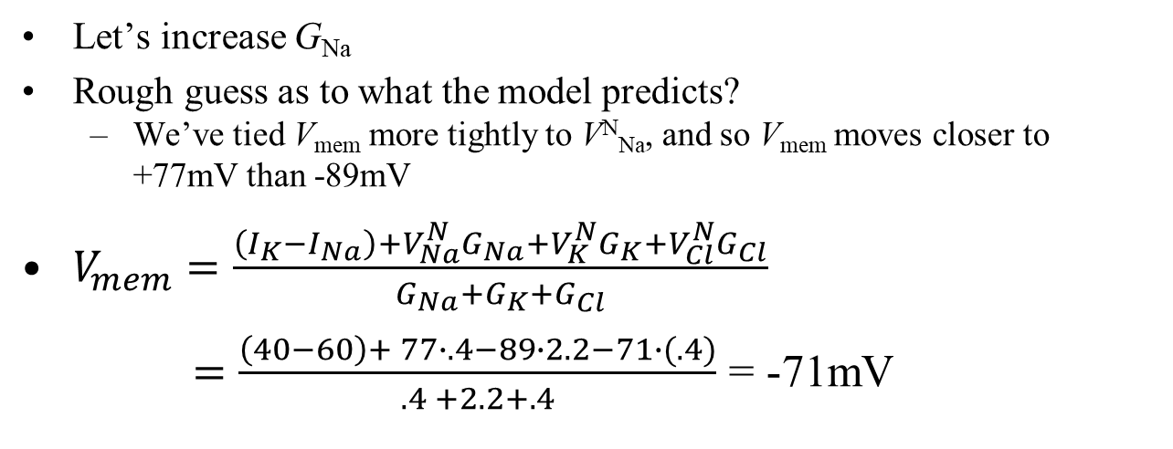
V_{mem}=19mV
ICF
V_{mem}=-71mV
I_{Na}
I_{K}
5
2.2
.4
.4
60 40
$$V_{Na}^{N}$$
$$V_{K}^{N}$$
$$V_{Cl}^{N}$$
ECF
77mV
-89mV
-71mV
Let’s increase G_{Na}
Rough guess as to what the model predicts?
We’ve tied V_{mem} more tightly to V^{N}_{Na}, and so V_{mem} moves closer to +77mV than -89mV
$V_{mem}=\frac{\left(I_{K}−I_{Na}\right)+V_{Na}^{N}G_{Na}+V_{K}^{N}G_{K}+V_{Cl}^{N}G_{Cl}}{G_{Na}+G_{K}+G_{Cl}}$
$=\frac{\left(40−60\right)+ 77∙.4−89∙2.2−71∙(.4)}{.4 +2.2+.4}$ = -71mV
5
19
5
Notes:
In Bitsey, the units on Gth are (ions entering the cell/m2s) per Volt of Vmem; thus Gth tends to be negative for Na and K, and positive for Cl.
However, Bitsey then scales the resultant ion fluxes by each ion’s Z to get charge fluxes. If we’re restricted to Z=+1 and Z= -1, then we get the same effect by simply assuming that all G values are positive (which is what this slide does)
The actual Vmem is +18.52

Slide 27
ICF
V_{mem}=+19mV
Na: (77-19)*5≈292
I_{Na}
I_{K}
Cl: (-71-19)*.4≈-36
5
2.2
.4
60 40
$$V_{Na}^{N}$$
$$V_{K}^{N}$$
$$V_{Cl}^{N}$$
K: (-89-19)*2.2≈-236
ECF
77mV
-89mV
-71mV
Let’s look at the new currents
Here’s the math, above
Which way does Na flow?
K?
Cl?
Observation: each ion is individually unbalanced!
In total: net charge flow into cell via ion channels =
net flow leaving via pumps =
Into the cell, since V_{mem}=19mV and 19<77
Out of the cell, since 19 > -89
Charge out (Cl in) the cell, since 19 > -71
292 -236 - 36 = 20
60 - 40 = 20
Are we in SS or QSS?
Notes:
The actual Vmem is +18.52, which makes the numbers on the slide actually work right without needing the “approximately equals.”
The units on the fluxes are moles/(m2s).

Slide 28
What’s going on?
ICF
V_{mem}=19mV
I_{Na}
I_{K}
292 236 36
60 40
$$V_{Na}^{N}$$
$$V_{K}^{N}$$
$$V_{Cl}^{N}$$
The model predicted SS once and QSS once. Why?
ECF
77mV
-89mV
-71mV
Settling to the new QSS value will happen quickly
Do ion concentrations change much in this short time?
No, they can’t
Is there any slow process that the schematic doesn’t model?
Each ion has nonzero flux → concentration slowly changes
How does that concentration change affect our model parameters?
V^{Nernst} changes slowly

Slide 29
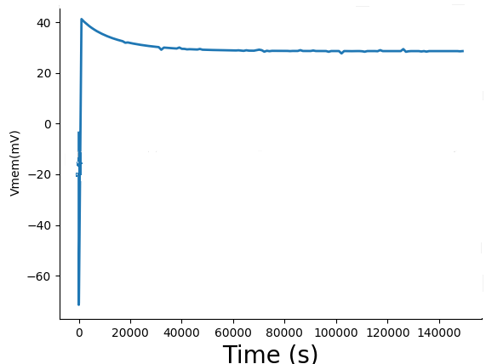
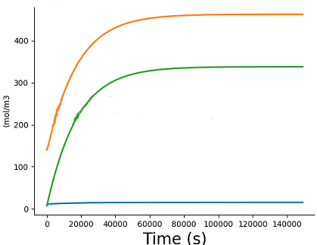
Setup:
G_{Na} and G_{K} originally set for -71mV
At t=100s, they suddenly change
Eventually we reach true SS
Na⁺
K⁺
Cl⁻
Dynamic phase: V_{mem} swinging rapidly
Thus so does V_{mem}
QSS: concentrations changing very slowly
Notes:
Oops… the last slide popped up to 30mV, and this slide does 40mV. I could redo this if I have extra time.
Anyway, the message is that the slow ion-concentration changes do eventually reach an QSS that happens to be SS

Slide 30
QSS big picture
Change how many Na, K ion channels are on
and that quickly swings V_{mem} positive, negative
That’s how neurons work
Large-scale [Na], [K], [Cl] don’t really change

Slide 31
Summary
ICF
We have a nice equivalent circuit that we can analyze
I_{Na}
I_{K}
G_{Na}
G_{K}
G_{Cl}
$$V_{Na}^{N}$$
$$V_{K}^{N}$$
$$V_{Cl}^{N}$$
ECF
77mV
-89mV
-71mV
The V^{Nernst} values come from ion concentrations
G values depend on how many ion channels are turned on
KCL on the ICF node:
$I_{K}−I_{Na}+\left(V_{Na}^{N}−V_{mem}\right)G_{Na}+\left(V_{K}^{N}−V_{mem}\right)G_{K}+\left(V_{Cl}^{N}−V_{mem}\right)G_{Cl}=0$
$V_{mem}=\frac{\left(I_{K}−I_{Na}\right)+V_{Na}^{N}G_{Na}+V_{K}^{N}G_{K}+V_{Cl}^{N}G_{Cl}}{G_{Na}+G_{K}+G_{Cl}}$

Slide 32
Ion channels, QSS and SS
Change G value → V_{mem} changes rapidly (ms to seconds)
Large-scale concentrations change much more slowly (minutes to hours) – quasi-steady state
Eventually we reach a new steady state again, where each ion flux is 0

Slide 33
What’s up next?
Done with the physics part of the course!
You understand bioelectricity fairly deeply ☺
Python Lab #2, cell voltages in QSS
Reinforces that voltages change fast
Walking quiz
reinforces that G_{Na} and G_{K} are your knobs to swing V_{mem}
Now onto the medical/applications part
Then onto current research

Slide 34
Mini quiz (prep for the oral quiz)
ICF
I_{Na}
I_{K}
G_{Na}
G_{K}
G_{Cl}
$$V_{Na}^{N}$$
$$V_{K}^{N}$$
$$V_{Cl}^{N}$$
ECF
77mV
-89mV
-71mV
What is the value of V_{mem} if, e.g., G_{Na} gets very big?
What is the value of V_{mem} if, e.g., G_{K} gets very big?
What if G_{Na} and G_{K} are both close to 0?

Slide 35
BACKUP

Slide 36
analyze_equiv_network() tries to keep results pretty
It sometimes only prints to one significant digit
Here are some better numbers
 | Na | K | Cl
G (mol/m²s per mV) | 3.19 | 38.4 | 4.44
V_{nernst} (mV) | 71 | -86 | -25
I_{pump} (mol/m²s) | 810 | 540

