Slide 1
Bioelectricity
Fall 2022
Tufts University
Instructor: Joel Grodstein
joel.grodstein@tufts.edu
Bioelectricity 2a – neurons

Slide 2
Big picture of the course
Where does bioelectricity come from?
Neurons and working with the nervous system
Cardiac bioelectricity
Worms
How a single neuron works
Lots of neurons – the nervous system
EMG, prosthetics, NCS, SCS, PNS, electroceuticals

Slide 3
Turning off cytokine storms
Can you explain the science here?
www.setpointmedical.com (white paper at https://setpointmedical.com/sp-content/uploads/2018/09/Setpoint_Medical_White_Paper_digital.pdf )
https://spectrum.ieee.org/the-human-os/biomedical/devices/handheld-vagus-nerve-stimulator-gets-emergency-approval-for-covid19-use
Notes:
Cytokines are signaling chemicals used by the immune system. There are many different cytokines, with different effects. A cytokine storm is when the immune system produces way too many pro-inflammatory cytokines.

Slide 4
Why neurons?
Why do humans have neurons?
Bacteria don’t have neurons, and they do fine ☺
Humans have brains and bacteria don’t
Bacteria can “think” without brains!
On Having No Head: Cognition throughout Biological Systems, 2016
Any other reasons humans have neurons and bacteria don’t?

Slide 5
The problem with being big
Imagine you’re Fred Flintstone and a dinosaur is chasing you
To run away, your brain must send a message to your feet – over 5’ away
Bacteria don’t need long-distance signaling

Slide 6
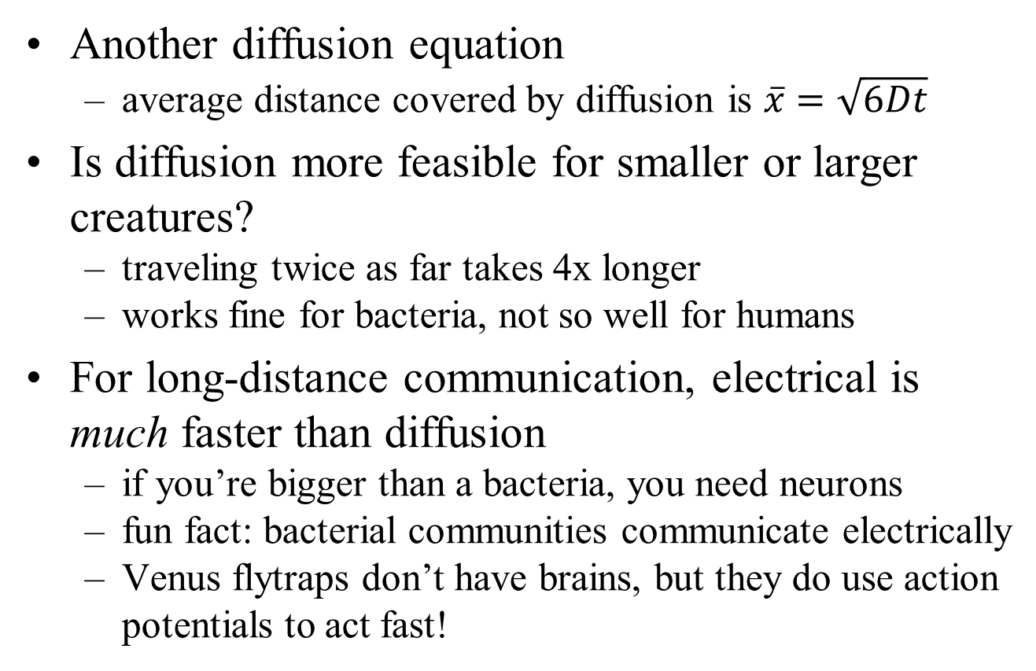
Long-distance diffusion is slow
Another diffusion equation
average distance covered by diffusion is $\overline{x}=\sqrt{6Dt}$
Is diffusion more feasible for smaller or larger creatures?
traveling twice as far takes 4x longer
works fine for bacteria, not so well for humans
For long-distance communication, electrical is much faster than diffusion
if you’re bigger than a bacteria, you need neurons
fun fact: bacterial communities communicate electrically
Venus flytraps don’t have brains, but they do use action potentials to act fast!
Notes:
Diffusion doesn’t work well for giraffes, either!
I’m not sure if the electrical communication in bacterial communities is providing a big speed advantage (bacterial communities are still pretty small).

Slide 7
Slick video
https://www.youtube.com/watch?v=UZthGjcuTDs
Joe Hansen video
5 minutes in class
the rest on your own if you like

Slide 8
This slide set
How a single neuron works
Lots of neurons – the nervous system

Slide 9
What is a neuron?
Long skinny cell that conducts action potentials
Communication (mostly) between your brain and the rest of your body
One neuron is not very useful
Your brain has ≈86 billion neurons
Notes:
People used to say 100 billion; now they say 86.

Slide 10
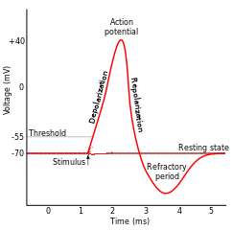
How neurons spike
Nature has built a pretty amazing system
By altering G_{Na} and G_{K}, we can quickly swing between -89mV and +77mV
We can build any waveshape by suitably altering G_{Na} and G_{K}
ICF
I_{Na}
I_{K}
G_{Na}
G_{K}
G_{Cl}
$$V_{Na}^{N}$$
$$V_{K}^{N}$$
$$V_{Cl}^{N}$$
ECF
77mV
-89mV
-71mV

Slide 11
In-class exercise
For each of the three regions
what do you think is happening to G_{Na}?
to G_{K}?
G_{K} rising
Both return to baseline
G_{Na} rising
both “baseline”
V^{N}_{Na}=+54mV; V^{N}_{K}=-90mV; V^{N}_{Cl}=-70mV

Slide 12
Detailed waveforms
If you were to guess, how do you think G_{Na} and G_{K} change over the course of a spike? Draw it
G_{Na} is the green curve
G_{K} is the blue curve
Na has high G
Both return to baseline
K has high G
Na and K both have low G
V^{N}_{Na}=+54mV; V^{N}_{K}=-90mV; V^{N}_{Cl}=-70mV

Slide 13
How do we get those shapes?
Now we know what shapes we want for G_{Na} and G_{K}; how do we get them?
The Hodgkins-Huxley model
Differential equations for the blue and green curves
Basic idea is voltage-sensitive ion-channel turnon
G_{Na} contains an increasing function of V_{mem}; fast positive feedback → rising spike with a turnon threshold
Slow negative-feedback mechanism shuts the spike off
Exercise – can you explain the refractory period?
G_{Na} is the green curve
G_{K} is the blue curve
Notes:
The Na gate is m^3*h; m is a monotonically increasing function of Vmem (with a fast tau), and h is a monotonically decreasing function of Vmem (with a slow tau). So overall they work to make G_{Na} actually shut itself off even without needing G_{K}. The K gate is n^4, where n is monotonically increasing and medium slow.
In fact, to really explain the refractory period you need to know about “h”; the refractory period is when h is low, and thus the Na ion channels cannot turn on until h (slowly) goes back to 1. But we can roughly explain the refractory period by saying that it’s when the slow negative-feedback mechanism is forcing the spike off, and since it’s slow G_K stays high for a while.

Slide 14
It’s nice that APs are short & sweet
Neurons are fast
Change G_{Na} and/or G_{K} → near instant change in V_{mem}
But…
the march to a new steady state starts instantly too
if the changes in G_{Na} and/or G_{K} lasted long enough, the internal [Na], [K] and [Cl] would change
Any consequences of that?
the neuron would function differently at the next spike
But it doesn’t happen; we saw that neurons return to baseline quite quickly
There’s a good reason why action-potential spikes are short and sweet!
Notes:
This one is a semi-backup. Mention that!
Now we know all about APs. What missing? The fact that they travel!

Slide 15
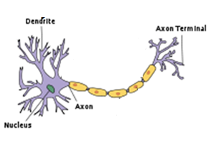
APs travel
+40
Speed=0.5 – 150 m/s
0
V_{mem}(mV)
-55
-70
0
1
2
3
4
5
Time(ms)
Notes:
This is our first exposure to a neuron – we’ll look at it in more detail later. For now, it just has an input on the left, output on the right
AP starts on the left
It looks like a traveling wave.
There’s a wide range of neuron speeds – more on that later

Slide 16
Mechanism of travel
Start with an action potential (AP) at one end of a neuron
it started when V_{mem} was pushed high enough
V_{mem} is changing via drift, diffusion through ion channels
But – diffusion is 3D
goes axially as well as radially
ion channels
Notes:
The AP was caused by a bit of extra + charge at one point.
Diffusion happens left/right as well as through ion channels!

Slide 17
Mechanism of travel
Next plot: V_{mem} vs. x
V_{mem}
t=0: blue
t=1: green
Now there’s enough V_{mem} here to fire an AP
distance from the neuron’s starting (dendrite) end
0 1 2 3
Notes:
The AP was caused by a bit of extra + charge at one point.

Slide 18
Mechanism of travel
Start with an action potential (AP) at one end of a neuron
it started when V_{mem} was pushed high enough
Diffusion:
it damps
but this pushes V_{mem} higher nearby
V_{mem} nearby
x axis is time; each graph is a different location

Slide 19
Traveling APs
Why don’t they reverse direction?
Why doesn’t the green AP at x=2 diffuse to x=1 as well as to x=3?
It does diffuse. But x=1 is in refractory mode
Rising above threshold won’t kick off an AP
x=2
+40
x=1
0
V_{mem}(mV)
-55
-70
0
1
2
3
4
5
Time(ms)

Slide 20

Myelin
$$C=\frac{εA}{d}$$
Some neurons are coated with myelin
A fatty, non-conductive layer
How does myelin affect membrane capacitance?
cell membrane
myelin

Slide 21
Myelin
What good is myelin?
Makes neurons propagate an action potential fast
A big evolutionary step in our brains being useful ☺
Thick membrane → low C
Q=CV: does low C means faster or slower?
Multiple sclerosis is an auto-immune disease where (among other issues) nerves get demyelinated
faster. Takes less Δq to make enough ΔV

Slide 22
The problem with myelin
ion channels
Neuron without myelin
Action potential travels slowly
Gets regenerated frequently
Neuron with myelin
Ion channels cannot traverse the sheath
V_{mem} wave spreads much faster. But…
Without ion channels, action potentials cannot regenerate!
Die out before reaching the other end of the neuron ☹
Solution:
Nodes of Ranvier
Occasional gaps in the myelin sheath, big enough to allow AP regeneration

Slide 23
That’s a neuron!
Takes inputs from upstream neurons
Generates an AP
The AP travels
Myelin makes it go fast
Drives downstream neurons

Slide 24
This section
How a single neuron works
Lots of neurons – the nervous system

Slide 25
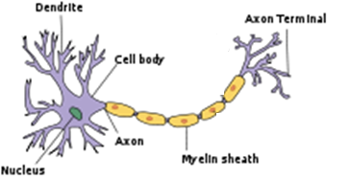
Lots of neurons
synapse
The brain has ≈86B neurons.
Each dendrite takes inputs from ≈1000 other neurons and decides when to fire
Each input pulse raises V_{mem} slightly; fires when it hits a threshold
An action potential then travels along the axon to the next downstream synapse(s)
Notes:
For those of you who are into NNs, is this exciting? It’s a very nonlinear response, which ANNs depend on. Of course, your brain doesn’t really care if some computer scientist built an ANN like a real brain or not, but it’s probably comforting for the CS person :-).

Slide 26
How neurons talk to each other
synapse
Driving neuron stores neurotransmitter molecules. AP → release them into the synapse
Neurotransmitter diffuses across the synapse, binds to receptor proteins
Receptor protein acts as an open ion channel, thus allowing a packet of charge to enter or leave it, changes receiver V_{mem}
Doesn’t this diffusion slow down the system?
Cardiac lookahead – some neurons talk with GJs
Notes:
Diffusion over short distances like a neural cleft is fine – the big diffusion issue is traveling for longer distances

Slide 27
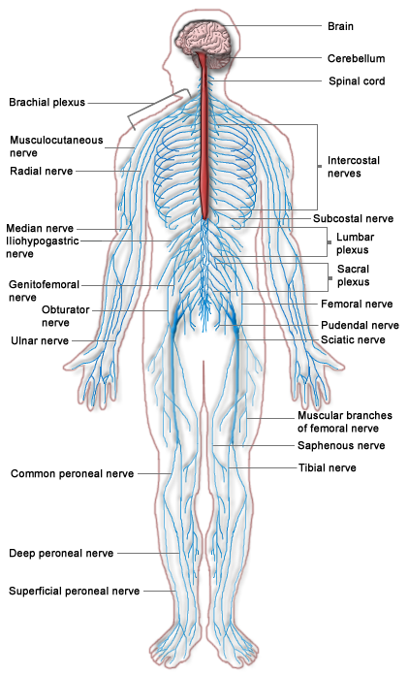
Central nervous system (CNS, red)
brain + spinal cord
controls most everything
big mystery
Peripheral nervous system (PNS, blue)
everything but the CNS
CNS signals must usually traverse PNS to do anything
typically 100s of neurons per nerve
electroceuticals target here

Slide 28
Sensory neuron
Carries information towards the brain
E.g., touch a hot stove
Motor neuron
Carries information away from the brain
e.g., control your muscles
anything else?
Notes:
First, we’ve skipped a neuron type – sensory, motor and interneurons (which connect the two, especially in reflexes).
Second – a motor neuron can drive a gland as well as a muscle. Glands produce & secrete various molecules, typically under nervous-system control. E.g., your sweat glands or your hormones.

Slide 29
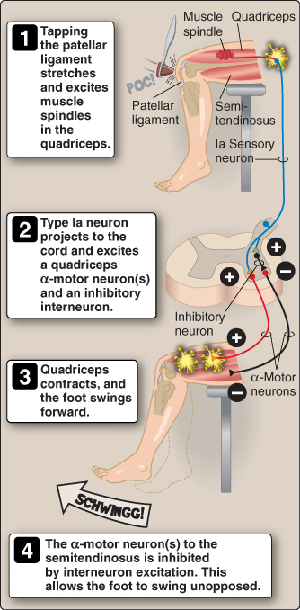
Reflexes
What is a reflex?
A sensory nerve detects a signal
Travels into spine
Synapses with a motor nerve to come right back
Example: tap under your kneecap and your leg kicks
Lippincott Ch 11

Slide 30
Why do we have reflexes?
Why not have all signals just travel to the brain and back?
Central Pattern Generator (CPG)
small state machine in your spine
Why might this be useful in addition to brain, reflexes?
intermediate solution (faster than the brain, more powerful than reflexes)
walking is likely controlled by a CPG
CPG
Notes:
Talk about the tradeoffs involved. Reflexes can be very fast; getting to/from the brain takes at least 20ms each way (plus any actual thinking!). A CPG is an intermediate compromise. It also reduces upper-spinal-cord thickness and can give you some motion after spinal-cord injury.

Slide 31
Mini-quiz
Take 5 minutes & check yourself in groups
What is a refractory period?
What does myelin do, and why?
What do neurotransmitters do? They diffuse from one neuron to another – why doesn’t that slow down the system?
What is the central vs. peripheral nervous system?
What is a reflex?

