Slide 1
EE 123 Bioelectricity
Fall 2022
Tufts University
Instructor: Joel Grodstein
joel.grodstein@tufts.edu
Lecture 4a: Biology backgrounder

Slide 2
Big picture of the course
Where does bioelectricity come from?
Neurons and working with the nervous system
Cardiac bioelectricity
Worms

Slide 3
Biology backgrounder
The fun part in a class with a wide variety of people
getting everyone up to speed
learn each others’ basic concepts and terminology
Non-goals
turn everyone into a biology major
A little knowledge is a dangerous thing: give everybody just enough knowledge to be dangerous ☺
Goals
Give everybody enough biology background for morphogenesis
Ultimate goal: give non-biologists enough background to work productively with biologists in a team
Or, look reasonably intelligent on a job interview ☺
Or understand what “central dogma” means

Slide 4
Morphogenesis
One of the black mysteries of biology
An egg and sperm unite to form one cell. That cell contains all of your DNA
Fast forward 9 months or so. You now have 37 T cells
Each has roughly the same DNA as the one starting cell
DNA has the instructions to create proteins
proteins control most everything
So how can (e.g.,) your eyes be different from your toes?
Time to add some detail to our DNA picture

Slide 5
The cell machine
chemical signals
outputs
inputs
V_{mem}
chemical signals
V_{mem}
DNA =
software
proteins
What I am
shape, mineralization, …
if (in1 & in2 & !in3)
make protein #1
if (in2 & (V_{mem}>-5mV))
make protein #2
Each cell = 1 core in a huge distributed computer

Slide 6
Takeaways
Each cell is a machine (a.k.a. processor)
Each cell has the same DNA
So they all run the same software!
The function of this software is called the “central dogma of biology”
Somehow they all figure out who is the eyes & who is the feet !?!
Impressive feat of distributed networked computing

Slide 7
Proteins
We said DNA is software, telling the cell’s HW what to build
What do cells build?
So: what’s a protein, and why are they so important?
A protein is one or more chains of 20 different amino acids
Nested-definition alert: what’s an amino acid?
It’s the main component of proteins ☺
The cell assembles amino acids into proteins
Proteins

Slide 8
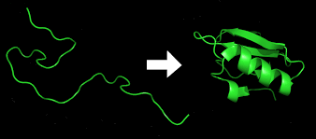
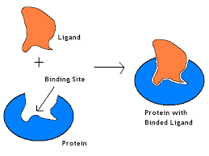
Why are proteins important?
They have powerful magic
They quickly fold themselves into intricate shapes
Because of this, they are amazingly good at recognizing and binding to other molecules in an extremely selective manner

Slide 9
So what?
Proteins can fold ⇒ complex shapes & bind. So what?
Binding ⇒ proteins self-assemble into larger structures
Build 93T puzzle pieces that self-assemble into a body?
Body contains molecular machines built from proteins
Example: your muscles are a molecular machine
To get protein in your diet, you eat meat
Are some of the puzzle pieces building machines that direct our assembly?
Proteins can be part of logic gates
They work with DNA to implement software
This is almost certainly part of the picture!
Notes:
We’ll talk later about whether our assembly is really 93T parts self-assembling

Slide 10
Next level of detail
Not really needed for this course
But you may find it interesting…
What are the insides of the cellular processor?
I.e., the computer architecture of the cell

Slide 11
The central dogma
The key to what a cell does is what proteins it makes. How do cells make protein?
The method is so important it’s described by what’s called the central dogma of biology
biologists’ equivalent of “in the beginning… and it was good”
in the cell: DNA creates mRNA, which creates protein

Slide 12
What is DNA?
DNA is a long molecule that is a sequence of bases. Each base can be adenine (A), guanine (G), cytosine (C) and thymine (T)
The punch-line: a long sequence of DNA (e.g., AUGGCUAGUUAG) specifies a long chain of amino acids that build a protein
But how can 4 DNA bases specify 20 amino acids? Any ideas?

Slide 13
What is DNA?
DNA is a code in base 4
4 choices of base (A,G,C,T); 4³=64; 64>20
Three bases = one codon ⇒ specifies one of 20 AAs, or a start/stop codon
Alanine
Leucine
gene
AUGGCUAGUUAG
promoter AUG GCU AGU UAG terminator…
discuss this shortly
The coding sequence (CDS)
Three bases = 1 codon
start and stop codons bound the CDS

Slide 14
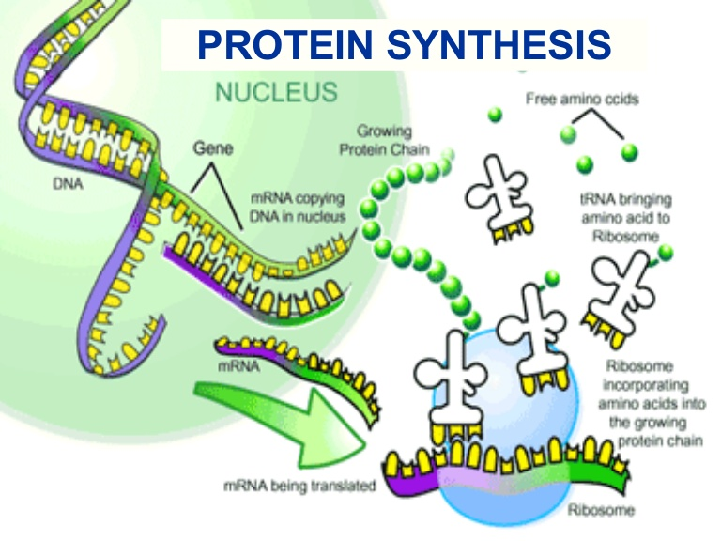
mRNA and tRNA
Central dogma of biology
Transcription reads the DNA and turns a CDS (A, G, C, T) into a roughly-equivalent chain of messenger-RNA (mRNA) bases. They are A, G, C and uracil (U)

Slide 15
mRNA and tRNA
Central dogma of biology
Translation uses a ribosome to turn the mRNA molecule into a protein – chains of amino acid
each codon of mRNA mates with a specific tRNA molecule
tRNA has an anti-codon on one end (that mates w/mRNA); the other end of tRNA is the appropriate amino acid

Slide 16
The big picture
Humans have 23 pairs of chromosomes
Each chromosome is one long molecule of DNA
One chromosome contains many genes
Each gene makes one protein (not quite true)
All of this is in one cell
But where does the software come in?

Slide 17
What is DNA?
DNA is a long molecule that is a sequence of bases. Each base can be adenine (A), guanine (G), cytosine (C) and thymine (T)
promoter AUG GCU AGU UAG terminator…
says when to make this protein
Leucine, Alanine
The coding sequence (CDS)
Three bases = 1 codon, that works in base 4
start and stop codons bound the CDS

Slide 18
What is DNA?
The promoter controls whether the DNA builds mRNA (and thus protein) or not – i.e., whether transcription happens or not
It’s an if statement
if (
promoter AUG GCU AGU UAG terminator…
) {
}
But what controls whether the promoter is True or False?

Slide 19
Promoters
Does this sound like software yet?
What turns a promoter on or off?
A number of possibilities
Often, a transcription factor (TF)
A TF is a protein. It can itself be activated or deactivated based on, e.g., the presence or absence of other proteins or small molecules
In a cell
A gene builds its protein if its promoter is on
A promoter is on if its TF is present and activated
A TF is activated if the right inputs are present
We can thus control, at any given time, what subset of all of a cell’s genes get expressed
Promoters can use more complex logic functions
E.g., AND of two TFs, or NOR, …

Slide 20
A
True
protein1
if (True):
build protein1
B
promoter
protein2
if (A):
build protein2
if (protein1 and A):
build protein2
if (protein2 and (not B)):
build protein3
promoter
protein3
if (A and (not B)):
build protein3
Notation: arrow turns on, right-angle line is off
External inputs can be small molecules
canaries for many internal and environmental factors
can also be other protein TFs
V_{mem} can sweep them into a cell
What function of A and B did we build above?
Now we can compute!
These structures can get very complex

Slide 21
Lots of logic
How important are these TFs?
Differentiating a toe cell from an eye cell
The if/then network is key
Toe cell and an eye cell have the same DNA
But different TFs and activators sitting in and around
So they express very different proteins
 | E.Coli | Humans
# of genes | 4300 | 30K
Genome size | 4.3x10⁶ base pairs | 3200x10⁶
% of bps in a CDS | 89% | 1.5%

Slide 22
Other resources
Plenty of YouTube videos on the central dogma
https://www.youtube.com/watch?v=gG7uCskUOrA

Slide 23
Who does what?
We’ve reverse-engineered the human genome
we know all the letters in human DNA
and yeast, e-coli, …
but we don’t understand what all that code does
Synthetic biologists
make minor software edits for various purposes
yes, often without really understanding the code
Computational biologists
Use big data, machine learning, etc. to correlate DNA to various illnesses & drugs
Again, hampered by not understanding the code!

Slide 24
BACKUP

Slide 25
mRNA and tRNA
We’ve talked about computing
What is the HW and what is the SW?
The SW is the DNA
The HW is everything else
The entire cell (and your entire body) just build whatever proteins your DNA tells them to
DNA is the software that makes you you.

