Slide 1
EE 194/Comp 150: Modeling, simulating and optimizing biological systems
Spring 2018
Tufts University
Instructor: Joel Grodstein
joel.grodstein@tufts.edu
Lecture 2: Biology backgrounder

Slide 2
Biology backgrounder
The fun part in a class with a wide variety of people
getting everyone up to speed
learn each others’ basic concepts and terminology
This is our 1st backgrounder: morphogenesis & bioelectricity to follow
Non-goals
turn everyone into a biology major
A little knowledge is a dangerous thing: give everybody just enough knowledge to be dangerous
Goals
Give everybody enough biology knowledge to follow the course
Ultimate goal: give non-biologists enough background to work productively with biologists in a team
Or, look reasonably intelligent on a job interview ☺

Slide 3
Proteins
We said that DNA is software, telling the cell’s HW what to build.
What do cells build? Proteins.
So: what’s a protein, and why are they so important?
A protein is one or more chains of 20 different amino acids
Nested-definition alert: what’s an amino acid?
It’s the main component of proteins ☺
The cell assembles amino acids into proteins.

Slide 4
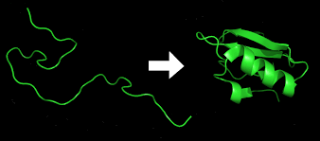
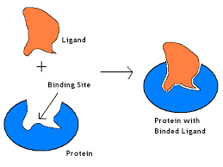
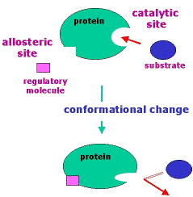
Why are proteins important?
They have powerful magic:
They quickly fold themselves into intricate shapes.
Because of this, they are amazingly good at recognizing and binding to other molecules in an extremely selective manner.
And can then change shape as a result

Slide 5
Protein folding is easy, in theory
Mostly just + and - charges attracting each other
Often really, really hard computationally
Those - charges are electron clouds
Protein folding has made it into the public eye:
https://xkcd.com/1430/
Luckily, the proteins don’t care if we can compute their behavior or not ☺

Slide 6
So what?
Proteins can fold, bind and change shape. So what?
Most of the molecular machines in the body are largely built from proteins.
Example of a molecular machine: your muscles. To get protein in your diet, you eat meat
Lots of other good protein sources in food, because proteins are everywhere in plants and animals ☺
We’ll soon see that they can be part of logic gates

Slide 7
So what (part 2)
Your body is not solely protein
You have fats, carbohydrates, …
Where does the other stuff come from?
Often, you eat it. But there’s lots of reprocessing
Protein helps make non-protein parts
Proteins can be enzymes.
Slow reaction + enzyme → fast reaction
Proteins control the rate of most chemical reactions (both in bacteria and humans)
Proteins are the controls that turn everything on, off or in between.

Slide 8
The central dogma
So the key to what a cell does is what proteins it makes. How do cells make protein?
The method is so important it’s described by what’s called the central dogma of biology
biologists’ equivalent of “in the beginning… and it was good.”
in the cell: DNA creates mRNA, which creates protein

Slide 9
What is DNA?
DNA is a long molecule that is a sequence of bases. Each base can be adenine (A), guanine (G), cytosine (C) and thymine (T)
The punch-line: a long sequence of DNA (e.g., AUGGCUAGUUAG) specifies a long chain of amino acids that build a protein
But how can 4 DNA bases specify 20 amino acids? Any ideas?

Slide 10
What is DNA?
DNA is a code in base 4
Three bases = one codon ⇒ specifies one of 20 AAs, or a start/stop codon
Alanine
Leucine
gene
AUGGCUAGUUAG
promoter AUG GCU AGU UAG terminator…
says when to make this protein
The coding sequence (CDS)
Three bases = 1 codon
start and stop codons bound the CDS

Slide 11
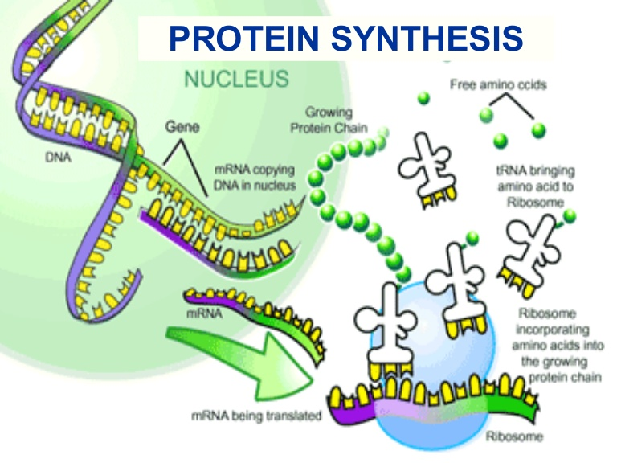
mRNA and tRNA
Central dogma of biology
Transcription reads the DNA and turns a CDS (A, G, C, T) into a roughly-equivalent chain of messenger-RNA (mRNA) bases. They are A, G, C and uracil (U).

Slide 12
Dilemma
mRNA-codon chain ⇒ AA chain: how?
AUG GCU AGU UAG (piece of mRNA)
sequence of AAs, making a protein
leucine alanine
What we would like:
Each of the 20 amino acids binds tightly to one codon
The AA chain thus self-assembles correctly, and then forms a protein by some chemical reaction
Problem: proteins can bend to a very precise shape; a base can bind to its complementary base; but an AA can do neither
So a single AA cannot bind to a specific codon
Any ideas?

Slide 13
tRNA: an adaptor
A tRNA molecule has two ends
One end (the anticodon) has base-pair anti-codon shapes to match mRNA codon shapes; it precisely matches one codon*
The other end has evolved to precisely match one amino-acid shape*
*As usual, there are some exceptions

Slide 14
mRNA and tRNA
Central dogma of biology
Translation uses a ribosome to turn the mRNA molecule into a protein – chains of amino acid.
each codon of mRNA mates with a specific tRNA molecule
tRNA has an anti-codon on one end (that mates w/mRNA); the other end of tRNA is the appropriate amino acid

Slide 15
The big picture
Humans have 23 pairs of chromosomes
Each chromosome is one long molecule of DNA
One chromosome contains many genes
Each gene makes one protein (not quite true)
All of this is in one cell
If you’re a bacteria or a yeast:
you are one cell and one cell is you
Humans have about 37 trillion cells!
Every single one (mostly) has the above mechanisms

Slide 16
Morphogenesis
One of the black mysteries of biology
An egg and sperm unite to form one cell. That cell contains all of your DNA.
Fast forward 9 months or so. You now have 37 T cells.
Each has roughly the same DNA as the one starting cell.
We just saw that:
DNA has the instructions to create proteins
proteins control most everything
So how can (e.g.,) your eyes be different from your toes?
Time to add some detail to our DNA picture

Slide 17
What is DNA?
DNA is a long molecule that is a sequence of bases. Each base can be adenine (A), guanine (G), cytosine (C) and thymine (T)
promoter AUG GCU AGU UAG terminator…
says when to make this protein
Leucine, Alanine
The coding sequence (CDS)
Three bases = 1 codon, that works in base 4
start and stop codons bound the CDS

Slide 18
What is DNA?
The promoter controls whether the DNA builds mRNA (and thus protein) or not – i.e., whether transcription happens or not
It’s an if statement
if (
promoter AUG GCU AGU UAG terminator…
) {
}
But what controls whether the promoter is True or False?

Slide 19
Promoters
Does this sound like software yet?
What turns a promoter on or off?
A number of possibilities
For us, a transcription factor (TF)
A TF is a protein. It can itself be activated or deactivated based on, e.g., the presence or absence of other proteins or small molecules
So:
A gene builds its protein if its promoter is on
A promoter is on if its TF is present and activated
A TF is activated if the right inputs are present
We can thus control, at any given time, what subset of all of a cell’s genes get expressed
Promoters can use more complex logic functions
E.g., AND of two TFs, or NOR, …

Slide 20
A
True
protein1
if (True):
build protein1
B
promoter
protein2
if (A):
build protein2
if (protein1 and A):
build protein2
if (protein2 and (not B)):
build protein3
promoter
protein3
if (A and (not B)):
build protein3
Notation: arrow turns on, right-angle line is off
External inputs can be small molecules
canaries for many internal and environmental factors
can also be other protein TFs.
What function of A and B did we build above?
Now we can compute!
These structures can get very complex
Part II of the course: how organisms use TFs to compute

Slide 21
Lots of logic
How important are these TFs?
Differentiating a toe cell from an eye cell
The if/then network is key
Toe cell and an eye cell have the same DNA
But different TFs and activators sitting in and around
So they express very different proteins
 | E.Coli | Humans
# of genes | 4300 | 30K
Genome size | 4.3x10⁶ base pairs | 3200x10⁶
% of bps in a CDS | 89% | 1.5%

Slide 22
The Lac operon
Simple example of a GRN; very well studied
Big-picture idea: a GRN can implement logic
and it can be really useful for survival ☺
What does the Lac operon do?
produce lactose-digestion enzymes when there is lactose and not glucose
Why is this important for a bacteria?
Digesting glucose is more energy efficient
But sometimes we don’t have glucose, do have lactose
Why not make both enzymes all of the time?
Protein production is expensive
Only build them when they’re needed and useful

Slide 23
Lac operon
(not exactly correct)
lactose
lacI promoter
lacI
Operon: a set of contiguous genes that share one promoter
Intuitive operation:
Produce LacY, lacZ, lacA when we have lactose but not glucose
Lac promoter is ON when we have CAP and not lacI
Glucose → less CAP
lacI
CAP
lac promoter
lacZ
lacY
lacA
β-galactosidase (cleaves lactose)
galactoside acetyltransferase
β-galactoside permease (lactose transport→cell)

Slide 24
We can draw this as gates
lacI
lactose
lactose
lacI promoter
lacI
CAP
glucose
The lac promoter is an AND gate
The lacI promoter is inverting lactose
Another inverter for glucose
Glucose → less CAP
lacI
CAP
lac promoter
lacZ
lacY
lacA
CAP
lacI
lacZ, lacY, lacA

Slide 25
Where are the wires?
Note that we did not draw any wires!
VLSI chips have wires that conduct electrons exactly where we want them
Chemicals move randomly in cells by diffusion
Cells have no wires
If we want two inverters, they had better use different chemicals!
lacI
lactose
CAP
glucose
CAP
lacI
lacZ, lacY, lacA

Slide 26
What’s left in biology
Well, like, almost everything!
Two more key pieces for us, though:
bioelectricity
synthetic biology

Slide 27
Bioelectricity
Bioelectricity has many roles
including: it’s part of our gene-expression logic
Bioelectricity gives us even more tools to make our computational network bigger and more powerful
gate the ion channels that control V_{mem}
gene expression
V_{mem}
And: bioelectricity makes neurons work
sweep in ions that activate TFs

Slide 28
Design challenge
Design a cell that
Senses the presence of IPTG
Glows green if IPTG is present; glows red if it is not present now but previously was
Assume:
IPTG is negatively charged (not actually true!) and can travel through the cell membrane
You can make your promoters produce any protein(s) you wish, including green fluourescent protein (GFP) and Red (RFP)
Materials:
A cell. Its default V_{mem} < 0V.
A protein Pplus that turns on ion channels to make a cell’s V_{mem}>0
A lac promoter
Single-input promoters that turns on if its input TF is present (buffer); also, a single-input inverter promoter
Two-input AND promoter

Slide 29
Synthetic biology
Remaining biology topic: synthetic biology
What is it?
“New” forms of life
Typically created by making a minor modification to an existing organism
Recombinant DNA techniques are becoming more powerful

Slide 30
What can we do with software?
Why is synthetic biology relevant to this course?
Because we can modify DNA. I.e., can now not only learn how organisms compute, but change their software!
The main obstacle:
other than fairly simple model organisms (e.g., E.coli and yeast), we have no idea what most of the software does!
So what do people do, then?
Mostly: make small changes/additions to bacteria and yeast
Try to understand the building blocks; low-level functions that get called over and over

Slide 31
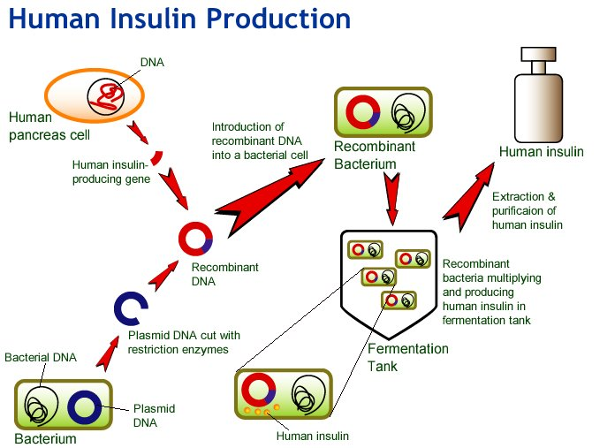
Human insulin
https://www.ied.edu.hk/biotech/eng/classrm/class_health5.html

Slide 32
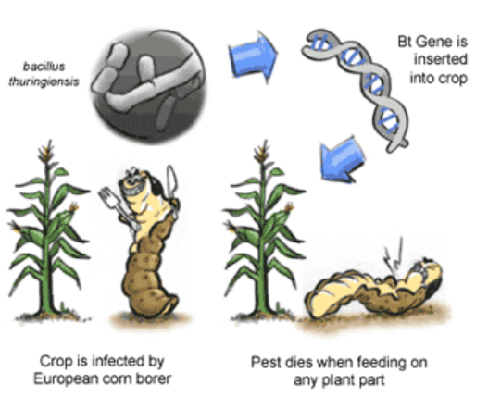
BT corn
https://www.scq.ubc.ca/bt-corn-is-it-worth-the-risk/

Slide 33
Impossible burger
https://impossiblefoods.com/food
Genes for heme protein (makes meat taste like meat) transferred into yeast and grown at industrial scale

Slide 34
Usage for logic
We will not be designing new foods for this class!
We will discuss
taking logic gates from various species
and designing new ones
transferring them into (e.g.,) bacteria
Our focus
will not be on the lab techniques
will be on design, modeling, and analysis of the resultant system

Slide 35
Transgenic mice
Can you really take genes from one species and transplant them into a different species?
Does DNA from a bacteria still work in a mouse?
Example from The Lac operator-repressor system is functional in the mouse (Genes and Dev. 2001)

Slide 36
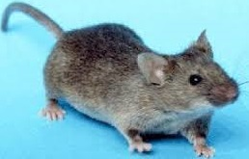
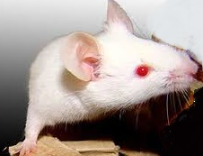
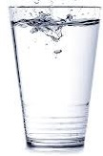
Normal mouse
Mouse with mutated TYR gene
TYR gene produces tyrosinase, which produces melanin
Lac
promoter
tyros.
LacI
LacI turns off Lac promoter, so no melanin
The Lac promoter, taken from bacteria, works perfectly well in mice
There are often robustness issues that we will discuss later
Mouse + inverter = computer?
IPTG

Slide 37
Cancer-hunting bacteria
Synchronized cycles of bacterial lysis for in-vivo delivery, Nature 2016 (MIT group)
Salmonella typhimurium seem to naturally hunt down tumors. Take advantage of this
Work done on mice with colorectal tumors grafted onto them
Add the following software to S. typhimurium
express a mobile molecule AHL
if ([AHL] > quorum_threshold):
express haemolysin E (toxic to many tumor cells) self destruct
Nobody quite knows why (hypoxic?)
This is called quorum sensing
How do you cure your salmonella infection?
Could be antibiotics
You can engineer your salmonella to be dependent on a chemical that you provide
Not all of them die; a few survive, grow until a new quorum, and the cycle repeats indefinitely
Notes:
You cannot really express AHL (a small molecule). But you can express the protein LuxI, which catalyzes the production of AHL

Slide 38
Other resources
Plenty of YouTube videos on the central dogma
https://www.youtube.com/watch?v=gG7uCskUOrA

Slide 39
BACKUP

Slide 40
Minor modeling issue
lactose → allolactose+…
lacI promoter
lacI
We oversimplified
Allolactose is a byproduct of lactose digestion
Allocatose binds to LacI and inactivates it
How does the system get started?
leaky expression of lac operon
Anything you don’t much like about this whole “genetic logic gates” idea?
Glucose → less CAP
lacI
-
CAP
+
lac promoter
lacZ
lacY
lacA

Slide 41
Gate-level model
lactose
allolactose
lacY, lacZ
lacZ, lacY, lacA
lacI
glucose
CAP
Notes
This still does not explicitly show the leaky expression; our reaction models will do that
There are no physical wires in the cell, but they make it easier to read the picture ☺; we must only draw wires to model diffusion

Slide 42
mRNA and tRNA
We’ve talked about computing
What is the HW and what is the SW?
The SW is the DNA
The HW is everything else
The entire cell (and your entire body) just build whatever proteins your DNA tells them to
DNA is the software that makes you you.

