Slide 1
EE 193/Comp 150: Computing with Biological Parts
Spring 2019
Tufts University
Instructor: Joel Grodstein
joel.grodstein@tufts.edu
Bioelectricity I – intro

Slide 2
How much will we learn?
The usual song and dance: enough to…
… make sense of a model
… understand what’s in our electrical junk heap, and what might happen when we connect some parts together
… talk to EEs and sound smart
reasonably

Slide 3
Electricity: the master plan
Balancing act:
Some people think biological physics is the cat’s meow
Others go into sleep mode
Wide range of backgrounds
First pass: intuition but no equations
Charge; force; voltage; current; V_{mem}
Second pass:
Do it again, in more depth
Can state some equations and call it a day…or derive them all
Derive just enough to get some intuition about why they’re true. With the intuition, hopefully remember the basic principles
More detail in backup slides if you’re interested
Notes:
bioelectricity and electroceuticals are a newly-growing field; it’s hard to predict where it will be in 10 years. So I’ve tried to error bit on helping you to understand the fundamentals quite well, because those are unlikely to change

Slide 4
Electric charge
So what is electricity, anyway?
Start with the basics: charge.
Atoms have electrons (negative charge) and protons (positive charge).
Same number of each → net zero charge
An atom can give away an electron to another atom
The “giver” then has one more proton than electron → net charge of +1.
The receiver has net charge of -1
Both are now called ions
Example: NaCl → Na⁺ and Cl⁻.
Na
Na⁺
Cl
Cl⁻
11 protons
17 protons
10 e-
11 e⁻
17 e⁻
18 e-

Slide 5
Electric force
+ and - ions attract each other
Like there’s a big invisible rubber band between them.
You pull them apart & they go back together!
Two positive ions (or two negative) repel each other.
Push them together & they run away.
That’s pretty much what charge is.
“Coulomb’s Law” says how hard they push and pull
We’ll get quantitative soon enough
The unit of charge is a “Coulomb” (named after Charles-Augustin de Coulomb)

Slide 6
Na⁺
Cl⁻
Opposite charges attracting

Slide 7
Na⁺
K⁺
Two positive charges repel
Two negative charges do too

Slide 8
Work can overcome this
Na⁺
Na⁺
Two positive charges repel

Slide 9
Fixed and movable charges
these charges are stuck in place
Na⁺
K⁺
Cl⁻
Why are the Na⁺ and Cl⁻ stuck?
who knows, it’s just an example
maybe there’s a cell membrane between them, with an ion channel that’s permeable to K⁺ but not to Na⁺ or Cl⁻
What will happen?
The movable K⁺ will travel to the right
cell interior
this charge is movable

Slide 10
Fixed and movable charges
these charges are stuck in place
Na⁺
K⁺
Cl⁻
cell interior
Again, we can move it back with enough work
this charge is movable

Slide 11
Voltage
this charge is movable
these charges are stuck in place
Na⁺
Cl⁻
K⁺
K⁺
Na⁺
Cl⁻
What if we had twice as many fixed-in-place ions?
There would be twice as much electric force on the K⁺
it would move twice as fast
it would require twice as much work to move it back
Any time you separate charges, you get a voltage
Separating charges across a cell membrane is the basis of bio-electricity
Voltage is the amount of energy/work needed to push 1C of charge across from point A to point B
The unit is Volts
1C of charge, moving across 1V, takes 1J of work
2C of charge, moving across 3V, takes 6J of work

Slide 12
Current
Na⁺
K⁺
Cl⁻
Say we have an observer (that’s the eye!) sitting in the middle and counting how many ions pass by.
the number of ions that pass by every second is called current
the current per m² of cross-sectional area is called flux
the unit of current is an Ampere (from André-Marie Ampere)
1 A ≡ 1 C/s
What are the units of flux?
A/m²

Slide 13
Electricity in cells
Na⁺, K⁺, Cl⁻, other
Extra-cellular fluid (ECF)
Na⁺, K⁺, Cl⁻ , other big “-” ions
cell
Start with a cell and environment full of ions

Slide 14
Electricity in cells
+
-
-
+
-
+
+
-
+
+
-
-
-
cell
+
+
-
+
+
-
Simplify: just call them “+” and “-”

Slide 15
Electricity in cells
pump
+
The cell interior is usually about .06V below the external fluid
We call this V_{mem}
It can range from perhaps +.01 to -.09V (other than action potentials)
Assume that the ECF is always 0V
-
V_{mem}=-.06V
-
+
-
+
+
-
+
+
-
-
-
cell
+
+
-
+
+
-
Ion pumps transfer 3 Na⁺ out of the cell and 2 K⁺ in (so net “+” moving outside)
The interior “-” charges get attracted to the membrane
Now we have separated “+” and “-” charges
That creates a voltage

Slide 16
End of part I
That’s electricity in a nutshell.
It’s very useful for everything from washing machines to cell phones.
And…most cells in our body create voltage
Mini exercise:
we’ve defined voltage, current
Ohm’s Law says V = I R
Can you justify why Ohm’s Law makes sense?
A constant that say how easy the ion is to push
Is it sliding on ice or on sandpaper?

Slide 17
Time for quantitative
We’ve taken an intuitive, qualitative look at how cells create bioelectricity.
Let’s do it again – quantitatively
Notes:
bioelectricity and electroceuticals are a newly-growing field; it’s hard to predict where it will be in 10 years. So I’ve tried to error bit on helping you to understand the fundamentals quite well, because those are unlikely to change

Slide 18
What equations will we learn?
Diffusion and drift
This is how ions make current
the two basic forces behind bioelectricity
With those, we can quickly derive…
The Nernst equation
Required by doctors to pass their boards!
We’ll actually learn what it means ☺
Most importantly, a model(s) for the cell:
Given ion concentrations and ion-channel turn-on
Relate ion current and cell voltage
Will work for slow circuits (morphogenesis) and fast (neurons)

Slide 19
Diffusion
“(In the nanoworld), everything is dancing,” Philip Nelson, Biological Physics
Particles move randomly; on average, they move from high concentration to low concentration
https://www.youtube.com/watch?v=oDgNBkxDoPM

Slide 20
Diffusion
Cell
ECF
cell membrane
Intuition:
Assume particles move in random directions
On average more particles cross the membrane left→right than right→left.
It is probabilistic, but deterministic if there are enough particles
The magic of statistical mechanics!
how big the gradient is
how fast ions cross the membrane
$${flux}_{Na}=−D\frac{d\left[Na\right]}{dx}$$
Note the sign: diffusion evens out concentrations
Units: $\frac{ions}{{s∙m}^{2}}=\frac{m^{2}}{s}∙\frac{ions}{m^{4}}$
Notes:
The diffusion story: Richard Brown, Brownian motion, saw pollen move around in a vial with a microscope. Assumed the pollen was alive. Stuck the vial in a dark room for a year – still moved around! Several similar experiments, including: Took flecks of stone from the Giant Sphynx and dropped them in water – they moved too! Einstein finally explained it.

Slide 21
What is D, really?
$${flux}_{Na}=−D\frac{d\left[Na\right]}{dx}$$
We have a simple equation
We (hopefully) know what it means
D is how fast an ion moves, for a given gradient pushing it
What affects D, our magic proportionality constant?
High-volume ion:
In a vacuum:
In a liquid
will bump into lots of things and slow down, so D will be small
D will be quite large (not relevant for us!)
Not nearly so large.

Slide 22
Example
Cell
1 ion/m³
ECF
3 ions/m³
$${flux}_{Na}=−D\frac{d\left[Na\right]}{dx}$$
dx = 1μ
If D=.1 m²/s, then what is the flux?
$−\frac{.1m^{2}}{s}∙\frac{2x{10}^{6} ions}{m^{4}}$ $=−200,000\frac{ions}{{s∙m}^{2}}$
Negative sign means ions are moving to the left
After enough time, what will happen?
The right-side space will go empty and the left-side will have all the ions?
They will equalize? If so, why?
Will they always eventually equalize to 2 moles/m³
No. E.g., if the ECF is really big then they will equalize to just under 3
And the ECF is usually really big
3
1
concentration
time
Notes:
Note that diffusion is really a partial differential equation; there are derivatives with respect to both time and position. We’ve hidden this by, e.g., assuming d[Na]/dx is 0 in the cells and constant in the membrane

Slide 23
Example
dx = 1μ
Cell
1 ion/m³
Cell
2.99 ions/m³
$${flux}_{Na}=−D\frac{d\left[Na\right]}{dx}$$
ECF
2.99 ions/m³
ECF
3 ions/m³
The ECF is really big; the cell is relatively small
After diffusion is done…
Why? At any time,
# of ions leaving the ECF = # entering the cell
So [ion] changes faster in the cell than in the ECF
An analogy:
It’s 20° outside, your house is 70°, and you open the door.
After a few hours your house is also 20°, and you’ve not appreciably warmed up the earth.
3
1
concentration
time

Slide 24
Voltage
this charge is movable
these charges are stuck in place
Na⁺
Cl⁻
K⁺
K⁺
Na⁺
Cl⁻
Separating charges across a cell membrane is the basis of bio-electricity
The fixed separated charges (Na⁺ and Cl⁻) create, e.g., 3V
A Volt is a Joule/Coulomb
moving (e.g.,) 2C of K⁺ across 3V takes how much work?
Next question: why did the Na⁺ and Cl⁻ create 3V and not 4V?
How much voltage gets made by how much separated charge?
Q=CV
$\frac{3 Joules}{C}∙\frac{2C}{1}$=6 Joules
Capacitance of the cell membrane (mostly, how thick it is). In this case, .33 Farads
how much charge: e.g., 1 Coulomb
how much voltage: like, 3 Volts

Slide 25
Drift currents
this charge is movable
these charges are stuck in place
Na⁺
Cl⁻
K⁺
Na⁺
Cl⁻
We said that similar charges repel, opposite charges attract
That causes charges to move
Drift current tells us how much current results
How we phrase it:
The separated charges (Na⁺ and Cl⁻) create a voltage (Q=CV)
The voltage creates a K⁺ drift current (or flux)

Slide 26
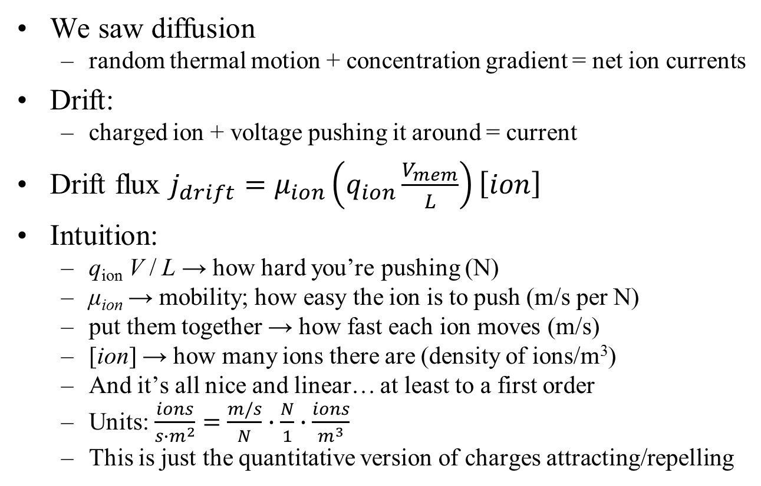
Drift
We saw diffusion
random thermal motion + concentration gradient = net ion currents
Drift:
charged ion + voltage pushing it around = current
Drift flux $j_{drift}=μ_{ion}\left(q_{ion}\frac{V_{mem}}{L}\right)\left[ion\right]$
Intuition:
q_{ion} V / L → how hard you’re pushing (N)
μ_{ion} → mobility; how easy the ion is to push (m/s per N)
put them together → how fast each ion moves (m/s)
[ion] → how many ions there are (density of ions/m³)
And it’s all nice and linear… at least to a first order
Units: $\frac{ions}{{s∙m}^{2}}=\frac{m/s}{N}∙\frac{N}{1}∙\frac{ions}{m^{3}}$
This is just the quantitative version of charges attracting/repelling
ion density
mobility
pushing force (attract/repel)

Slide 27

Backup
We just said $j_{drift}=μ_{ion}\left(q_{ion}\frac{V_{mem}}{L}\right)\left[ion\right]$
We previously said same(opposite) charges repel(attract)
These facts are actually connected

Slide 28
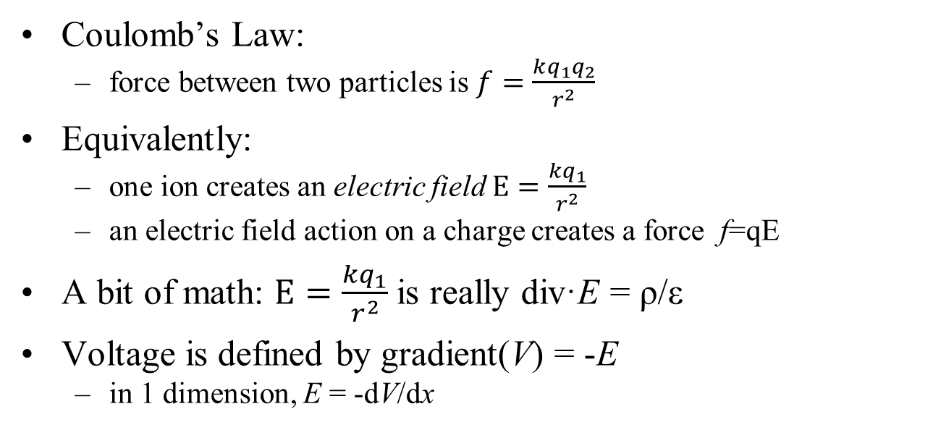
The equations (backup)
Coulomb’s Law:
force between two particles is $f=\frac{kq_{1}q_{2}}{r^{2}}$
Equivalently:
one ion creates an electric field $E=\frac{kq_{1}}{r^{2}}$
an electric field action on a charge creates a force f=qE
A bit of math: $E=\frac{kq_{1}}{r^{2}}$is really div·E = ρ/ε
Voltage is defined by gradient(V) = -E
in 1 dimension, E = -dV/dx
Maxwell’s 1st eqn
+++++
- - - - -
The above two equations can derive that E=V/L, and Q=CV, and even the value of C

Slide 29
Coulomb’s Law (backup)
A basic statement of electric charges
f=qE
A charge q
feels a force f
in the presence of a field E
Newton’s first Law
acceleration a = f / m = q_{ion}E/m_{ion}.
Constant E field implies constant acceleration.
Will the ion travel faster and faster until it goes infinitely fast?
Not really
First, nothing ever goes infinitely fast ☺.
Einstein said relativity gets in the way.

Slide 30
Mobility (backup)
Car with your foot on the gas (providing a constant force)
What stops your car from hitting 10K mph?
Air drag.
The faster you go, the more drag, until it all balances out
Ions see the same drag forces
Car bumps into random air molecules
An ion bumps into other ions & molecules
End result: v = μ_{ion} f = μ_{ion} q_{ion} E
Intuition:
More charge or field → more force → more speed
More V → more E
And it’s all nice and linear… at least in our simple model
And then J_{drift} = v[ion]
mobility
velocity

Slide 31
What is μ, really? (backup)
We have a simple equation
We (hopefully) know what it means
What affects μ, our magic proportionality constant?
High-volume ion:
In a vacuum:
In a liquid:
The units work
f=qE: E is N/C, q is C and so E q is N
v= μf: μ is m/s per N, so μ f is a velocity
will bump into lots of things and slow down, so μ will be small
μ will be quite large (not relevant for us!)
Not nearly so large.

Slide 32
What equations will we learn?
Diffusion and drift
This is how ions make current
the two basic forces behind bioelectricity
With those, we can quickly derive…
The Nernst equation
Required by doctors to pass their boards!
We’ll actually learn what it means ☺
Most importantly, a model(s) for the cell:
Given ion concentrations and ion-channel turnon
Relate ion current and cell voltage

Slide 33
Nernst equation
Assume:
At any point in space, drift + diffusion = 0
I.e., no net current
Intuitive derivation (e.g., for Na⁺):
drift flux $∝\left[Na\right]\frac{dV}{dx}$
diffusion flux $∝\frac{d\left[{Na}^{+}\right]}{dx}$
assume that drift flux = diffusion flux everywhere
a little calculus gives us $∆V≡V_{in}−V_{out}=26mV∙ln\frac{{\left[Na\right]}_{out}}{{\left[Na\right]}_{in}}$
This is called a Nernst voltage
Why do we care?
If we know, e.g., [Na]_{int} and [Na]_{ext} then we know V_{mem}!
We’ll use it very soon
$$j_{drift,Na}=μ_{ion}\left(q_{Na}\frac{V_{mem}}{L_{mem}}\right)[Na]$$
$$j_{diff,Na}=−D\frac{d\left[Na\right]}{dx}$$

Slide 34
Nernst assumptions
The big assumption: drift = diffusion
Why might that by true?
Biology is full of machines that create homeostasis
Maintain your body temp at 98.6°
Maintains chemical concentrations quite steady
Every flux leaving a cell is balanced by one entering
Drift and diffusion are “often” balanced at homeostasis
But not always
We’ll see why pretty soon, and make this more precise

Slide 35
In-class exercise
extra-cellular fluid
[K⁺]=400mM
[Na⁺]=50mM
[Cl⁻]=52mM
other⁻=408mM
[K⁺]=20mM
[Na⁺]=440mM
[Cl⁻]=560mM
other⁺=110mM
intra-cellular fluid
These are typical concentrations for a giant squid (!)
Compute ΔV for Na, for K and for Cl
$∆V≡V_{in}−V_{out}=26mV∙ln\frac{{\left[Na\right]}_{out}}{{\left[Na\right]}_{in}}$

Slide 36
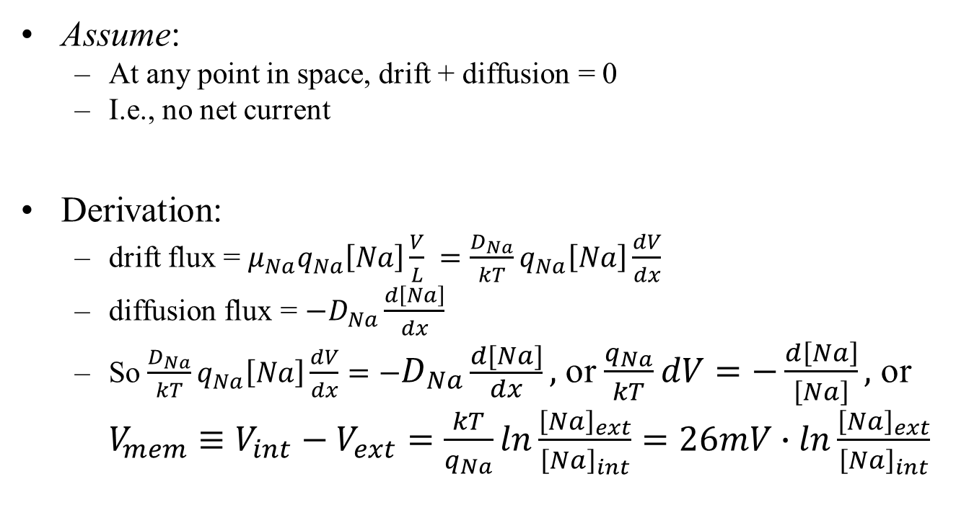
Nernst equation (backup)
Assume:
At any point in space, drift + diffusion = 0
I.e., no net current
Derivation:
drift flux = $μ_{Na}q_{Na}\left[Na\right]\frac{V}{L} =\frac{D_{Na}}{kT}q_{Na}\left[Na\right]\frac{dV}{dx}$
diffusion flux = $−D_{Na}\frac{d\left[Na\right]}{dx}$
So $\frac{D_{Na}}{kT}q_{Na}\left[Na\right]\frac{dV}{dx}=−D_{Na}\frac{d\left[Na\right]}{dx},$ or $\frac{q_{Na}}{kT}dV=−\frac{d\left[Na\right]}{\left[Na\right]},$ or $V_{mem}≡V_{int}−V_{ext}=\frac{kT}{q_{Na}}ln\frac{{\left[Na\right]}_{ext}}{{\left[Na\right]}_{int}}=26mV∙ln\frac{{\left[Na\right]}_{ext}}{{\left[Na\right]}_{int}}$
Einstein relation says D = μ kT

Slide 37
What equations will we learn?
Diffusion and drift
This is how ions make current
the two basic forces behind bioelectricity
With those, we can quickly derive…
The Nernst equation
Required by doctors to pass their boards!
We’ll actually learn what it means ☺
Most importantly, a model(s) for the cell:
Given ion concentrations and ion-channel turnon
Relate ion current and cell voltage

Slide 38
Ions in a giant squid
extra-cellular fluid
[K⁺]=400mM
[Na⁺]=50mM
[Cl⁻]=52mM
other⁻=408mM
[K⁺]=20mM
[Na⁺]=440mM
[Cl⁻]=560mM
other⁺=110mM
intra-cellular fluid
Q = CV
Observation: ICF and ECF each have high ion concentrations, but are roughly charge neutral
Consequence: a small charge flow can greatly change the net charge
and hence the net voltage
That’s what allows our nervous system to react quickly
Notes:
If we had Q=100 C, then a ΔQ of 1C would make only a 1% change in Vmem. But if Q=1 C, then the same ΔQ doubles Vmem

Slide 39
Forces on the system
extra-cellular fluid
intra-cellular fluid
[K⁺]=20mM
[Na⁺]=440mM
[Cl⁻]=560mM
other⁺=110mM
[K⁺]=400mM
[Na⁺]=50mM
[Cl⁻]=52mM
other⁻=408mM
First force: diffusion (our old friend)
Which way does diffusion flow for K⁺, Na⁺ and Cl⁻?
K⁺ out; Na⁺ and Cl⁻ in
Note: the “other” usually cannot diffuse through a membrane (and other⁺ is different from other⁻)

Slide 40
How do ions move?
Minor problem: none of K⁺, Na⁺ or Cl⁻ can pass through a cell membrane, either! So how can diffusion happen?
the membrane has ion channels
little holes in the cell membrane that ions can diffuse through (aided by molecular machines)

Slide 41
Results of diffusion
extra-cellular fluid
[K⁺]=20mM
[Na⁺]=440mM
[Cl⁻]=560mM
other⁺=110mM
[K⁺]=400mM
[Na⁺]=50mM
[Cl⁻]=52mM
other⁻=408mM
If diffusion happens long enough, what will happen to the concentrations [K⁺], [Na⁺] and [Cl⁻] inside vs. outside of the cell?
For each ion, the concentration inside and outside the cell will eventually become equal
This is not what actually happens!
diffusion is not the only force at work

Slide 42
Drift currents
--- +++ 60mV
[K⁺]=20mM
[Na⁺]=440mM
[Cl⁻]=560mM
other⁺=110mM
[K⁺]=400mM
[Na⁺]=50mM
[Cl⁻]=52mM
other⁻=408mM
Blue arrows = diffusion
Green arrows = electric current
Charge on each side is roughly (but not exactly) neutral
Net - charge inside, + outside
Result: about 60mV of voltage resulting (Q=CV)
This voltage will push the ions around, as we’ve discussed
Which way do drift currents flow?

Slide 43
Nernst sanity check
--- +++ 60mV
[K⁺]=20mM
[Na⁺]=440mM
[Cl⁻]=560mM
other⁺=110mM
[K⁺]=400mM
[Na⁺]=50mM
[Cl⁻]=52mM
other⁻=408mM
Blue arrows = diffusion
Green arrows = electric current
First look at Cl⁻. Can electric and diffusion currents balance?
Yes; electric current out, and diffuses in
V_{Cl}^{Nernst} = 26mV ∙ ln (52/560) ≈ -60mV. Cool!

Slide 44
Nernst sanity check
--- +++ 60mV
[K⁺]=20mM
[Na⁺]=440mM
[Cl⁻]=560mM
other⁺=110mM
[K⁺]=400mM
[Na⁺]=50mM
[Cl⁻]=52mM
other⁻=408mM
Blue arrows = diffusion
Green arrows = electric current
Next look at K⁺. Can electric current and diffusion balance?
Yes; electric current in, and diffuses out
V_{K}^{Nernst} = 26mV ∙ ln (20/400) ≈ -78mV.
Not quite right ?!?

Slide 45
Nernst sanity check
--- +++ 60mV
[K⁺]=20mM
[Na⁺]=440mM
[Cl⁻]=560mM
other⁺=110mM
[K⁺]=400mM
[Na⁺]=50mM
[Cl⁻]=52mM
other⁻=408mM
Blue arrows = diffusion
Green arrows = electric current
Finally, look at Na⁺. Can electric current and diffusion balance?
No – they both flow inwards!
V_{Na}^{Nernst} = 26mV ∙ ln (440/50) ≈ +57mV.
Not even close ?!?
What’s going on here?

Slide 46
Another ion-flow source
--- +++ 60mV
3Na⁺
2K⁺
[K⁺]=20mM
[Na⁺]=440mM
[Cl⁻]=560mM
other⁺=110mM
[K⁺]=400mM
[Na⁺]=50mM
[Cl⁻]=52mM
other⁻=408mM
Blue arrows = diffusion
Green arrows = electric current
Red arrows = ion pump
Drift and diffusion currents do not balance
another molecular machine at work: ion pumps.
Ion pumps pump 3 Na⁺ out and 2 K⁺ in.
Na⁺ flows in (drift & diffusion currents) through ion channels, and gets pumped right out again (inward and outward flows balance at steady state).
K⁺ flows in from drift current and is also pumped in; diffusion out exactly balances this total inwards flow
Why was Cl⁻ the only ion whose V^{Nernst} exactly matched the cell voltage?
There is no Cl⁻ pump

Slide 47
Steady state
--- +++ 60mV
3Na⁺
2K⁺
[K⁺]=20mM
[Na⁺]=440mM
[Cl⁻]=560mM
other⁺=110mM
[K⁺]=400mM
[Na⁺]=50mM
[Cl⁻]=52mM
other⁻=408mM
Blue arrows = diffusion
Green arrows = electric current
Red arrows = ion pump
Steady state: all concentrations and rates are unchanging over time
Cl:
Na:
K:
diffusion in = drift out
diffusion in + drift in = pump out
diffusion out = drift in + pump in
No net flow in/out
concentrations unchanging
flow rates unchanging
We are at steady state
Nernst is only true for Cl

Slide 48
Definitions (backup)
Define some terms:
detailed balance: every forwards reaction is balanced by a reverse reaction
equilibrium: everything is unchanging over time, and no energy is being expended
steady state: all concentrations and rates are unchanging over time. Energy can be expended.
Nernst is true
You are dead
You are alive
Ion pumps require energy
Steady state doesn’t imply detailed balance
and thus does not imply Nernst
Na, K pumps run
Cl has no pumps
Nernst is false
Nernst is true
Notes:
This is partly a backup slide. The important thing is not the definitions of detailed balance, equilm and steady state (though we will use those terms, and redefine them each time). Really, the important thing is the notion that pumps break Nernst.

Slide 49
Where are we?
We learned what drift and diffusion are
When drift = diffusion, Nernst is true and we know V_{mem}
But for a cell, that’s only true for Cl
The cell is at SS
But Nernst is not true for Na, K
Clearly the cell “works;” it can stay at SS essentially forever
Our nice Nernst formula doesn’t work.
Now we know why – but we still have a problem.
How do we model/analyze a cell?

Slide 50
What equations will we learn?
Diffusion and drift
This is how ions make current
the two basic forces behind bioelectricity
With those, we can quickly derive…
The Nernst equation
Required by doctors to pass their boards!
We’ll actually learn what it means ☺
Most importantly, a model(s) for the cell:
Given ion concentrations and ion-channel turnon
Relate ion current and cell voltage
☺

Slide 51
Modeling diffusion in a cell
${flux}_{Na}=−D\frac{d\left[Na\right]}{dx}$
Simplifying assumptions:
Cell concentrations are big
They change very slowly over time
Assume they’re pretty much constant over time
So diffusion flux is…
Our model is really simple ☺
j_{diff,Na} = constant
a constant!
It’s only constant for a given set of concentrations!
If [Na] changes over time, then so does j_{diff,Na}

Slide 52
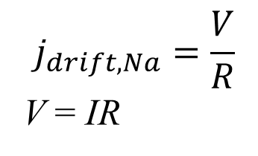
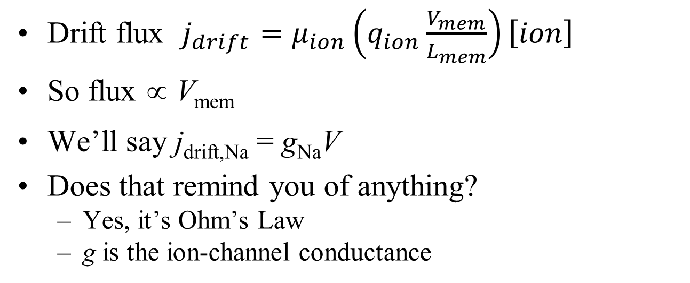
Modeling drift in a cell
Drift flux $j_{drift}=μ_{ion}\left(q_{ion}\frac{V_{mem}}{L_{mem}}\right)\left[ion\right]$
So flux ∝ V_{mem}
We’ll say j_{drift,Na} = g_{Na}V
Does that remind you of anything?
Yes, it’s Ohm’s Law
g is the ion-channel conductance
$$j_{drift,Na}=\frac{V}{R}$$
V = IR

Slide 53
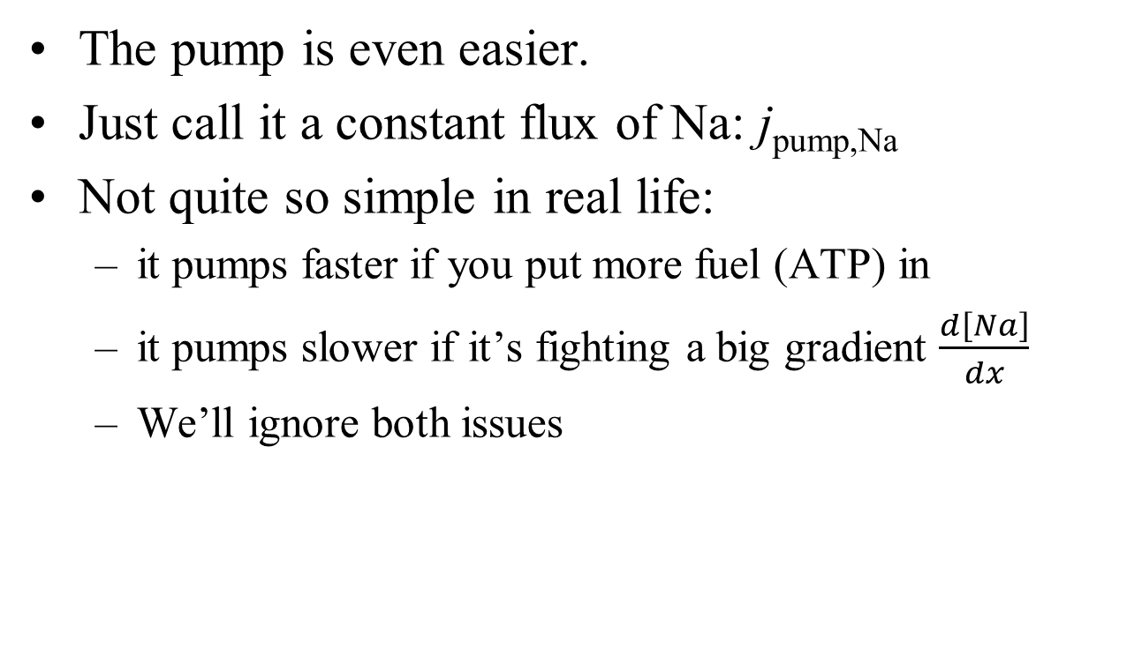
Modeling the ion pumps
The pump is even easier.
Just call it a constant flux of Na: j_{pump,Na}
Not quite so simple in real life:
it pumps faster if you put more fuel (ATP) in
it pumps slower if it’s fighting a big gradient $\frac{d\left[Na\right]}{dx}$
We’ll ignore both issues

Slide 54
Simple equation
j_{total,Na} = j_{diff,Na} + g_{Na}V_{mem} + j_{pump,Na}
= g_{Na} (V_{mem} + (j_{diff,Na}/g_{Na})) + j_{pump,Na}
This is reasonably simple, but we can do even a bit better
Ignore the pump for a moment
We know that, without pumps, diffusion and drift balance (i.e., no net flux) at the Nernst voltage
So a revised equation:
Is this surprising?
The units work, of course
We know that V_{mem} * g_{Na} = j_{drift,Na} , which must equal j_{diff} when V=V_{N,Na}. So it’s not at all surprising
This is bioelectricity in a nutshell! Does it make sense?
j_{total,Na} = g_{Na} (V_{mem} - V_{N,Na}) + j_{pump,Na}

Slide 55
What the model says
Main input: V_{mem}
There’s a separate model for each ion. Cl doesn’t have a pump
j_{total,Na} = g_{Na} (V_{mem} - V_{N,Na}) + j_{pump,Na}
Output: flux (how fast the ion is entering the cell)
g_{Na}, V_{N,Na} and j_{pump,Na} depend on [Na]
There’s only one V_{mem}, shared by all ions
Drift
Hidden input: [Na]_{int}.
[Na]_{ext} is usually assumed constant
Diffusion

Slide 56
What can we do with our model?
We can build a simulator (BITSEY)
flux tells us how fast the concentrations are changing
If there are 2 moles of Na in the cell, and a flux of .3 M/second entering, then if we simulate for 1s
there are now 2.3 moles of Na.
A simulator just does this over and over (each time computing new j_{diff}, g and V_{N} for the new [Na]
We said that total charge in the cell determines V_{mem} (Q=CV)
So our simulator will also tell us V_{mem} over time.
Run the simulator until things stabilize
Then we’ve computed the steady-state V_{mem} for a cell
In fact, that’s Lab #1
Simulate short transients around steady state
that’s how neurons work

Slide 57
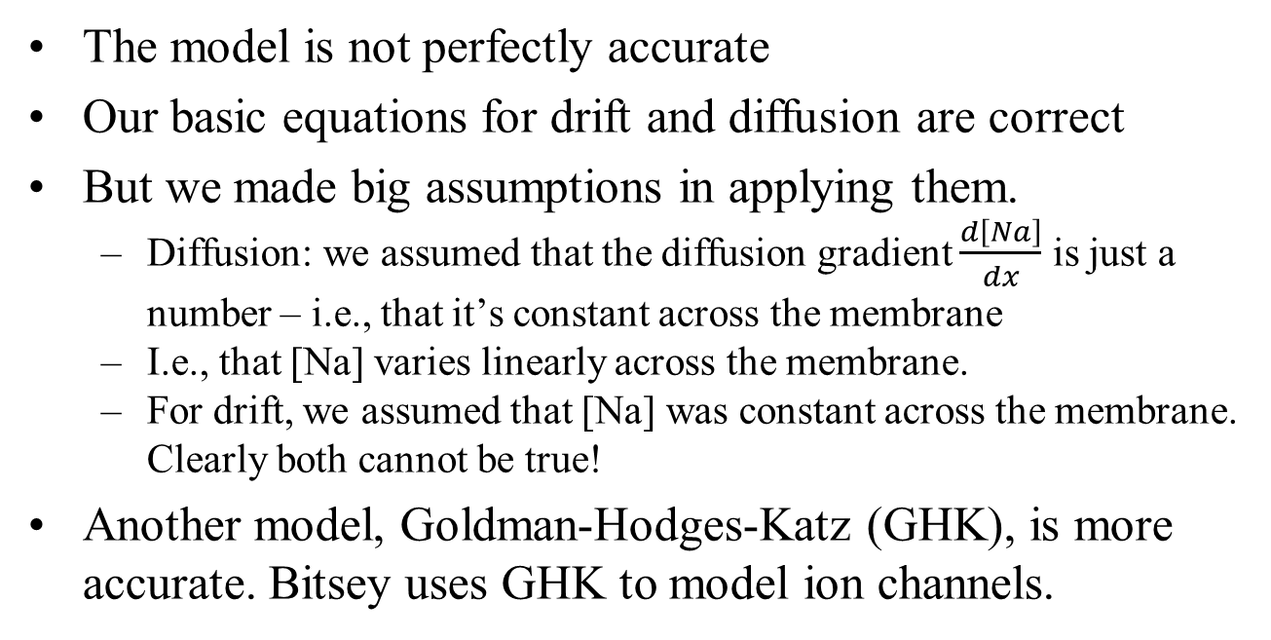
Inaccuracies
The model is not perfectly accurate
Our basic equations for drift and diffusion are correct
But we made big assumptions in applying them.
Diffusion: we assumed that the diffusion gradient $\frac{d\left[Na\right]}{dx}$ is just a number – i.e., that it’s constant across the membrane
I.e., that [Na] varies linearly across the membrane.
For drift, we assumed that [Na] was constant across the membrane. Clearly both cannot be true!
Another model, Goldman-Hodges-Katz (GHK), is more accurate. Bitsey uses GHK to model ion channels.
potential final project

Slide 58
Our model is still useful
j_{total,Na} = g_{Na} (V_{mem} - V_{N,Na}) + j_{pump,Na}
“All models are wrong. Some are still useful,” George Box
Our model had a hidden input [Na]_{int}
The model only works at that [Na]_{int}
But the model is still “reasonably” good if we’re “reasonably” near that [Na]_{int}
We must re-compute g, V_{N} and j_{pump} when [Na]_{int} changes substantially
Most important
simple model = intuitive
helps us to understand how cells behave

Slide 59
Done with the basics!
The main part of bioelectricity is done ☺
But we haven’t built anything yet ☹
What’s coming next:
lab #1 solidifies what we’ve learned
add a few more details (QSS) and build a neuron
add one more detail (GJs) and build neural networks
build worms
GRN computing
But the hard part is done ☺

Slide 60
Biological part #1
Our first biological part in the pile of stuff: a cell
Inputs:
g_{Na}, g_{K} (the ion-channel conductivities)
Why are these the inputs? Lab1 will show us
Output:
V_{mem} (takes hours to compute its output!)
What controls the inputs:
grow more ion channels → higher conductivity
ion channels can be turned on/off very quickly by voltage or ions
Focus on these next

Slide 61
Start of Lab #1
Start Lab #1 in class
Learn about Bitsey
Run the 5-second simulations
Then run the long simulations at home
In a week or so, Ashton will lecture on how to analyze these circuits, and we’ll have class time to do the analysis

Slide 62
Modeling our cell as a circuit
$$j_{total,Na}=G_{Na}\left(V_{mem}−V_{Na}^{N}\right)+j_{pump,Na}$$
$$j_{total,K}=G_{K}\left(V_{mem}−V_{K}^{N}\right)+j_{pump,K}$$
$$j_{total,Cl}=G_{Cl}\left(V_{mem}−V_{Cl}^{N}\right)$$
ICF
A current source simply provides a constant current
V_{mem}
I_{Na}
I_{K}
G_{Na}
G_{K}
G_{Cl}
$$V_{Na}^{N}$$
$$V_{K}^{N}$$
$$V_{Cl}^{N}$$
ECF
77mV
-89mV
-71mV
ECF

Slide 63
Modeling our cell as a circuit
$$j_{total,Na}=G_{Na}\left(V_{mem}−V_{Na}^{N}\right)+j_{pump,Na}$$
$$j_{total,K}=G_{K}\left(V_{mem}−V_{K}^{N}\right)+j_{pump,K}$$
$$j_{total,Cl}=G_{Cl}\left(V_{mem}−V_{Cl}^{N}\right)$$
ICF
A voltage source (a.k.a. a battery) simply provides a constant voltage
V_{mem}
I_{Na}
I_{K}
G_{Na}
G_{K}
G_{Cl}
$$V_{Na}^{N}$$
$$V_{K}^{N}$$
$$V_{Cl}^{N}$$
ECF
77mV
-89mV
-71mV
ECF

Slide 64
Modeling our cell as a circuit
$$j_{total,Na}=G_{Na}\left(V_{mem}−V_{Na}^{N}\right)+j_{pump,Na}$$
$$j_{total,K}=G_{K}\left(V_{mem}−V_{K}^{N}\right)+j_{pump,K}$$
$$j_{total,Cl}=G_{Cl}\left(V_{mem}−V_{Cl}^{N}\right)$$
ICF
A resistor operates according to Ohm’s Law: I=V/R (or I=GV with G≡1/R)
V_{mem}
I_{Na}
I_{K}
G_{Na}
G_{K}
G_{Cl}
$$V_{Na}^{N}$$
$$V_{K}^{N}$$
$$V_{Cl}^{N}$$
ECF
77mV
-89mV
-71mV
ECF

Slide 65
Material to potentially be taught by the EEs:
Draw the model as an equivalent ckt that has V & R for Na & K, R for Cl.
Show how it reaches a final voltage
Show how changing each R affects the voltage (for lab #1)
ICF
I_{Na}
I_{K}
G_{Na}
G_{K}
G_{Cl}
$$V_{Na}^{N}$$
$$V_{K}^{N}$$
$$V_{Cl}^{N}$$
ECF
77mV
-89mV
-71mV

Slide 66
Skittles diffusion

