Slide 1
EE 193/Comp 150: Computing with Biological Parts
Spring 2019
Tufts University
Instructor: Joel Grodstein
joel.grodstein@tufts.edu
Bioelectricity II – QSS and neurons

Slide 2
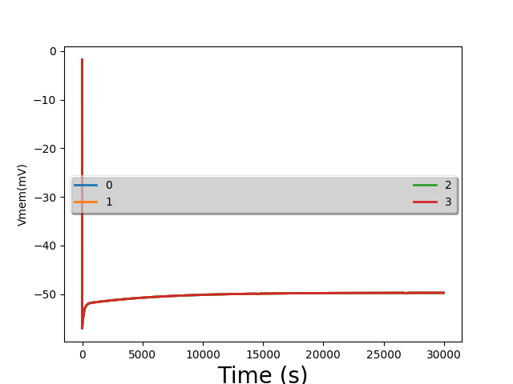
Lab #1, first plots

Slide 3
Problem for the day
We ran a bunch of simulations of cells
They created voltage. Cool!
“Minor” problem:
Our sims took several hours of simulated time to reach steady state
Our brains run on bioelectricity
Any problem there?

Slide 4
How can our brain be so fast?
We humans can think pretty fast
We can react pretty fast, too
We cannot build a useful deep NN in our brain if each neuron takes hours to settle!
Result: humans evolved a new way to use bioelectricity
Operation at quasi-steady-state
It’s how neurons work.
Computing on the time scale of hours is OK for morphogenesis
We’re in the womb for 9 months
Our cuts & scapes heal over days/weeks
But it’s not OK for brains ☹
Or for animorphs https://www.youtube.com/watch?v=jEKPDgjERt0&list=PL9AC274019AC09106&index=3
Notes:
At the “react fast” part, throw something!

Slide 5
What we will learn
How to use bioelectricity to compute really fast
How neurons work

Slide 6
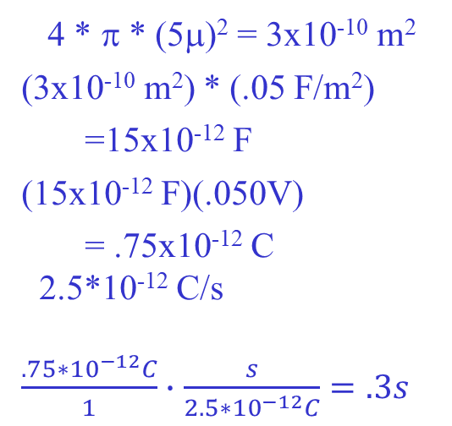
Back of the envelope speed
Quick electricity problem:
If the cell membrane is a capacitor C
How much charge Δq must enter the cell to change the voltage by ΔV?
Δq=CΔV
Typical planaria values:
Radius of a cell = 5μ
Capacitance of the cell membrane = .05 F/m²
ΔV = 50mV
What is Δq?
How long will it take to move V_{mem} by 50mV?
Area of membr. =
C =
Δq = CΔV =
Typical current =
Time =
4 * π * (5μ)² = 3x10⁻¹⁰ m²
(3x10⁻¹⁰ m²) * (.05 F/m²)
=15x10⁻¹² F
(15x10⁻¹² F)(.050V)
= .75x10⁻¹² C
2.5*10⁻¹² C/s
$\frac{.75∗{10}^{−12}C}{1}∙$ $\frac{s}{2.5{∗10}^{−12}C}=.3s$
Notes:
First convince them that Δq=CΔV is true by showing a few numbers: 10=2*5, and (10+2*3)=2*(5+3)
This works because the equation is linear

Slide 7
It only takes .3s to move V_{mem} around as much as needed!
That’s a planaria; humans are <1ms.
Random factoids… anybody know why human nerves are so much faster than worms?
That’s a lot faster than hours! Nice, but…

Slide 8
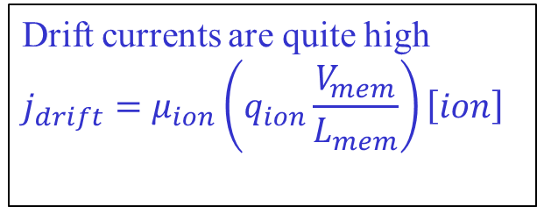
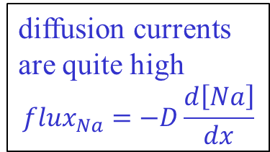
Why so fast
And so C is small too.
And q = CV, ∆q = C∆V
Why is this so fast?
Four facts:
Cells are very small
Each has quite a lot of charge
Inside and outside have very different concentrations from each other
Biology has built sensitive sensors – we need only move V_{mem} by 50mV
Drift currents are quite high
$$j_{drift}=μ_{ion}\left(q_{ion}\frac{V_{mem}}{L_{mem}}\right)\left[ion\right]$$
diffusion currents are quite high
$${flux}_{Na}=−D\frac{d\left[Na\right]}{dx}$$
V_{mem} can swing end to end very fast
Notes:
Biological voltages are small: 50mV or so. Compare to your IPhone CPU >1V. This is partly why your brain is so power efficient!
And your house is 120V. This also gives your body a lot of safety margin against getting electrocuted if something goes wrong. You would not want to be electrocuted every time you catch a cold!

Slide 9
But then why was Lab1 so slow?
--- +++ 60mV
3Na⁺
2K⁺
[K⁺]=20mM
[Na⁺]=440mM
[Cl⁻]=560mM
other⁺=110mM
[K⁺]=400mM
[Na⁺]=50mM
[Cl⁻]=52mM
other⁻=408mM
Blue arrows = diffusion
Green arrows = electric current
Red arrows = ion pump
Bioelectricity has another trick up its sleeve.
Consider increasing G_{Na}
Na+ is flowing inwards from both diffusion and drift, and then being pumped out
Increasing G_{Na} will increase the inwards flow; and not affect the outwards flow
This all happens very fast
concentrations barely change
diffusion doesn’t change (other than from G_{Na}↑).
Higher V_{mem} will push Na⁺ out again
We reach a V_{mem} higher enough to reduce drift enough to balance out the increased diffusion
This is negative feedback
V_{mem} will get more positive (i.e., closer to 0) very quickly
Are we done yet?
At this new V_{mem}, is the flow of, say, Cl⁻ balanced?

Slide 10
We’re not at steady state
--- +++ 60mV
3Na⁺
2K⁺
[K⁺]=20mM
[Na⁺]=440mM
[Cl⁻]=560mM
other⁺=110mM
[K⁺]=400mM
[Na⁺]=50mM
[Cl⁻]=52mM
other⁻=408mM
Blue arrows = diffusion
Green arrows = electric current
Red arrows = ion pump
Cl⁻ is not balanced
Cl⁻ has no pump. It’s only balanced when drift=diffusion. Are they balanced?
Cl⁻ diffusion is unchanged, but drift is changed…
Ditto for K⁺, in fact.
What must change for Cl⁻ to balance again (with this new drift)?
ICF [Cl] must change enough to make a new diffusion.
But that is what takes hours and not ms.
Remember: unbalanced charge flow changes V_{mem} very fast, but [] changes slowly.
So what’s going on? Why do we think we can compute fast?
so they cannot balance

Slide 11
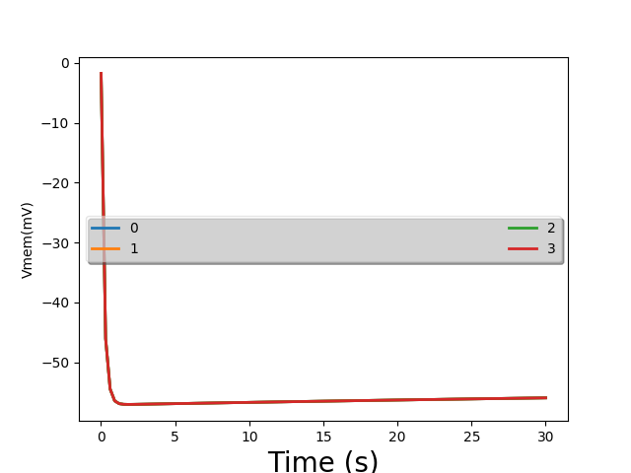
Lab #1 picture again
This time in more detail, from t=0 to t=30:
really fast change
really slow change
Notes:
We see one

Slide 12
--- +++ 50mV
3Na⁺
2K⁺
[K⁺]=5mM
[Na⁺]=145mM
[Cl⁻]=140mM
[K⁺]=400mM
[Na⁺]=50mM
[Cl⁻]=9mM
other⁻=408mM
Blue arrows = diffusion
Green arrows = electric current
Red arrows = ion pump
Big picture: if you make V_{mem} more positive
Diffusion and pump flows are unchanged
Drift currents push positive ions out, negative ions in

Slide 13
flux (mM/m²s)
-78 -60 0 +57 V_{mem} (mV)
Consider the situation at SS before we changed G_{Na}
V_{N,Na}=+57mV; V_{N,K}=-78mV; V_{N,Cl}=-60mV
Can you draw the flux-vs-V_{mem} lines:
the line for Cl?
the line for K?
the line for Na?
Notes:
Remember that these lines show drift + diffusion; they must sum to 0 at Vnernst. Then at other Vmem, diffusion stays the same and drift is proportional to Vmem. The flat lines show the pump flow

Slide 14
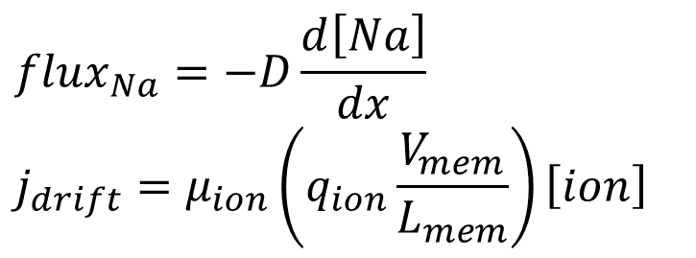
--- +++ 60mV
3Na⁺
2K⁺
[K⁺]=5mM
[Na⁺]=145mM
[Cl⁻]=140mM
[K⁺]=400mM
[Na⁺]=50mM
[Cl⁻]=9mM
other⁻=408mM
Blue arrows = diffusion
Green arrows = electric current
Red arrows = ion pump
Big picture: if you increase G_{Na}
Pump flows are unchanged
Diffusion and drift both scale
$${flux}_{Na}=−D\frac{d\left[Na\right]}{dx}$$
$$j_{drift}=μ_{ion}\left(q_{ion}\frac{V_{mem}}{L_{mem}}\right)\left[ion\right]$$

Slide 15
flux (mM/m²s)
-78 -60 0 +57 V_{mem} (mV)
V_{mem} where Na flux=0
So let’s increase G_{Na}. How would that change the picture?
Remember we’re not at SS
Total flux for Na need not be 0 at the SS V_{mem}
There is a V_{mem} where Na flux = 0
But at that V_{mem}, clearly total flux for Cl
and for K
>0
<0

Slide 16
--- +++ 50mV
3Na⁺
2K⁺
[K⁺]=5mM
[Na⁺]=145mM
[Cl⁻]=140mM
[K⁺]=400mM
[Na⁺]=50mM
[Cl⁻]=9mM
other⁻=408mM
Blue arrows = diffusion
Green arrows = electric current
Red arrows = ion pump
Big picture: if you make V_{mem} more positive
Diffusion and pump flows are unchanged
Drift currents push positive ions out, negative ions in
Net result
Cell trends more negative
So it’s a negative-feedback system again

Slide 17
flux (mM/m²s)
V_{mem} where total flux of charge=0
-78 -60 0 +57 V_{mem} (mV)
V_{mem} where Na flux=0
As V_{mem} gets larger, what happens to flux of
Na?
K?
Cl?
What happens to total flux of charge?
Is there some V_{mem} where total charge flux is zero?
becomes more negative
becomes more negative
becomes more positive
more negative

Slide 18
flux (mM/m²s)
We reach this V_{mem} quite quickly
-78 -60 0 +57 V_{mem} (mV)
What is the flux of individual ions at this V_{mem}?
Na?
K?
Cl?
At this V_{mem}, the charge in the cell stays constant
so this V_{mem} is stable
Individual ions typically have flux
Ion concentrations change – but very slowly
net flux into the cell ++
net flux out of the cell -
net flux into the cell -

Slide 19
Lab #1 picture again
Eventually we reach true SS
Dynamic phase: V_{mem} swinging rapidly
concentrations changing very slowly
Thus so does V_{mem}
Notes:
We see one

Slide 20
ICF
I_{Na}
I_{K}
G_{Na}
G_{K}
G_{Cl}
$$V_{Na}^{N}$$
$$V_{K}^{N}$$
$$V_{Cl}^{N}$$
ECF
77mV
-89mV
-71mV
Our intuitive model tells us V_{mem} quite easily.
KCL on the top node tells us when total charge flowing into the ICF is 0
This is exactly our condition for QSS!
How accurate is this?
We said that the G and V_{nernst} depend on [ions]
In QSS [ions] has no time to change much, so our model is excellent
Result: a simple model that accurately shows how changing G affects V_{mem}!

Slide 21
Analysis ⇒ intuition
ICF
I_{Na}
I_{K}
Ashton’s analysis
G_{Na}
G_{K}
G_{Cl}
$$V_{Na}^{N}$$
$$V_{K}^{N}$$
$$V_{Cl}^{N}$$
ECF
77mV
-89mV
-71mV
$I_{K}−I_{Na}+\left(V_{Na}^{N}−V_{mem}\right)G_{Na}+\left(V_{K}^{N}−V_{mem}\right)G_{K}+\left(V_{Cl}^{N}−V_{mem}\right)G_{Cl}=0$
$V_{mem}=\frac{\left(I_{K}−I_{Na}\right)+V_{Na}^{N}G_{Na}+V_{K}^{N}G_{K}+V_{Cl}^{N}G_{Cl}}{G_{Na}+G_{K}+G_{Cl}}$
What is the value of V_{mem} if, e.g., G_{Na} gets very big?
What if G_{Na} and G_{K} are both close to 0?
Other conclusion: as (e.g.,) G_{Na} rises, V_{mem} approaches $V_{Na}^{N}$
$$V_{mem}≈V_{Na}^{N}$$
$$V_{mem}≈V_{Cl}^{N}$$
Notes:
When we say that setting G_Na=G_K=0 gives us Vmem=VNernst_Cl *in QSS*, we’re not saying quite the same thing as when we said that Vmem will always equal VNernst_Cl *in SS*. The latter is true no matter what G_Na and G_K are (by virtue of VNernst_Cl adjusting itself appropriately). However, our current QSS statement is true *no matter what* the current concentrations are. We can always swing Vmem by swinging G.

Slide 22
ICF
V_{mem}=-71mV
Na: (77+71)*.4≈60
I_{Na}
I_{K}
G_{K}
G_{Na}
2.2
G_{Cl}
.4
.4
No net Cl⁻ flux
60 40
$$V_{Na}^{N}$$
$$V_{K}^{N}$$
$$V_{Cl}^{N}$$
K: (89-71)*2.2≈40
ECF
77mV
-89mV
-71mV
Work an example with actual ion-channel conductance numbers
Units?
G is (nmoles/m²·s) per mVolt
I_{pump} is nmoles/m²·s
Values shown are steady-state: each individual ion is balanced
Note the 3:2 ratio of pump currents
Make sure that the direction of current flow makes sense for each ion!
Notes:
In Bitsey, the units on Gth are (ions exiting the cell/m2s) per Volt of Vmem; thus Gth tends to be positive for Na and K, and negative for Cl.
The slide makes them all positive, which assumes you know what you’re doing when you calculate flows!

Slide 23
V_{mem}=+19mV
ICF
V_{mem}=-71mV
Na: (77-19)*5≈292
I_{Na}
I_{K}
Cl: (19+71)*.4≈36
5
2.2
.4
.4
60 40
$$V_{Na}^{N}$$
$$V_{K}^{N}$$
$$V_{Cl}^{N}$$
K: (89+19)*2.2≈236
ECF
77mV
-89mV
-71mV
Now let’s increase G_{Na}
We almost instantly get a new V_{mem}. Rough guess as to what it is?
We’ve tied V_{mem} more tightly to V^{N}_{Na}, and so V_{mem} moves closer to +77mV than -89mV
Let’s look at the new currents
Which way does Na flow?
K?
Cl?
Observation: each ion is individually unbalanced!
In total: net flow entering the cell via ion channels =
net flow exiting via pumps =
Into the cell, since V_{mem}=19mV and 19<77
Out of the cell, since 19 > -89
Into the cell, since 19 > -71
292 -236 - 36 = 20
60 - 40 = 20
Notes:
In Bitsey, the units on Gth are (ions exiting the cell/m2s) per Volt of Vmem; thus Gth tends to be positive for Na and K, and negative for Cl.
The slide makes them all positive, which assumes you know what you’re doing when you calculate flows!
The actual Vmem is +18.52, which makes the numbers on the slide actually work right.

Slide 24
QSS
So we next start the hours-long march to change the concentrations enough to reach true SS again.
The intermediate time frame: concentrations are slowly changing
thus so does V_{mem}
called quasi-steady-state

Slide 25
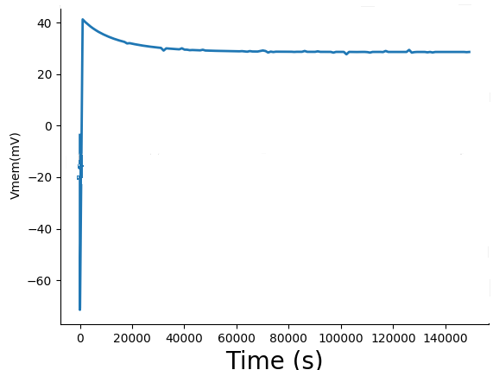
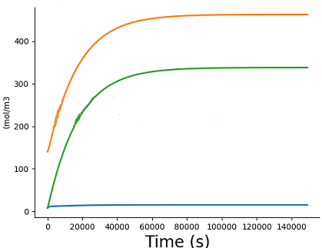
Setup:
G_{Na} and G_{K} originally set for -85mV
At t=100s, they suddenly change
Eventually we reach true SS
Na⁺
K⁺
Cl⁻
Dynamic phase: V_{mem} swinging rapidly
Thus so does V_{mem}
QSS: concentrations changing very slowly
Notes:
Oops… the last slide popped up to 30mV, and this slide does 40mV. I could redo this if I have extra time.

Slide 26
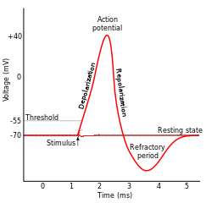
How neurons work
Nature has built a pretty amazing system
By altering G_{Na} and G_{K}, we can quickly swing between -89mV and +77mV
We can build any waveshape by suitably altering G_{Na} and G_{K}
ICF
I_{Na}
I_{K}
G_{Na}
G_{K}
G_{Cl}
$$V_{Na}^{N}$$
$$V_{K}^{N}$$
$$V_{Cl}^{N}$$
ECF
77mV
-89mV
-71mV

Slide 27
How neurons work
If you were to guess, how do you think G_{Na} and G_{K} change over the course of a spike? Draw it.
ICF
I_{Na}
I_{K}
G_{Na}
G_{K}
G_{Cl}
$$V_{Na}^{N}$$
$$V_{K}^{N}$$
$$V_{Cl}^{N}$$
ECF
77mV
-89mV
-71mV

Slide 28
How neurons work
If you were to guess, how do you think G_{Na} and G_{K} change over the course of a spike? Draw it
V_{N,Na}=+54mV; V_{N,K}=-90mV; V_{N,Cl}=-70mV
The Hodgkins-Huxley model:
G_{Na} and G_{K} are given empirically by differential equations that match the behavior you predicted
Na has high G
Both return to baseline
K has high G
Na and K both have low G

Slide 29
How neurons work
If you were to guess, how do you think G_{Na} and G_{K} change over the course of a spike? Draw it
V_{N,Na}=+54mV; V_{N,K}=-90mV; V_{N,Cl}=-70mV
The Hodgkins-Huxley model:
Differential equations for the blue and green curves
Basic idea is voltage-sensitive ion-channel turnon
G_{Na} is an increasing function of V_{mem}; fast positive feedback generates the rising spike
A slow negative-feedback mechanism shuts the spike off
G_{K} is the blue curve
G_{Na} is the green curve

Slide 30
Traveling action potentials
Start with an action potential at one end of a neuron
it started when V_{mem} was pushed high enough
Diffusion:
it travels and damps
but this pushes V_{mem} higher nearby
V_{mem} nearby
This is high enough to…
trigger an action potential over there!
and over and over

Slide 31
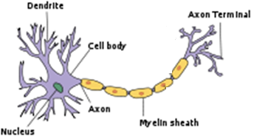
More facts about neurons
synapse
ANN nonlinear activation function sort of models this
The brain has ≈100B neurons.
Each dendrite takes inputs from ≈1000 other neurons and decides when to fire
Most common model: Leaky Integrate and Fire.
Each input pulse raises V_{mem} slightly; when we hit a threshold we fire
An action potential then travels along the axon to the next downstream synapse(s)
Electroceuticals: largely concerned with neurons
Morphogenesis: non-neuronal cells computing and communicating bio-electrically
Notes:
For those of you who are into NNs, is this exciting? It’s a very nonlinear response, which ANNs depend on. Of course, your brain doesn’t really care if some computer scientist built an ANN like a real brain or not, but it’s probably comforting for the CS person :-).

Slide 32
Traveling action potentials
Why don’t they reverse direction?
Why doesn’t the green action potential at x=2 diffuse to x=1 as well as to x=3?
It does diffuse. But x=1 is in refractory mode, and the diffusion can’t bring it high enough to kick off an action potential
x=2
+40
x=1
0
V_{mem}(mV)
-55
-70
0
1
2
3
4
5
Time(ms)

Slide 33
A bit more
Neurons are fast.
Change G_{Na} and/or G_{K} → near instant change in V_{mem}
But…
the march to a new steady state starts instantly too
if the changes in G_{Na} and/or G_{K} lasted long enough, the internal [Na], [K] and [Cl] would change
Any consequences of that?
the neuron would function differently at the next spike
But it doesn’t happen; we saw that neurons return to baseline quite quickly
There’s a good reason why action-potential spikes are short and sweet!

Slide 34
Myelin
Neurons are coated with myelin
A fatty, non-conductive layer
What good is myelin?
Makes neurons propagate an action potential fast
A big evolutionary step in our brains being useful ☺
But how does it work?
Remember capacitance? Thick membrane → low C
Q=CV, so low C means faster or slower?
Multiple sclerosis is an auto-immune disease where (among other issues) nerves get demyelinated
faster. Takes less Δq to make enough ΔV

Slide 35
The problem with myelin
ion channels
Neuron without myelin
Action potential travels slowly
Gets regenerated frequently
Neuron with myelin
Ion channels cannot traverse the sheath
Diffusion can make V_{mem} wave spread much faster. But…
Without ion channels, action potentials cannot regenerate!
Die out before reaching the other end of the neuron ☹
Solution:
Nodes of Ranvier
Occasional gaps in the myelin sheath, big enough to allow AP regeneration

Slide 36
Recap
What can we compute in steady state over hours?
A function V_{mem} = f (G_{Na}, G_{K})
Independent of initial concentrations [Na]_{int}, [K]_{int}, [Cl]_{int}.
Reasonably linear? I’ve never seen a simplified description (but it would be a good final project)
Morphogenesis is proposed to compute this way
What can we compute in quasi steady state over milliseconds?
A simple function V_{mem} = f (G_{Na}, G_{K}, G_{Cl})
It’s reasonably linear
In QSS, each ion individually has nonzero flux. So unless we quickly revert to default values, we get a long, slow march to SS
This is how neurons work!

Slide 37
What’s up next?
Lab #2, cell voltages in QSS.
Then the next unit: building non-neural neural networks

Slide 38
analyze_equiv_network() tries to keep results pretty
It sometimes only prints to one significant digit
Here are some better numbers
 | Na | K | Cl
G (mol/m²s per mV) | 3.19 | 38.4 | 4.44
V_{nernst} (mV) | 71 | -86 | -25
I_{pump} (mol/m²s) | 810 | 540

