Slide 1
EE 193/Comp 150: Computing with Biological Parts
Spring 2019
Tufts University
Instructor: Joel Grodstein
joel.grodstein@tufts.edu
Bioelectricity III – gap junctions and neural nets

Slide 2
Problem for the day
We learned that deep artificial NNs can do remarkable things (image recognition, …)
How can we use what we know so far to build an artificial NN with biology?
And we’ll learn about gap junctions, too ☺

Slide 3
What do we know so far?
We know most everything we need to about how a single cell computes bioelectrically
How it computes quickly (e.g., for neurons)
and slowly (perhaps for morphogenesis)
But that’s just one cell, computing one very wimpy function
Not worth writing home about
lots of small cells working together can do big things
Like a neural network
We could stop here – we’ve learned useful stuff
we understand bioelectricity pretty well
you could now go out and learn more about ion-channel blockers (used for Alzheimer’s and cystic fibrosis)
openers (used for high blood pressure)
neuroscience
But arguably, we haven’t been able to build anything fun yet
That’s about to change

Slide 4
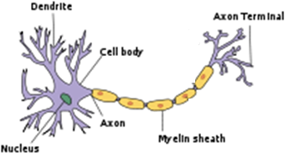
Communication
To do anything really useful, we need lots of these little engines working together
But how will they communicate?
Neurons communicate via neural synapses.
Most common type is a chemical synapse
Firing neuron releases a neurotransmitter; it binds to the downstream neuron’s cell membrane, influences V_{mem}
synapse

Slide 5
Electrical synapses
The brain also has electrical synapses
Communication by direct movement of charged ions from one neuron to another
We’ve briefly mentioned them – they are gap junctions
They work not only for neurons, but also for most other cells in the body
This will be the last bit of biological physics we need for bioelectricity
then we’re ready to build “neural” networks and worms!

Slide 6
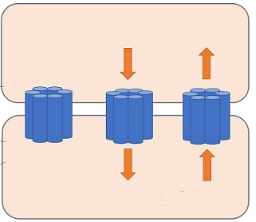
Gap junctions
We’ve said that morphogenesis is a marvel of distributed computing
Clearly that means cells must talk to each other!
How?
Via the brain (once it exists)
Via gap junctions (GJ)
A GJ is a little tube that connects two cells
Molecules can travel between the two cells
Think wires between gates
If a GJ connects two cells with different V_{mem}, then negative ions move towards the + cell
Just like ion channels did for ICF ↔ ECF
+10mV
Na⁺
Cl⁻
-20mV
Na⁺
Cl⁻

Slide 7
Gap junctions
A gap junction (GJ) is a small connecting tube between cells
What can GJs do?
allow ion flow between cells. I.e., current. GJs are wires
selectivity: GJs can pass some molecules and not others (based on which connexin proteins the GJ is built from)
A GJ can be turned on/off by either voltage or ligands
Most people believe that GJs+cells are a precursor to the nervous system
In primitive organisms, they computed just like your brain does (but slower and over smaller distances)

Slide 8
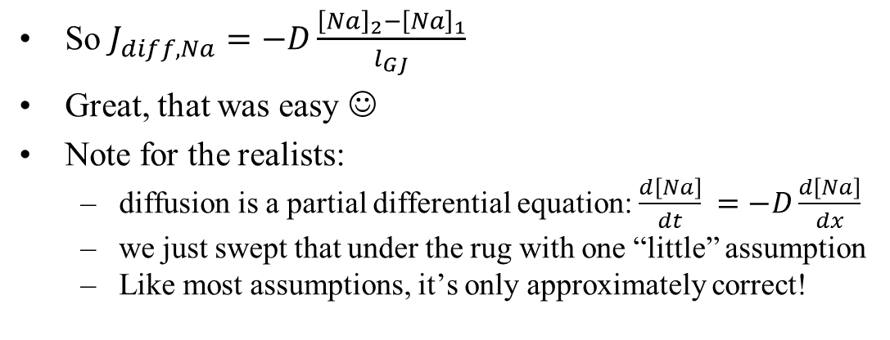
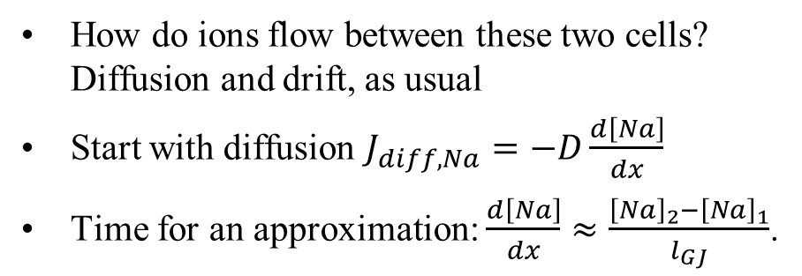
Modeling GJs
How do ions flow between these two cells? Diffusion and drift, as usual
Start with diffusion $J_{diff,Na}=−D\frac{d\left[Na\right]}{dx}$
Time for an approximation: $\frac{d\left[Na\right]}{dx}≈\frac{{\left[Na\right]}_{2}−{\left[Na\right]}_{1}}{l_{GJ}}$.
cell 1
cell 2
V_{mem,1}
[Na]₁
V_{mem,2}
[Na]₂
→l_{GJ}←
So $J_{diff,Na}=−D\frac{{\left[Na\right]}_{2}−{\left[Na\right]}_{1}}{l_{GJ}}$
Great, that was easy ☺
Note for the realists:
diffusion is a partial differential equation: $\frac{d\left[Na\right]}{dt} =−D\frac{d\left[Na\right]}{dx}$
we just swept that under the rug with one “little” assumption
Like most assumptions, it’s only approximately correct!

Slide 9
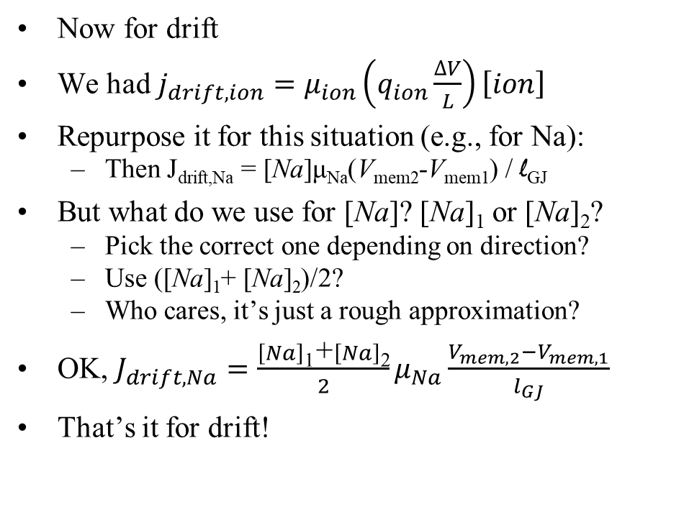
Modeling GJs
Now for drift
We had $j_{drift,ion}=μ_{ion}\left(q_{ion}\frac{∆V}{L}\right)\left[ion\right]$
Repurpose it for this situation (e.g., for Na):
Then J_{drift,Na} = [Na]μ_{Na}(V_{mem2}-V_{mem1}) / l_{GJ}
But what do we use for [Na]? [Na]₁ or [Na]₂?
Pick the correct one depending on direction?
Use ([Na]₁+ [Na]₂)/2?
Who cares, it’s just a rough approximation?
OK, $J_{drift,Na}=\frac{\left[Na\right]\text{1}\text{+}\left[Na\right]\text{2}}{2}μ_{Na}\frac{V_{mem,2}−V_{mem,1}}{l_{GJ}}$
That’s it for drift!
cell 1
cell 2
V_{mem,1}
[Na]₁
V_{mem,2}
[Na]₂
→l_{GJ}←

Slide 10
Put it all together
Total flux J_{total}= J_{diff} + J_{drift}
$J_{total}=−D_{Na}\frac{{\left[Na\right]}_{2}−{\left[Na\right]}_{1}}{l_{GJ}}+\frac{\left[Na\right]\text{1}\text{+}\left[Na\right]\text{2}}{2}μ_{Na}\frac{V_{mem,2}−V_{mem,1}}{l_{GJ}}$
This is a nice simple little equation
Really? Simple?
Let’s think about an intuitive model for QSS
D_{Na}, μ_{Na}, l_{GJ} are constant, of course
Concentrations change very slowly (call them constant)
At any given time, for any given ion
J_{total} = k₁ + k₂ (V_{mem2}-V_{mem1})
Nice and linear, and we did it in 15 minutes
What if [Na]₁ = [Na]₂?
E.g., all cells have the same ion baseline ion concentrations
Remember this for the next lab ☺
diffusion
drift

Slide 11
EE model
Let’s make a simple model
We modeled our cells as a half dozen batteries, resistors
Do the same thing with a GJ
I_{total} = k₁ + k₂ (V_{mem2}-V_{mem1})
Current source, value k₁
Resistor, conductance k₂
As usual, a separate version for each ion
What if k₁==0?
cell 1
cell 2
V_{mem,1}
c₁
V_{mem,2}
c₂

Slide 12
Time to play
That’s it – we’re ready to hook together a bunch of cells and see what happens
Do the setup_weighted_sum example (i.e., Lab #3)

Slide 13
Modeling our NN
ICF
This was our model for one cell at QSS
We’re going to assemble multiple cells and GJs
Let’s simplify the model
This is called a Thevenin equivalent circuit
I_{Na}
I_{K}
G_{Na}
G_{K}
G_{Cl}
V^{N}_{Na}
77mV
V^{N}_{K}
-89mV
V^{N}_{Cl}
-71mV
ECF
ICF
G_{cell}
ECF
V_{cell}
Any combination of batteries, resistors and current sources can be replaced with one battery & resistor!

Slide 14
Modeling our NN
ICF₃
no ion channels
Put it all together
It’s still a bit complicated!
Next simplification
In the lab, all cells have the same [Na]_{int}, [K]_{int}, and [Cl]_{int}
What happens to the current sources?
GJ₀
GJ₁
ICF₀
ICF₁
G_{cell0}
G_{cell1}
V_{cell0}
V_{cell1}
ECF

Slide 15
Lab 3
ICF₃
no ion channels
Goal: to implement a particular weighted sum
E.g., .5V_{mem,0} + .5V_{mem,1}
How do we pick values for G_{GJ0} and G_{GJ1}?
Fairly intuitive from the symmetry: set G_{GJ0}=G_{GJ1}
But should it be
G_{GJ0}=G_{GJ1} = 5 moles/(m²·s ·V)?
10?
Depends on the value of G_{cell0}, G_{cell1}?
Hint: think of a voltage divider
Use the lab’s scale to experiment
GJ₀
GJ₁
G_{GJ0}
G_{GJ1}
ICF₀
ICF₁
G_{cell0}
G_{cell1}
V_{cell0}
V_{cell1}
ECF

Slide 16
Lab 3
ICF₃
no ion channels
How about this weighted sum?
E.g., $\frac{1}{3}V_{mem,0}+\frac{2}{3}V_{mem,1}$
How can we pick G_{GJ0} and G_{GJ1} now?
G_{GJ0}=2 moles/(m²·s ·V), G_{GJ1} = 1?
G_{GJ0}=1 moles/(m²·s ·V), G_{GJ1} = 2?
G_{GJ0}+G_{cell0} is twice as big as G_{GJ1}+G_{cell1}?
And what about the scale again?
Hint: think of a voltage divider
Try, see what works, analyze
GJ₀
GJ₁
G_{GJ0}
G_{GJ1}
ICF₀
ICF₁
G_{cell0}
G_{cell1}
V_{cell0}
V_{cell1}
ECF

Slide 17
Next steps
We can now create a weighted sum
What are we missing for a full-scale neural network?
a way to build more than one layer of “neurons”
an activation function
Table it for now…
Bonus problem for the lab
Can be a nice final project if you like
Can return and go over it roughly when people want more info

Slide 18
Summary
What have we done?
Learned how neurons communicate
Learned how to use GJs to let non-neural cells communicate
Constructed a (nearly real) neural network from multiple cells
Neural nets are very good at pattern recognition
Is this how our body decides whether we’re at our target shape?
Perhaps

Slide 19
BACKUP

Slide 20
Building an activation function
Layer 1 (inputs)
Layer 2 (weighted sum)
Assume that layer 2 computes the weighted sum (like in Lab 3).
How do we compute the activation function?
Voltage-gated ion channels that “snap” V_{mem} to 0 or 1
Layer 2A

Slide 21
Snapping ion channels
Remember labs #1, #2?
In(de)crease Dm_array[Na,:] → V_{mem} rises(falls)
In(de)crease Dm_array[K,Cl,:] → V_{mem} falls(rises)
What if we had a voltage-sensitive Na channel:
Dm_{Na}
Larger V_{mem} → larger Dm_{Na} → even larger V_{mem}
Smaller V_{mem} → smaller Dm_{Na} → even smaller V_{mem}
End result: V_{mem} pegged at highest or lowest value, like a perceptron?
V_{mem}
Potential problems:
Is the system stuck after processing the first vector?
What if we want, e.g., ReLU instead of a perceptron?

Slide 22
Layer 2A
Layer 1 (inputs)
Layer 2 (weighted sum)
Layer 2A (activation function)
z
a
How do we compute the activation function?
Create a new layer, drive a from z with a GJ
The GJ gating function implements the activation function
What does the GJ gate on? Layer 2’s V_{mem}? Or concentration of some layer-2 ion? (Hint: remember that layer #2 is driven is QSS)
What does the GJ conduct from z to a? Diffusion of a charged ion? Of an uncharged ion? Which seems simpler?

Slide 23
Diffusion → equal [] everywhere
Layer 1 (inputs)
Layer 2 (weighted sum)
A problem with diffusion: say we have some ion i that diffuses from cell z to cell a.
Eventually [i] will even out – then the system is permanently stuck ☹. How can we fix this?
Perhaps assume a very large [i] in cell z, so that it effectively never changes? And assume another large cell with [i]=0?
Other ideas?
z
a
0

Slide 24
Chaining layers
ICF₃
Remember this picture?
For accurate computation, we needed GJ resistances to be larger than the driving G_{cell}.
What will happen when we try to build multiple layers?
I.e., we want to restore a low-impedance driver at each stage
GJ₀
GJ₁
ICF₀
ICF₁
ICF₂
G_{cell0}
G_{cell1}
G_{cell2}
V_{cell0}
V_{cell1}
V_{cell2}
ECF

Slide 25
Chaining multiple layers
Layer 1 (inputs)
Layer 2A
Layer 3 (next weighted sum)
Layer 3A
Layer 2
a₂₁
z₂
a₃₁
z
a₂₂
We need multiple layers for a deep NN.
How do we get a₂₁ and a₂₂ to have a low resistance?
Ligand-gated ion channels in a₂₁, a₂₂?
Do we even have to? (NNs can be resilient to errors)

Slide 26
Take some time and brainstorm in small groups.
Do you understand the problems?
Do you like these solutions?
Any other solutions?

Slide 27
Final model
diffusion
$J_{total}=−D\frac{{\left[Na\right]}_{2}−{\left[Na\right]}_{1}}{l_{GJ}}+\frac{\left[Na\right]\text{1}\text{+}\left[Na\right]\text{2}}{2}μ_{Na}\frac{V_{mem,2}−V_{mem,1}}{l_{GJ}}$
= k₁ + k₂ (V_{mem2}-V_{mem1})
We have the flux, and we want a current
Flux is ions/(m²·s)
Current is ions/s
Multiply by what?
Cross-sectional area of all GJs in a cell
The coverage fraction can vary dramatically
It goes directly into D and μ. So we multiply by the maximum GJ cross-sectional area of an ion; and scale down D and μ if the actual area is smaller
drift

