Slide 1
EE 193/Comp 150: Computing with Biological Parts
Spring 2019
Tufts University
Instructor: Joel Grodstein
joel.grodstein@tufts.edu
Bioelectricity IV: worms

Slide 2
Goal for this unit
Now for this one
We built a NN for this one
Remember the morphogenesis problem?
37 trillion cells, and the body must decide which are eyes, ears, toes, …
Our hypothesis: a V_{mem} pattern is the API that decides which cells become what
A machine compares current shape vs. the goal & decides what to do
The simplest V_{mem} pattern:
a coordinate system (V_{mem} gradually increasing from left to right)
and understand what might make it robust

Slide 3
Positional cues
y
1
.8
.6
.4
.2
0
Human embryo, 9-10 weeks
0 .2 .4 .6 .8 1
x
Assume that there is some way for cells to know their x and y coordinates
Perhaps two chemicals whose concentration varies gradually with position?
Coordinates doesn’t really extend into space… but my artwork is limited ☺
Inside every cell is the code
if (x==.3 and y==.55):
I_am_nose=True
So a few of the cells set I_am_nose=True (whatever that means)
That triggers their if-then promoters to start building nose proteins
Notes:
Minor problem: we can’t have Vmem both be the x coordinate and also the y coordinate! So let’s assumes we’ve e.g., done one and then saved location as a chemical.
Note also that we’ve talked about a NN to implement the API. The simple “if” statement here is clearly less robust, but it’s simple enough to fit on a slide! And it could be correct, if the coordinate system itself is quite robust.

Slide 4
Positional cues
y
1
.8
.6
.4
.2
0
Human embryo, 9-10 weeks
0 .2 .4 .6 .8 1
x
Assume that there is some way for cells to know their x and y coordinates
Perhaps two chemicals whose concentration varies gradually with position?
Inside every cell is the code
if (x==.3 and y==.55):
I_am_nose=True
But who creates the V_{mem} coordinate system?
The worm cells. Let’s see how
Note that it must work when the mother is both lying and standing! (Doing handstands does not create birth defects)
Notes:
The fact that a pregnant woman can do handstands means that gravity cannot enter into the picture very much

Slide 5
0V
1V
not too useful as a coordinate system ☹
much more useful!
Start with a tube full of negative ions M
Diffusion: it all spreads out evenly
Add a voltage differential (call it 0-1V for simplicity; really +20 to -70 mV)
What happens?
We settle to a steady state where diffusion and drift balance
the mystery ion
Notes:
“M” is because it’s a mystery ion – we haven’t actually found it

Slide 6
Nernst again
0V
.2V .4V .6V .8V
1V
[M]₀
$$\left[M\right]={\left[M\right]}_{0}e^{\frac{400mV}{26mV}}$$
$$\left[M\right]={\left[M\right]}_{0}e^{\frac{800mV}{26mV}}$$
“We settle to a steady state where diffusion and drift balance”
But that’s how we derived the Nernst equation!
$\frac{{\left[M\right]}_{b}}{{\left[M\right]}_{a}}=e^{\frac{V_{mem,b}−V_{mem,a}}{26mV}}$
Conclusions
if we know the V_{mem} profile, we know [M]
there’s a nice, smooth [M] profile!

Slide 7
0V
1V
Won’t gravity interfere with electricity?
Why doesn’t your head fall off if you do a handstand?
Electric forces are far stronger than gravity (small, light particles suspended in water)
So pregnant flatworms can do handstands ☺

Slide 8
So what?
Again: cells can include the software
if ([M] < .1):
I am toes
elif ([M] < .2):
I am knees
elif ([M] < .3):
I am a bellybutton
elif ([M] < .3):
I am a shoulders
else:
I am the head
…
As always, every cell has the same program
but each sees its location-appropriate [M]
So a few of the cells set I_am_toes=True (whatever that means)
That triggers their if-then promoters to start building toe proteins

Slide 9
But what about a flatworm?
We’ve shown how a coordinate system might exist – but
do flatworms have tubes in them?
how do the cells know what voltages to make?
how does this help us to explain regeneration from small body parts?
or head/tail reversal from a battery?
Let’s try to answer those questions
at least with a hypothesis!

Slide 10
Do flatworms have tubes in them?
M
M
M
M
M
Yes – gap junctions
5 cells, connected by 4 GJs
A real planaria has many more cells, and 3D
Assume a negatively charged mystery ion M that can travel through the GJs.

Slide 11
How do cells know what V_{mem} to create?
1V
1V
M
1V
M
1V
1V
M
M
M
M
M
M
M
B B B B B
Consider a few patterns of cell V_{mem}
First: all cells have the same V_{mem} (1V in this example)
Note: ECF is the voltage reference
What pattern will [M] settle out to?
No voltage differences driving left-to-right ion flow
Diffusion is the only force acting here
[M] will become perfectly uniform
Everything is a belly button!

Slide 12
0V
M
M
1V
M
M
M
M
M
M
M
M
T K B S H
Next V_{mem} pattern:
1V at the head, 0V at the tail, no voltage in between
What pattern will [M] settle out to?
our Nernst gradient

Slide 13
1V
0V
1V
M
0V
.5V
M
M
M
M
M
M
M
M
H T
H
T
B
But what stops the cells from deciding on any old pattern of voltages?
With the resulting random [M] profile
and the resulting body-part assortment

Slide 14
Code for one cell
How does the cell know this? A physical sensor?
Consider the following code:
if (I’m at an end of the worm)
if my [M] is bigger than average:
raise my V_{mem}
else:
lower my V_{mem}
else:
I have no ion channels at all
same code in every cell!
Build a positive-feedback system. The + and - ends will continually get more so
Keep things simple for now: lots of feedback in the middle of the worm ⇒ more complex

Slide 15
Regeneration
0V
M
M
M
1V
M
M
M
M
M
M
M
T K B S H
Start with a fully-grown planaria, with the given [M] gradient
Chop off one small piece
Let it regrow
It will get larger (i.e., more cells)
Simplify; assume that happens instantly
Let’s watch the profiles for [M] and V_{mem}

Slide 16
$${\left[M\right]}_{right}={{\left[M\right]}_{left}e}^{\left(\frac{∆V}{26mV}\right)}$$
.5V
M
M
.6V
M
M
M
M
M
M
M
M
S S S S S
Just after the cut, we have:
Slightly higher voltage on the right than the left
Slightly higher [M] on the right as well
Next: the M diffuses around, according to the new voltage profile
Again, more than average on the right, and less on the left

Slide 17
if (I’m at an end of the worm)
if my [M] is bigger than average:
raise my V_{mem}
else:
lower my V_{mem}
.8V
.5V
.6V
.2V
M
M
M
M
M
M
M
M
M
M
K B S S H
S S S S S
On the left side, V_{mem} falls
On the right side, V_{mem} rises
Result: the voltage profile exaggerates
This exaggerates the [M] profile
Round and round we go…
positive feedback!

Slide 18
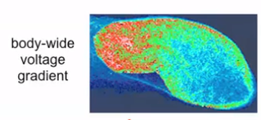
0V
M
M
M
1V
M
M
M
M
M
M
M
T K B S H
Eventually getting the full 0V-1V range…
…and the associated [M] gradient
From https://vimeo.com/184365295 , time 27:00

Slide 19
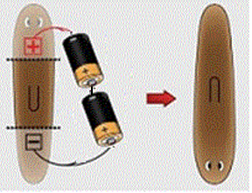
Head-tail reversal
Another experiment to explain:
Start with a planarian
Cut out a body segment as usual
Apply an external voltage
The worm regenerates with head/tail reversed
*Picture taken from Modeling Planarian Regeneration: A Primer for Reverse-Engineering the Worm, Lobo et al 2012
Notes:
Note that, as explained in the Morphogenesis slide deck, I’ve altered this picture by reversing battery polarity, and changing parallel batteries into series

Slide 20
Regeneration + battery
0V
M
M
1V
M
M
M
M
M
M
M
M
T K B S H
Start with a fully-grown planaria, with the given [M] gradient
Chop off one small piece
Let it regrow
It will get larger (i.e., more cells)
Simplify; assume that happens instantly
Let’s watch the profiles for [M] and V_{mem}

Slide 21
if (I’m at an end of the worm)
if my [M] is bigger than average:
raise my V_{mem}
else:
lower my V_{mem}
1V
.5V
.6V
battery +
M
M
M
M
M
M
M
0V
M
M
M
battery -
H S B K T
Apply the external voltage
[M] profile feels an electric force, moves accordingly
Remove the battery
The cell’s software preserves the new voltage & [M] profiles
Everything proceeds as before – but with head/tail reversed
It’s difficult to see how to explain this without bioelectricity

Slide 22
More realism
if (I’m at an end of the worm)
if my [M] is bigger than average:
raise my V_{mem}
else:
lower my V_{mem}
else:
I have no ion channels at all
How do we implement this?
We want [M] to control V_{mem}. How?
What’s a good mechanism to control V_{mem}?
Gated ion channels – but this time gated by [M] rather than by V_{mem}

Slide 23
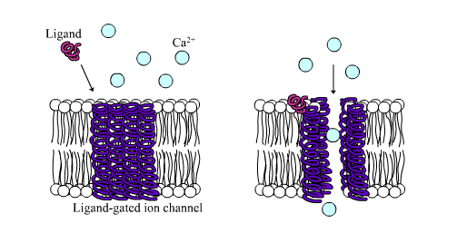
Ligand-gated ion channels
How does this work physically?
Ion channels are made from proteins
Proteins are good at changing their shape

Slide 24

The Bitsey “magic” system
Bitsey lets you control any conductance (ion channel or GJ) with any V_{mem} or [ion]
V_{mem} in a cell could control its G_{Na} and/or G_{K} (neuron)
[M] in the head can control the head’s G_{Na} and/or G_{K}
Ligand gating uses a Hill equation (inverter)
G is scaled by $\frac{1}{1+{\left(\frac{\left[ion\right]}{k_{M}}\right)}^{N}}$
[ion]=k_{M} ⇒ scale=½

Slide 25
The Bitsey “magic” system
Remember: V_{Nernst,Na}≈+60mV, V_{Nernst,K}≈-80mV
If we want high [M] ⇒ high V_{mem}, which ion channel should [M] control?
K
Higher [M] ⇒ lower G_{K}
moves V_{mem} closer to V_{Nernst,Na} (+60mV)

Slide 26
if (I’m at an end of the worm)
if my [M] is bigger than average:
raise my V_{mem}
else:
lower my V_{mem}
if (I’m at an end of the worm)
G_{K} = Hill buffer ([M])
0V
M
M
M
1V
M
M
M
M
M
M
M
T K B S H
High V_{mem} ⇒ high [M] ⇒ low G_{K} ⇒ higher V_{mem}
Low V_{mem} ⇒ low [M] ⇒ high G_{K} ⇒ lower V_{mem}

Slide 27

Hill buffer
Bitsey also provides a Hill buffer
Any idea what we might use it for?
Control G_{Na}
But why bother controlling both of them?
$$\frac{{\left(\frac{\left[ion\right]}{k_{M}}\right)}^{N}}{1+{\left(\frac{\left[ion\right]}{k_{M}}\right)}^{N}}$$
[ion]=k_{M} ⇒ scale=½

Slide 28
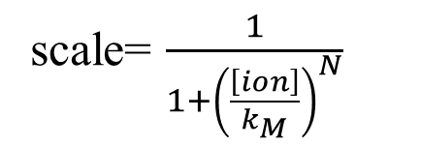
What about N>1?
As N gets larger, is k_{M} still the scale=½ point?
[ion]=k_{M} ⇒ scale=½ still
higher gain near [ion]=k_{M}
But why is gain useful?
scale= $\frac{1}{1+{\left(\frac{\left[ion\right]}{k_{M}}\right)}^{N}}$

Slide 29
if (I’m at an end of the worm)
G_{K} = Hill buffer ([M])
.6V
.2V
.8V
.5V
M
M
M
M
M
M
M
M
M
M
S S S S S
K B S S H
Consider the following sequence
Head-to-tail voltage difference increases by ΔV₀
Nernst equation: the ratio [M]_{head}/ [M]_{tail} increases by some ΔM₁
Ion-channel gating: resulting head-to-tail voltage difference ΔV₂
If ΔV₂ > ΔV₁ then we have positive feedback, and the disturbance grows

Slide 30
Summary
We’re about done with bioelectricity!
What have we learned?
Bioelectrical computation in one cell
slow computation of a function in SS
faster computation of a simple linear function in QSS
Cells working together to start to build NNs
How to build a coordinate system
Now each cell can know its location in the body

Slide 31
Why did we care, again?
Let’s remind ourselves what connection this has with our initial mysteries.
Hypothesis: morphogenesis is a layered system
An outer layer builds a Vmem pattern
An inner layer implements cell development accordingly
That’s our coordinate system
That’s our neural net
Compares current body shape to desired body shape
Outputs instructions on what to do next

Slide 32
What comes next?
Build and analyze a simple worm (lab #4)
Decide what to do for a final project

Slide 33
Backup

Slide 34
0
.5
1
1.5
2
Assume this is the final [M] for a full-grown worm
[M]_{average} = 1
Now try to regrow a slice from the belly

Slide 35
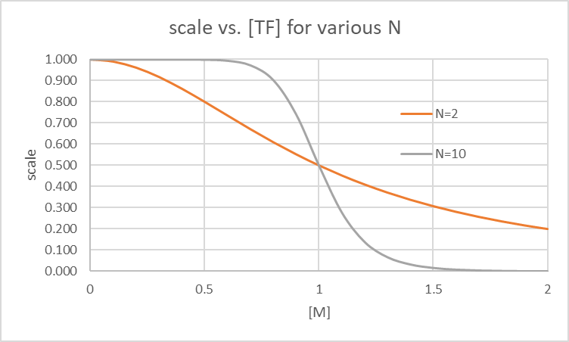
scale=.8
G_{K}=.8*1.7e-17
≈ 1.4e-17
scale=.2
G_{K}=.34e-17
.8
.9
1
1.1
1.2
Initial [M]
Look at the N=10 case
We build a substantial head-to-tail ΔV quite quickly

Slide 36
scale=.8
G_{K}=.8*1.7e-17
≈ 1.4e-17
scale=.6
G_{K}≈ 1e-17
scale=.45
G_{K}≈.8e-17
scale=.2
G_{K}=.34e-17
.8
.9
1
1.1
1.2
Initial [M]
But what if N=2?
We do not build ΔV as well
Less gain to amplify a small Δ[M]

Slide 37
0
.5
1
1.5
2
Assume this is the final [M] for a full-grown worm
[M]_{average} = 1
Now try to regrow a slice from the belly
knees

Slide 38
.2
.3
.4
.5
.6
Initial [M]
Ouch!
Now almost nothing happens
Any ideas on how to make a knee regrow well?
Look at the N=10 case

Slide 39
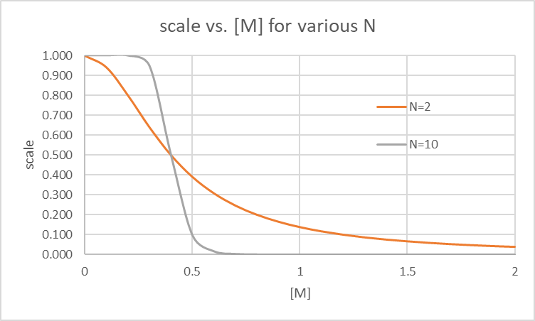
.2
.3
.4
.5
.6
Initial [M]
Set k_{M}=.4
Sure, but…
now the belly and head slices won’t work ☹
Conclusion: try to make N=2 work (or even N=1)
those have some gain everywhere
Look at the N=10 case

Slide 40
scale=.8
G_{K}=.8*1.7e-17
≈ 1.4e-17
scale=.2
G_{K}=.34e-17
.8
.9
1
1.1
1.2
Initial [M]
Next look at GJ_scale

Slide 41
scale=.8
G_{K}=.8*1.7e-17
≈ 1.4e-17
scale=.2
G_{K}=.34e-17
.8
.9
1
1.1
1.2
Initial [M]
GJ_scale gets bigger:
GJ resistances get lower
head and tail short out
V_{mem,head} and V_{mem,tail} both collapse to middle
ICF
ICF
G_{tail}
G_{head}
ECF
V_{cell}
ECF
V_{cell}

Slide 42
Where does M come from?
0
.5
1
1.5
2
Take a small tail slice
2 cells regrow to 5
total [M] stays constant
[M] will keep shrinking as the worm divides and regrows ☹
Actually M is constantly being produced and decaying
0
.05
.1
.15
.2

Slide 43
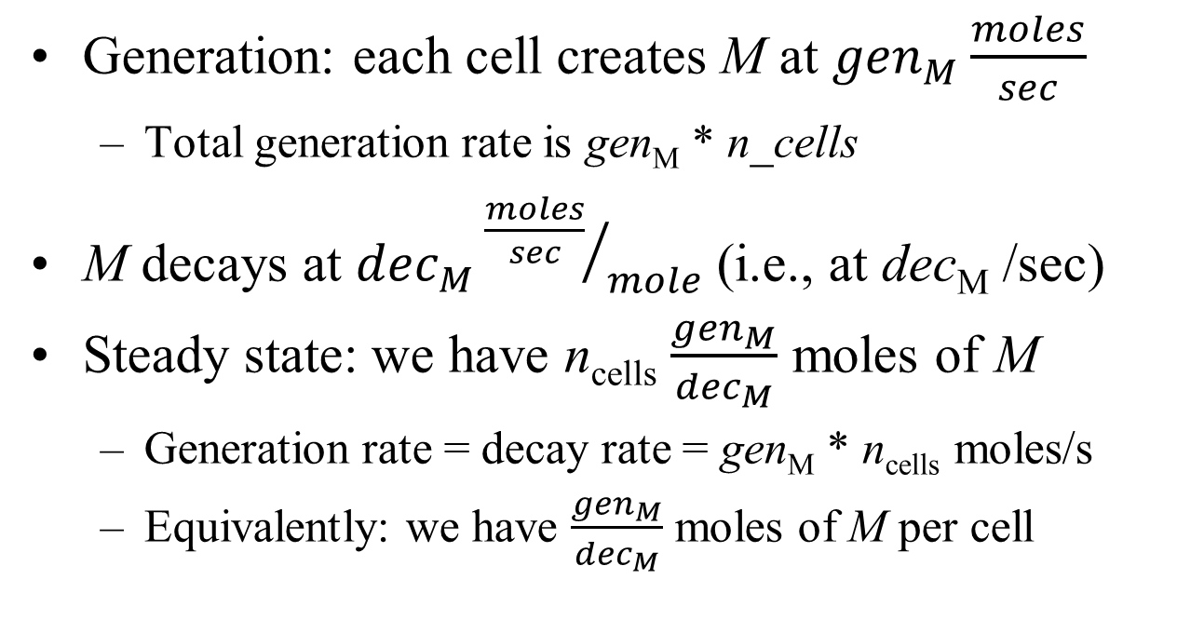
Generation and decay
Generation: each cell creates M at ${gen}_{M}\frac{moles}{sec}$
Total generation rate is gen_{M} * n_cells
M decays at ${dec}_{M}{\frac{moles}{sec}}/{mole}$ (i.e., at dec_{M} /sec)
Steady state: we have n_{cells} $\frac{{gen}_{M}}{{dec}_{M}}$ moles of M
Generation rate = decay rate = gen_{M} * n_{cells} moles/s
Equivalently: we have $\frac{{gen}_{M}}{{dec}_{M}}$ moles of M per cell

Slide 44
What to vary
Our inverter parameters: k_{M} and N
GJ_scale, number of cells
G_{K}, G_{Na}, G_{Cl}
GJ_diff for M

Slide 45
How to judge your worm
Seed the worm big a big symmetrical Δ[M]. Sim for 10K seconds. Does it hold a ΔV?
Yes
How big a ΔV does it hold?
How many of the pieces regrow?
Can you regrow a really small piece?
No
How slowly does the original ΔV shrink to halfway?

