Slide 1
EE 193/Comp 150 Computing with Biological Parts
Spring 2019
Tufts University
Instructor: Joel Grodstein
joel.grodstein@tufts.edu
Neural nets

Slide 2
What is a neural net?
Neural net (NN): a specific computing architecture modeled after the human brain
The human brain is really, really good at recognizing and classifying patterns
both visual and audio
not surprisingly, so are NNs
a “simple” task, like recognizing handwritten digits is actually really hard for a computer – unless you’re using a NN

Slide 3
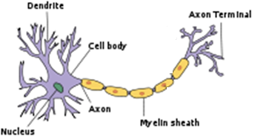
The human brain
synapse
The brain is built from ≈100B neurons.
Each dendrite takes inputs from ≈1000 other neurons and decides when to fire
Each input pulse raises or lowers V_{mem} slightly; when we hit a threshold the neuron generates a spike

Slide 4
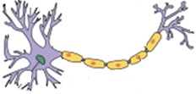
100B neurons is a very big interconnected network
Each neuron fires at various times; affects when its downstream neurons fire
The human brain is very efficient and powerful machine
It’s traditionally been better at (e.g.,) image classification than any computer
Except… neural nets, modeled after the brain, now work quite well
The most obvious way to build a neural net: spiking neural net (SNN)
It’s “just like a brain”
Why might that be easier said than done?
One “small” problem in building a neural net like a brain:
We understand the low-level neuron implementation reasonably well – but
the high level is (yet another) mystery. E.g., …

Slide 5
How do we represent a number?
Say we want to use neurons to add two numbers
First question: how do we represent a number?
big little
Frequency?
Period?
Space between two edges?
Use multiple neurons like binary?
SNN designers have tried all the above
Mostly unsure how the human nervous system works

Slide 6
This is a problem!
It would be nice to know how the brain represents data. Without that…
Makes it hard to design a SNN
Human brain is about 12 Watts
SNNs are, like brains, very energy efficient
But hard to design
Makes it hard to design electroceuticals
Which neurons should you stimulate?
For now it’s somewhat trial & error
Yet another problem…

Slide 7
A brain can compute most anything
The trick is the weights and connections
Change them, and we compute something completely different
Problem: we don’t really know how the brain alters them!
Some reasonable hypotheses
And this is where we stood – until ANNs

Slide 8
Artificial neural network
Each node represents a number
Very simple solution to “how do you represent a number?” ☺
Compute each node as a weighted sum z=w₁in₁+w₂in₂+…
every arrow has a weight
Followed by an activation function
e.g., out = (z>.5? 1 : .3)
sort of the analog of a single biological neuron
Each vertical slice is a layer
Deep neural net has lots of layers

Slide 9
Artificial neural network
We had two big problems:
Which neurons are connected to which?
Each layer is fully connected
What are the weights?
We will soon learn about training…
but first, an example

Slide 10
Some logic functions
1
1
X
1
X=0,Y=0: 1*0 + 1*0 = 0, 0>1.5⇒0
X=0,Y=1: 1*0 + 1*1 = 1, 1>1.5⇒0
X=1,Y=1: 1*1 + 1*1 = 2, 2>1.5⇒1
0
1
0
0
X AND Y
Y
1
>1.5
1
0
X=0,Y=0: 1*0 - 1*0 = 0, 0>.5⇒0
X=1,Y=0: 1*1 - 1*0 = 1, 1>.5⇒1
X=0,Y=1: 1*0 - 1*1 = -1, -1>.5⇒0
0
1
0
0
X
1
X AND $\overline{Y}$
Y
-1
>0.5
Can you design an XOR gate?
True if $\left(X AND \overline{Y}\right) OR \left(\overline{X} AND Y \right)$
You will need multiple neurons

Slide 11
Inference
output
input
Let this be an ANN to recognize a single number
Input could be a 35 nodes of 1=black, 0=white (I only drew 3 inputs to save space)
Assume we know all of the weights (we’re fully trained)
Propagate it through the network (inference)
Again: each node is a weighted sum z=w₁in₁+w₂in₂+…, and the activation function
And then you get to the output
Probably we would have 10 output neurons (for the digits 0-9)
The output pattern (.1, .9, .2, .1, 0, .2, .1, .1, 0, .2) ⇒ the digit “1”

Slide 12
Activation function
output
input
Without the activation functions, each node would just implement z=w₁in₁+w₂in₂+…
Could such a network do anything interesting?
This is a linear function
A composition of linear functions is itself linear
The entire network would reduce to a single linear function – not real useful!
Activation function at each node makes the NN useful ☺

Slide 13
Activation function
Simplest activation function: a perceptron
output = $\sum_{inputs i}{w_{i}x_{i}}$ > threshold? 1 : 0
You can build most anything with enough perceptrons
We built logic gates
But they’re not really used, because of that little problem: how do you compute the weights fast?

Slide 14
Training
Each node: a weighted sum z=w₁in₁+w₂in₂+…
every arrow has a weight
Practical ANNs have lots of weights. Where do they come from?
Training. It’s why, for a long time, NNs “didn’t work.”
Nobody knew how to figure out the best weights for a task
The same architecture, with different weights, will perform a completely different task
The training task (example)
Input: a single handwritten digit
Output: the weights to best recognize the digit

Slide 15
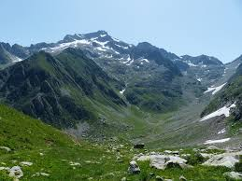
Stochastic gradient descent
Get a whole bunch of examples
Define a cost function
Average, over all the examples, of how close your ANN gets to the right answer
Here’s a cost function for just two weights
High cost = high altitude
Stochastic gradient descent
Pick a random initial set of weights
roughly compute which way is downhill
take a step in that direction
you’ll occasionally go in a bad direction; that’s OK
tends to work well even if there are multiple valleys

Slide 16
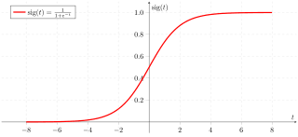
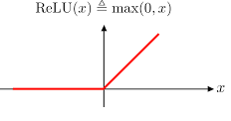
Perceptrons
sum > .7? 1 : 0
do not make a nice landscape
which way is downhill?
Better choices:
sigmoid
ReLU

Slide 17
Learning
Stochastic gradient descent works quite well for ANNs
That’s why almost all commercial NNs are ANNs
No equally good method for SNNs
We don’t really know how a brain learns

Slide 18
Summary
What do we want to build?
Neurons: to understand the brain, and electroceuticals
ANNs: morphogenesis and synthetic bio
What we’ll learn
Bioelectricity 2: the basics of neurons
Lab #2: build a baby neuron
Joel/Imran: electroceuticals
Lab #3: build a small, chintzy ANN
Potential final projects:
build a bigger ANN, or a better one
report out on electroceuticals, or efficiency of some NNs

Slide 19
Backup

Slide 20
References:
http://neuralnetworksanddeeplearning.com , by Michael Nielsen

Slide 21
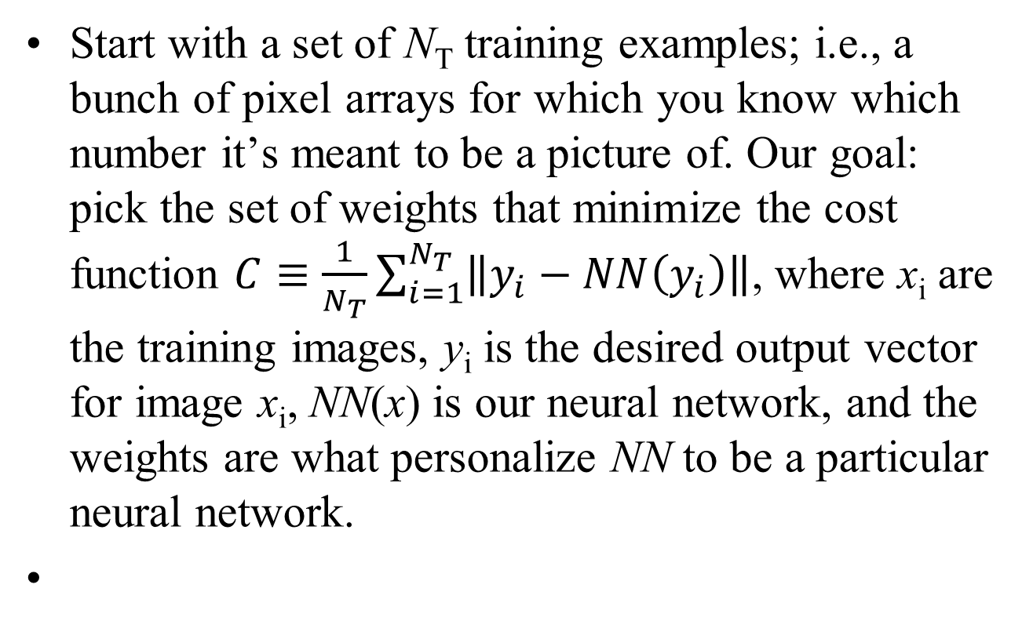
Start with a set of N_{T} training examples; i.e., a bunch of pixel arrays for which you know which number it’s meant to be a picture of. Our goal: pick the set of weights that minimize the cost function $C≡\frac{1}{N_{T}}\sum_{i=1}^{N_{T}}{\left\|y_{i}−NN\left(y_{i}\right)\right\|}$, where x_{i} are the training images, y_{i} is the desired output vector for image x_{i}, NN(x) is our neural network, and the weights are what personalize NN to be a particular neural network.

Slide 22
We usually use a form of steepest-descent algorithm (show a 3D picture), where as usual:
start with some initial set of weights w⁰
find the gradient ∇Cost; i.e., $\left[\frac{∂C}{∂w_{1}},\frac{∂C}{∂w_{2}},⋯\right]$
pick some learning rate η
set w¹=w⁰-η∇Cost (i.e., walk in the direction of the gradient, so as to maximally decrease our cost)

