Slide 1
EE 193/Comp 150 Computing with biological parts
Spring 2019
Tufts University
Instructor: Joel Grodstein
joel.grodstein@tufts.edu
Synthetic bio: models and gates

Slide 2
What’s next
Done with bioelectrical computation
Up next – a quick look into gene-regulatory networks (GRNs). Why?
Everybody believes in neurons
electrical computation in non-neural cells is not fully accepted
it may not be significant
The mainstream view of non-neuron computation is with GRNs
many well-understood examples in nature

Slide 3
Remember the Lac operon?
lacI
lactose
lactose
lacI promoter
lacI
CAP
glucose
The lac promoter is an AND gate
The lacI promoter is inverting lactose
Another inverter for glucose
Glucose → less CAP
lacI
CAP
lac promoter
lacZ
lacY
lacA
CAP
lacI
lacZ, lacY, lacA

Slide 4
Examples of digital logic in you
Our cells have many common patterns of logic
Oscillators. Any idea why?
Set your 24-hour body rhythm (2017 Nobel Prize)
Latches.
Create memory. Every cell in your body has memory! Needed for morphogenesis
Delay lines, pulse generators
Just-in-time assembly
That’s what we’ll cover
First learn to build and model simple gates

Slide 5
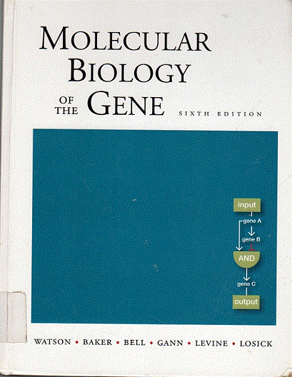
6th edition (2008)
cover art for each edition highlights important new changes in molecular biology

Slide 6
SentiBio
GRN logic is now being designed for our benefit
Sensors for disease markers
Program cells with gene circuits that allow the therapeutic to be controlled once administered
Sensors for multiple disease indicators and severity levels
Founder: Tim Lu (MIT)
In 2017, Lu’s group at MIT showed that a genetic circuit could trigger T cells to spot and kill cancer cells in mice, while leaving healthy cells alone.
Senti is creating a genetic circuit that activates a CAR-T cell, or similar cell therapies, only in the presence of two proteins found on a cancer cell
$53M in initial funding

Slide 7
Cooperative computation
GRNs and bioelectricity can work together
proteins gate ion channels that control V_{mem}
gene expression
V_{mem}
sweep in ions that activate TFs

Slide 8
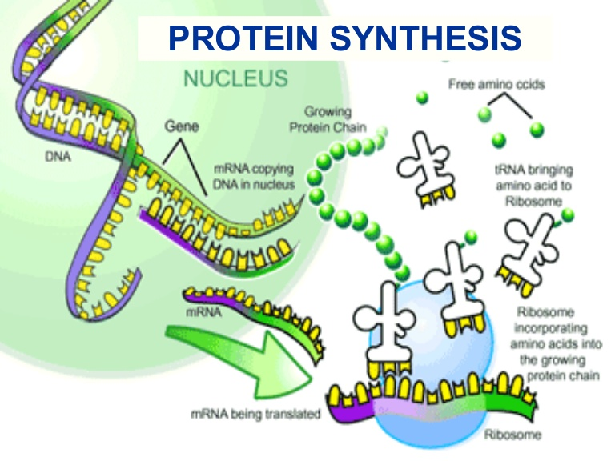
Review central dogma
The promoter controls whether the DNA builds mRNA (and thus protein) or not – i.e., whether transcription happens or not

Slide 9
Our model
What we’re modeling
TF +DNA →P→∅
$\frac{d[P]}{dt}=k_{vMax}\frac{1}{1+{\left(\frac{\left[TF\right]}{k_{M}}\right)}^{N}}−k_{DP}\left[P\right]$
generation; Hill function
degradation
Notes:
How to explain degradation: assume that, say, 10% of a given type of protein P degrades every minute. Then twice as much P means twice as much will degrade per minute. Kdp is the “10%”

Slide 10
What assumptions got made
Modeling: What could(should) we model?
TF binding a promoter
xcription
mRNA degradation
xlation
protein degradation
seconds
1-2 min (20 bp/sec)
3-8 min mRNA halflife
1-2 min; 20(2) bp/sec in pro(eu)kar.
protein halflife = hours

Slide 11
BACKUP

Slide 12
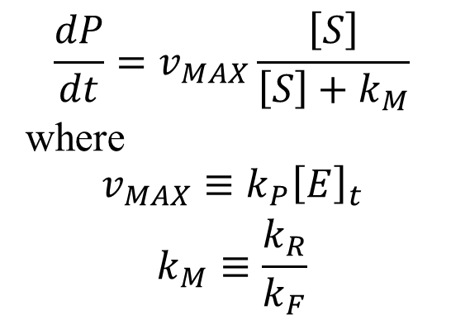
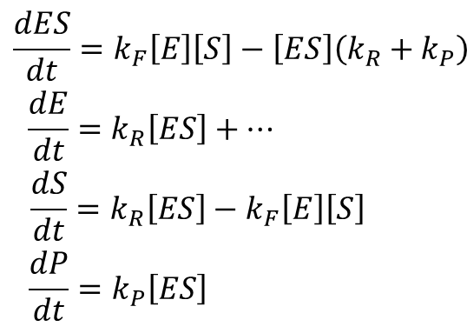
Michaelis-Menton
BACKUP
k_{F}
k_{R}
k_{P}
E+S ⇄ ES → E + P
Mass-action equations
MM equation
$$\begin{matrix}\frac{dES}{dt}=k_{F}\left[E\right]\left[S\right]−\left[ES\right]\left(k_{R}+k_{P}\right) \\ \frac{dE}{dt}=k_{R}\left[ES\right]+… \\ \begin{aligned}\frac{dS}{dt}=k_{R}\left[ES\right]−k_{F}\left[E\right]\left[S\right] \\ \frac{dP}{dt}=k_{P}\left[ES\right] \end{aligned}\end{matrix}$$
$$\frac{dP}{dt}=v_{MAX}\frac{\left[S\right]}{\left[S\right]+k_{M}}$$
where
$$\begin{matrix}v_{MAX}≡k_{P}{\left[E\right]}_{t} \\ k_{M}≡\frac{k_{R}}{k_{F}}\end{matrix}$$
How did we get from A to B?

Slide 13
Michaelis-Menton
BACKUP
k_{F}
k_{R}
k_{P}
E+S ⇄ ES → E + P
Mass-action equations
Assumptions:
[E]_{total} is constant
E+S ⇄ ES is faster than ES→E+P, and hence always at equil^{m}.
$$\begin{matrix}\frac{dES}{dt}=k_{F}\left[E\right]\left[S\right]−\left[ES\right]\left(k_{R}+k_{P}\right) \\ \frac{dE}{dt}=k_{R}\left[ES\right]+… \\ \begin{aligned}\frac{dS}{dt}=k_{R}\left[ES\right]−k_{F}\left[E\right]\left[S\right] \\ \frac{dP}{dt}=k_{P}\left[ES\right] \end{aligned}\end{matrix}$$

Slide 14
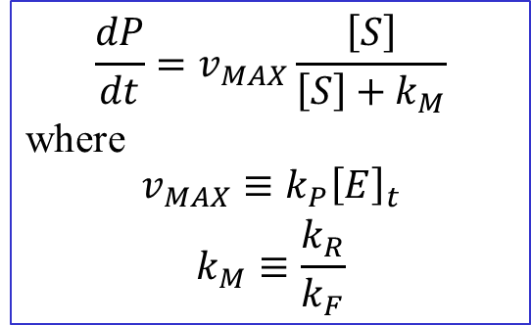
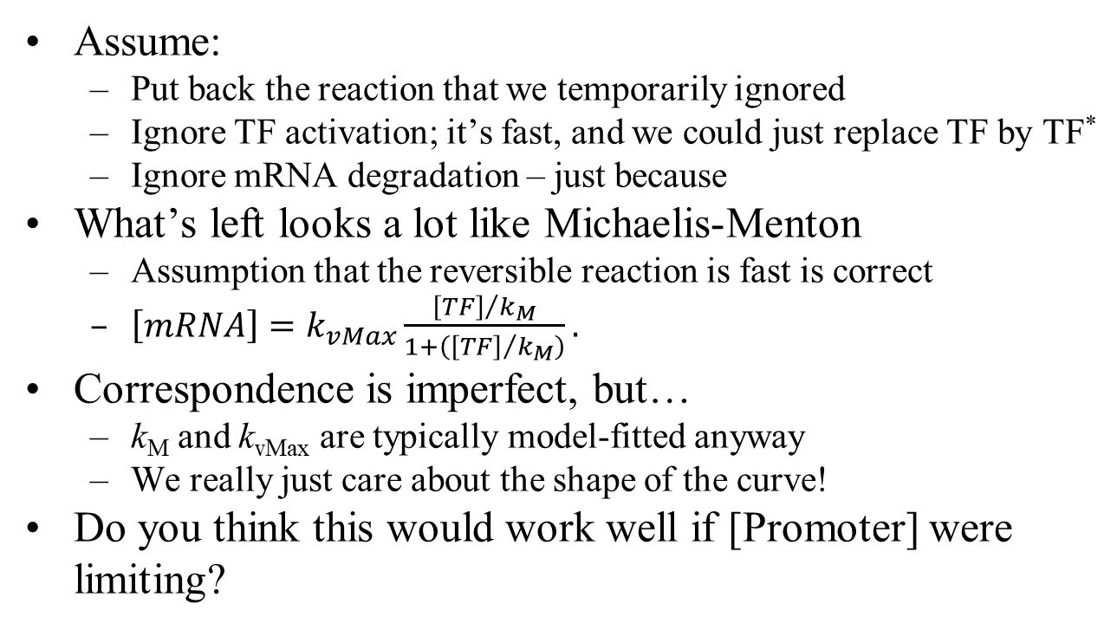
$$\frac{dP}{dt}=v_{MAX}\frac{\left[S\right]}{\left[S\right]+k_{M}}$$
where
$$\begin{matrix}v_{MAX}≡k_{P}{\left[E\right]}_{t} \\ k_{M}≡\frac{k_{R}}{k_{F}}\end{matrix}$$
k_{Tx}
k_{Tl}
TF + P ⇄
TF∙P → mRNA → P
k_{DM}
k_{DP}
BACKUP
↓
∅
↓
∅
Assume:
Put back the reaction that we temporarily ignored
Ignore TF activation; it’s fast, and we could just replace TF by TF*
Ignore mRNA degradation – just because
What’s left looks a lot like Michaelis-Menton
Assumption that the reversible reaction is fast is correct
$\left[mRNA\right]=k_{vMax}\frac{{\left[TF\right]}/{k_{M}}}{1+\left({\left[TF\right]}/{k_{M}}\right)}.$
Correspondence is imperfect, but…
k_{M} and k_{vMax} are typically model-fitted anyway
We really just care about the shape of the curve!
Do you think this would work well if [Promoter] were limiting?
TF is the “substrate”
P is the “enzyme”

Slide 15
Degradation
BACKUP

Slide 16

“Final” model
BACKUP
Finally cast these as a single DFQ:
$\frac{d\left[P\right]}{dt}=k_{vMax}\frac{{\left[TF\right]}/{k_{M}}}{1+\left({\left[TF\right]}/{k_{M}}\right)}−k_{DP}\left[P\right]$
By and large, the literature claims it works pretty well.

Slide 17
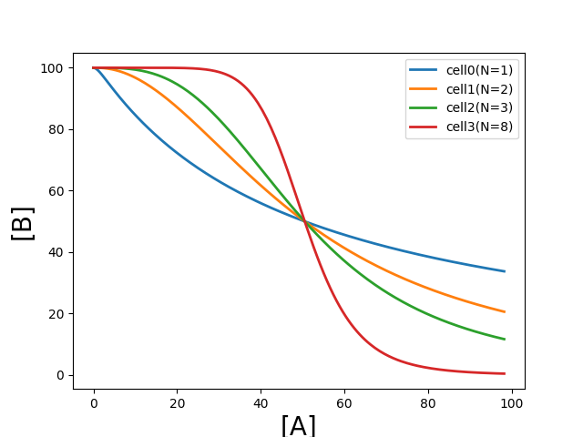
Hill inverter xfer curve
Use our model to build a simple inverter
Define two proteins A and B
Build a GRN whose input is [A] and output is [B]
Transfer function ignores dynamics
Ramp [A] very slowly
Plot [B] vs [A]
grn_Hill_xfer()

Slide 18
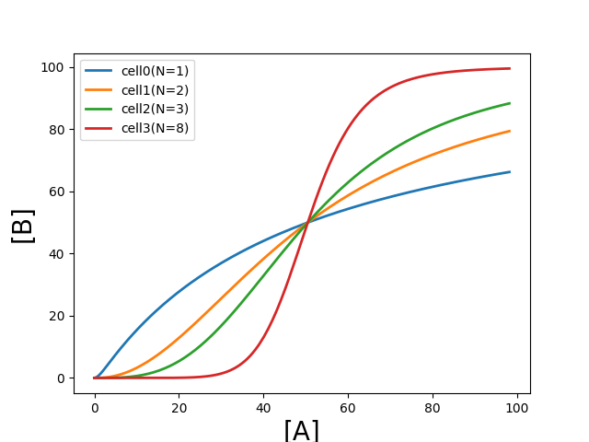
Hill buffer xfer curve
Same thing, but for a buffer this time

Slide 19
Design parameters
Why do we care about changing the design?
Synthetic biology
If we’re going to design new organisms, we have to understand what we’re building
k_{M}, k_{vMax}, N, k_{DP} can all be manipulated by synthetic biology
Increasing N gives us more gain
helps the worm to have positive feedback
and other good things, too…

Slide 20
Life is not perfect
Building gates with synBio has not been a case study in instant success.
Early attempts only occasionally worked
We’re getting more robust – but slowly
Some robustness issues:
growth-rate variability
temperature sensitivity of enzymes
loading on the cell (we’re generating many large proteins)
mutations (your alterations usually make cells less fit)
crosstalk of ATP
non-orthogonality of TFs
many more

Slide 21
Design parameter: N
Idea: sigmoid is important because life is noisy; a sharp sigmoid rejects noise.
high gain
medium gain

Slide 22
For n=1, how much does the output change if the ideal [in]=0 changes to [in]=.5?
For n=10?
Intuitively, this is a consequence of high gain at the switching point
So the gate really only cares whether [in] is <k_{M} or >k_{N}.
high gain
medium gain

Slide 23
Design parameters: k_{vMax}, k_{DP}
BACKUP
Build a GRN whose input is [A] and output is [B]
$\frac{d[B]}{dt}=k_{vMax}\frac{1}{1+{\left(\frac{\left[A\right]}{k_{M}}\right)}^{N}}−k_{DP}\left[B\right]$
Questions:
Could we have predicted the maximum [out] from looking at the parameters?
Analysis:
Equilm when $k_{vMax}\frac{1}{1+{\left(\frac{\left[A\right]}{k_{M}}\right)}^{N}}=k_{DP}\left[B\right]$
Maximum [B] is when left side is also maximum
That’s when [A]=0 ⇒ k_{vMax}
So max [B]_{max} = k_{vMax}/k_{DP}

Slide 24
Design parameters: k_{vMax}, k_{DP}
Build a GRN whose input is [A] and output is [B]
$\frac{d[B]}{dt}=k_{vMax}\frac{1}{1+{\left(\frac{\left[A\right]}{k_{M}}\right)}^{N}}−k_{DP}\left[B\right]$
Question:
Try multiplying both k_{VMax} and k_{DP} by the same number – does the xfer curve change at all?
Analysis:
Equilm when $k_{vMax}\frac{1}{1+{\left(\frac{\left[A\right]}{k_{M}}\right)}^{N}}=k_{DP}\left[B\right]$
If this equation is already true, and we multiply both k_{VMax} and k_{DP} by the same number, then it must still be true
So the same [A] ⇒ [B] pair still works
BACKUP

Slide 25
Design parameter: k_{P}
BACKUP
Theory is important… at least in theory
$$\frac{dP}{dt}=k_{P}−k_{DP}\left[P\right]$$
DFQ solution:
homogeneous solution $P\left(t\right)=ke^{−k_{DP}t}$
particular solution $P\left(t\right)=\frac{k_{P}}{k_{DP}}$
full solution $P\left(t\right)=P_{SS}+\left(P_{0}−P_{SS}\right)e^{−k_{DP}t}$, where $P_{SS}≡$ $\frac{k_{P}}{k_{DP}}$
Conclusions:
Now we understand the asymptotic approach to P_{SS}
Time constant is independent of k_{P}. What??!!!
But k_{P} does affect the final value and the ramp rate

Slide 26
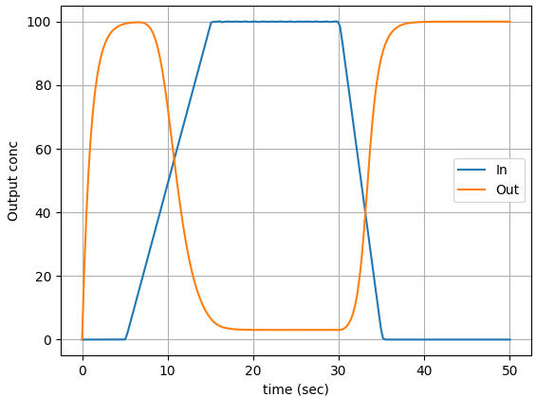
Transient response
inv_Hill_transient()
There is always a delay from input to output
“reaction time” of a logic gate
40 years of electronic design has tried to minimize this delay
Evolution can take advantage of it!

Slide 27
Buffers and inverters are nice, but you can’t really build logic until you have two-input gates
Logical AND
output is 1 when both inputs are 1
Logical OR
output is 1 when either input is 1

Slide 28
Biology of an OR
LacI
foo
TetR
foo
Many ways to skin this cat. Here’s an easy one: two separate promoters
EEs call this a wire-OR.
What logic function is this computing?
foo = LacI | TetR

Slide 29
Biology of an OR
AND
Could these same biological parts actually be implementing an AND gate?
LacI
foo
TetR
foo
Many ways to skin this cat. Here’s an easy one: two separate promoters
EEs call this a wire-OR.
What logic function is this computing?
foo = LacI | TetR

Slide 30
Assume the gate works like this:
LacI | TetR | [foo]
0 | 0 | 0
0 | 1 | 50
1 | 0 | 50
1 | 1 | 100
LacI
foo
TetR
foo
What if the downstream gate has k_{M}=75?
k_{M}=50?
AND!
OR

Slide 31
Slightly different version
Many versions of the same idea
Now what’s it computing?
foo = !LacI | !TetR
= !(LacI & TetR)
not (AND)
LacI
foo
deMorgan’s Laws
!A | !B = !(A & B)
!A & !B = !(A | B)
TetR
foo

Slide 32
Summary
We can build inverters, buffers, AND and OR gates from GRNs
Bitsey can model and simulate them (somewhat)
Biology is noisy – building robust gates is hard
Even simple logic circuits can be very useful

Slide 33
BACKUP

Slide 34
Cooperativity
Draw N TFs binding each other, and then binding a promoter

Slide 35
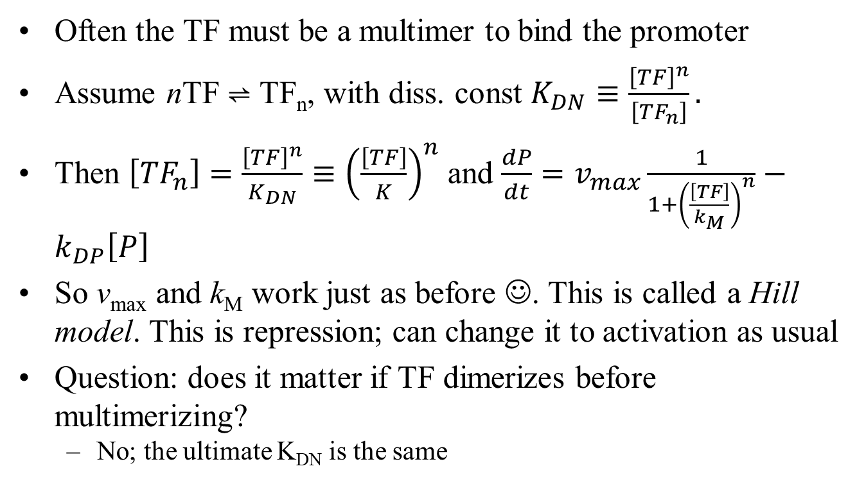
Cooperativity
Often the TF must be a multimer to bind the promoter
Assume nTF ⇌ TF_{n}, with diss. const $K_{DN}≡\frac{{\left[TF\right]}^{n}}{\left[{TF}_{n}\right]}.$
Then $\left[{TF}_{n}\right]=\frac{{\left[TF\right]}^{n}}{K_{DN}}≡{\left(\frac{\left[TF\right]}{K}\right)}^{n}$ and $\frac{dP}{dt}=v_{max}\frac{1}{1+{\left(\frac{\left[TF\right]}{k_{M}}\right)}^{n}}−k_{DP}\left[P\right]$
So v_{max} and k_{M} work just as before ☺. This is called a Hill model. This is repression; can change it to activation as usual
Question: does it matter if TF dimerizes before multimerizing?
No; the ultimate K_{DN} is the same
Notes:
Really, this is not cooperativity; it is the promoter binding to a multimer. True cooperative binding is when each successive bound ligand makes the binding of the next ligand easier. You can do a derivation for cooperative binding that comes to the same conclusion as this simple (but incorrect) presentation. It’s at http://www.bio.brandeis.edu/classes/biochem104/cooperativity_intro_to_hill_2007.pdf

Slide 36
Buffers vs. inverters
Hill inverters and buffers are pretty similar
Hill buffer = $\frac{{\left(\frac{\left[TF\right]}{k_{M}}\right)}^{n}}{1+{\left(\frac{\left[TF\right]}{k_{M}}\right)}^{n}}$; inverter = $\frac{1}{1+{\left(\frac{\left[TF\right]}{k_{M}}\right)}^{n}}$
Why would “out=in” be useful?
Delay, gain stage, change of molecule

