Slide 1
EE 194 Synthetic Biology
Fall 2018
Tufts University
Instructor: Joel Grodstein
joel.grodstein@tufts.edu
Lecture 2: Single-input modules

Slide 2
What will we learn
Single-input module
A collection of gates that, viewed as a system, has only one input!
But we’ve already seen inverters and buffers. What else is there?
timing: yes, one input seems to have limited usefulness. But we’ll get lots of mileage from timing
setpoints: we’ll build systems with negative feedback to get (among other things) homeostasis
memory: we’ll use positive-feedback single-input modules to build memory circuits (but not until the next lecture)
Today we’ll mostly just look at examples from nature

Slide 3
Reference
An Introduction to Systems Biology: Design Principles of Biological Circuits, Uri Alon
On reserve at Tisch

Slide 4
Circuit #1
in
dly
out
Any idea what it does?
Logically, it’s just a buffer: out=in. What?!?
With the signal name “dly,” any ideas?

Slide 5
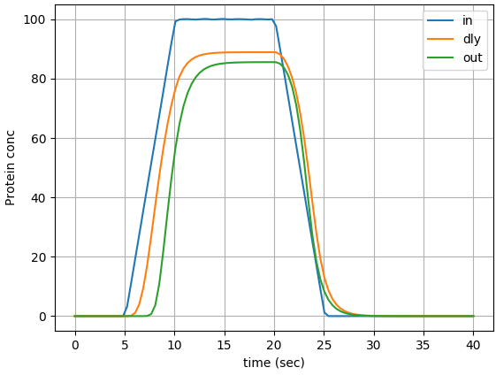
in
dly
out
Output pulse:
shorter than the input
only turns on if the input stays on for a while

Slide 6
Pulse shrinkers are common in cells. Why might we want one?
Any time an action is expensive, and the cell wants to only do it if an input is definitely present.
See Alon page 55 for a nice usage example.
E.coli arabinose pathway: active when arabinose is present but not glucose
Glucose is easier to metabolize (similar to Lac operon)
As E.coli is swimming around, it may pass by transient regions of arab & !glucose – don’t want to turn on the expensive machinery unless the region is big

Slide 7
Next SIM example
in
dly
out
What does this circuit do?
Logically, the output is always zero!
Think in terms of delays again

Slide 8
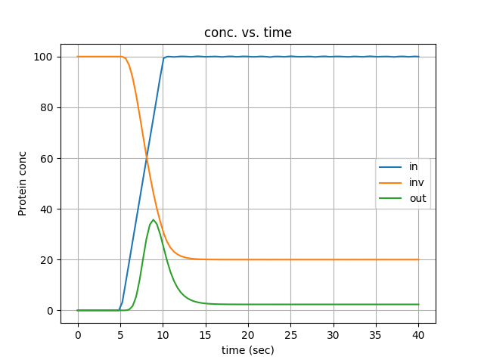
Next SIM example
in
dly
out
Questions:
why might a one-shot be useful?
Will there be a pulse when ‘in’ falls?
How might we get the pulse on ‘out’ to be higher than 35?
What controls the width of the pulse?

Slide 9
But why do we care?
Input arrives:
you create a pulse of an enzyme that builds a structure to deal with the input
enzyme goes away shortly, since the structure will be fully built
And for another example…

Slide 10
JIT
in_d2
out3
in_d1
out2
out1
in
A sequence of buffers, each tap driving a pulse generator.
What do you think it does?

Slide 11
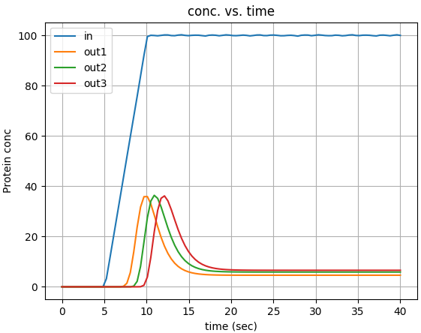
JIT
pulse
generator
out3
in_d2
pulse
generator
out2
in_d1
pulse
generator
out1
in

Slide 12
Just-in-time manufacturing
What is JIT manufacturing?
Each assembly-line input is delivered to the plant just before it is ready to be used
Minimizes warehouse storage space
Plus, some resources might spoil over time
Bacterial-chemotaxis example (Alon):
Bacteria needs to swim to find food, and to change direction when needed
This requires flagella, which self-assemble in multiple steps
Each step requires an enzyme; enzymes appear just in time
Enzymes break down over time

Slide 13
Autoregulation
Autoregulation: a protein serving as its own TF
its own activator → positive feedback. Can make memory (unit #3) or robust oscillators (unit #4).
its own repressor → negative feedback. Let’s see why
LacI
LacI

Slide 14
So what?
Lets the cell robustly control protein concentration
Creates homeostasis
LacI↑ ⇒ more repression ⇒ slower mRNA creation⇒ LacI↓
LacI↓ ⇒ less repression ⇒ faster mRNA creation ⇒ LacI↑
LacI
LacI

Slide 15
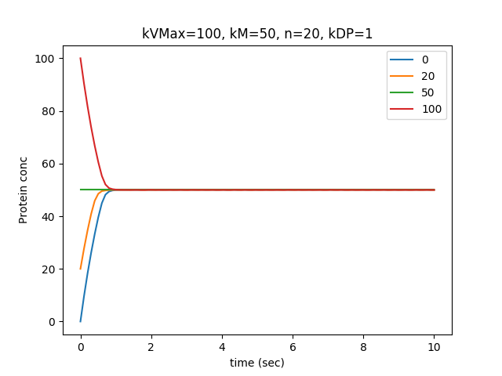
Autoregulation
Multiple sims plotted on one graph
Each sim starts with a different [protein]
Over time, they all reach the same endpoint
Very much like QSS

Slide 16
Autoregulation in nature
E.coli transcription network: 424 nodes, 519 edges
Node = 1 operon. 519 edges is about 100 unique TFs
Mutations are frequent ⇒ every arrow is a miracle ☺
Random connections ⇒ about 1 self loop
E.coli has 40 self loops! (34 are negative FB)
So negative FB must be useful and practical (at least for E.coli)
in
dly
out
in dly out

