Slide 1
ChBe 193/EE 193 Synthetic Biology
Fall 2018
Tufts University
Instructors: Nik Nair, Joel Grodstein
joel.grodstein@tufts.edu
Unit 4: oscillators

Slide 2
What we will learn
What is an oscillator, and why do we care?
Where are oscillators useful?
How to build a good oscillator

Slide 3
What is an oscillator?
Well… something that oscillates ☺
on… off… on… off… on… off…
Example:https://www.youtube.com/watch?v=Ce-bqtaGlvw

Slide 4
Examples of oscillators
Can you think of some oscillators in biology?
Control your heartbeat (do you think this is a GRN?)
Circadian rhythms (circa de = about a day)
We’ll see other applications shortly; most digital systems use a clock, to keep the pieces aligned
Circadian cycle in humans is quite complex
Originally thought to be 24 hours, then 25, and now 24
Must be entrainable (your body readjusts after jet lag). We will learn to build entrainable oscillators.
Even cells that don’t see sunlight must sync to the cycle
2017 Nobel prize in medicine
Jeffrey Hall, Michael Rosbash and Michael Young
Drosophila circadian rhythm
https://qz.com/1095294/2017-nobel-laureate-jeffrey-hall-left-science-because-he-ran-out-of-funding/

Slide 5
The simplest oscillator
1
1
P
0
0
How it works
Assume P starts at 0
Inverter with input=0 → output=1
Inverter with input=1 → output=0
Inverter with input=0 → output=1

Slide 6
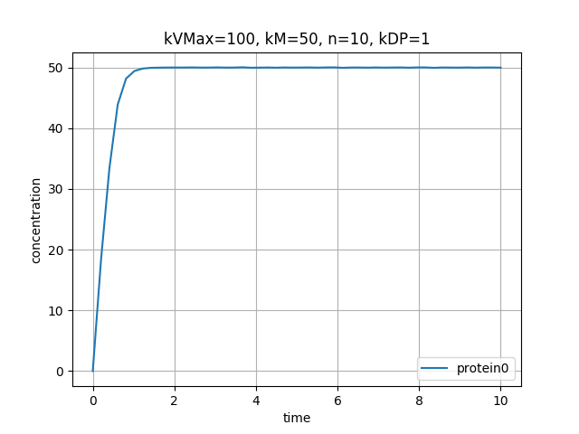
Simulation
Let’s simulate our “simplest oscillator”; one_inv()
Questions:
Did it oscillate?
Any ideas why not?
How different is this circuit from our negative-feedback circuits for setting a fixed [P]?
P

Slide 7
Oscillators and showers
My upstairs shower oscillates
Moral of the story: delayed feedback is good (if you’re building an oscillator)
Notes:
but bad if you want to take a relaxing shower!

Slide 8
Simulation and DFQ
Our simulator is actually doing a numerical solution to a DFQ, given an initial value
$\frac{d\left[P\right]}{dt}=k_{vMax}\frac{1}{1+{\left(\frac{\left[P\right]}{k_{M}}\right)}^{N}}−k_{DP}\left[P\right]$
If we had more than one metabolite, we would have a system of DFQ (with variables [P₁], [P₂], …

Slide 9
Intuitive math
[P]
time
We would like our oscillator to oscillate (as above)
Note that, unlike math, our [P] can never be negative ☺
Can the DFQ $\frac{d\left[P\right]}{dt}=k_{vMax}\frac{1}{1+{\left(\frac{\left[P\right]}{k_{M}}\right)}^{N}}−k_{DP}\left[P\right]$ do that?
Really, it’s just $\frac{d\left[P\right]}{dt}=f\left(\left[P\right]\right)$.
Look at the two red points. Both have the same [P] – but different slopes. But no function f([P]) can do that!
A system of equations with just one state variable cannot oscillate.

Slide 10
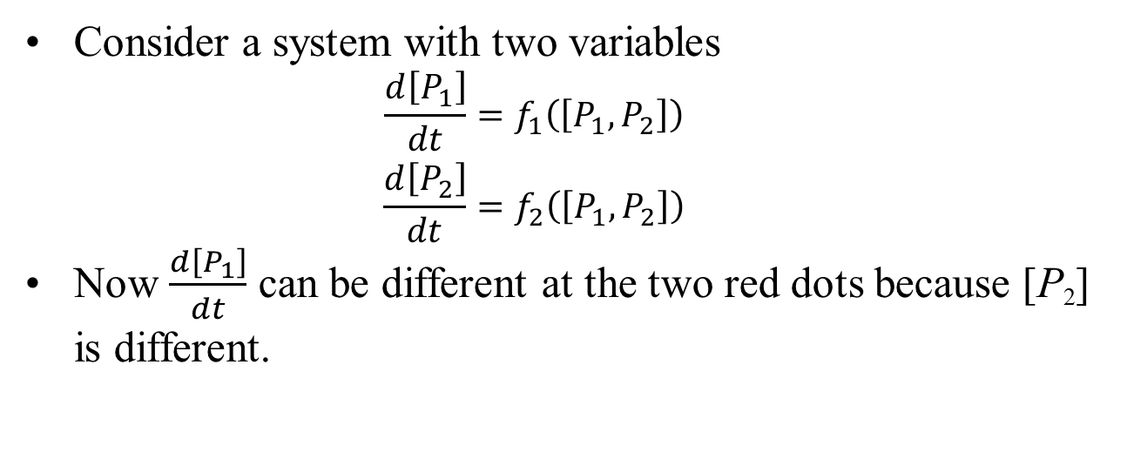
Intuitive math
[P₁]
time
Consider a system with two variables
$$\begin{matrix}\frac{d\left[P_{1}\right]}{dt}=f_{1}\left(\left[P_{1},P_{2}\right]\right) \\ \frac{d\left[P_{2}\right]}{dt}=f_{2}\left(\left[P_{1},P_{2}\right]\right)\end{matrix}$$
Now $\frac{d\left[P_{1}\right]}{dt}$ can be different at the two red dots because [P₂] is different.

Slide 11
Loop gain
P₁
P₂
[P₁]
[P₂]
time
Random noise generates a little sine wave at P₁
It gets inverted (with a bit of delay) at P₂
We get more delay through the buffer
If the red signal is
in sync with the blue, and
amplified relative to blue,
then random noise will create bigger and bigger oscillations; if not, it will die out

Slide 12
What frequency will oscillate?
P₁
P₂
[P₁]
[P₂]
time
Start with the original blue signal
Invert it to get the green signal
Delay it by one phase
Now it’s in sync again
Conclusion: delay around the loop will be one phase of the oscillator period – i.e., T_{C} = 2 * loop_delay
Random noise occurs at lots of frequencies – but only one will oscillate
If the system has loop gain > 1at that frequency

Slide 13
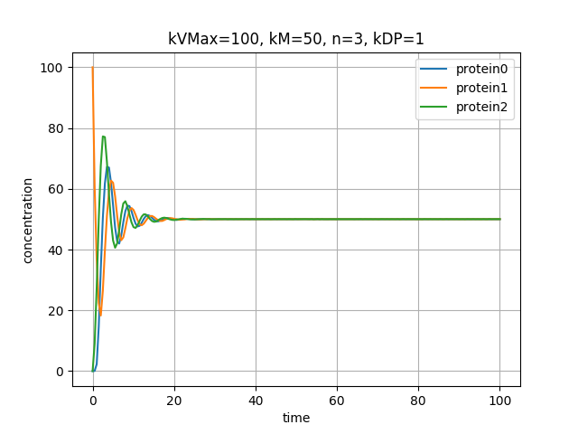
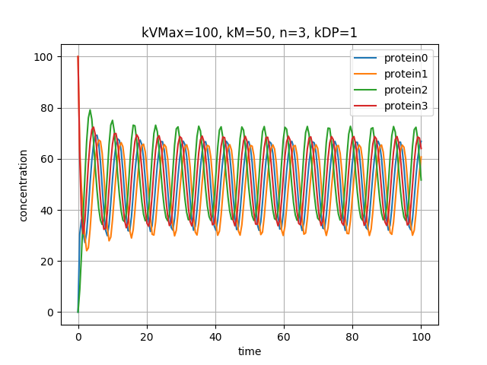
Example
P1
P2
P3
P1
P2
P3
P4
Run inv_bufs()
Extra buffer gives more delay & more gain

Slide 14
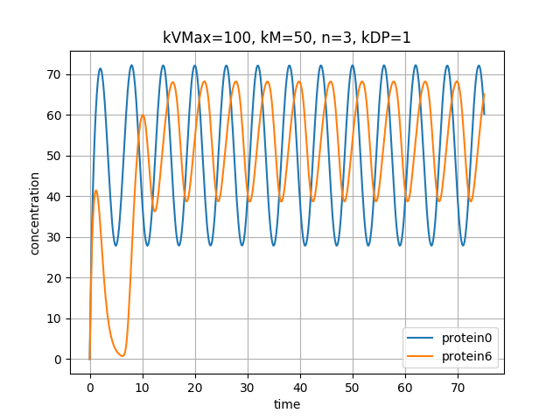
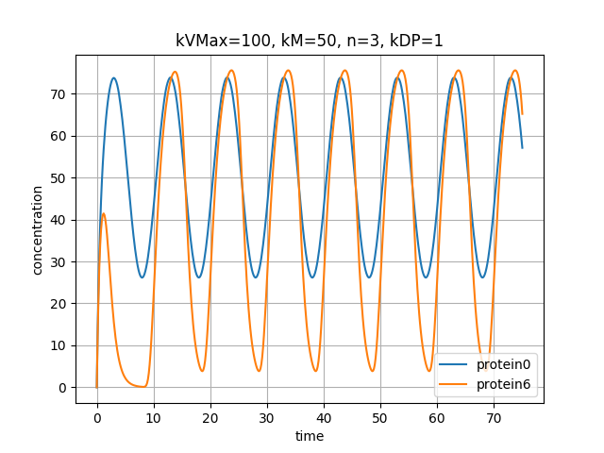
Input period = 6s
Circuit: a sine wave generator driving a chain of buffer + 5 invs
Same circuit, two different sine-wave inputs.
Circuit gain depends on input frequency!
Shower criterion (need delay) is about the same as the loop-gain criterion
Input period = 10s

Slide 15
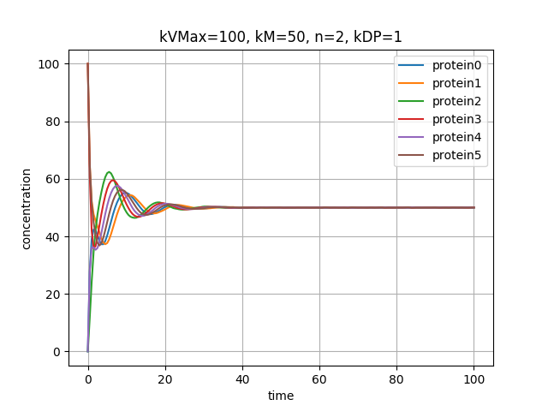
Without enough gain…
P1
P2
P3
Parameters:
6-long chain
Each gate has N=2
Each gate has gain < 1; cascading them is not enough!
P4

Slide 16
Repressilator
We’ve built something very much like the repressilator
Any real difference?
Not much, in principle
Any even number of oscillations will cancel out
The repressilator was the first “successful” synthetic oscillator
A synthetic oscillatory network of transcriptional regulators, Elowitz 2000

Slide 17
Drosophila circadian clock
enters nucleus
PER∙TIM
kinases, phosphatases
CLK∙CYC
CRY
PDP1, VRI, PER, TIM
CLK
See, e.g., The molecular ticks of the Drosophila circadian clock, Emery 2015
Light activates CRY, which degrades TIM
PER and TIM heterodimerize when activated by kinases
The main loop is negative FB; the various reactions and travel add delay and gain
Notes:
The kinates add a phosphate group; the resulting energetic versions of PER and TIM can thus dimerize. The phosphatases help them un-dimerize.
The effect of PER.TIM is just to deactivate the CLK.CYC transcription factor; it’s not actually a TF itself.

Slide 18
Drosophila circadian clock
enters nucleus
PER∙TIM
kinases, phosphatases
CLK∙CYC
CRY
PDP1, VRI, PER, TIM
CLK
Nice picture, but it’s not enough
How do we entrain cells that cannot see the sunlight?
Human red blood cells have circadian rhythm, but no nucleus (PMLS page 278)
In mammals, 20K neurons are a central oscillator that send signals everywhere
Drosophila is thought to have some neural control; I don’t believe it’s settled yet

Slide 19
Entrainment
We’ve built an oscillator
Our body has lots of little oscillators
Sinoatrial node in the heart is about as big as a fingernail
How does a football team with 10M random players get anything done?
https://www.youtube.com/watch?v=HFwSnqYC5LA

Slide 20
Entrainment
What is it and why do we care?
Our 24-hour circadian clock can tick indefinitely in a dark room
But it can also adjust itself perfectly well as the days shorten in winter
And adjust itself to a jet flight (after a few days)
Different cells in our body (even those that cannot see sunlight) must work together; it helps if their clocks are reasonably coordinated
Your heart works by entrainment (but it’s electrical)

Slide 21
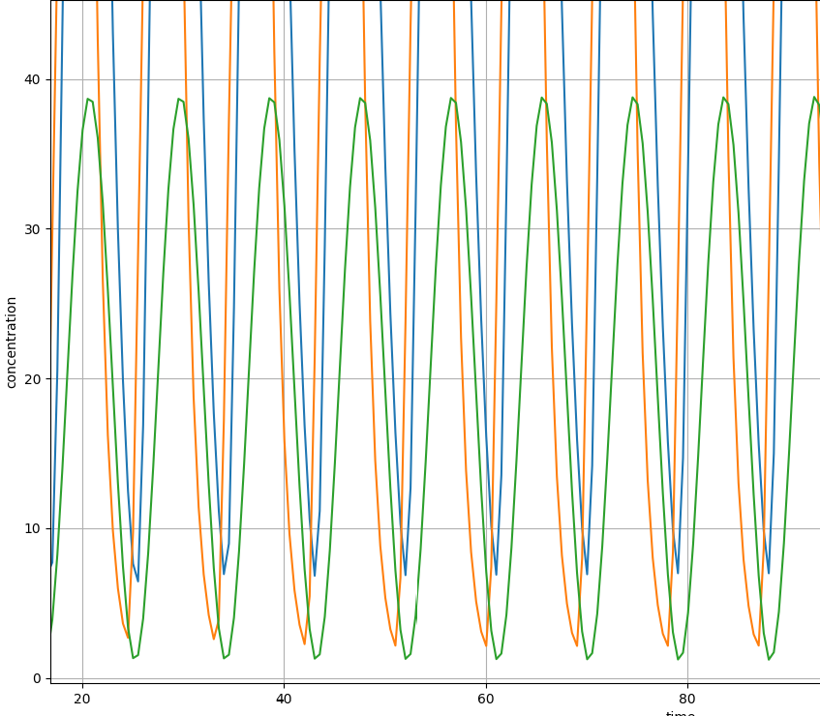
Entrainment simulation
ref
P1
P2
P3
P4
P5
Driver (green): period=9.5s
Oscillator P1=blue, P5=orange
natural period = 8s
would not entrain at driver=10s
Notes:
We can tell if the ring oscillator entrains by looking at protein5 vs. ref. Do they sync up and maintain the same delta-t between their peaks, or do they move cyclically around each other?
Note that the two sine-wave drivers drawn above have different implementations. The one driving ‘ref’ drives whatever current is needed to keep ref’s concentration following the sine wave. The one below that drives a sine-wave amount of current, and lets the resulting concentration be whatever the multiple sources produce.

Slide 22
Intuition of entrainment
P1
P2
P3
P4
P5
Assume the driver is ahead of the oscillator P1
Driver rises when the osc. P1 is still 0
Driver creates P1 ⇒ helps the oscillator node rise faster
Oscillator starts to sync to the driver
oscil.
driver

Slide 23
Intuition of entrainment
P1
P2
P3
P4
P5
Driver is ahead of the oscillator… continued
When the oscillator falls, the driver P1 is already 0
Driver thus does not affect this edge
Net effect: rising edges help move oscillator earlier
oscil.
driver

Slide 24
Intuition of entrainment
P1
P2
P3
P4
P5
Now assume the driver is behind the osc.
When the oscillator rises, driver P1 is still 0
So it has no effect on the oscillator
oscil.
driver

Slide 25
Intuition of entrainment
Driver is behind the oscillator… continued
When the oscillator falls, driver P1 is still 1
So the driver slows down the oscillator falling
oscil.
driver

Slide 26
Drosophila circadian clock
enters nucleus
PER∙TIM
kinases, phosphatases
CLK∙CYC
CRY
PDP1, VRI, PER, TIM
CLK
In the circadian clock, CRY degrades TIM; our driver degrades rather than creates.
Still similar; now the driver can speed up falling edges and slow down rising edges rather than vice versa.

Slide 27
Quorum sensing
The Stricker oscillator is quite robust. But how do we synchronize the cells?
We could entrain every cell to some master signal (like circadian rhythms)
Let’s just sync the cells to each other.
Here’s our idea (stolen from bacterial quorum sensing):
Each cell has an oscillator
Each oscillator produces some particular molecule M as the oscillator output
M diffuses freely between cells and quickly establishes a global [M]
Each cell’s oscillator entrains itself to [M].
But what molecule should we use for M?
Should we use a protein?
Doesn’t diffuse quickly enough (or, usually, pass through a cell membrane)
Should we use a small molecule?
It can diffuse easily – but usually will not act as a TF.
So what do we do?

Slide 28
Other fun oscillators
Some cicadas emerge from their nest every 17 years
“Biological oscillators range from your once-per-second heartbeat, to … the 17 year cycles of certain insects,”*
How could we possible build an oscillator with a cycle time of 17 years??!!
https://entomologytoday.org/2016/03/22/how-do-cicadas-know-when-to-emerge-from-the-ground
Hypothesis: trigger on a once-per-year event, and count to 17 (they have not yet found the trigger!)
*Physical Models of Living Systems,
Philip Nelson, MacMillan 2014, page 277.

