Slide 1
EE 193 – Embedded Medical Devices
Fall 2023
Tufts University
Instructor: Joel Grodstein
joel.grodstein@tufts.edu
Arduino, uPython and Pi (oh my)

Slide 2
Today’s topic
So many programming environments
Do we need them all? If so, why?
Are there any pros/cons of each?
Case study: DAC in Arduino, MicroPython and the HW

Slide 3
A few players
Arduino, Raspberry Pi
MicroPython, CircuitPython
STM CMSIS, HAL, Mbed
Anyone have experience/comments with these?

Slide 4
Abstraction level
Arduino, Raspberry Pi
CircuitPython
High-level
MicroPython, Mbed
STM HAL
Intermediate-level
STM CMSIS
Low-level
What does that really mean?
Let’s go back to the problem to be solved
There is an endless variety of useful, somewhat-different peripherals
Notes:
On the intermediate level, we’ll see that MicroPython is higher level than HAL (and almost as high as CircuitPython).

Slide 5
Case study: DAC
DAC = Digital to Analog Converter
two DACs on our Disco kit
digital in
0-max
analog out
0-3.3V
DAC
Arduino API: writeAnalog (pin, value)
if pin is a DAC pin (one or two of them), sets voltage
value is in [0,255] (and [0,1023] for analogRead()!)
MicroPython API:
d = dac(pin=1 or 2, bits=8 or 12, buffering=True/False)
d.write (val)
Nothing to it ☺
Notes:
But even at this early stage, it’s obvious that MicroPython seems to give more hardware control than Arduino does.
If you call writeAnalog() with a digital (rather than analog) pin, Arduino will treat it as PWM
Some Arduino boards have API extension functions analogReadResolution() and analogWriteResolution(), letting you pick any resolution at all. It will then left-shift (if, e.g., you set the write resolution lower than the board supports) or right-shift accordingly.

Slide 6
DAC precision
If we set up the DAC in 8-bit mode..
it wants data in [0,255]
What if we give it 256?
What if we give it -1?
If we read a number with an 8-bit ADC and operate on it, how do we know if it’s in [0,255]?
256 = 0x100
-1 = 0xFFFFFFFF

Slide 7
Let’s make it complex
Look at the CSR list for the DAC (reference manual 19.7)
There are 20 CSRs for our “simple” DAC!
Quick look at the first two
DAC_CR (the control register) is complicated!
DAC software trigger register is simple

Slide 8
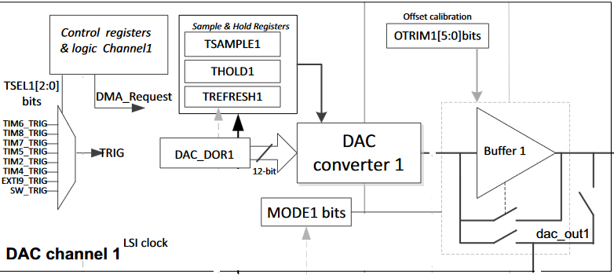
What are those CSRs doing?
“There are gourmets in the art of boiling water…” James Beard?
What is all this?
Notes:
This is from the RM0351 STM32L476 reference manual.

Slide 9
Complexity: sample/hold
The sample/hold is nice to save power
not available on Arduino or MicroPython
Notes:
This is from the RM0351 STM32L476 reference manual.
Go through the features quickly: sample/hold for power savings. Tsample is time for the original sampling after writing a new value to the DAC. Then THold is how long to hold the value in the capacitor; finally, Trefresh is how long to refresh the value (and is typically less than Tsample since the value has only slightly degraded during the holding period).

Slide 10
Output buffer
Output buffer is useful sometimes
not available on Arduino
MicroPython d = dac(…, buffering=True/False)
Notes:
The output buffer gives a lower output impedance, but more nonlinearity.

Slide 11
Economics
You don’t have to use these features
but you’ve already paid for them!

Slide 12
Programming CSRs is annoying
Learning, programming those CSRs is annoying
like working in assembly
Arduino seems like a big value added, right?

Slide 13
Triggers and DMA
Arduino doesn’t seem to use all of the HW
Triggers and DMA unused. Are they just fluff?
Let’s look at another use model

Slide 14
Our own function generator
Goal: drive out a sample ECG waveform to a pin
Remember why it’s useful (lab #6)?
Notes:
It was useful since (a) the students had the convenience of not needing to hook themselves up to the leads. But more importantly, it gate the ECG waveform total repeatability – which greatly improves debuggability.

Slide 15
Canned ECG driver on Arduino
Here’s an Arduino version
for (int i=0; i<1024; ++i) {
analog_write (DAC_out_pin, ECG_array[i]);
delay(1); // 1ms
}
Any issues with this code?
Spin wait in delay() uses the whole CPU!
Any suggestions?
Arduino doesn’t make threads easy
Interval between points is >1ms
Any ideas why?
Notes:
With this code, we cannot also use the CPU to, e.g., analyze your ECG! We would need a dedicated CPU for just this.
And the interval between points is only 1ms if the time for analog_write() is zero.

Slide 16
Canned ECG driver with FreeRTOS
Can we do better with FreeRTOS?
Brainstorm how
void task_synthesizer (…) {
int i=0;
while (1) {
write_to_DAC (1, ECG_array[i]);
if (++i == 256) i=0;
vtaskDelay(1);
}
}
What are its limitations?
Notes:
It only runs up to 1KHz, which is fine for an ECG but not great for music synthesis.

Slide 17
Canned ECG driver in HW
But we still haven’t used the triggers or DMA
Our canned ECG generator can do even better
Notes:
Yes, we can build an ECG generator with FreeRTOS. But even that takes some CPU time. We can actually do it with zero CPU overhead!

Slide 18
Canned ECG driver in HW
STM32L476 has hardware timers
Program a timer to fire every 1ms, trigger the DAC
Program DMA to send a new array value each time
What’s the advantage of this over FreeRTOS?
Notes:
Yes, we can build an ECG generator with FreeRTOS. But even that takes some CPU time. We can actually do it with zero CPU overhead!

Slide 19
Canned ECG driver
No way that’s available in Arduino
MicroPython
DAC.write_timed(data, freq, mode=DAC.NORMAL)
Notes:
It turns out that even this MicroPython call doesn’t use the full strength of the HW; it forces both DACs to run at the same frequency. And it’s interrupt driven rather than DMA driven, so it doesn’t use the full power of the HW.

Slide 20
Hmm…
OK, the CSRs do seem useful
Do we dump Arduino and program the CSRs?
But wait…

Slide 21
What’s in an STM32L476?
From the data sheet:
Arm 32-bit Cortex-M4 CPU with FPU
5 clock sources, up to 114 fast I/Os
real-time clock
LCD controller, up to 24 capacitive touch-key sensors
16x timers, 4x digital filters
3x 12-bit ADC, 2x 12-bit DAC, 2x op-amp
USB OTG, 3x I2C, 5x USART, 3x SPI, …
Numerous variations!
L4XX has 34 variants
L476XX has different numbers of GPIO, …

Slide 22
Who does what
ARM designs the core
STM licenses it (for a fee); adds its own peripherals
So does Infineon, Apple, Cypress, Microchip, …
Each wants to show their value-added
Many power/speed/uarch/price points of the core
Numerous combinations of cool peripherals
But we only want to pay ($$ and watts) for what we use

Slide 23
Classical CSR programming
Look at the CSR list for the DAC (reference manual 19.7) again
There are 20 CSRs for our “simple” DAC!
Quick look at the first two
DAC_CR (the control register) is complicated!
DAC software trigger register is simple

Slide 24
Classical CSR programming
To take 100% advantage of the hardware’s full power, we must program these CSRs
Classical process
Read the data sheet
Figure out which CSRs to access
Write the code
Debug your mistakes

Slide 25
Classical CSR programming
Pull up the code for our lib_ee115.c LED functions
Isn’t it nice? You don’t have to bother looking up those CSRs!
Oops! That’s how I spent my summer ☹
Notes:
This statement isn’t quite truthful. Actually, I stole much of the code from the EE14 textbook, and then just commented it myself.

Slide 26
Portability
What if we switch from STM32L476 to STM32L432?
“Most” of the CSR’s are the same ☺
Not all! ☹
Why the chip-to-chip differences? How come STM cannot impose consistency between their own products?
Different product lines built by different teams who don’t talk to each other
Engineers come up with a great new idea and don’t value compatibility “enough”
Marketing (i.e., customers!) want feature tweaks
Notes:
STM32L432 is the Nucleo board that we’ll probably switch to next year.
A “product line,” in STM-speak, is all of the 32F4xx chips.
There’s nothing that locks in a large hesitant customer better than giving them a feature that they want – no matter what it does for long-term product-line maintainability.
I do *not not not* plan on totally rewriting lib_ee115.c next summer. I’ll just use HAL.

Slide 27
CSR hell
Rewriting lib_ee115 for a different STM chip is WORK
And what if we switch from STM to Espressif?
Almost total rewrite.Yikes!

Slide 28
As a product designer, why don’t you just pick an MCU and stay with it?
New chips appear all the time
You want to play one manufacturer against another
Remember those chip shortages?

Slide 29
What’s the answer?
Program using every trick in the book and every bit in every CSR?
Takes forever
Use an abstract API, like Arduino?
You’re leaving hardware power on the table
May be forced to use a more expensive microcontroller
Any other ideas? Go brainstorm. Is there an analogy to assembly-language programming?

Slide 30
Analogy
Sounds a bit like programming in assembly language in the old days?
HLLs didn’t give good enough performance
Switching to a new computer was hard back then!
Nowadays, it’s just a simple matter of writing portable code ☺
How good is this analogy?

Slide 31
Choices today
Arduino and Pi
Great for fast prototype; not for industry production
Great for hobbyists
Programming CSRs
the ultimate in performance as long as you don’t mind delivering your product late
Good for university classes ☺
STM HAL
a mid level between Arduino and CSRs
not completely portable between STM product families
Cube MX: graphically generate initialization code (in HAL) for STM32 devices
Cannot generate anything other than initialization code

Slide 32
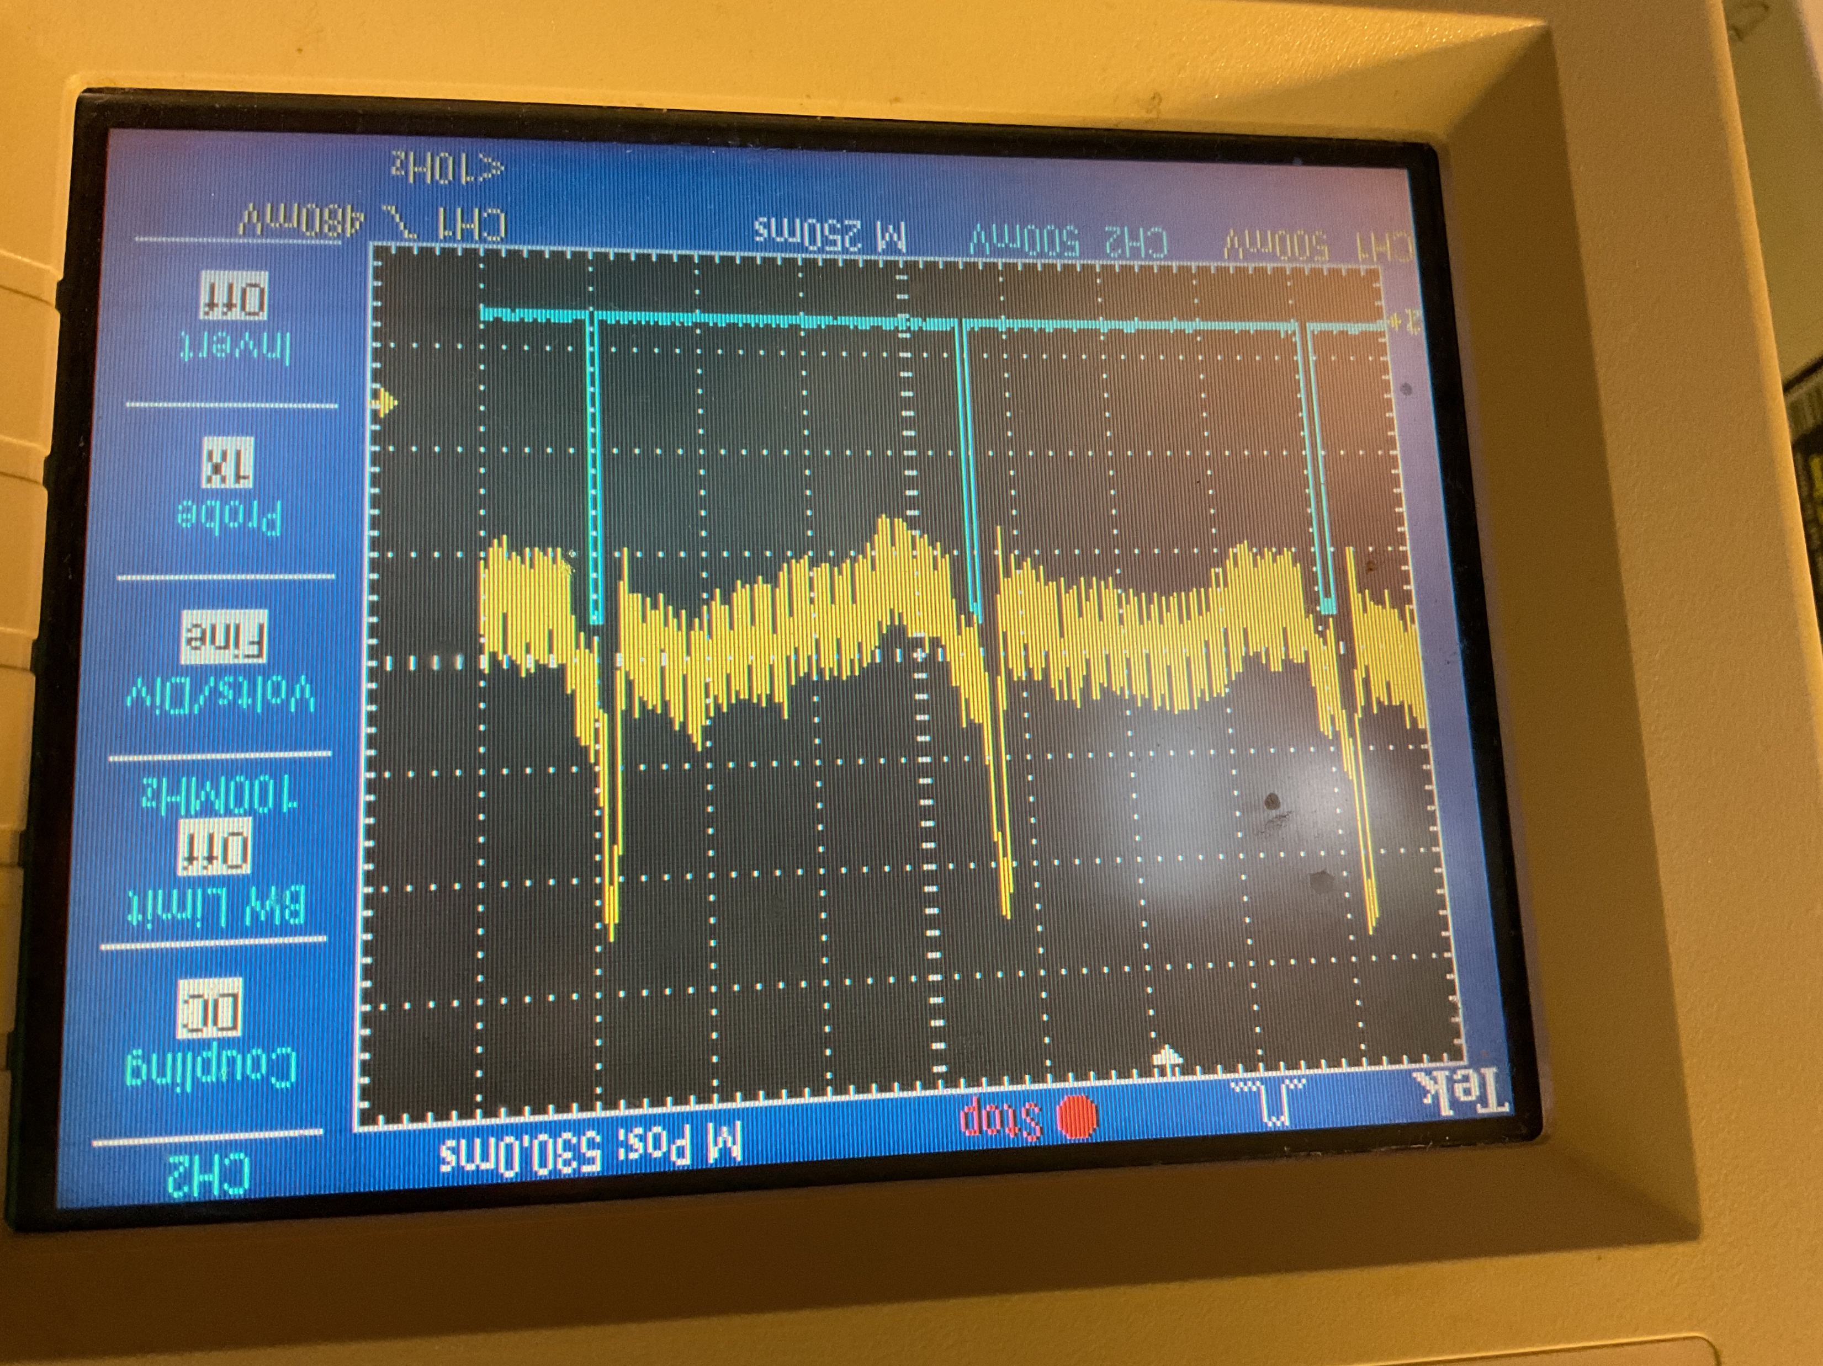
dual_QRS
500mV/div, 250ms/div

Slide 33
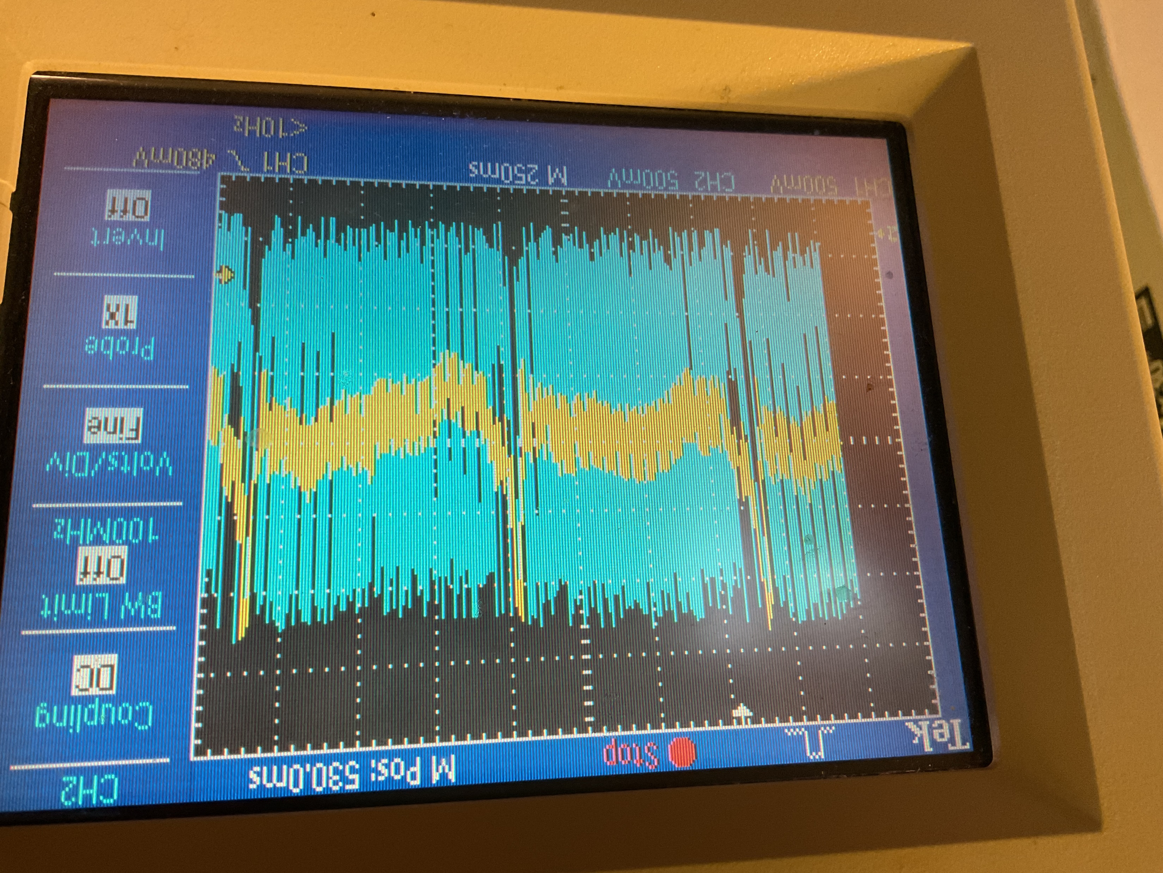
sample_1
500mV/div, 250ms/div
Notes:
divided by 2

Slide 34
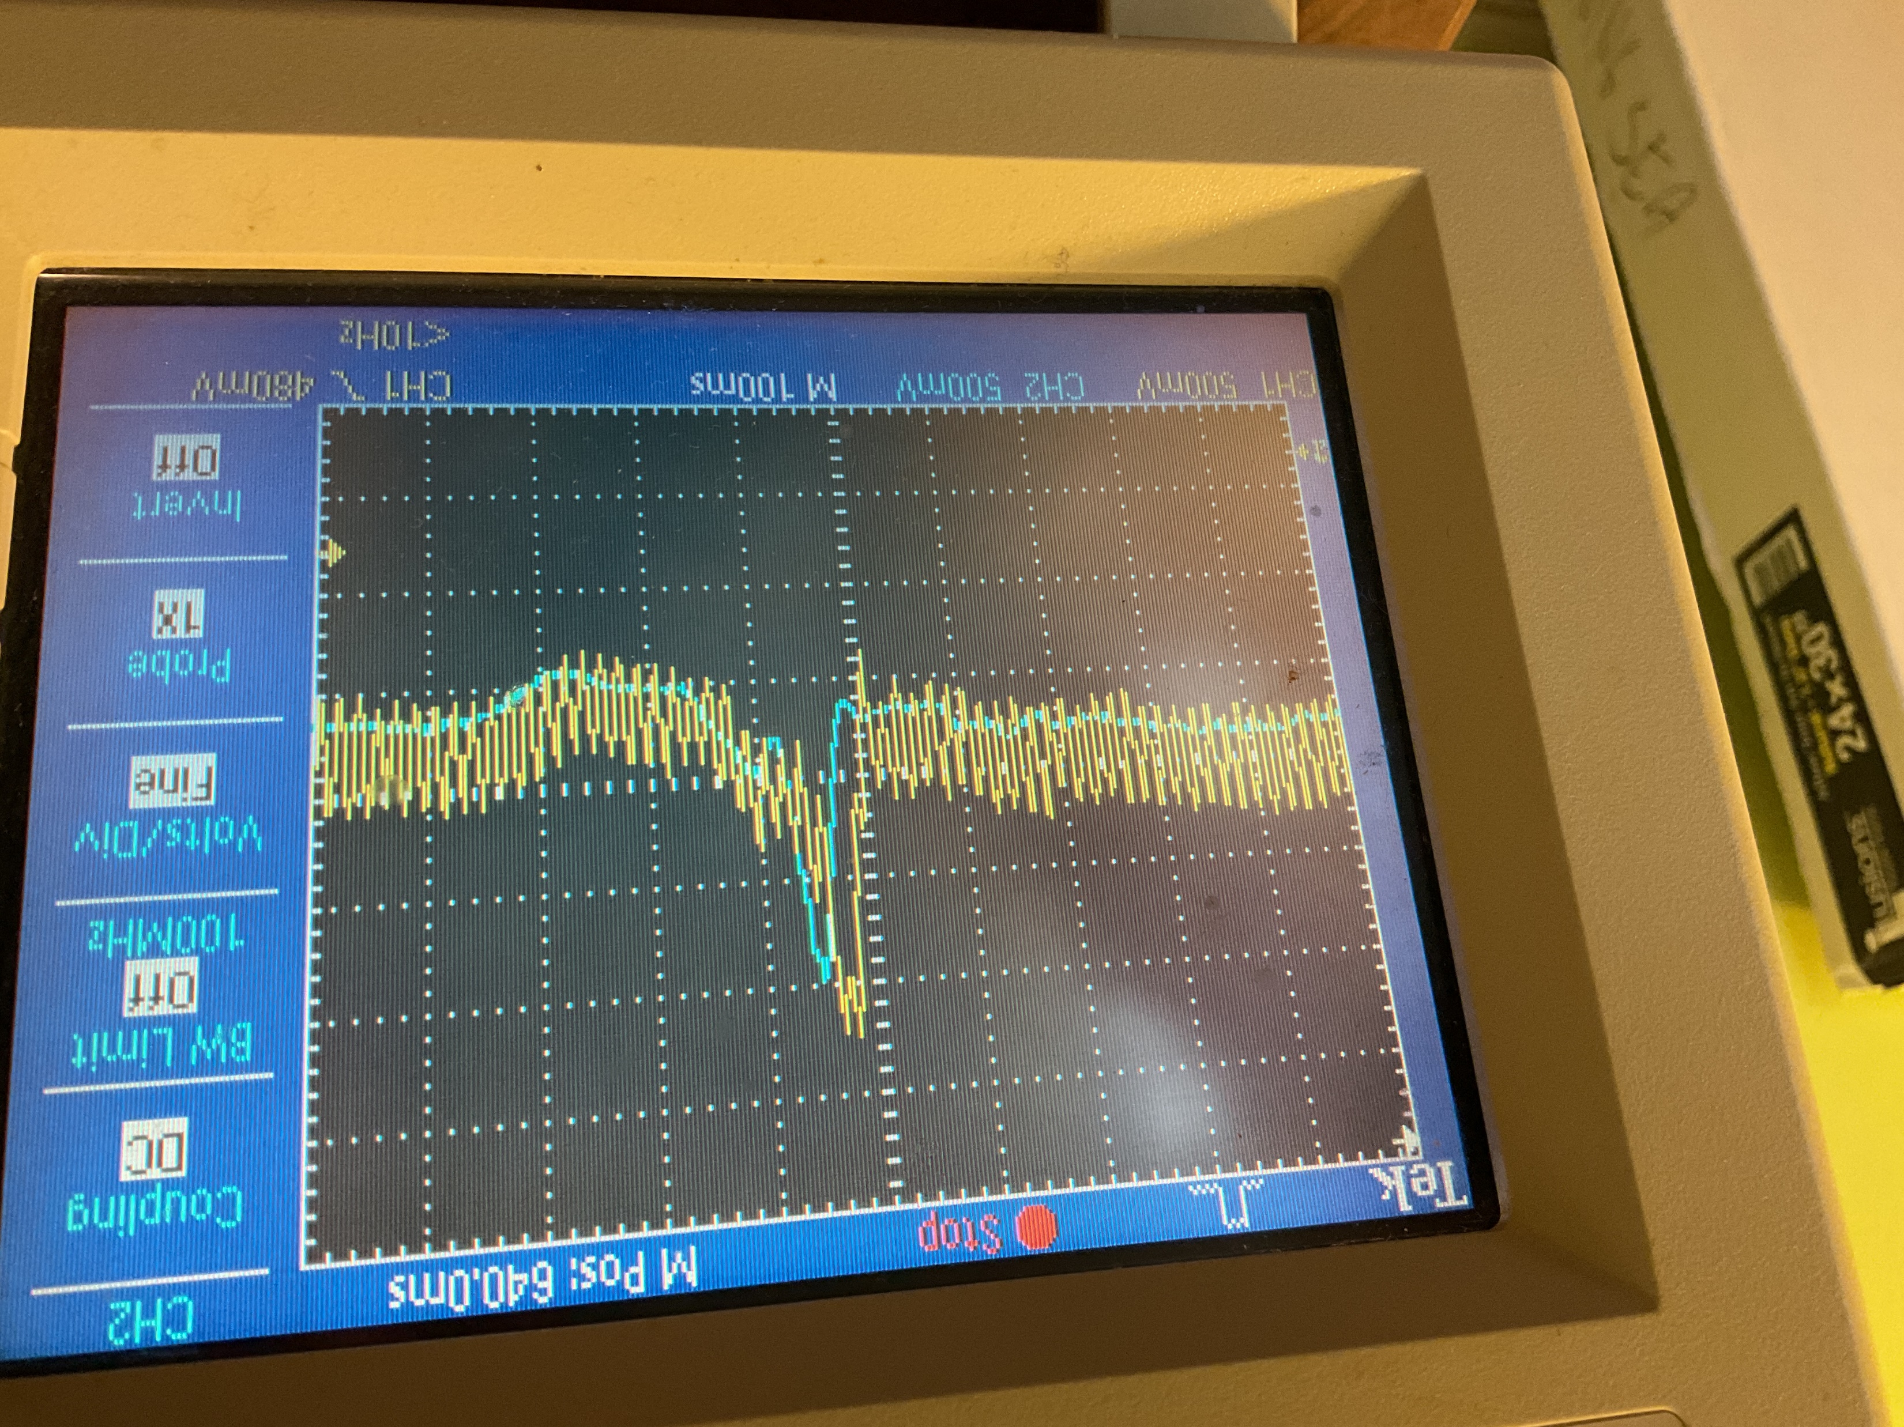
filtered_1
500mV/div, 250ms/div
Notes:
divided by 2

Slide 35
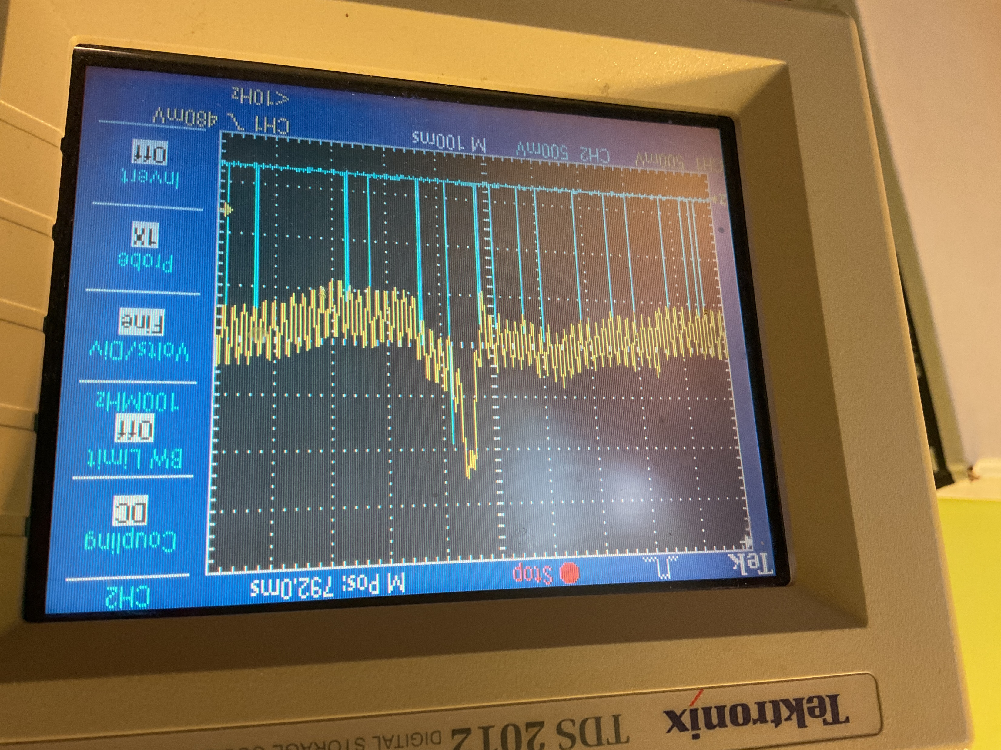
peak_1
500mV/div, 250ms/div
Notes:
divided by 2

Slide 36
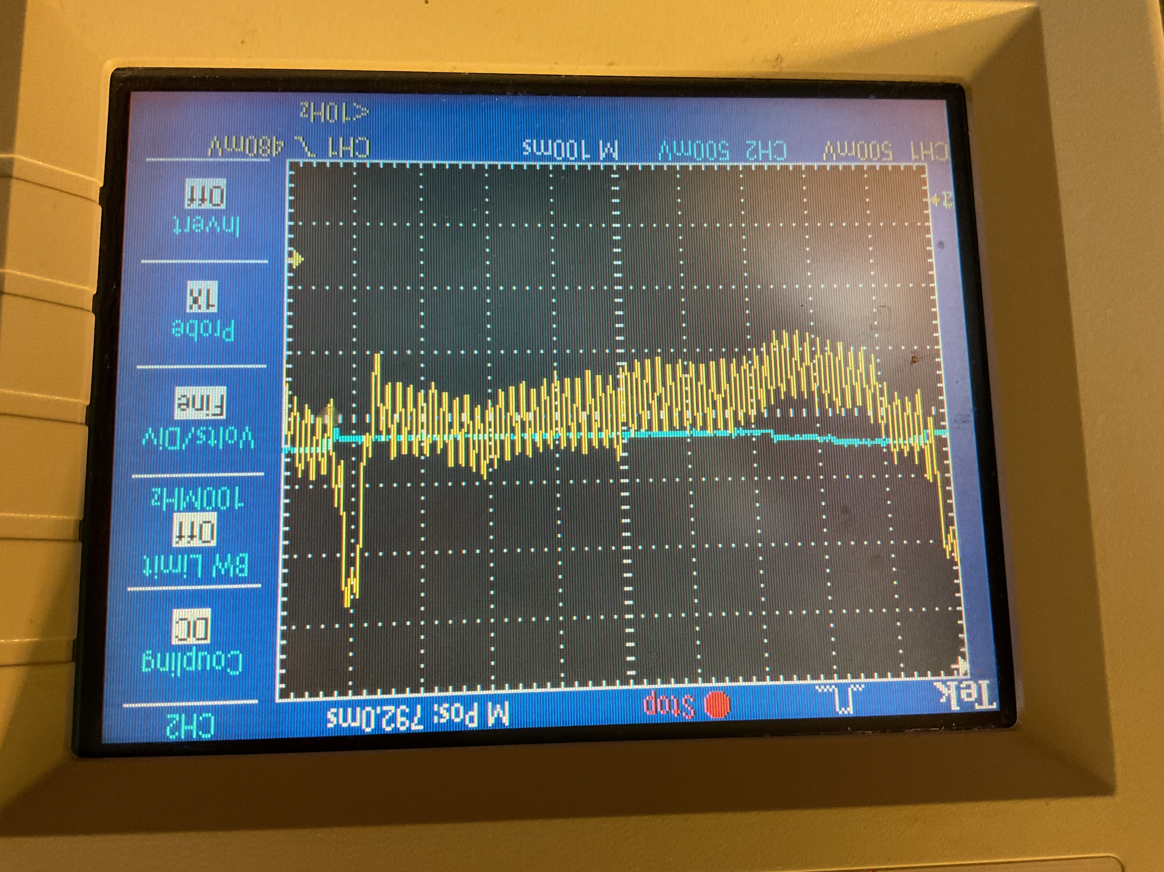
thresh_1
500mV/div, 250ms/div
Notes:
divided by 2

Slide 37
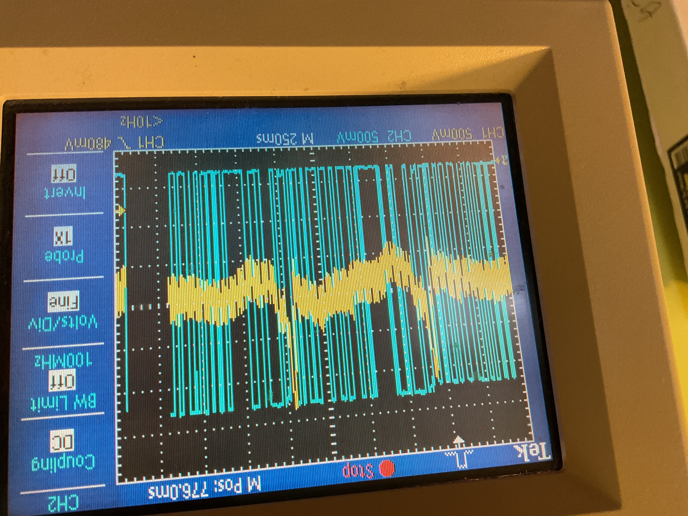
deriv_2
500mV/div, 250ms/div
Notes:
divided by 2

Slide 38
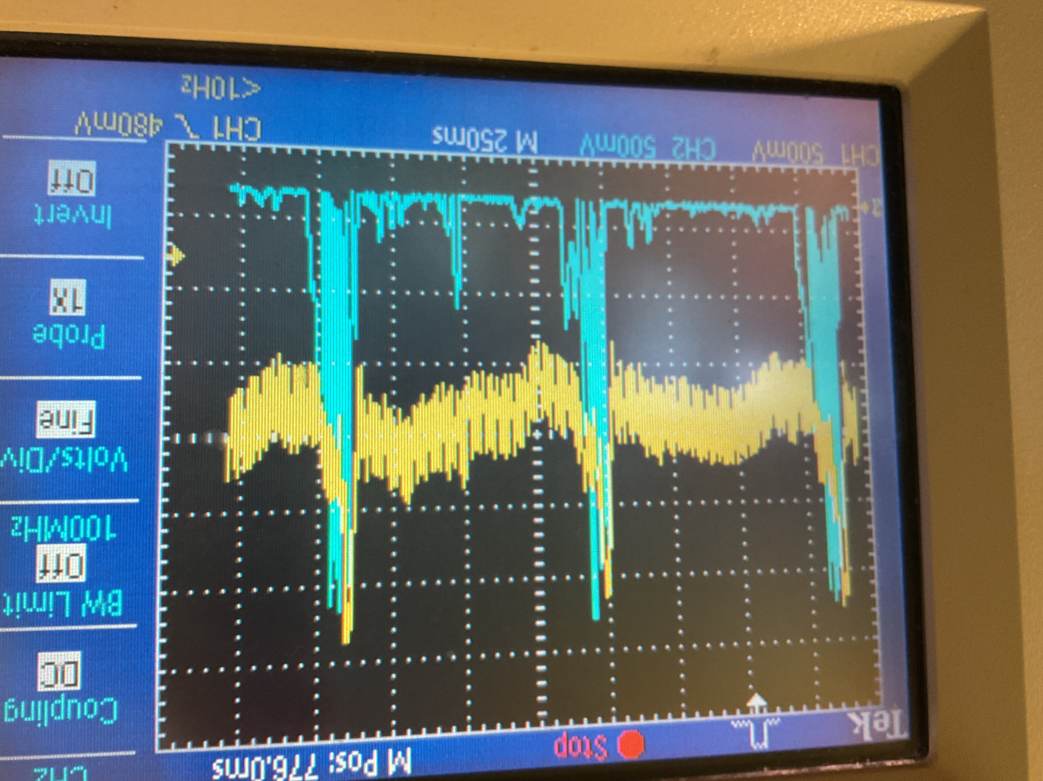
deriv_sq_2
500mV/div, 250ms/div
Notes:
divided by 2? Maybe 4.

Slide 39
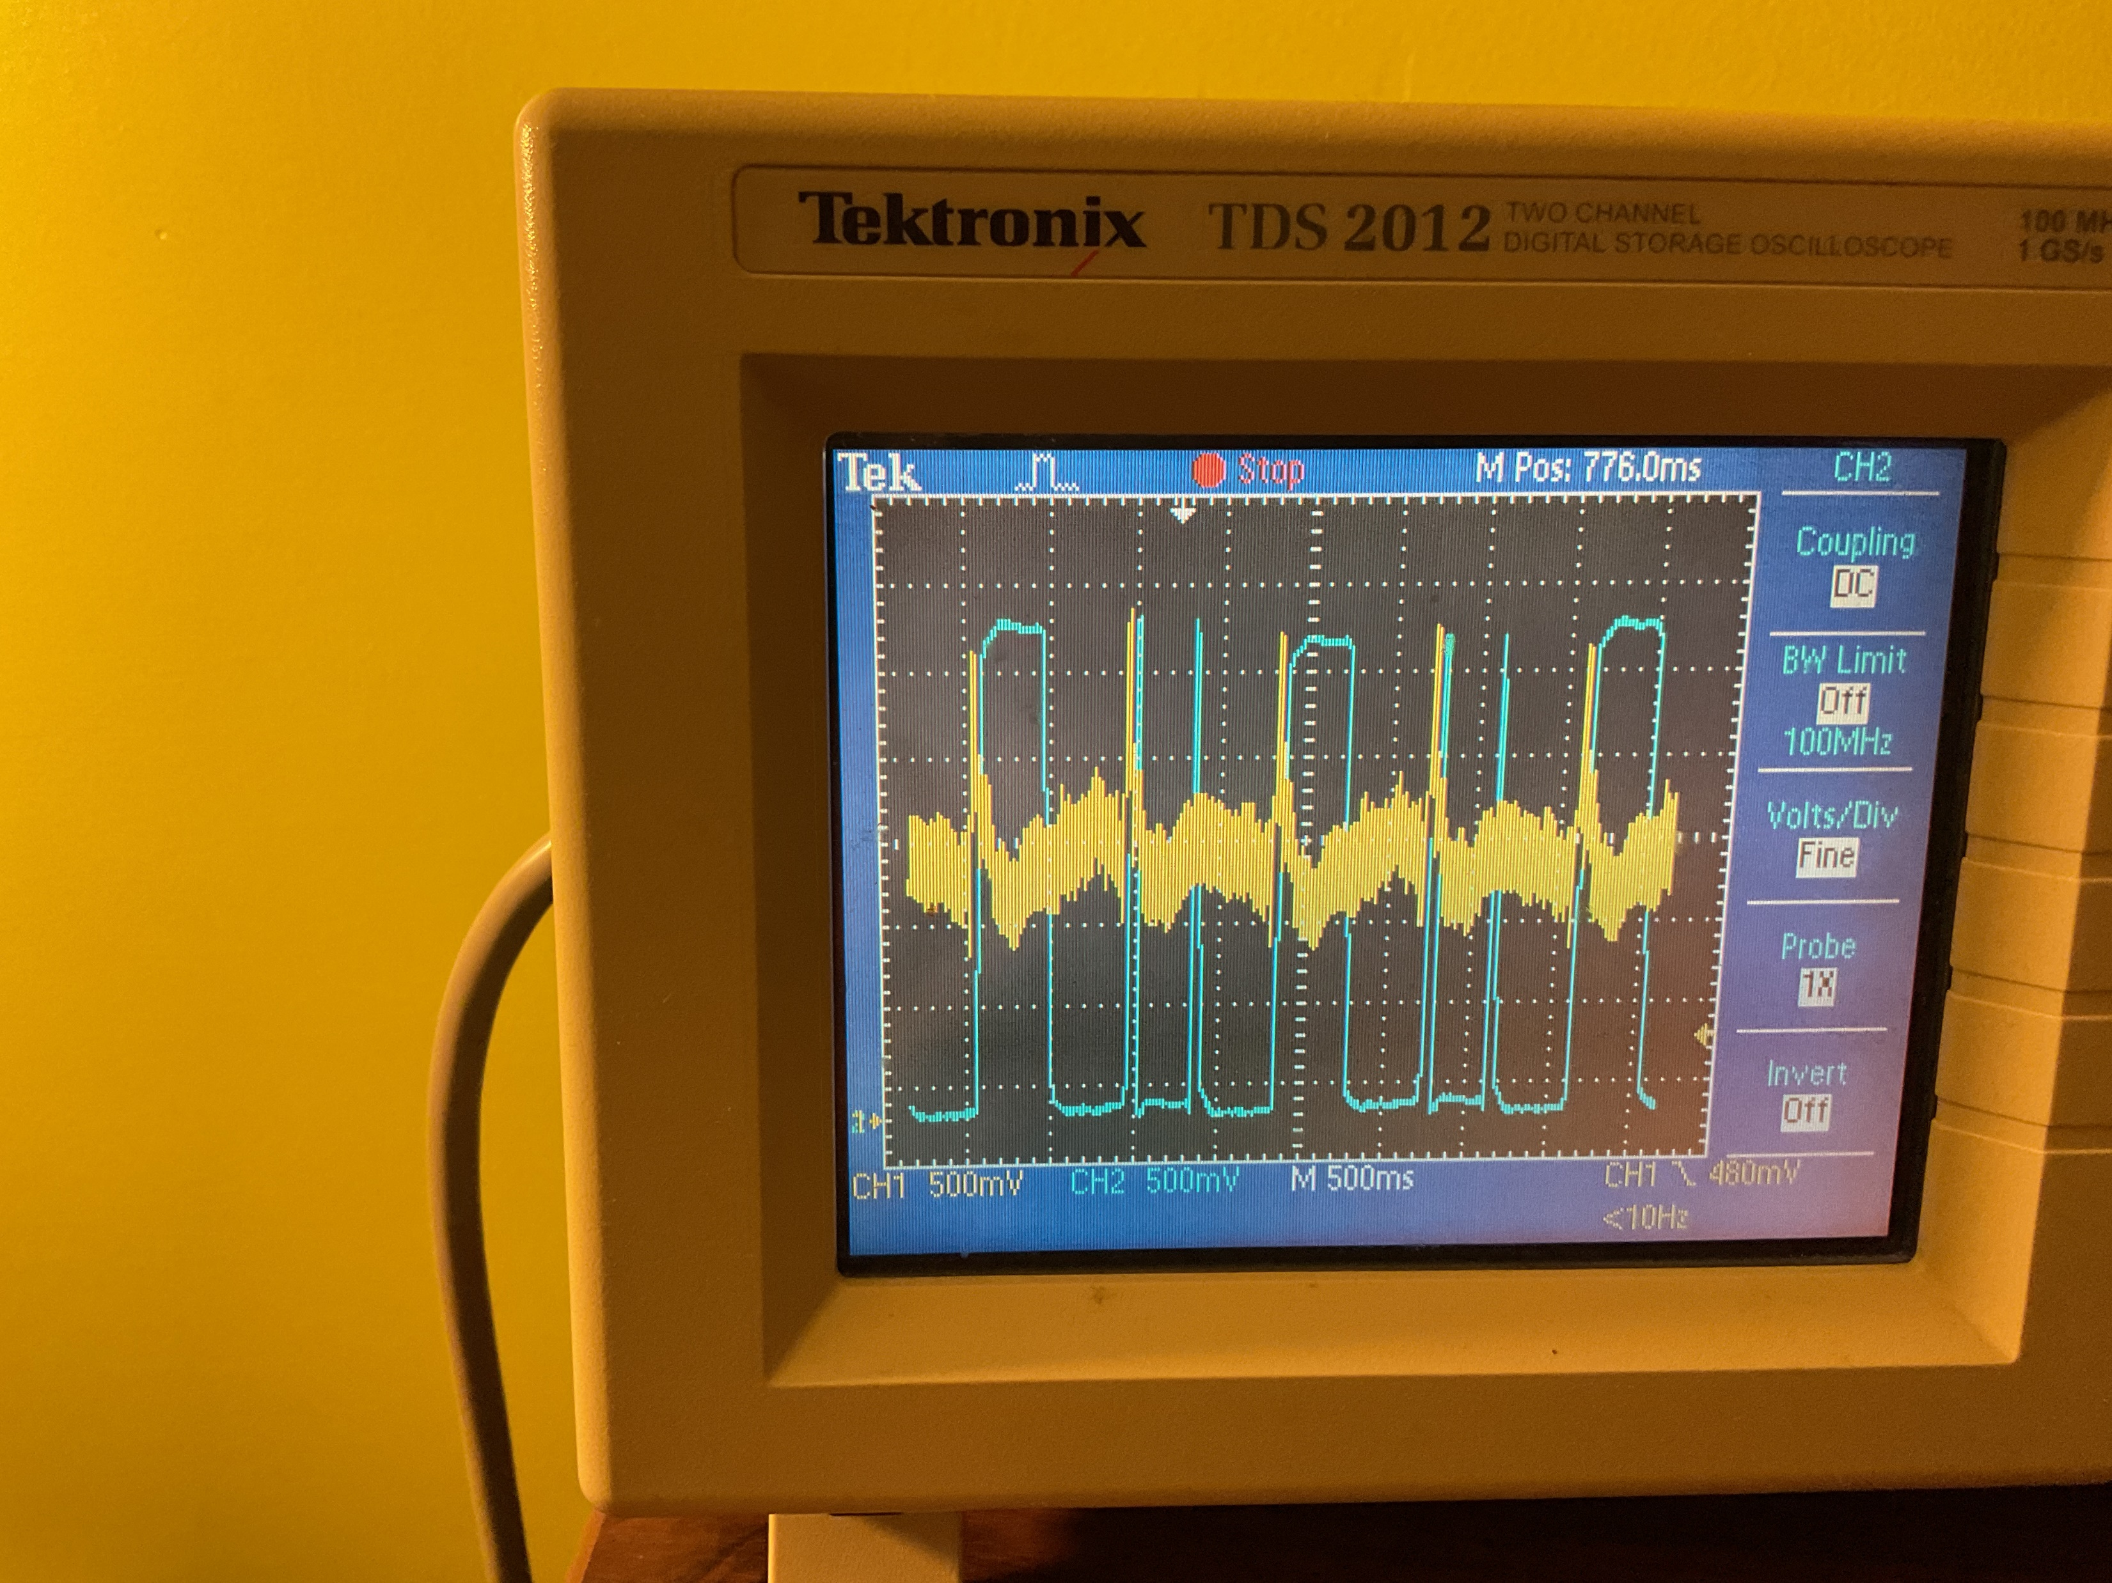
avg_200ms_2
500mV/div, 250ms/div
Notes:
divided by 4

