Slide 1
Wavelet Transform

Slide 2
What motivated the Wavelet Transform(WT)? A problem with the Fourier Transform(FT)
The Fourier Transform is time independent!
Meaning, the FT can only tell you what frequencies are present in your entire signal, not WHEN those frequencies occur.

Slide 3
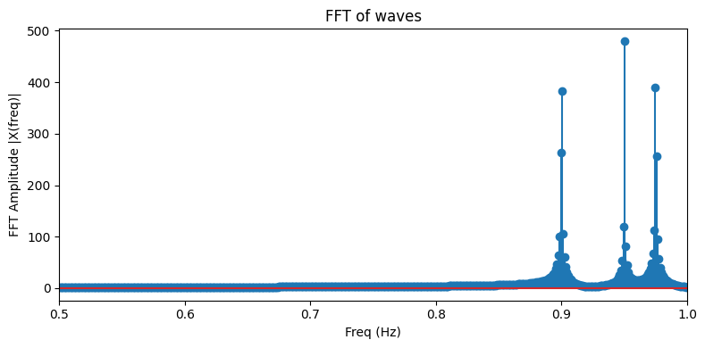
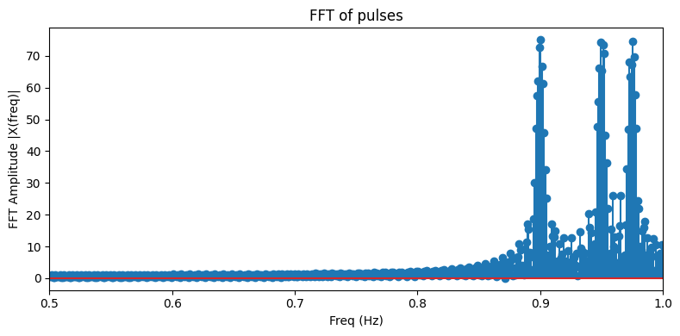
The Wavelet Transform (WT) was created to overcome a shortcoming of the Fourier Transform (FT): The FT gives only frequency content of a signal, no time content. One cannot tell when a frequency occurs from a FT
Stationary Signal
Dynamic signal
These 2 different signals produce approximately the same FT!

Slide 4
Wavelet Transforms: a solution to the time independence of the FT
Wavelet Transforms were made to solve a big shortcoming of the FT. A FT produces approximately the same results for stationary and dynamic signals, in other words, FTs give no temporal information about a signal.
Another way of phrasing this idea: the FT allows you to either be in the time domain or the frequency domain, not both.
But… What if we could have information simultaneously from the time and frequency domain?? Enter Wavelet Transform.

Slide 5
Why should you care???
Biological signals are almost always dynamic
When designing medical devices, a prime concern is knowing how and when signals change
Wavelets allow you to have frequency and time information about a signal.

Slide 6
What does the wavelet transform give us that the FT doesn’t? The WT gives Time and Frequency information about a signal! Whereas the FT gives only frequency information. The continuous wavelet transform (CWT) produces a scalogram: time on the x-axis, frequency on the y-axis, amplitude of frequency on the z-axis (color axis)
Stationary Signal
Dynamic signal

Slide 7
The main idea behind the Wavelet: A transform that allows insight into both the time and frequency content of a signal
However, in order to know how to use the WT well, some knowledge on how it works is necessary.
Note: Wavelet theory is a bit hard to understand, so don’t worry if it takes several times of exposure to get comfortable with these concepts

Slide 8
Convolution, the mathematical operator of signal matching. For symmetric signals
Convolution allows you to “Find” a target signal within your larger signal.
Example: say you want to detect anything that looks like a square in your signal
You would convolve a square with your signal, and the result would have peaks whenever a square is present in your signal
The result of a convolution is a function. At each point, the function is equal to the overlap between the 2 input signals. In this case, the amount of overlap of the square with the rectangle is the graph on the bottom: the result of the convolution

Slide 9
Start with Fourier: Convolution with a sin wave If your signal (shown in blue) has some component at a specific frequency, convolving your signal with a sin wave (red wave) at that frequency will produce a large result from the convolution (green).

Slide 10
Same problem with FT: no time resolution
This highlights our problem with the FT: since a sine wave is infinite, the convolution cannot tell you when (in time) the sine wave resonated with your signal.
In other words, since the sine wave is infinite, you get no information on when a specific frequency is present in your signal

Slide 11
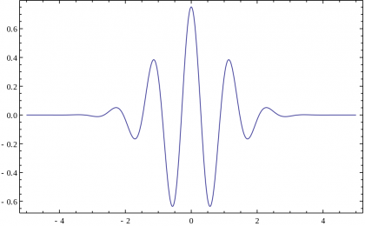
Solution: what if the sine wave wasn’t infinite?
Now if we take this “finite sine wave” and convolved it with our signal, what will happen?
BTW: this is a wavelet!
Wavelets are functions that need to satisfy 2 properties:
The average of the wavelet = 0
The squared magnitude of the wavelet is finite (this provides time locality) (sine waves have infinite squared magnitude)
This can be thought of as a sine wave with a gaussian window over it

Slide 12
Convolving a wavelet with a signal
21:36 /24:37

Slide 13
Outcomes from the video
We can see that the convolution between a wavelet and our signal produces a high response when our signal has the same frequency of the wavelet
The only difference between this and the FT, is that our wavelets tell us when their corresponding frequencies occur.
Each single wavelet with one fundamental frequency can only tell us when similar frequencies are present in our signal.
We need a family of wavelets to give us a spectrum of different frequencies

Slide 14
Designing wavelets
As we saw, each wavelet allowed us to look at a small range of frequencies.
When designing wavelets, we reach a tradeoff.
Lower frequencies require longer wavelets: this means less time resolution
Higher frequencies can have better time resolution, but as frequencies increase the smaller the differences between them, thus lower frequency resolution

Slide 15
Uncertainty Principal
Similar to Heisenberg's uncertainty principle relating position and momentum.
One cannot have precise frequency and time information about a signal. This is because frequency is time dependent. Given a signal of 1Hz, you need at least 1 second to correctly measure that signal.

Slide 16
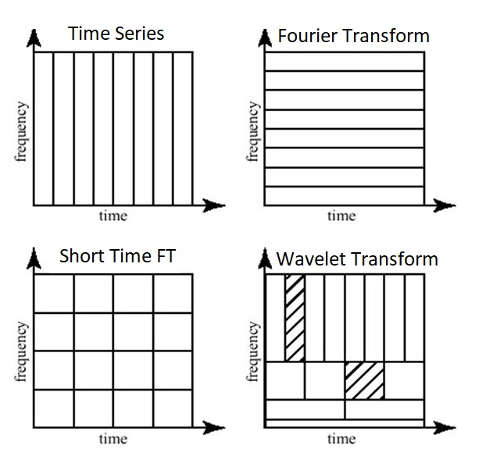
Time vs Frequency tradeoff
Wavelet transform allows for an efficient use of the uncertainty principal.
Lower frequencies inherently have less time resolution (1Hz takes 1s to sample)
The timing of high frequencies are more important than their frequency resolution
As opposed to STFT, which breaks up the Time/frequency domain into boxes and does the Fourier transform on each box (this is much less accurate than WT)
The WT can be seen of the optimization of the uncertainty principal.

Slide 17
What do people do with Wavelets?
Image denoising
Image compression
Dynamic signal frequency analysis
Epilepsy prediction
EEG analysis
Other brain analysis
Filtering

Slide 18
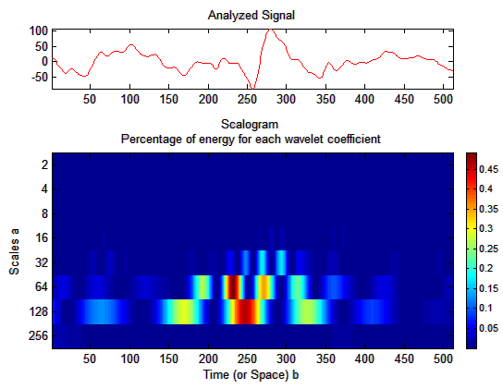
Wavelets for seizure prediction: Scalograms
A WT of EEG (brain scan) for epilepsy patients shows when spikes of different frequencies occur. This information was used to predict seizures in Epilepsy patients.
The scalogram of patients right before they experience seizures were used as training data for a Neural Network to predict seizures
Wavelets before NN’s are a popular data analysis tool. Especially for Seizure prediction

Slide 19
Another implementation of the WT: Wavelets as bandpass filters
Wavelets in the frequency domain look like bandpass filters! They only let a certain range of frequencies through while attenuating all others.
So, if wavelets are almost equivalent to bandpass filters, how could we easily implement them with filters?

Slide 20
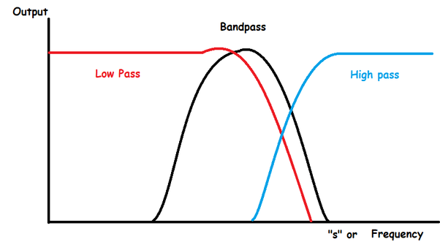
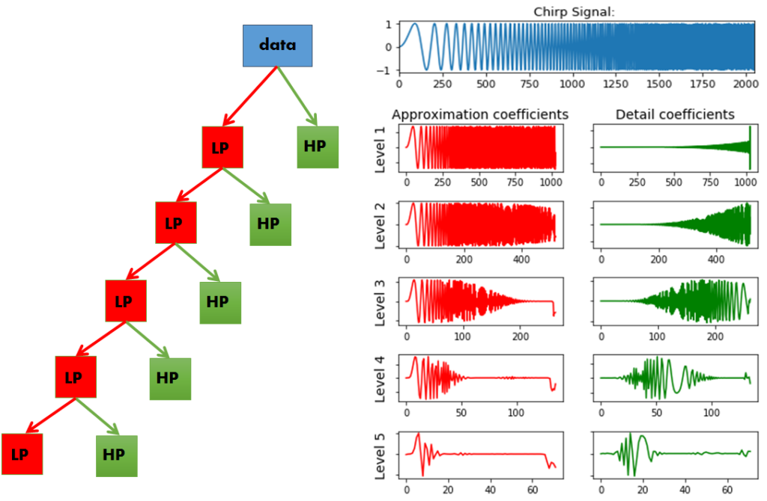
A common implementation of wavelets: bandpass filters
A common way people implement wavelets are a cascade of high and low pass filters
Cascading these high and low pass filters create a sequence of bandpass filters!
Note: the different bandpass regions might have overlap with one another

Slide 21
Wavelets as filter banks
The first plot is the raw EEG, then each subsequent plot can be thought of as the rawEEG put through a bandpass filter at a different frequency range, for instance: delta, theta, alpha, beta, and gamma frequency ranges.
This allows us to achieve our original goal of simultaneous time and frequency information about our signal. Here we sacrifice more frequency resolution for time resolution

Slide 22
Conclusion
Wavelets allow us to analyze the time and frequency content of a dynamic signal
Wavelets allow us to look at when specific frequency ranges are present in our signal
Wavelets are limited by the uncertainty principal: as precision in frequency resolution increases, precision in time resolution decreases, and vice versa
The WT can be seen as the optimization of this uncertainty principal
Wavelets can produce 2 types of graphs
Scalogram: 3D plot of time/space, frequency, and frequency amplitude
Bandpass: several 2D plots that break our signal into different bandpasses

Slide 23
For those who understand linear algebra
The FT is a change of basis to the complex exponentials, ie, a change of basis to sinusoids (which brings you to the frequency domain)
The WT is a change of basis where the basis has both time and frequency components (this basis is the orthogonal set of wavelets).

