Slide 1
The Dilbert Approach

Slide 2
EE 183: Parallel Computing
Fall 2017
Tufts University
Instructor: Joel Grodstein
joel.grodstein@tufts.edu
Lecture 1: Introduction

Slide 3
Final exam
 | Haswell Server | Nvidia Pascal P100
# cores | 18 | 3840
Die area | 660 mm² (22nm) | 610 mm² (16nm)
Frequency | 2.3 GHz normal | 1.3 GHz
Max DRAM BW | 100 GB/s | 720 GB/s
LLC size | 2.5 MB/core (L3) | 4 MB L2/chip
LLC-1 size | 256K/core(L2) | 64 KB/SM (64 cores)
Registers/core | 180 (2 threads/core) | 500
Power | 165 watts | 300 watts
Company market cap | $160B | $90B
Why are they so different?

Slide 4
Primary goals
Learn how hardware and software interact to result in performance (or the lack thereof)
Because life is multi-disciplinary.
Learn about parallel architectures: SIMD, multi-core, GPU
Why do we care?
How did we get here?
What might be coming?
Learn about concurrent-programming issues
Why is writing parallel programs so hard?

Slide 5
Secondary Goal
Learn some concurrent programming languages (C++ threads, CUDA)
Pthreads is largely superceded by C++ threads
We're engineers, and we like to build stuff, and writing a piece of software lets us actually make stuff that's useful.
And fast.

Slide 6
EE 193: topics, in order
Intro to parallel processing
C++ threads & CUDA – take 1
Quick review of EE126/Comp46 (caches, OOO, branch pred, speculative, multicore)
SIMD instructions
More multicore: ring caches and MESI
Performance: false sharing and matrix multiply
The trickiness of concurrent programming
GPUs
Project or final

Slide 7
Instructor
Instructor: Joel Grodstein
Office Hours:
Monday/Wednesday 2-3pm (i.e., before class), or email for an appointment
Halligan extension
Foils and homeworks are available on the course web page
My Background
30 years in the semiconductor industry
My first semester as official ECE faculty

Slide 8
A short history of computers
1970-now: computers got really fast
And the number of transistors doubled every 1-2 years
Result: superscalar, OOO, speculative, SMT
2002: ran out of fun things to do with the transistors
But the number of transistors still kept doubling
Logical result: multi-core (1-50 cores)
And SIMD (1 core), GPU (1000s of cores)
But there’s a problem:
When you combine a lot of little systems, you get a really big system.
Human beings are not good at programming these

Slide 9
A Trend in Computing Last Few Decades
Old conventional wisdom: Trade performance for improved programmer productivity
Higher-level languages, interfaces, abstraction layers, frameworks
Graphical user interfaces (GUIs)
How many hardware instructions to put “hello world” in a window?
See: “Spending Moore’s Dividend”, Jim Larus, CACM 2009
New conventional wisdom: Obtain performance by parallel programming
Programmers given additional burden: writing parallel software
More conventional wisdom:
Parallel programming is intractably difficult
Conclusion: obtain performance by reducing programming productivity
Or, equivalently: life kind of sucks ☹

Slide 10
What is Old is New Again
Parallelism isn’t new
Commonplace for computational science and engineering
To tackle problems too large to solve on any one computer
Old-school “supercomputers” were also highly parallel
Mainstream parallel computing “next big thing” for decades
Many companies bet on parallelism and failed
Why? One reason: non-parallel computers got faster so quickly
Ok, so why is parallelism so talked about now?
The entire industry has bet on parallelism!
Driven to parallelism by technology and architectural realities (next)
Sequential (non-parallel) performance is lagging
Thus, need for parallel programmers & related research
Based on a slide by Katherine Yelick

Slide 11
Buying milk
You live with 3 roommates.
Saturday morning you wake up, get the cereal and notice a problem: no milk
Go to the store and buy milk
Get back home, open the fridge
It has 3 brand-new containers of milk in it!
What went wrong?
Parallel systems are tricky!
So tricky that we need an entire course about it (OK, the course is more about performance than correctness)

Slide 12
Any ideas how to fix this?
Sprint to the store & back really really fast
Good luck with that strategy
Padlock the fridge when you go to the store
People might get a bit mad
We call this a "critical section."
Take the shopping list with you when you go to the store
If there is no list on the fridge, is it because somebody else is at the store, or because nobody made a list yet?

Slide 13
Some code
Load m = "there is milk"
if (m==false) {
get milk from store
put it in fridge
}
Load m = "there is milk"
if (m==false) {
get milk from store
put it in fridge
}
Does this work?
No, as we've just showed. Person #2 may do the load & check before person #1 returns.

Slide 14
Some code
Load m = "there is milk"
Load s = "there's a sign"
if (!m && !s) {
put a sign on the fridge
get milk from store
put it in fridge
}
Load m = "there is milk"
Load s = "there's a sign"
if (!m && !s) {
put a sign on the fridge
get milk from store
put it in fridge
}
Now we've fixed it!

Slide 15
Some code
Load m = "there is milk"
Load s = "there's a sign"
if (!m && !s) {
put a sign on the fridge
get milk from store
put it in fridge
}
time
Load m = "there is milk"
Load s = "there's a sign"
if (!m && !s) {
put a sign on the fridge
get milk from store
put it in fridge
}
s=true, since the sign is already on the fridge
Each core may execute at a different rate
This way works fine. Or does it?

Slide 16
Some code
Load m = "there is milk"
Load s = "there's a sign"
if (!m && !s) {
put a sign on the fridge
get milk from store
put it in fridge
}
time
Load m = "there is milk"
Load s = "there's a sign"
if (!m && !s) {
put a sign on the fridge
get milk from store
put it in fridge
}
s=false, since the sign is not on the fridge yet
Different timing breaks the algorithm
OK, the analogy isn’t perfect. But the message is that parallel programming is filled with corner cases.

Slide 17
Example: add lots of numbers
sum=0;
for i=1…n {
sum += f(i)
}
If n is big, this can take a while
Idea: divvy up the work among multiple cores!
Let each processor add n/p of the numbers

Slide 18
extern sum=0;
for i=1…n/2 {
sum += f(i)
}
extern sum;
for i=1+n/2…n {
sum += f(i)
}
Problems?
sum += f(i) requires a load, add, store.
What if, between the load and the store, somebody else went to the store and got milk too?
Ideas?

Slide 19
How can we use p processors to speed this up?
Let each processor add n/p numbers itself
Then add the p partial sums
sum[0]=0;
for i=1…n/p {
sum[0] += f(i)
}
sum[1]=0;
for i=n/p+1…2n/p {
sum[1] += f(i)
}
int sum=0;
for i=0..p-1 {
sum += sum[i]
}
But this part only uses one core to do
p additions. Can we do better?

Slide 20
Better parallel algorithm
Don’t make the master core do all the work.
Share it among the other cores.
Pair the cores so that core 0 adds its result with core 1’s result.
Core 2 adds its result with core 3’s result, etc.
Work with odd and even numbered pairs of cores.

Slide 21
Better parallel algorithm (cont.)
Repeat the process now with only the even cores.
Core 0 (which has c0+c1) adds the result from core 2 (which has c2+c3).
Core 4 (which has c4+c5) adds the result from core 6 (which has c6+c7), etc.
Now repeat over and over, making a kind of binary tree, until core 0 has the final result.

Slide 22
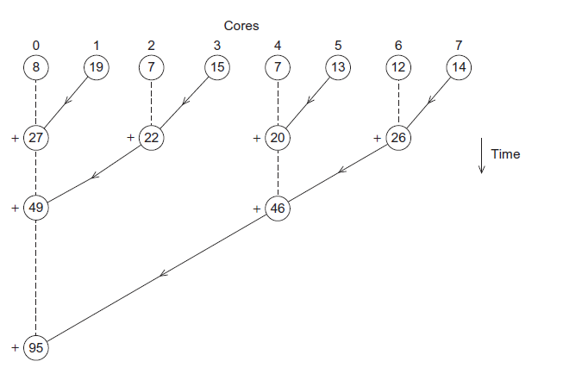
Multiple cores form a global sum
Adding 8 numbers only takes 3 time units this way ☺

Slide 23
Analysis (cont.)
The difference is more dramatic with a larger number of cores.
If we have 1000 cores:
The first algorithm would require the master to perform 999 receives and 999 additions.
The second algorithm would only require 10 receives and 10 additions.
That’s an improvement of almost a factor of 100!

Slide 24
Multiple cores form a global sum
But is it really that simple? Any issues?
How does a consumer know when its data is ready?
We’ve assumed that data can move from any core to any other core infinitely fast.

Slide 25
A crossbar needs too many wires
How many wires for p processors?
p*(p+1)/2
Does not scale well to hundreds of cores!
C0
C4
C1
C3
C2

Slide 26
Multiple cores form a global sum
If only one core can talk to another at a time… the graph looks very different

Slide 27
Motto
Transistors are cheap
Wires are expensive
Software is really expensive
Parallel software that actually works is priceless

Slide 28
The rest of the course
So now we know we have some problems
Parallel architecture is here today
But it's really hard to use it correctly
And to use it efficiently
We'll learn techniques to avoid everyone buying milk
atomic operations, critical sections, mutex, …
We'll learn more architecture: multicore, GPUs, SIMD
We'll learn about performance
When is multicore appropriate? GPUs? SIMD?
This will require learning (a lot) more about caches & coherence
And of course…
we can't really apply that knowledge unless we learn enough software to write some programs

Slide 29
That's all there is
That's all there is to the course
except, well, all of the actual details
Questions?

Slide 30
Why we need ever-increasing performance
Computational power is increasing, but so are our computation problems and needs.
Problems we never dreamed of have been solved because of past increases, such as decoding the human genome.
More complex problems are still waiting to be solved.

Slide 31
Climate modeling
Both weather prediction and climate change

Slide 32
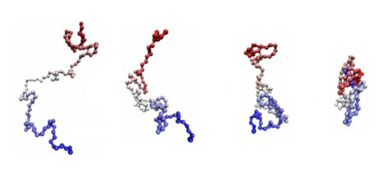
Protein folding

Slide 33
Drug discovery

Slide 34
Energy research

Slide 35
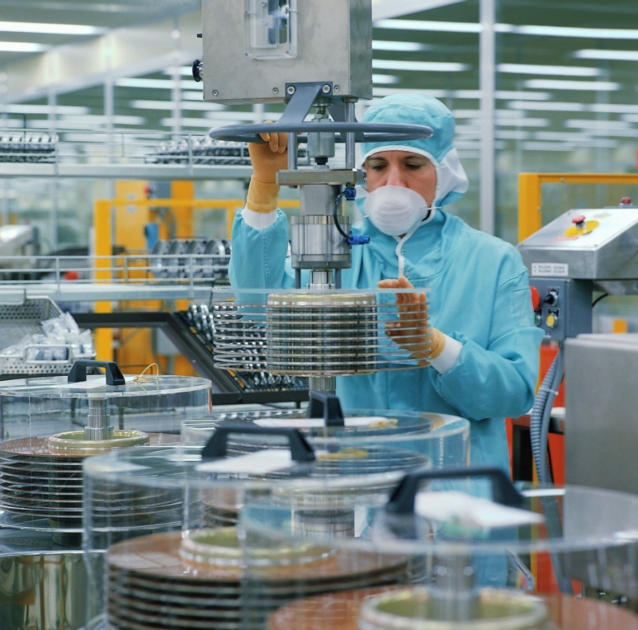
Data analysis

Slide 36
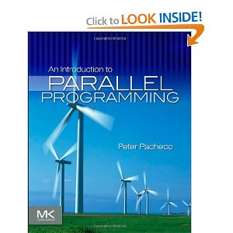
Resources
"An Introduction to Parallel Programming" by Peter S. Pacheco (1st Ed 2011)
online at Tisch
good for concurrency problems
not so great for hardware, architecture
we're using C++ threads, which appeared after this book was written

Slide 37
“Computer Architecture: A Quantitative Approach,” Fifth Edition, John L. Hennessy and David A. Patterson
online at Tisch
Great reference for architecture
I found the chapter on GPU architecture to be confusing (the terminology is inconsistent)

Slide 38
Matrix Computations, Golub and Van Loan, 3rd edition
The bible of matrix math (including how to make good use of memory)
Not always easy to read for a beginner
One copy on reserve in Tisch
Various GPU books available online (listed in the syllabus)

Slide 39
Prerequisites
ECE 126 (Computer Architecture) or similar
Logic Design (computer arithmetic)
Basic ISA (what is a RISC instruction)
Pipelining (control/data hazards, forwarding)
Basic Caches and Memory Systems
We'll spend 1-2 weeks reviewing it
Reasonable C/C++ Programming Skills
UNIX/Linux experience

Slide 40
Grading
Grade Formula
Programming Assignments – 50% (C++ threads & CUDA)
Quizzes – 30%
Final or project: 20% (see the syllabus for project suggestions)
There will be about five quizzes with the lowest quiz grade dropped

Slide 41
Late Assignments + Academic Integrity
10% grade reduction per day
Copying even small portions of assignments from other students or open-source projects and submitting them as your own will be a violation of academic integrity. Sharing code with other students would also be considered an offense.
The best way to ensure that your code is your own is to only have high level discussions with other students and never share a line of code.

