Slide 1
EE 193: Parallel Computing
Fall 2017
Tufts University
Instructor: Joel Grodstein
joel.grodstein@tufts.edu
Lecture 2: definitions

Slide 2
An Introduction to Parallel Programming
Peter Pacheco
Chapter 1
Why Parallel Computing?

Slide 3
What we'll talk about
A lot of definitions of terms, and simple concepts
  Can be a bit boring, but we have to get through it
  Because everyone uses these terms
Remember: why are we here in the first place?
  Single-thread performance isn't improving much any more
  But we want to keep solving harder problems, and we do keep getting more and more threads.
So concurrent programming is a crooked game, but the only game in town
  getting older is no fun, but it's a lot better than the alternative

Slide 4
Terminology
(these definitions have a lot of overlap with each other)
Concurrent computing – a program in which multiple tasks can be in progress at any instant
  the emphasis is not on computational efficiency, but on correctly handling so many tasks that can all interact
Parallel computing – a program in which multiple tasks cooperate closely to solve a problem
  the emphasis is on taking advantage of working in parallel to get high performance
Distributed computing – a program may need to cooperate with other programs to solve a problem.
  usually this just means we're running on a distributed-memory system (see next foils). An application can thus be distributed and also (concurrent or parallel)
Our focus

Slide 5
Parallelization: Definitions
Some preliminary definitions:
  task – arbitrarily defined piece of work
  process - abstract computational thread which performs one or more tasks. Each process has its own virtual-address space
  thread – abstract computational thread which performs one or more tasks. All threads in a process share virtual-address space.
  processor – the physical hardware on which a process executes
Tasks are performed by processes/threads that execute on processors.

Slide 6
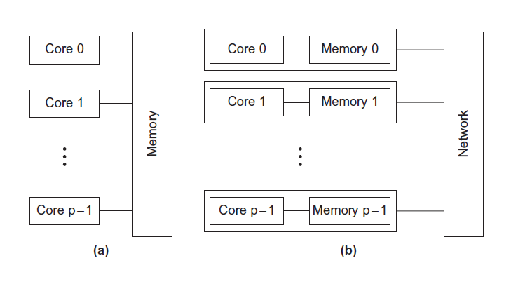
Type of parallel systems
Shared-memory
Distributed-memory

Slide 7
Type of parallel systems
Shared-memory
  The cores can share access to the computer’s memory.
  Coordinate the cores by having them examine and update shared memory locations.
Distributed-memory
  Each core has its own, private memory.
  The cores must communicate explicitly by sending messages across a network.
Our focus

Slide 8
How do we write parallel programs?
Task parallelism
  Partition various tasks carried out solving the problem among the cores.
Data parallelism
  Partition the data used in solving the problem among the cores.
  Each core carries out similar operations on its part of the data.

Slide 9

Professor P
15 questions
300 exams

Slide 10

Professor P’s grading assistants
TA#1
TA#2
TA#3

Slide 11
What's a task?
15 tasks
  grade question #1 on all exams
  grade question #2 on all exams
  …
  grade question #15 on all exams
If we instead defined that there were 300 tasks (i.e., grade exam #1, grade exam #2,… grade exam #300), we then task parallelism and data parallelism would mean different things!

Slide 12
Division of work – task parallelism
TA#1
TA#3
Questions 11 - 15
Questions 1 - 5
TA#2
Questions 6 - 10

Slide 13
Division of work – data parallelism
TA#1
TA#3
100 exams
100 exams
TA#2
100 exams

Slide 14
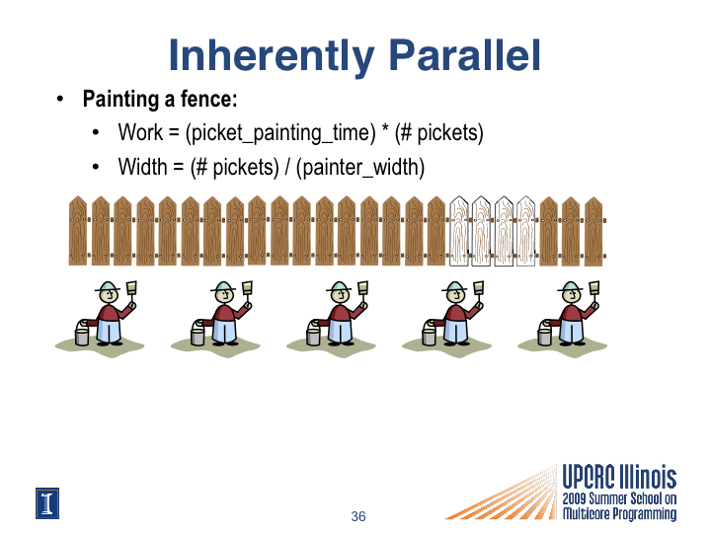
# of painters
pickets per painter
CIS 534 (Martin): Why Program for Parallelism?

Slide 15
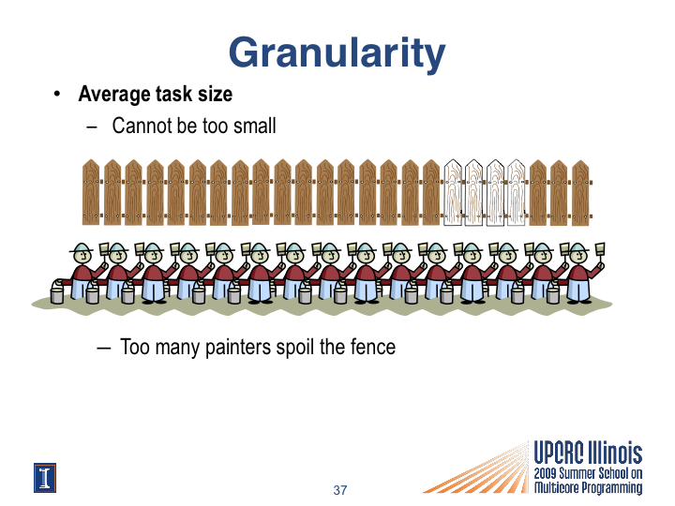
CIS 534 (Martin): Why Program for Parallelism?

Slide 16
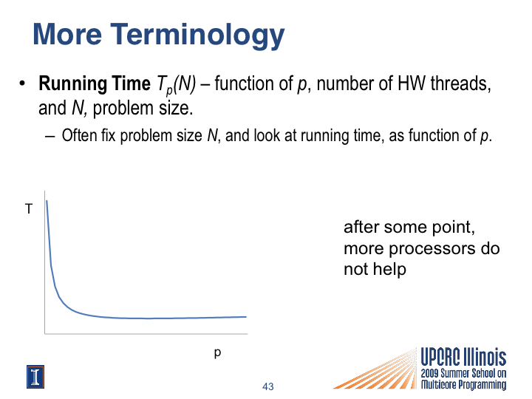
CIS 534 (Martin): Why Program for Parallelism?

Slide 17
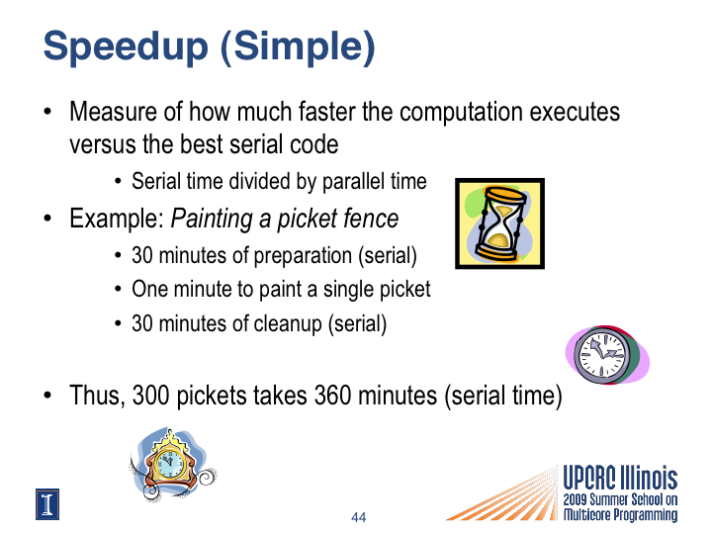
CIS 534 (Martin): Why Program for Parallelism?

Slide 18
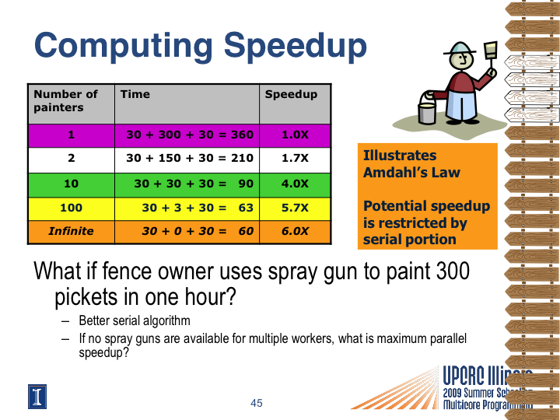
CIS 534 (Martin): Why Program for Parallelism?

Slide 19
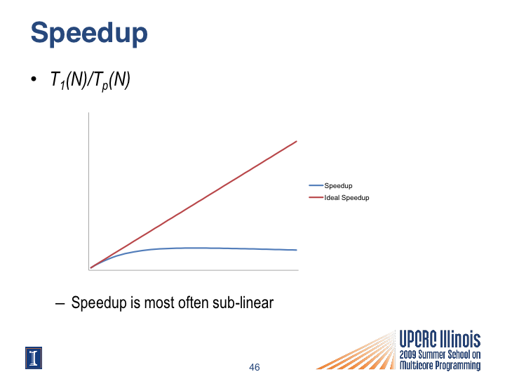
speedup
actual speedup
# of painters
CIS 534 (Martin): Why Program for Parallelism?

Slide 20
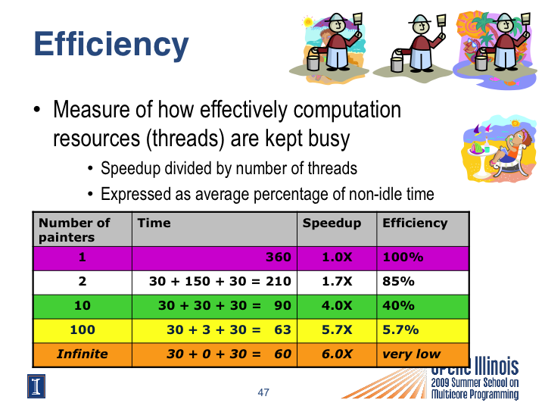
CIS 534 (Martin): Why Program for Parallelism?

Slide 21
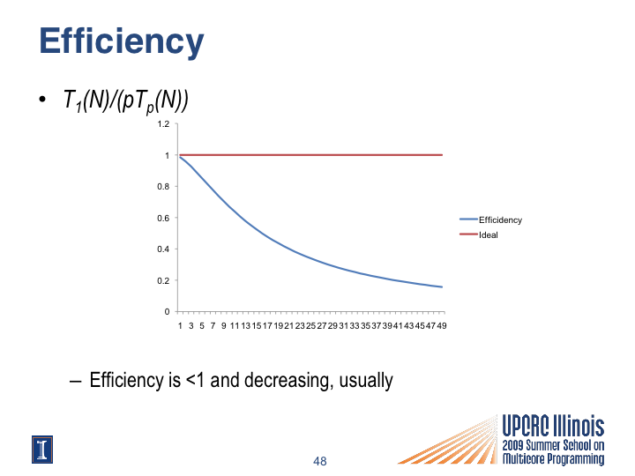
efficiency
actual efficiency
ideal efficiency
# of processors
CIS 534 (Martin): Why Program for Parallelism?

Slide 22
Two Types of “Efficiency”
Efficiency as “performance per core”
  Are you capturing the peak efficiency?
Efficiency as “performance per unit of energy”
  Is the computation energy efficient
Examples:
  Use all cores half the time, one core half the time
    Assuming unused cores “idle”, power efficient
  Uses all cores all the time, but overheads reduce performance
    Inefficient in both efficiency metrics

Slide 23
Efficiency is hard
We already showed (the milk example) that writing bug-free parallel programs is hard
Even if we do get everything correct, writing efficient parallel programs is hard, too.
  Many reasons (we'll discuss a few right now)
  They're all summed up in Amdahl's Law

Slide 24
Short quiz
Do you remember the definitions for:
  a process vs. a thread (slide #5)?
  a shared-memory system vs. a distributed-memory system (#6)?
  speedup (#17) and efficiency is (#20)?
The constraints on task granularity for the application to be efficient (#15, #29)?

Slide 25
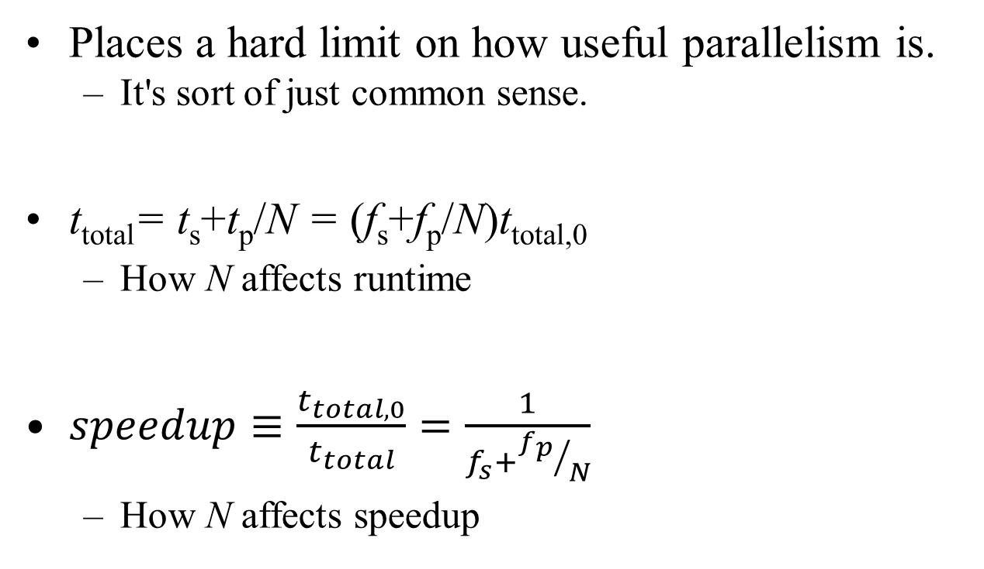
Amdahl's Law
Places a hard limit on how useful parallelism is.
  It's sort of just common sense.
t_{total}= t_{s}+t_{p}/N = (f_{s}+f_{p}/N)t_{total,0}
  How N affects runtime
$speedup≡\frac{t_{total,0}}{t_{total}}=\frac{1}{f_{s}+{f_{p}}/N}$
  How N affects speedup
t: time
f: fraction
s: serial
p: parallel

Slide 26
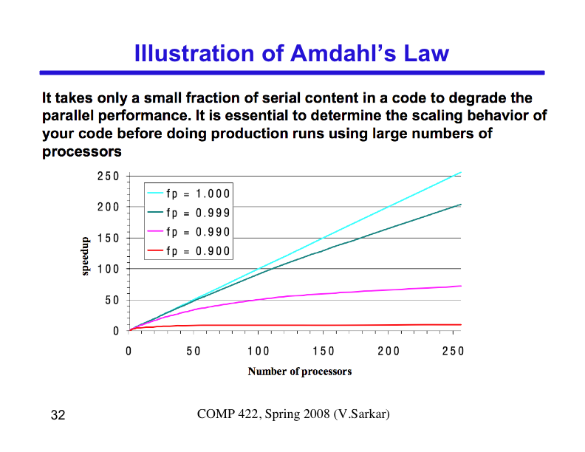
25
CIS 534 (Martin): Why Program for Parallelism?

Slide 27
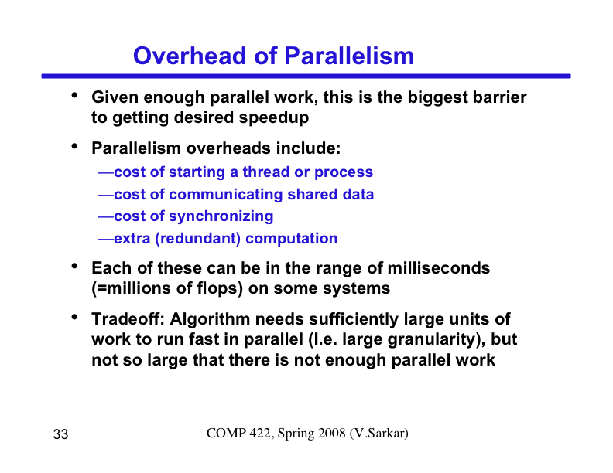
CIS 534 (Martin): Why Program for Parallelism?
26

Slide 28
Impediments to Parallel Computing
Identifying “enough” parallelism
  Problem decomposition (tasks & data)
Performance
  Parallel efficiency & scalability
  Granularity
    Too small: too much coordination overhead
    Too large: fewer tasks than cores
  Load balance
    Effective distribution of work (statically or dynamically)
  Memory system: data locality, data sharing, memory bandwidth
  Synchronization and coordination overheads
Correctness
  Incorrect code leads to deadlock, crashes, and/or wrong answers

Slide 29
Even Parallelism Has Limits
1 core. 2 cores. 4 cores. 8 cores. 1024 cores!
  This is how some multicore researchers count
Power scaling limitations: “utilization wall”
  Energy per transistor is decreasing...
  But, not as rapidly as the number of transistors available
  Will limit the number of transistors in use at one time
Memory system: “memory wall”
  Limited cache capacity, memory bandwidth
Amount of parallelism in applications: “Amdahl’s Law”
  Few algorithms scale up to 1000s of cores

Slide 30
Short in-class exercise
Speed up 95% of the task by 1.1x:
Speedup_{Overall} =1/(.05+(.95/1.1))=1.094
Speed up 5% of the task by 10x:
Speedup_{Overall} =1/(.95+(.05/10))=1.047
Speed up 5% of the task infinitely:
Speedup_{Overall} =1/.95=1.052
Make the common
case fast!

