Slide 1
EE 193: Parallel Computing
Fall 2017
Tufts University
Instructor: Joel Grodstein
joel.grodstein@tufts.edu
Lecture 7: SIMD

Slide 2
Goals
Where are we?
We've learned some basic (and some not so basic) architecture.
Today is a different topic (SIMD)…
…just so you don't get too burnt out on architecture ☺
Then back to our final architecture topic – ring caches
Primary goals:
Learn what SIMD is, and (roughly) how to use it
No programming assignments on this ☺
But, yes, it is covered in the short quizzes
And if you want, you can do some SIMD programming for a final project

Slide 3
Flynn’s Taxonomy*
classic von Neumann
SISD
Single instruction stream
Single data stream
today's class
(SIMD)
Single instruction stream
Multiple data stream
MISD
Multiple instruction stream
Single data stream
(MIMD)
Multiple instruction stream
Multiple data stream
multicore
not used
*Mike Flynn, Stanford, 1966

Slide 4
Problems with multithreading
We had lots of flexibility (many threads all doing different things)
Our simple use model actually had all the threads executing the same code
Keeping them all in sync was hard

Slide 5
SIMD
Parallelism achieved by dividing data among multiple execution units (which may be just one datapath) in the same thread.
Applies the same instruction to multiple data items.
Called data parallelism.

Slide 6
SIMD example
n data items
n ALUs
control unit
…
x[1]
x[2]
x[n]
ALU₁
ALU₂
ALU_{n}
for (i = 0; i < n; i++)
x[i] += y[i];

Slide 7
SIMD
What if we don’t have as many ALUs as data items?
Divide the work and process iteratively.
Example: 4 ALUs and 15 data items.
Round | ALU₁ | ALU₂ | ALU₃ | ALU₄
1 | X[0] | X[1] | X[2] | X[3]
2 | X[4] | X[5] | X[6] | X[7]
3 | X[8] | X[9] | X[10] | X[11]
4 | X[12] | X[13] | X[14]

Slide 8
Problems with SIMD
We’ve shown the use of many ALUs. But we skipped the hard part. What have we skipped?
How do you get the data from memory to the ALUs?
SIMD does have parallel loads & stores, but it gets harder when you load many things, and some hit and some miss
Not as flexible as MIMD
Even when we had different threads all running the same code, cache misses can get them out of sync, and the ones that had cache hits will happily move forwards
SIMD cannot do that

Slide 9
SIMD history
1996 MMX: reused the FP regs (!) for 2x32b, 4x16b and 8x8b integer ops. MMX was aimed at graphics shading operations – but graphics cards soon took over that.
1996 SSE: new 16B regfile XMM0-15. 4x float, 2x double, numerous int.
2011 AVX: new 32B regfile YMM0-15, 8x float.
2015 AVX512: new 64B regfile ZMM0-15. Only available on Xeon Phi so far.

Slide 10
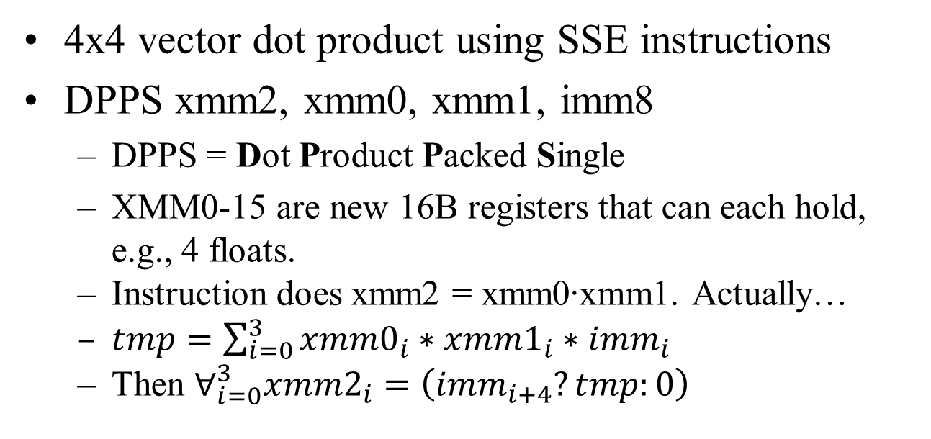
Example
4x4 vector dot product using SSE instructions
DPPS xmm2, xmm0, xmm1, imm8
DPPS = Dot Product Packed Single
XMM0-15 are new 16B registers that can each hold, e.g., 4 floats.
Instruction does xmm2 = xmm0∙xmm1. Actually…
$tmp=\sum_{i=0}^{3}{{xmm0}_{i}∗{xmm1}_{i}∗{imm}_{i}}$
Then $∀_{i=0}^{3}{xmm2}_{i}=\left({imm}_{i+4}?tmp:0\right)$
imm_{3:0} are mask bits
imm_{7:4} choose where to place the result

Slide 11
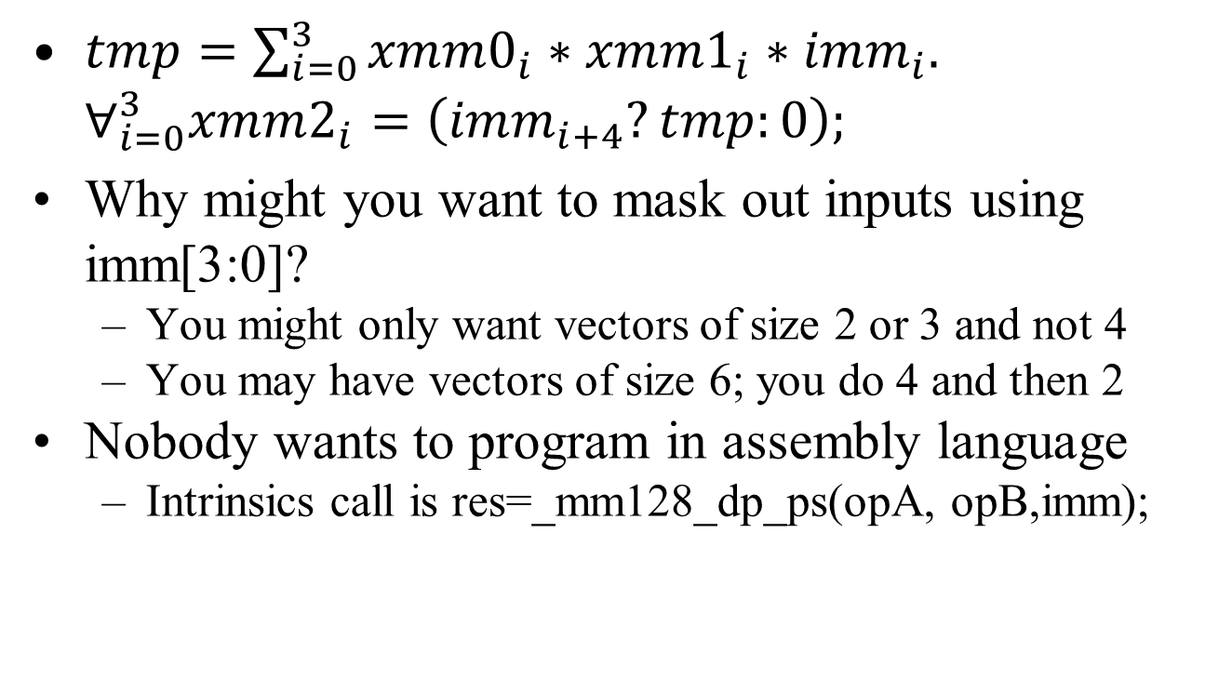
SIMD
$tmp=\sum_{i=0}^{3}{{xmm0}_{i}∗{xmm1}_{i}∗{imm}_{i}.}$ $∀_{i=0}^{3}{xmm2}_{i}=\left({imm}_{i+4}?tmp:0\right);$
Why might you want to mask out inputs using imm[3:0]?
You might only want vectors of size 2 or 3 and not 4
You may have vectors of size 6; you do 4 and then 2
Nobody wants to program in assembly language
Intrinsics call is res=_mm128_dp_ps(opA, opB,imm);

Slide 12
What's good about SIMD
A cheap, simple, power-efficient way to get parallelism.
Cheap: just add a few new inst. to an existing core
It's easy to turn a 64b adder into 4 16b adders.
It's not hard to widen the FPU datapath.
Simple: it’s still one thread, so no critical-section issues.
SIMD is easier to program than multithreading
Many fewer weird corner-case bugs.
Power-effective: one instruction launches many computations
saves energy of decoding lots of instructions.

Slide 13
Matrix multiply with DPPS
The usual question: the computes sound good, but how do you get data to them?
Consider a matrix multiply
P₀₀ P₀₁ P₀₂ P₀₃
P₁₀ P₁₁ P₁₂ P₁₃
P₂₀ P₂₁ P₂₂ P₂₃
P₃₀ P₃₁ P₃₂ P₃₃
A₀₀ A₀₁ A₀₂ A₀₃
A₁₀ A₁₁ A₁₂ A₁₃
A₂₀ A₂₁ A₂₂ A₂₃
A₃₀ A₃₁ A₃₂ A₃₃
B₀₀ B₀₁ B₀₂ B₀₃
B₁₀ B₁₁ B₁₂ B₁₃
B₂₀ B₂₁ B₂₂ B₂₃
B₃₀ B₃₁ B₃₂ B₃₃
=
*
Matrix multiply is just a lot of vector dot products. We should be able to use DPPS. Time for some details.

Slide 14
Data storage
P₀₀ P₀₁ P₀₂ P₀₃
P₁₀ P₁₁ P₁₂ P₁₃
P₂₀ P₂₁ P₂₂ P₂₃
P₃₀ P₃₁ P₃₂ P₃₃
A₀₀ A₀₁ A₀₂ A₀₃
A₁₀ A₁₁ A₁₂ A₁₃
A₂₀ A₂₁ A₂₂ A₂₃
A₃₀ A₃₁ A₃₂ A₃₃
B₀₀ B₀₁ B₀₂ B₀₃
B₁₀ B₁₁ B₁₂ B₁₃
B₂₀ B₂₁ B₂₂ B₂₃
B₃₀ B₃₁ B₃₂ B₃₃
=
*
How should we store our matrices to use DPPS?
What about the normal way (row major)? We will store each row of a matrix in a single XMM register
A₀₀ A₀₁ A₀₂ A₀₃
A₁₀ A₁₁ A₁₂ A₁₃
A₂₀ A₂₁ A₂₂ A₂₃
A₃₀ A₃₁ A₃₂ A₃₃
Each rectangle is one XMM register
=

Slide 15
Data storage
P₀₀ P₀₁ P₀₂ P₀₃
P₁₀ P₁₁ P₁₂ P₁₃
P₂₀ P₂₁ P₂₂ P₂₃
P₃₀ P₃₁ P₃₂ P₃₃
A₀₀ A₀₁ A₀₂ A₀₃
A₁₀ A₁₁ A₁₂ A₁₃
A₂₀ A₂₁ A₂₂ A₂₃
A₃₀ A₃₁ A₃₂ A₃₃
B₀₀ B₀₁ B₀₂ B₀₃
B₁₀ B₁₁ B₁₂ B₁₃
B₂₀ B₂₁ B₂₂ B₂₃
B₃₀ B₃₁ B₃₂ B₃₃
=
*
Does this work for matrix multiply?
No. DPPS can grab a row of A, but it cannot grab a column of B.
Would it help to store each matrix column in a register?
No. Then DPPS could access B but not A
Any clever ideas?

Slide 16
Data storage
P₀₀ P₀₁ P₀₂ P₀₃
P₁₀ P₁₁ P₁₂ P₁₃
P₂₀ P₂₁ P₂₂ P₂₃
P₃₀ P₃₁ P₃₂ P₃₃
A₀₀ A₀₁ A₀₂ A₀₃
A₁₀ A₁₁ A₁₂ A₁₃
A₂₀ A₂₁ A₂₂ A₂₃
A₃₀ A₃₁ A₃₂ A₃₃
B₀₀ B₀₁ B₀₂ B₀₃
B₁₀ B₁₁ B₁₂ B₁₃
B₂₀ B₂₁ B₂₂ B₂₃
B₃₀ B₃₁ B₃₂ B₃₃
=
*
How about this way?
Store rows of A in 4 XMM registers, and store columns of B in 4 more XMM registers
Now can we use DPPS?
Well, let's find out

Slide 17
In-class exercise
Can you fill in the rest of this matrix-multiply code?
Assume A, B and P are 4x4 matrices, implemented as a vector of 4 XMM registers (4 packed floats per register)
vector<XMM> A, B, P;
// Assume A and P are stored with one XMM per row
// Assume B is stored with one XMM per column
for r=0..3 {
P[r] = 0;
for c=0..3 {
unsigned imm = 1<<(c+4) | 0xF;
P[r] |= _mm256_dp_ps(A[r], B[c], imm);
}
}

Slide 18
Setup
How do we get A to be stored in our registers in rows, but B in columns?
Write some code to do a matrix transpose
B₀₀ B₀₁ B₀₂ B₀₃
B₁₀ B₁₁ B₁₂ B₁₃
B₂₀ B₂₁ B₂₂ B₂₃
B₃₀ B₃₁ B₃₂ B₃₃
B₀₀ B₀₁ B₀₂ B₀₃
B₁₀ B₁₁ B₁₂ B₁₃
B₂₀ B₂₁ B₂₂ B₂₃
B₃₀ B₃₁ B₃₂ B₃₃
MMX, SSE and AVX have instructions (pack/unpack, shuffle) that help with matrix transpose

Slide 19
Gather/scatter
We could avoid transposing the matrix if we had instructions to gather data from columns.
This is available in AVX2, but arguably doesn't work that well (must be iterated to read >1 cache line).
The matching scatter only appeared as of AVX512, and has the same issues as the gather instruction.

Slide 20
SIMD summary
The good:
SIMD is cheaper to implement, easier to program (since there's only one thread), & more power efficient than other alternatives.
The bad:
There's no special instruction to build 4 histograms ☹. They've parallelized many common cases, but not everything.
The # of elements in a vector is encoded in the instruction, which makes it hard to have an orthogonal instruction set (they’re starting to fix this with mask bits, but those are usually an immediate field, and so must be constant).
The state of SIMD:
Compilers now use AVX reasonably well.
It's also been inserted by hand into various libraries.
You can put it into your C++ code using intrinsics
https://software.intel.com/sites/landingpage/IntrinsicsGuide/#=undefined

