Slide 1
EE 193: Parallel Computing
Fall 2017
Tufts University
Instructor: Joel Grodstein
joel.grodstein@tufts.edu
Lecture 9: Google TPU

Slide 2
Resources
In-datacenter performance analysis of a tensor-processing unit
Norm Jouppi et. al, Google, ISCA 2017
https://eecs.berkeley.edu/research/colloquium/170315
a talk by Dave Patterson
he mostly just presented the above paper
Efficient Processing of Deep Neural Networks: A Tutorial and Survey
Vivienne Sze et al., MIT, 2017
Available at Cornell Libraries
Design and Analysis of a Hardware CNN Accelerator
Kevin Kiningham et al, 2017 Stanford Tech Report
Describes a systolic array
Is it similar to the TPU? Don’t know…

Slide 3
Summary of this course
Building a one-core computer that’s really fast is impossible
Instead, we build lots of cores, and hope to fill them with lots of threads
We’ve succeeded
But we had to do lots of work (especially for a GPU)
Is there a better way?
Domain-specific architectures
Build custom hardware to match your problem
Only cost effective if your problem is really important

Slide 4
The problem
Three problems that Google faces:
Speech recognition and translation on phones
Search ranking
Google fixes your searches for you
Common solution: deep neural networks

Slide 5
Neural net
Each node: a weighted sum y=w₁in₁+w₂in₂+…
Followed by an excitation function
e.g., out = (y<0? 0 : 1)
Each vertical slice is a layer
Deep neural net has lots of layers

Slide 6
Types of neural nets
Multi-layer perceptrons are fully connected (60%)
Convolutional neural net has connections to nearby inputs only (30%)
Recurrent NN has internal state, like an IIR filter (5%)

Slide 7
What does this remind you of?
Matrix multiplication – yet again!
y=w₁in₁+w₂in₂+… This is a vector dot product
One layer: output vector = weight matrix * input vector
So, yes, Deep Neural Networks is mostly just lots of matrix multiplies (plus the excitation function)

Slide 8
How do we make it run fast?
We’ve spent an entire course learning that.
For Google, it wasn’t good enough
One network can have 5-100M weights
Lots and lots of customers
Goal: improve GPU performance by 10x
Strategy: what parts of a CPU/GPU do we not need?
Remove them, add more computes

Slide 9
What did they add?
Matrix-multiply unit
65K multiply-accumulate units!
Pascal has 3800 cores.
Lots of on-chip memory to hold the weights, and temporary storage
3x more on-chip memory than a GPU
Still can’t hold them all, but a lot
What did they remove to make room for this stuff?

Slide 10
What did they remove?
No OOO
No speculative execution or branch prediction
Actually, no branches at all!
Far less registers
Pascal has 64K registers/SM; TPU has very few
How can they get away with that?
Like a GPU
Like a GPU
Just the arithmetic

Slide 11
Very few registers
Outputs of one stage directly feed the next stage
GPU or CPU approach
stuff outputs into registers
read them again as next-stage inputs
costs silicon area, and also power
just get rid of them, direct feed
part of what’s called a systolic array
also remove intermediate registers for the sums

Slide 12
What did they remove?
Far fewer threads
Haswell = 2 threads/core
Pascal ≈ 1000 threads/SM
TPU = ??
No SMT
But isn’t lots of threads and SMT what makes things go fast?
SMT: when one thread is stalled, swap in another
Stalls are hard to predict (depend on memory patterns, branch patterns)
Keep lots of threads waiting
1 thread!
TPU has no branches
TPU has only one application

Slide 13
Downsides of SMT
Lots of threads required lots of registers
TPU doesn’t need nearly as many registers
Moving data back and forth between registers and ALUs costs power
SMT is a way to keep the machine busy during an unpredictable stalls
It doesn’t change the fact that a thread stalled unpredictably
It doesn’t make the stalled thread faster
It improves average latency, not worst-case latency
Google’s requirement:
Customers want 99% reliability on worst-case time
They don’t want unpredictable waits more than 1% of the time
SMT does not fit this customer requirement

Slide 14
What did they remove?
No OOO
No branches (or branch prediction, speculative execution)
Far less registers
1 thread, no SMT
8-bit integer arithmetic
training vs inference
training is in floating point; done infrequently and can be slow
inference can be done with 8-bit integers
TPU uses 8-bit MACs. Saves substantial area – but TPU cannot do training

Slide 15
Results
15-30X faster at inference than GPU or CPU
30X-80X better performance/watt
“Performance” is 99th percentile

Slide 16
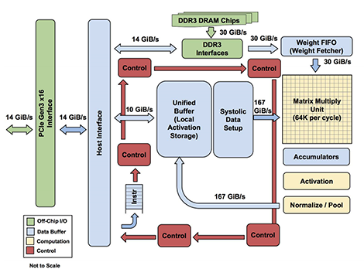
Block diagram

Slide 17
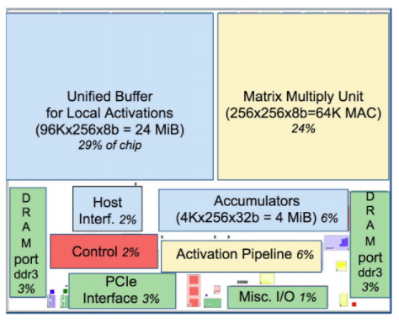
Chip floorplan

