Slide 1
EE 194/Bio 196/BIO 196: Modeling,simulating and optimizing biological systems
Spring 2018
Tufts University
Instructor: Joel Grodstein
joel.grodstein@tufts.edu
Lecture 1: Introduction

Slide 2
Big title: modeling, simulating and optimizing biological systems
It’s a new class. So, what do you think the course is about? What do you want it to be about?

Slide 3
What it means
Modeling
building (in our case) a computer program to use instead of the real system
Simulating:
run the model (often with different parameters) to see what it predicts
example: model a population, and change the food supply
Optimizing
Find the parameters that best achieve some goal
E.g., what management strategy makes the population grow best
There may be a lot of choices!

Slide 4
Why do we care about models?
Sometimes the real-life system is unavailable to experiment with
William Sellers, Leeds University, "Investigating the running abilities of Tyrannosaurus rex using stress-constrained multibody dynamic analysis"
https://www.youtube.com/watch?v=rxqHVoZ0fzc
Conclusion: T.Rex max speed was about 12mph
Can you think of other systems that are difficult to work with?

Slide 5
Instructor & TA
Instructor: Joel Grodstein
Office Hours:
Monday/Wednesday 2-3pm (i.e., before class), or email for an appointment
Halligan extension room 11
My Background
30 years in the computer industry
My 2nd semester as official ECE faculty
First time I've ever taught a "biology" course
TA: Cassandra Donatelli

Slide 6
Why would we want EE faculty to teach a biology course, anyway?
This is not only a biology course.
The world is becoming more and more interdisciplinary
Interesting problems are becoming hard enough that no one discipline can be an island any more
For the biologists:
The world is becoming more quantitative
Programming is a very useful job skill
For the engineers:
mix of biology and engineering has lots of potential to change the future
Making interdisciplinary teams work is really hard (but fun):
Everyone has to at least speak the same language
Bio PhDs will definitely know more about their area than I will
Please have fun correcting my biology mistakes ☺
Learning to live (and thrive) in that environment is part of working on an interdisciplinary team

Slide 7
Course web page
http://www.ece.tufts.edu/ee/194MSO/
Syllabus, calendar
Lecture foils, HWs

Slide 8
Course speed
It's a new course
It's not clear how quickly we should cover material, or in what depth
Not bound by any requirements other than to learn as much as is reasonable for the large majority of people
Grades will work out fine in the end
Request: let me know if we're moving too fast or slow.. we will try to adjust the pace as needed
We can remove homeworks or topics if needed
Each HW has an extra-credit problem
Office hours are meant to be used

Slide 9
Population modeling
What we'll learn about biology
l_{x}-m_{x} models
What we'll learn about modeling
Simulating models
GIGO
stochastic models
Using models for things we cannot easily measure (desert tortoises)
What we'll learn about programming
the basics: variables, loops, if/then, arrays
2-3 homeworks

Slide 10
Kinetic proofreading
What we'll learn about biology
How the body discriminates between closely-related molecules
What we'll learn about modeling & optimization
Exhaustive algorithms… try absolutely everything and still finish before dinner
Using a pre-existing framework
What we'll learn about programming
multiply-nested loops, user-defined functions
1 HW

Slide 11
Manduca sexta
What we'll learn about biology
How M.sexta crawls
What we'll learn about modeling
Genetic algorithms; running evolution at computer speed to evolve better solutions to problems
Models can give us new insights about our system – even (especially) when they’re wrong
Optimization and visualization can give us new insights about our models
What we'll learn about programming
Object-oriented programming
1 long HW

Slide 12
Bacterial chemotaxis
What we'll learn about biology
How bacteria create goal-directed movement with simple chemical reactions
How bacteria use memory circuits to help them get to their goal
What we'll learn about modeling
top-down vs. bottom-up modeling
What we'll learn about programming
Practice, practice… and 1 HW

Slide 13
Bioelectricity
What we'll learn about biology
What is bioelectricity, and how is it part of morphogenesis
What we'll learn about modeling
A framework to model bioelectricity
More on top-down vs. bottom-up modeling
What we'll learn about programming
Still more practice, and 1 HW

Slide 14
Math
Differential equations are part of modeling
We're not going to make everyone into math majors
We're not going to try
But differential equations are very common in models
We want to understand intuitively what a differential equation is, and what it means
We want you to not be scared when people talk about them
We're not going to solve them ourselves

Slide 15
Python
Why learn a computer language?
It's becoming a more and more valuable job skill
A one-semester intro will not make you a CS major
But we will teach you to write small programs, read other people's programs, and not be scared of them
Give you the tools to learn more, and the exposure to see if you like it
Why Python?
Easy to learn and still quite powerful
At or near the top in most language-popularity surveys
It has a nice interface to GIS (Geographic Information System).
Named after a British comedy series & movie

Slide 16
Recitation session
Programming will be a challenge
Like any language, you learn by doing
Weekly recitation, in Halligan PC lab, for help with the programming HW
What times work best?
Before class Tues?
Before class Thurs?
Other?

Slide 17
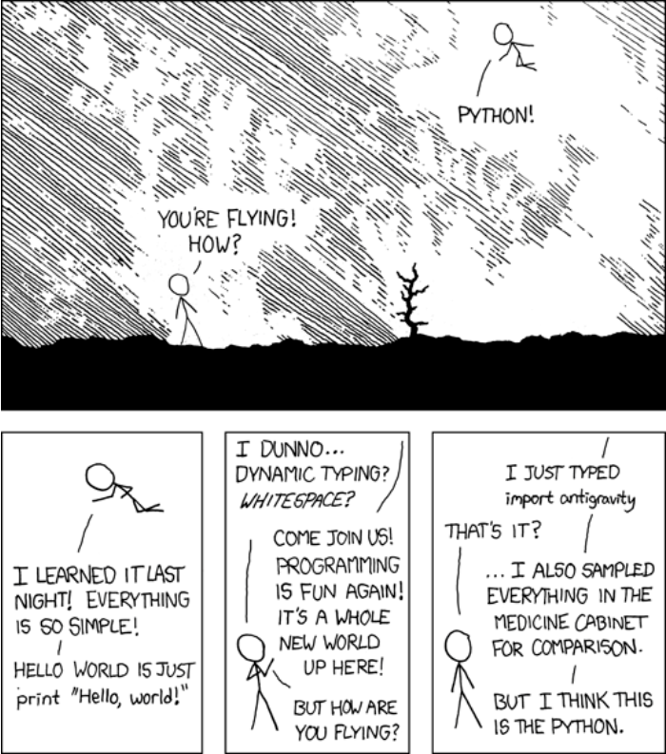
From xkcd
Perhaps almost nobody gets it?
Guarantee: by the end of the course you'll get this cartoon
It may still not be funny, though

Slide 18
Learning to program
Learning any new language takes time and effort
Not something you can cram for… just daily practice
“A physicist is looking for the truth. An engineer just wants to build something.”
Sten Graff Larsen
Programming and modeling make it easy to make stuff

Slide 19
Expectations (will likely change)
About 6 programming assignments (75%)
A few quizzes (15%)
Class participation (10%)
Perhaps a final project
Take a problem and take it further
Work in teams to get more done; will hopefully allocate the last 2 weeks of class
Present during final-exam slot

Slide 20
First modeling issue
A road map is a model.
It is a representation of, e.g., Boston
We don't really use it for simulation or optimization, but we still do useful things with it
Question: what scale of map is most useful?
OK, Google maps lets you scale in and out dynamically
But what scale is most useful for a paper map?
Too detailed, and the map is unwieldy
Too abstract, and it's almost useless

Slide 21
Too precise…
What do you consider the largest map that would be really useful?”
“About six inches to the mile.”
“Only six inches!” exclaimed Mein Herr. “We very soon got to six yards to the mile. Then we tried a hundred yards to the mile. And then came the grandest idea of all! We actually made a map of the country, on the scale of a mile to the mile!”
“Have you used it much?” I enquired.
“It has never been spread out, yet,” said Mein Herr: “the farmers objected: they said it would cover the whole country, and shut out the sunlight! So we now use the country itself, as its own map, and I assure you it does nearly as well.
From Sylvie and Bruno (Lewis Carroll)

Slide 22
The other extreme
The Bellman's map, from The hunting of the snark (Lewis Carroll again)
https://people.duke.edu/~ng46/topics/lewis-carroll.htm
Takeaway:
"No model is correct. Some are still useful," George Box
“Art is a lie that helps us to see the truth,” Picasso
Choosing the most useful level of detail for a model is rarely easy
Making the model unwieldy or inaccurate is all too easy
Especially since we're often modeling systems that we don't really understand

Slide 23
Questions?

