Slide 1
EE 194/Bio 196 Modeling,simulating and optimizing biological systems
Spring 2018
Tufts University
Instructor: Joel Grodstein
joel.grodstein@tufts.edu
Lecture 3: differential equations

Slide 2
Differential equations
Sounds scary? Is this the lecture you’ve been afraid of?
Hopefully, it’s easier than it sounds
What we won’t do:
fill 10 pages with equations and ways to solve them.
What we will (hopefully) do:
get an intuitive feel for what a differential eqn is
understand why it is so useful
make it as painless as we can
Why do we care?
Differential equations are used very commonly in modeling. Knowing what they are and why they’re used helps us understand each other

Slide 3
Dive right in
f is the function that tells you how big dx/dt is as any point in your simulation.
x is the thing we want to measure. E.g., our total population
$$\frac{dx}{dt}=f\left(x,t,params\right)$$
f depends on x, t and any other parameters. So basically, how fast x is growing depends on how big x is, depends on time (e.g., more growth in the spring), and on any other parameters (like the food supply)
dx/dt means “how fast x is changing.”
When x (e.g., our population) is growing fast, dx/dt is a big positive number.
When it’s shrinking fast, dx/dt is a big negative number
When it’s pretty constant, dx/dt is roughly 0.

Slide 4
Population growth
We sort of been using differential equations already
well, almost
and we just haven’t used that word yet
but if we’ve already sort of done it, then it can’t be that hard
A population starts with 50 individuals. Let N be the population at any given time
Over the course of a year, 5% of the population dies (.05N)
and 13% are born (.13N)
net change = .13N-.05N=.08N
$\frac{dN}{dt}=.08N$

Slide 5
Free software
Now that we know how to describe simple population growth as $\frac{dN}{dt}=.08N$, so what?
Python has a differential-equation solver built in that we can use.

Slide 6
Computer solutions
How does a computer solve a differential equation?
Numerical integration (usually)
We know how big the population is now
We know how fast it’s changing
So we can predict the new population
Differential equation: $\frac{dN}{dt}=.08N$
Discretized form: N(t+∆t) = N(t)+(.08N)∆t
Looks a lot like our l_{x}-m_{x} method

Slide 7
N(t+∆t) = N(t)+(.08N)∆t

Slide 8
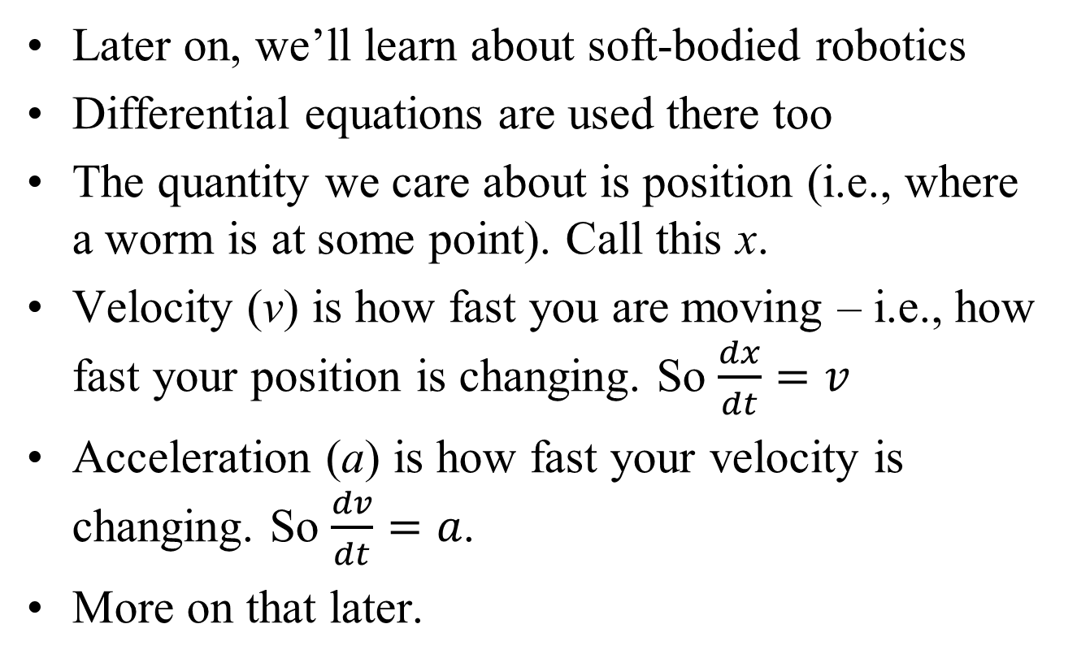
Coming later…
Later on, we’ll learn about soft-bodied robotics
Differential equations are used there too
The quantity we care about is position (i.e., where a worm is at some point). Call this x.
Velocity (v) is how fast you are moving – i.e., how fast your position is changing. So $\frac{dx}{dt}=v$
Acceleration (a) is how fast your velocity is changing. So $\frac{dv}{dt}=a$.
More on that later.

Slide 9
Bioelectricity
Bioelectricity is full of differential equations
Electrical $current=\frac{d\left(charge\right)}{dt}$
Diffusion current = $−D\frac{d\left(concentration\right)}{dx}$
More coming later when we learn about bioelectricity and morphogenesis

Slide 10
Differential eqns for chemistry
Kinetic proofreading will model chemical equation rates. How?
Consider a chemical reaction A + B ⇄ C
This tells us which reactants become which products
It doesn’t tell us how fast anything happens
Remember mass action from chemistry class?
For the reaction A + B ⇄ C, the forwards rate is k_{f}[A][B]
If you have more A or more B, the reaction runs more quickly.
The rate constant k_{f} says how fast you go; depends on the energetics of the reaction. Rate constants are often hard to predict/measure
What does “reaction rate” mean exactly?
How fast you produce C
Or, how much C you produce per unit time (in moles or molecules)
$\frac{d\left[C\right]}{dt}=k_{f}\left[A\right]\left[B\right]$ Another differential equation!
What are the units on k_{f}?
The same thing works in reverse
$\frac{d\left[A\right]}{dt}=k_{r}\left[C\right]$ and $\frac{d\left[B\right]}{dt}=k_{r}\left[C\right]$

Slide 11
Not really like population
Chemistry is not really like population
A + B → C, $\frac{d\left[C\right]}{dt}=k_{f}\left[A\right]\left[B\right]$
We’re creating new [C]. Sort of like a new birth – but the A and B disappear. Parents don’t disappear when they have babies!
C → A + B, $\frac{d\left[A\right]}{dt}=k_{r}\left[C\right]$
Sort of like saying a baby can disappear in a puff of smoke and two parents appear
Chemistry and population growth are very different
But they both use standard differential equations
One solver can simulate both of them
One language can describe both of them
Differential equations are the basic language of modeling

Slide 12
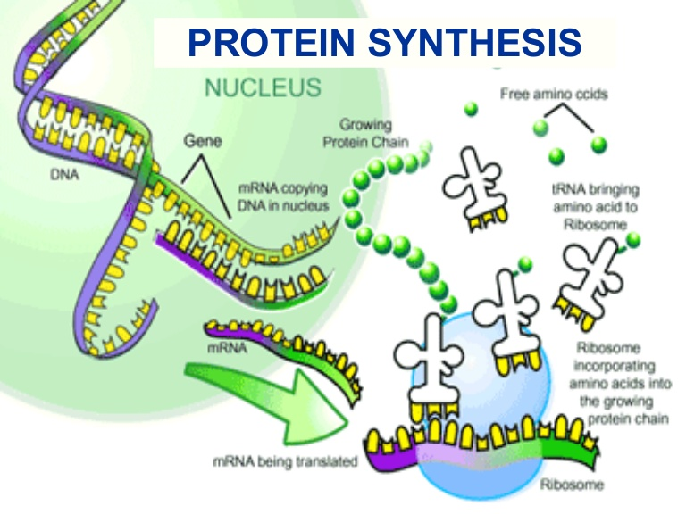
mRNA and tRNA
Central dogma of biology
DNA is transcribed to create an mRNA chain
each codon of mRNA mates with a specific tRNA molecule
tRNA has an anti-codon on one end (that mates w/mRNA); the other end of tRNA is the appropriate amino acid

Slide 13
The central dogma
DNA holds all of the information necessary to build an organism. But how?
DNA → RNA (transcription)
RNA → amino acids → proteins (translation)
Proteins fold into different shapes (electrostatic)
Protein shapes mate with other protein shapes → self-assemble into cells
Lots of molecules in cells other than proteins
all built by chemical reactions
proteins are usually the catalysts

Slide 14
Adaptive DNA
DNA is organized into 23 pairs of chromosomes
Each chromosome contains many genes
Not all parts of a gene contain protein-making instructions
1 Gene consists of:
promoter region
5’ UTR
start codon
coding sequence (array of amino-acid types)
stop codon
3’ UTR
terminator
Promoter region:
digital and analog logic making a sophisticated control network
This is what lets a cell behave differently in response to different environmental conditions
We can reprogram it (e.g., CRISPR)

Slide 15
Codons
DNA is a sequence of 4 bases (Adenine, Cytosine, Guanine or Thymine)
There are 22 amino acids
It takes 3 bases to specify one AA
3 bases = 1 codon
3 bases = 64 possible codons
a few are set aside for “start,” “stop”
numerous duplicates; multiple codons all code for the same AA
30 different tRNA molecules + wobble base pairing

Slide 16
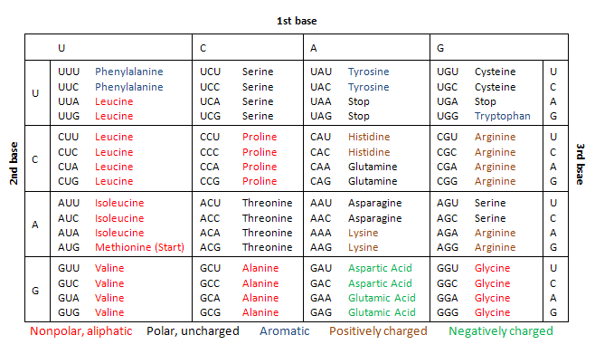

Slide 17
Real life isn’t so simple
“each codon of mRNA mates with a specific tRNA molecule”
actually, it doesn’t. Remember why not?
wobble base pairing means one mRNA can mate with multiple tRNA (but that’s not what we’ll focus on)
in fact, an mRNA can mate with any tRNA (of course, with some much more strongly than others)
This is just a chemical reaction, like A + B ⇄ C

Slide 18
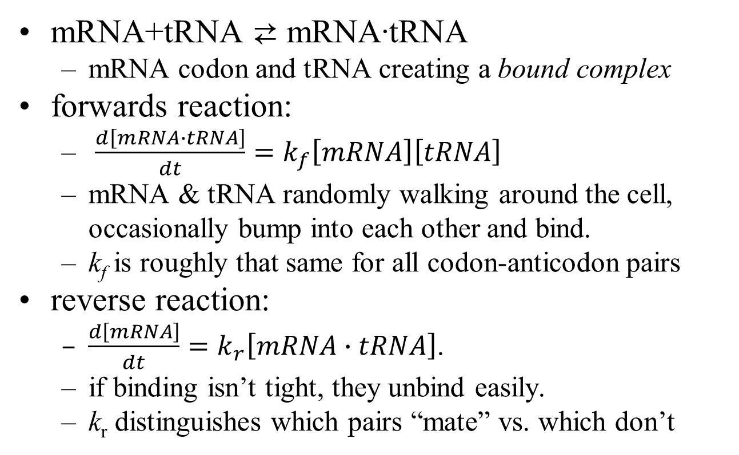
Example
mRNA+tRNA ⇄ mRNA∙tRNA
mRNA codon and tRNA creating a bound complex
forwards reaction:
$\frac{d\left[mRNA∙tRNA\right]}{dt}=k_{f}\left[mRNA\right]\left[tRNA\right]$
mRNA & tRNA randomly walking around the cell, occasionally bump into each other and bind.
k_{f} is roughly that same for all codon-anticodon pairs
reverse reaction:
$\frac{d\left[mRNA\right]}{dt}=k_{r}\left[mRNA∙tRNA\right]$.
if binding isn’t tight, they unbind easily.
k_{r} distinguishes which pairs “mate” vs. which don’t

Slide 19
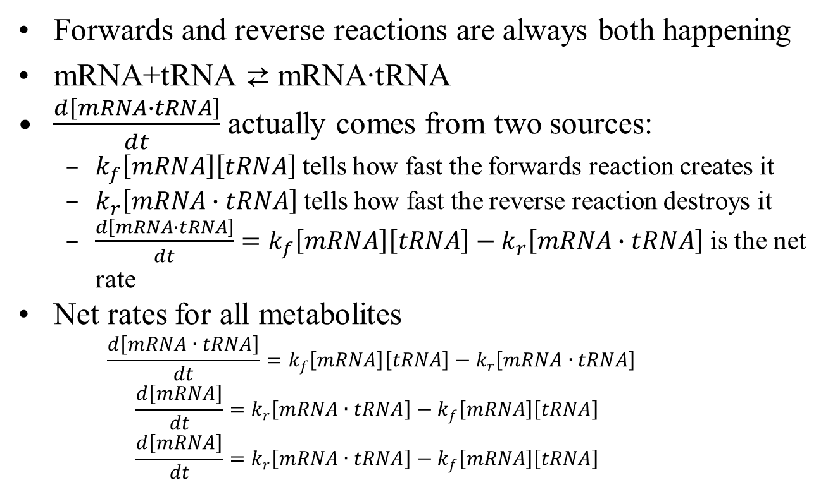
Example, continued
Forwards and reverse reactions are always both happening
mRNA+tRNA ⇄ mRNA∙tRNA
$\frac{d\left[mRNA∙tRNA\right]}{dt}$ actually comes from two sources:
$k_{f}\left[mRNA\right]\left[tRNA\right]$tells how fast the forwards reaction creates it
$k_{r}\left[mRNA∙tRNA\right]$tells how fast the reverse reaction destroys it
$\frac{d\left[mRNA∙tRNA\right]}{dt}=k_{f}\left[mRNA\right]\left[tRNA\right]−k_{r}\left[mRNA∙tRNA\right]$ is the net rate
Net rates for all metabolites
$$\frac{d\left[mRNA∙tRNA\right]}{dt}=k_{f}\left[mRNA\right]\left[tRNA\right]−k_{r}\left[mRNA∙tRNA\right]$$
$$\frac{d\left[mRNA\right]}{dt}={k_{r}\left[mRNA∙tRNA\right]−k}_{f}\left[mRNA\right]\left[tRNA\right]$$
$$\frac{d\left[mRNA\right]}{dt}={k_{r}\left[mRNA∙tRNA\right]−k}_{f}\left[mRNA\right]\left[tRNA\right]$$
coupled differential equations

Slide 20
Coupled differential equations
coupled differential equations
$$\frac{d\left[mRNA∙tRNA\right]}{dt}=k_{f}\left[mRNA\right]\left[tRNA\right]−k_{r}\left[mRNA∙tRNA\right]$$
$$\frac{d\left[mRNA\right]}{dt}={k_{r}\left[mRNA∙tRNA\right]−k}_{f}\left[mRNA\right]\left[tRNA\right]$$
$$\frac{d\left[mRNA\right]}{dt}={k_{r}\left[mRNA∙tRNA\right]−k}_{f}\left[mRNA\right]\left[tRNA\right]$$
The general form:
$$\frac{dx_{1}}{dt}=f\left(x_{1},x_{2},…,t,params\right)$$
$$\frac{dx_{2}}{dt}=f\left(x_{1},x_{2},…,t,params\right)$$
$$\frac{dx_{3}}{dt}=f\left(x_{1},x_{2},…,t,params\right)$$
the things we care about
how fast they’re changing
parameters

Slide 21
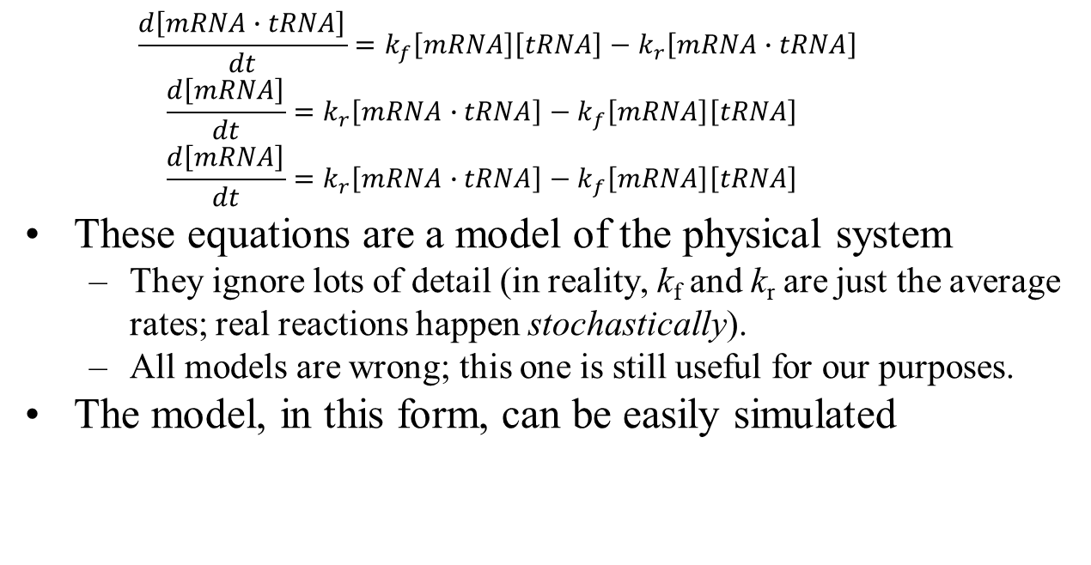
Beat the dead horse some more
$$\frac{d\left[mRNA∙tRNA\right]}{dt}=k_{f}\left[mRNA\right]\left[tRNA\right]−k_{r}\left[mRNA∙tRNA\right]$$
$$\frac{d\left[mRNA\right]}{dt}={k_{r}\left[mRNA∙tRNA\right]−k}_{f}\left[mRNA\right]\left[tRNA\right]$$
$$\frac{d\left[mRNA\right]}{dt}={k_{r}\left[mRNA∙tRNA\right]−k}_{f}\left[mRNA\right]\left[tRNA\right]$$
These equations are a model of the physical system
They ignore lots of detail (in reality, k_{f} and k_{r} are just the average rates; real reactions happen stochastically).
All models are wrong; this one is still useful for our purposes.
The model, in this form, can be easily simulated

Slide 22
Stage-based analysis
$\frac{dN}{dt}=.03N$ is fine, but what about all of our stage-based l_{x}-m_{x} models? Can we represent them as differential eqns?
Next more complex version:
$$\frac{dx_{1}}{dt}=f\left(x_{1},x_{2},…,t,params\right)$$
$$\frac{dx_{2}}{dt}=f\left(x_{1},x_{2},…,t,params\right)$$
$$\frac{dx_{3}}{dt}=f\left(x_{1},x_{2},…,t,params\right)$$
These are coupled differential equations
Yes!

Slide 23
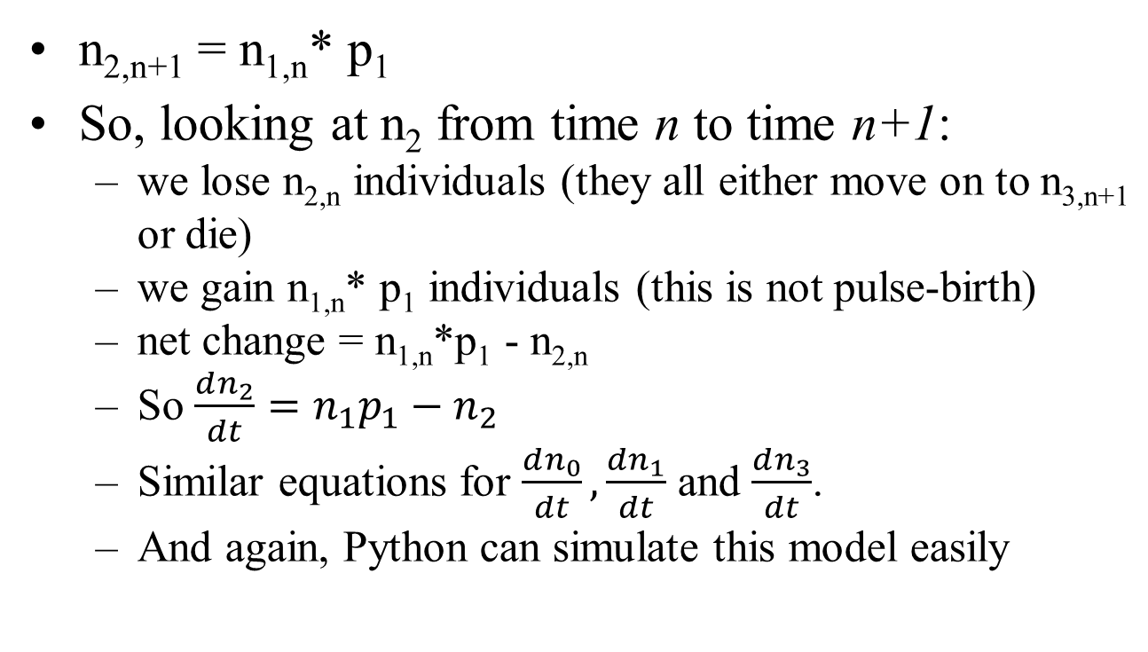
l_{x}-m_{x} as a differential eqn
n_{2,n+1} = n_{1,n}* p₁
So, looking at n₂ from time n to time n+1:
we lose n_{2,n} individuals (they all either move on to n_{3,n+1} or die)
we gain n_{1,n}* p₁ individuals (this is not pulse-birth)
net change = n_{1,n}*p₁ - n_{2,n}
So $\frac{dn_{2}}{dt}=n_{1}p_{1}−n_{2}$
Similar equations for $\frac{dn_{0}}{dt}, \frac{dn_{1}}{dt}$ and $\frac{dn_{3}}{dt}$.
And again, Python can simulate this model easily

