Slide 1
EE 194/Bio 196: Modeling, simulating and optimizing biological systems
Spring 2018
Tufts University
Instructor: Joel Grodstein
joel.grodstein@tufts.edu
Lecture 4: kinetic proofreading

Slide 2
Kinetic proofreading
What we’ll learn about biology
How the body discriminates between closely-related molecules
What we’ll learn about modeling
Inverse problems: find the parameters that give us a desired output
Exhaustive algorithms… try practically everything and still finish before dinner
Emergent properties
A simple framework for modeling molecular biology
What we’ll learn about programming
if/then, multiply-nested loops, 1 HW

Slide 3
Background reading
Interesting reading (not required for class)
An Introduction to Systems Biology: Design Principles of Biological Circuits, Uri Alon, Chapter 9 (on reserve)
Kinetic proofreading: a new mechanism for reducing errors in biosynthetic processes requiring high specificity, J.J. Hopfield, PNAS 1974
Direct experimental evidence for kinetic proofreading in amino acylation of tRNAIle, ibid, PNAS 1976

Slide 4
Kinetic proofreading
What is it, and why do we care?
Kinetic proofreading is when your body is much better at recognizing specific molecules than it seems it should be
Example: mRNA codons bind to one specific tRNA molecule
Bind to the wrong one → build a protein from incorrect amino acids
Example: antibodies are amazingly good at recognizing, binding and targeting one specific antigen
Even if other antigens look very similar
Consequences of attacking the wrong molecule are severe
Does it sound easy? Your body does much better than basic chemistry would seem to predict

Slide 5
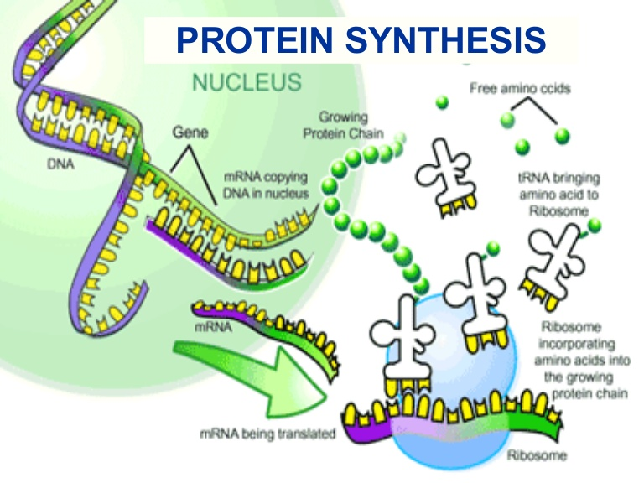
mRNA and tRNA
Central dogma of biology
DNA is transcribed to create an mRNA chain
each codon of mRNA mates with a specific tRNA molecule
tRNA has an anti-codon on one end (that mates w/mRNA); the other end of tRNA is the appropriate amino acid

Slide 6
Why isn’t translation easy?
Translation seems like it should be easy
b_{f}
p
mRNA+tRNA ⇄ mRNA∙tRNA → product
b_{r}
amino acid added to the protein
mRNA binds to tRNA
For those who recognize it…
Sort of the same idea as Michaelis-Menton kinetics

Slide 7
Simple analysis
b_{f}
p
mRNA+tRNA ⇄ mRNA∙tRNA → product
b_{r}
Equilibrium definition:
All reactions have their forwards and rate balance the reverse rate
Thus, all [metabolites] are unchanging
Thermodynamics says that any isolated system will eventually reach equilibrium (maximal entropy)
Why isn’t the product reaction at equilibrium?
Irreversible reactions cannot be at equilibrium. A contradiction?
No reaction is completely irreversible
As long as we’re alive, our body can sweep away products and make reactions essentially irreversible

Slide 8
Molecular machines
Ribosome is a molecular machine
In practice, molecular machines are often irreversible
Machines usually expend energy
E.g., convert ATP→ADP
Running backwards is highly unlikely (2nd Law again)
Your body fuels the machines by eating

Slide 9
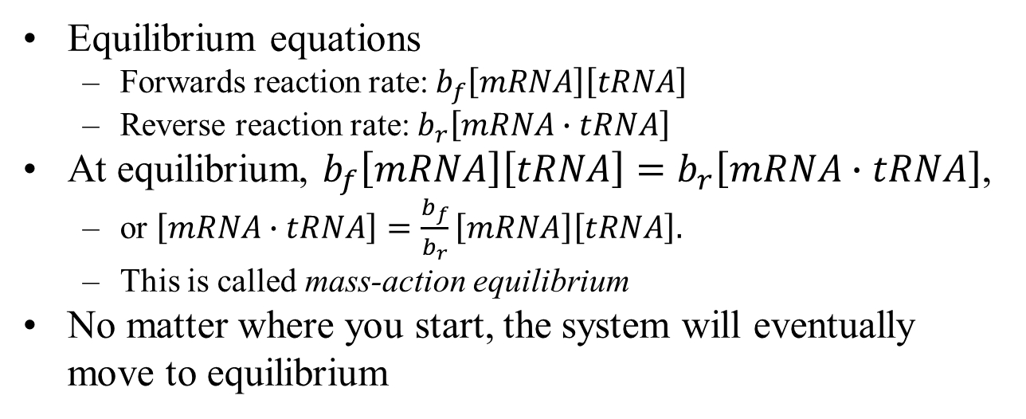
Analyzing a simple model
b_{f}
mRNA+tRNA ⇄ mRNA∙tRNA
b_{r}
Equilibrium equations
Forwards reaction rate: $b_{f}\left[mRNA\right]\left[tRNA\right]$
Reverse reaction rate: $b_{r}\left[mRNA∙tRNA\right]$
At equilibrium, $b_{f}\left[mRNA\right]\left[tRNA\right]=b_{r}\left[mRNA∙tRNA\right]$,
or $\left[mRNA∙tRNA\right]=\frac{b_{f}}{b_{r}}\left[mRNA\right]\left[tRNA\right].$
This is called mass-action equilibrium
No matter where you start, the system will eventually move to equilibrium

Slide 10
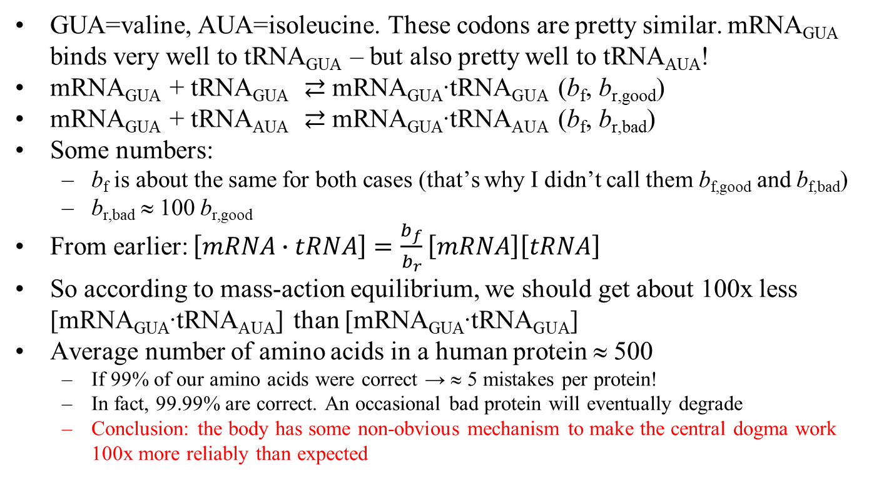
Simple model is not robust
GUA=valine, AUA=isoleucine. These codons are pretty similar. mRNA_{GUA} binds very well to tRNA_{GUA} – but also pretty well to tRNA_{AUA}!
mRNA_{GUA} + tRNA_{GUA} ⇄ mRNA_{GUA}∙tRNA_{GUA} (b_{f}, b_{r,good})
mRNA_{GUA} + tRNA_{AUA} ⇄ mRNA_{GUA}∙tRNA_{AUA} (b_{f}, b_{r,bad})
Some numbers:
b_{f} is about the same for both cases (that’s why I didn’t call them b_{f,good} and b_{f,bad})
b_{r,bad} ≈ 100 b_{r,good}
From earlier: $\left[mRNA∙tRNA\right]=\frac{b_{f}}{b_{r}}\left[mRNA\right]\left[tRNA\right]$
So according to mass-action equilibrium, we should get about 100x less [mRNA_{GUA}∙tRNA_{AUA}] than [mRNA_{GUA}∙tRNA_{GUA}]
Average number of amino acids in a human protein ≈ 500
If 99% of our amino acids were correct → ≈ 5 mistakes per protein!
In fact, 99.99% are correct. An occasional bad protein will eventually degrade
Conclusion: the body has some non-obvious mechanism to make the central dogma work 100x more reliably than expected

Slide 11
Bodily time scales
A few time scales in your body:
TF binding to a promoter: seconds
DNA → mRNA: minutes
mRNA → protein: minutes
mRNA lifetime: 10s of minutes (creating 10s of proteins)
protein lifetime: 10s of hours
So a 1% error rate is bad, but .01% is OK

Slide 12
The mystery, circa 1970
The body works really well – but how?
The facts as of 1973
b_{f}
e_{f}
p
mRNA+tRNA ⇄ mRNA∙tRNA ⇄ mRNA∙tRNA* → product
b_{r}
e_{r}
⇅
d_{f}
d_{r}
but what are these reactions for?
mRNA+tRNA
amino acid added to the protein
mRNA binds to tRNA
We knew the reactions
We did not know all of the rate constants
Problem in molecular biology: until you know the rate constants, it’s not always obvious what reactions are for
We did not know what the extra reactions were for
People did not really know how to proceed

Slide 13
Are the issues linked?
Our two mysteries:
Two reactions that don’t seem to have a purpose (if we knew the rate constants, maybe we would know their purpose)
The system is 100x more reliable than we would predict
Are these related? And what are the missing rate constants?
Our hope: for some magic set of rate constants, kinetic proofreading will magically appear

Slide 14
Proofreading
1974 JJ Hopfield hypothesis:
hypothesizes the missing rate constants
in fact, they explain how the “useless” reactions make the system reliable
1976: two years of lab work prove him correct
“I have all of these reactions and I don’t know what they do:” a hard problem
“I have a specific hypothesis: prove or disprove it:” often a much easier problem.
Allowed the lab work to be very focused

Slide 15
What did he do exactly?
Build a model: mass action rates on 4 chemical reactions
A set of differential equations
State: concentrations of mRNA, tRNA, bound complex, bound-excited complex, product
Parameters: the rate constants

Slide 16
Coupled differential equations
Coupled differential equations for one reaction
$$\frac{d\left[mRNA∙tRNA\right]}{dt}=k_{f}\left[mRNA\right]\left[tRNA\right]−k_{r}\left[mRNA∙tRNA\right]$$
$$\frac{d\left[mRNA\right]}{dt}={k_{r}\left[mRNA∙tRNA\right]−k}_{f}\left[mRNA\right]\left[tRNA\right]$$
$$\frac{d\left[mRNA\right]}{dt}={k_{r}\left[mRNA∙tRNA\right]−k}_{f}\left[mRNA\right]\left[tRNA\right]$$
The general form:
$$\frac{dx_{1}}{dt}=f\left(x_{1},x_{2},…,t,params\right)$$
$$\frac{dx_{2}}{dt}=f\left(x_{1},x_{2},…,t,params\right)$$
$$\frac{dx_{3}}{dt}=f\left(x_{1},x_{2},…,t,params\right)$$
the things we care about
how fast they’re changing
parameters

Slide 17
What did he do exactly?
Invent rate constants
they must “reasonable”
they must make the model match the data (i.e., robustness)
inventing rate constants is hard – so many choices for the rate constants
How to tell if we match the data
Simulate the model once with the rate constants for mRNA_{GUA} reacting with tRNA_{GUA}; record the predicted [product_{good}]
Simulate again with the rate constants for mRNA_{GUA} reacting with tRNA_{AUA}; record the predicted [product_{bad}]
Check that [product_{good}] ≈ 10000[product_{bad}]
Spoiler alert for HW #4:
there will indeed be a magic set of rate constants that allows life to exist on earth, and you will find it

Slide 18
Bottom-up, emergent model
This is an example of bottom-up, emergent modeling
Bottom-up:
Put together the low-level reactions, with as many details as possible
Assemble them into a system
Emergent:
With the right combination of parameters, a surprising and difficult-to-predict behavior suddenly emerges from the pieces
Bottom-up, emergent modeling is quite common in biology; we’ll see other alternatives shortly
Pros:
your final model has lots of detail, and probably is not GIGO
it matches the real reactions, and might thus be easier to validate in the lab
Cons:
Lots of low-level pieces often make it hard to understand
Intuition may be lacking

Slide 19
What we’ll do
How did Hopfield come up with his rate constants?
Stroke of genius, message from God, who knows
Either way, miraculous guesses are hard to come by
Instead, we’ll use optimization
What is optimization?
Optimization, in general: find a way to make something as “good” as possible
Pick the rate constants so that we maximize the production of correct amino acids vs. incorrect ones

Slide 20
Optimizing a model
b_{f}
e_{f}
p
mRNA+tRNA ⇄ mRNA∙tRNA ⇄ mRNA∙tRNA* → product
b_{r}
e_{r}
⇅
d_{f}
d_{r}
mRNA+tRNA
How many rate constants are there?
b_{f}, b_{r}, e_{f}, e_{r}, d_{f}, d_{r}, p
How many values could each of them have?
Pretty much anything!
Our task:
Try an infinite number of values for each of 7 parameters
Simulate each choice and see if any give us reliability
Finding a needle in a haystack sounds easier
Our goal: write a computer program that can try an infinite number of choices, and find the needle. Do it in half an hour. Sound useful?

Slide 21
Why do we care (take 2)
Because kinetic proofreading is cool
Because kinetic proofreading is a general concept:
used in translation, in the immune system, in DNA replication/damage/repair, …
Because it gives us a reason to learn about optimization

Slide 22
Our task, again
Our task:
Try an infinite number of values for each of 7 parameters
Simulate each choice and see if any give us reliability
“Simulate each choice and see if any give us reliability”
Set the parameters to the desired values
Set b_{r} to the good (i.e., low) value; simulate the model to find how fast we make the good AA
Set b_{r} 100x higher; simulate again to find how fast we make the bad AA
Hopefully, there’s a 10000x difference in AA production
Try the next parameter choice

Slide 23
How many choices to try
Our task:
Try an infinite number of values for each of 7 parameters
Simulate each choice and see if any give us reliability
“Try an infinite number of values for each of 7 parameters”
This sounds kind of impossible. Ideas?
Do we really have to try every parameter value?
No model is perfect: some are still useful
How good does our model have to be?
Good enough to screen away the bad rate-constant choices and focus lab work on the good one
Modeling + optimization → find a small number of reasonable hypotheses

Slide 24
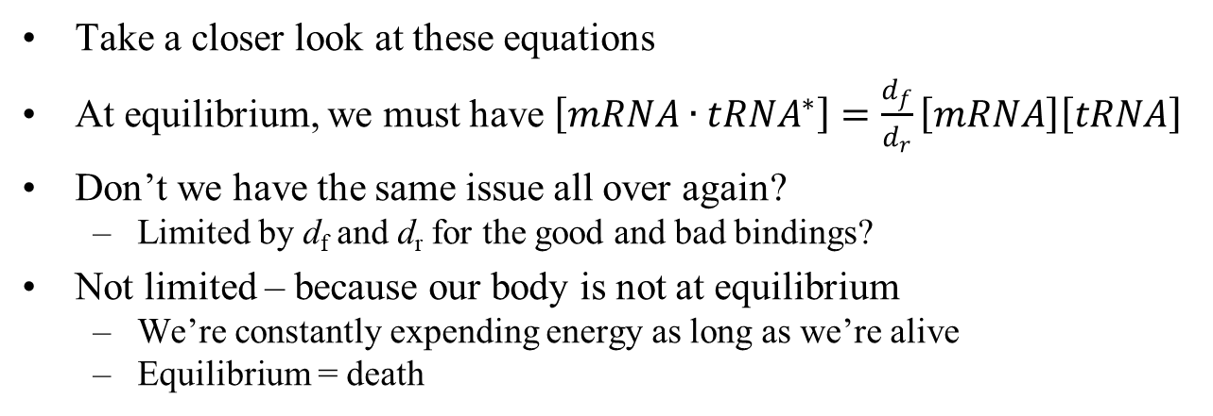
Equilibrium
b_{f}
e_{f}
p
mRNA+tRNA ⇄ mRNA∙tRNA ⇄ mRNA∙tRNA* → product
b_{r}
e_{r}
⇅
d_{f}
d_{r}
mRNA+tRNA
Take a closer look at these equations
At equilibrium, we must have $\left[{mRNA∙tRNA}^{∗}\right]=\frac{d_{f}}{d_{r}}\left[mRNA\right]\left[tRNA\right]$
Don’t we have the same issue all over again?
Limited by d_{f} and d_{r} for the good and bad bindings?
Not limited – because our body is not at equilibrium
We’re constantly expending energy as long as we’re alive
Equilibrium = death

Slide 25
What does “good enough” mean?
Close is only good enough in horseshoes and hand grenades
Rate constants often do not need to be exact
We’ll take advantage of this on the HW, and then talk about why it works
Idea: trying an infinite number of parameter choices takes, well, an infinite amount of time ☹
Try just enough to get within 10x? E.g., all rates can be 1, .1, .01, .001, .0001 and 0.
6 choices for 7 parameters: very feasible to try them all. A lot fewer than infinity ☺
Our optimization strategy: decide on a reasonable range of choices for each rate, and try every combination
and biochemistry!

Slide 26
Our optimization strategy
Our strategy:
decide on a reasonable range of choices for each rate
try every combination
Only really works if:
“almost” is good enough
you have a computer fast enough to try quite a few choices to see what is best

Slide 27
In-class programming exercise
Reminder on for p1 in [1, .1, .01] (arrays lecture foil 16)
Write code to:
try the values [1, .1, .01, .001, .0001 and 0] for each of 3 parameters p₁, p₂ and p₃.
for each parameter choice, call a function sim (p₁, p₂ and p₃). This function returns a “goodness” value.
Save the best parameter choice

Slide 28
Understanding the results
b_{f}
e_{f}
p
mRNA+tRNA ⇄ mRNA∙tRNA ⇄ mRNA∙tRNA* → product
b_{r}
e_{r}
⇅
d_{f}
d_{r}
mRNA+tRNA
What will our results tell us?
b_{f} and b_{r} are much faster than e_{f} and e_{r}.
e_{r}=d_{f}=0 (i.e., two irreversible reactions)
Let’s try to understand how/if this helps

Slide 29
The intuition
b_{f}
e_{f}
p
mRNA+tRNA ⇄ mRNA∙tRNA
⇄ mRNA∙tRNA* → product
b_{r}
e_{r}
⇅
d_{f}
d_{r}
mRNA+tRNA
Assume that b_{f} and b_{r} are much faster than e_{f} and e_{r}.
Then the leftmost reaction quickly reaches equilibrium, independent of everything else
with $\left[mRNA∙tRNA\right]=\frac{b_{f}}{b_{r}}\left[mRNA\right]\left[tRNA\right]$

Slide 30
Part 1: 100x discrimination
1
mRNA+tRNA ⇄ mRNA∙tRNA
Correct tRNA
1
1
.5
2
1
mRNA+tRNA ⇄ mRNA∙tRNA
Wrong tRNA
1
1
50
.02
We get 100x discrimination just in the binding/unbinding

Slide 31
concentration stays constant at $\frac{b_{f}}{b_{r}}\left[mRNA\right]\left[tRNA\right]$
b_{f}
e_{f}
p
mRNA∙tRNA ⇄ mRNA∙tRNA* → product
mRNA+tRNA ⇄ mRNA∙tRNA ⇄ mRNA∙tRNA* → product
b_{r}
e_{r}
⇅
d_{f}
d_{r}
mRNA+tRNA
OK, so $\left[mRNA∙tRNA\right]=\frac{b_{f}}{b_{r}}\left[mRNA\right]\left[tRNA\right]$
Assume p is the slowest (so we can ignore it for now)
Assume e_{r}=d_{f}=0 (i.e., two irreversible reactions)

Slide 32
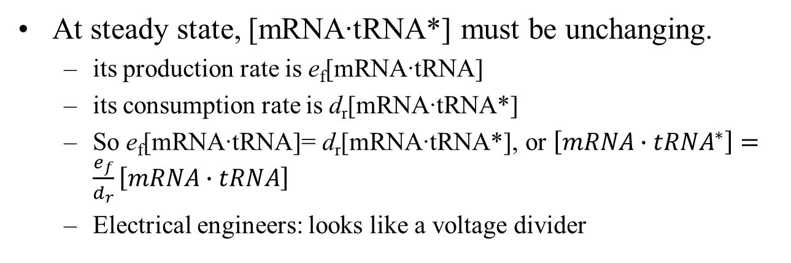
concentration stays constant at $\frac{b_{f}}{b_{r}}\left[mRNA\right]\left[tRNA\right]$
e_{f}
v
mRNA∙tRNA → mRNA∙tRNA* → product
↓
d_{r}
mRNA+tRNA
At steady state, [mRNA∙tRNA*] must be unchanging.
its production rate is e_{f}[mRNA∙tRNA]
its consumption rate is d_{r}[mRNA∙tRNA*]
So e_{f}[mRNA∙tRNA]= d_{r}[mRNA∙tRNA*], or $\left[{mRNA∙tRNA}^{∗}\right]=\frac{e_{f}}{d_{r}}\left[mRNA∙tRNA\right]$
Electrical engineers: looks like a voltage divider

Slide 33
.01
mRNA∙tRNA → mRNA∙tRNA*
2
.04
↓
Correct tRNA
.5
mRNA+tRNA
1
1
.01
mRNA∙tRNA → mRNA∙tRNA*
2
.0004
↓
100x discrimination
50
mRNA+tRNA
1
1
.01
mRNA∙tRNA → mRNA∙tRNA*
.02
.000004
↓
Wrong tRNA
10000x discrimination
50
mRNA+tRNA
1
1

Slide 34
Summary
b_{f}
e_{f}
p
mRNA+tRNA ⇄ mRNA∙tRNA ⇄ mRNA∙tRNA* → product
b_{r}
e_{r}
⇅
d_{f}
d_{r}
mRNA+tRNA
happens quite fast; essentially always at equilibrium
[mRNA∙tRNA] is 100x more for the correct binding
To the rest of the system, it seems like it presents a constant concentration
Very similar system; adds another 100x discrimination.
Concentrations here are independent of the first reaction (at least for a while)
[mRNA∙tRNA*] is 10000x more for the correct binding

Slide 35
What was the cost?
b_{f}
e_{f}
p
mRNA+tRNA ⇄ mRNA∙tRNA ⇄ mRNA∙tRNA* → product
b_{r}
e_{r}
d_{f}
⇅
d_{r}
mRNA+tRNA
The reactions are only independent because:
Separation of time scales made it work. But that means the system isn’t done until the slowest time scale. So we paid in speed
Excitation and decay are irreversible. That’s because there’s a molecular machine that expended energy. So we paid in “food cost”

Slide 36
What if…
1
1
mRNA+tRNA ⇄ mRNA∙tRNA → mRNA∙tRNA*
Correct tRNA
1
1
.5
.66
1
1
mRNA+tRNA ⇄ mRNA∙tRNA → mRNA∙tRNA*
Wrong tRNA
1
1
50
.02
Excitation happened as fast as binding?
Intuition: so much [mRNA∙tRNA] exits to the right that the difference between (1+.5) vs. (1+50) is no longer 100x
Discrimination is less powerful

Slide 37
What if…
.01
1
Correct tRNA
mRNA∙tRNA → mRNA∙tRNA* → product
2
↓
.013
.5
mRNA+tRNA
1
1
.01
1
mRNA∙tRNA → mRNA∙tRNA* → product
Wrong tRNA
2
↓
.0004
50
mRNA+tRNA
1
1
Product formation were very fast?
Intuitive argument: mRNA∙tRNA* would get turned into product so quickly that the difference between (1+.5) vs. (1+50) is no longer 100x
Again, discrimination is less powerful

Slide 38
What if…
.01
Correct tRNA
mRNA∙tRNA → mRNA∙tRNA*
2
2.04
⇅
1
.5
mRNA+tRNA
1
1
.01
mRNA∙tRNA → mRNA∙tRNA*
Wrong tRNA
.02
.02
⇅
50
1
mRNA+tRNA
1
1
Decay is not irreversible?
Only 100x discrimination, not 10000x
Intuitive argument: mRNA∙tRNA* would be created so quickly by new bindings that our first discrimination step would be irrelevant

Slide 39
Horseshoes and hand grenades
Why was it OK to only get the rate constants “good enough?”
Rate constants often do not need to be exact
They say which reactions have roughly the same rate (and so reach steady state jointly)
which reactions are way faster (can treat them as at equilibrium)
which are slower (they just sample the results of the others)
which are really slow (essentially irreversible)
Life must persist given unpredictable conditions
Cellular growth rates vary widely depending on environmental conditions
Mutations occur
Enzymes float around unpredictably
We’ve evolved to be extraordinarily robust
Life must tolerate changes in reaction rates

Slide 40
Talk about the lab code

Slide 41
How do molecular machines work?
Building a tiny machine is hard
cytoplasm is very viscous – to a molecule. Like swimming in honey
life in the world of low Reynolds numbers
How do you get energy from one place to another?
flywheels don’t work
inertia doesn’t work
store energy in chemical bonds
ratchet/pawl works pretty well
2016 Nobel prize for chemistry: molecular machines

Slide 42
The ribosome as a molecular machine
The ribosome is a complex machine
https://www.youtube.com/watch?v=1PSwhTGFMxs

Slide 43
The immune system
Anything that the immune system attacks is an antigen
Some antigens (e.g., pollen) are not pathogens
White blood cells called T cells recognize antigens
Each T cell binds with a slightly different antigen
The entire set of T cells can bind a very wide range of antigens
B cells are involved also (not relevant here)
T cell + antigen ⇒ activated complex
Starts a chain reaction that inactivates the antigen or kills the host cell.
Initiates clonal selection: …
T cell reproduces, producing effector T cells (which fight infection as above) and memory cells. This reproduction involves mutation; those that best bind the antigen undergo further clonal selection.
Effector cells die off after this infection; memory cells remain in your body for future infections

Slide 44
Result: an evolution-like process quickly produces T cells that bind/kill the antigen quite precisely
But: what if an antigen mistakenly binds something else?
E.g., binding pollen (hay fever)
Various auto-immune diseases
Antigens often have a shape that does not differ greatly from other molecules in the body
Why aren’t auto-immune diseases more common?
Nobody quite knows… but a form of kinetic proofreading is believed to be important

Slide 45
Compound interest
Stocks earn, on average, 7%
Start with $1. Invest it at 7% interest for 200 years → $750K
A mutual fund may take 1% in fees.
Start with $1, 6% for 200 years, you have → $115K
How did that happen?
Compounding over enough time makes small differences really big
Exponential growth is a very powerful thing

Slide 46
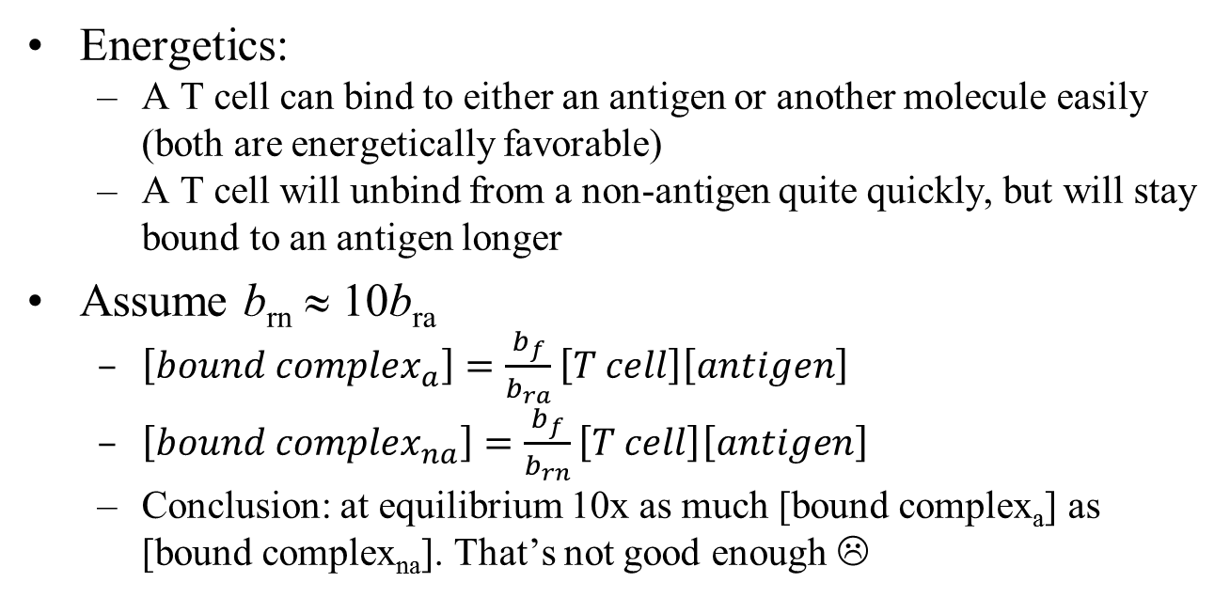
b_{f}
T cell+antigen ⇄ bound complex
b_{ra}
b_{f}
T cell+non-antigen ⇄ bound complex_{non-antigen}
b_{rn}
Energetics:
A T cell can bind to either an antigen or another molecule easily (both are energetically favorable)
A T cell will unbind from a non-antigen quite quickly, but will stay bound to an antigen longer
Assume b_{rn} ≈ 10b_{ra}
$\left[{bound complex}_{a}\right]=\frac{b_{f}}{b_{ra}}\left[T cell\right]\left[antigen\right]$
$\left[{bound complex}_{na}\right]=\frac{b_{f}}{b_{rn}}\left[T cell\right]\left[antigen\right]$
Conclusion: at equilibrium 10x as much [bound complex_{a}] as [bound complex_{na}]. That’s not good enough ☹

Slide 47
b_{f}
T cell+antigen ⇄ bound complex
b_{ra}
b_{f}
T cell+non-antigen ⇄ bound complex_{non-antigen}
b_{rn}
A different point of view (still assume b_{rn} ≈ 10b_{ra})
If an antigen has .9 likelihood of staying bound after 1 second, then is has ? likelihood of staying bound after n seconds
Then the non-antigen would have .09^{n} likelihood of staying bound after n seconds
If n=7, then the antigen is 10M x more likely to stay bound
That doesn’t change the fact that 10x as much [bound complex_{a}] as [bound complex_{na}] at equilibrium.
Things bind and unbind all the time, and usually there’s no prize for who stays bound the longest
.9^{n}

Slide 48
Phosphorylation
T cell +antigen ⇄ bound complex
Bound complex gets phosphorylated (another molecular machine)
And then again. And again…
Only after it gets phosphorylated numerous times does it attack an antigen.
Any time the antigen unbinds, all of the phosphorylation is removed
The next antigen to bind will start from a clean slate
Phosphorylation acts as a timer, ensuring that a molecule must stay bound a long time before being attacked
Kinetic proofreading
A molecular machine magnifies small affinity differences
No free lunch: the machine requires energy and time

Slide 49
T-cell references
T cell activation, Jennifer Smith-Garvin, Annual Rev. Immunology 2009
Excellent overall reference
Phenotypic models of T cell activation, Nature Reviews Immunology 2014
Current review of the different hypotheses for activation (including multiple variants of proofreading)
Alon chapter
High-level, readable overview

Slide 50
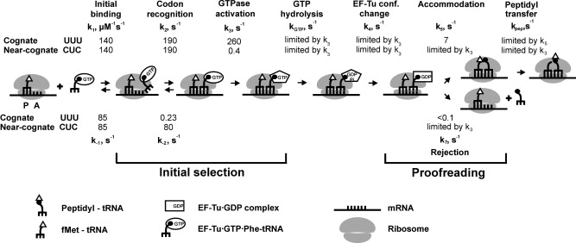
More detailed model
Binding
Excitation
Product
Decay
The model we’ve presented in class is over-simplified
The overall form is very similar
Two discrimination stages, separated by irreversible reaction
The differences are in the details…
*Picture from “Recognition and selection of tRNA in translation,” Rodnina 2004

Slide 51
Binding
Excitation
Binding is quite similar
Separated into two sub-stages now
tRNA is actually a complex; bound to EF-Tu and GTP
Helps the tRNA bind to the ribosome
Some of the energy from binding gets used for conformational change of the ribosome
The changed ribosome shape then allows…
GTPase is activated (and then hydrolyzed) much faster for a correct match
Near-cognate match does not give us enough energy for the ribosomal conformation change

Slide 52
Product
Product formation has an extra step
GTP hydrolysis allows EF-Tu to dissociate from tRNA
… which allows the tRNA to give its amino acid to the protein
… but first, the amino acid must move into place (70Å)
Accomodation is that movement
Takes longer for near-cognate than for cognate, so that near-cognate is more likely to dissociate from the ribosome
Just like T cells!

Slide 53
Decay
Decay is similar to our model from class
As noted, longer time period available for near-cognate matches
Irreversible step (tRNA must re-bind EF-Tu + GTP before it can re-bind a ribosome)

Slide 54
Potential final project:
Learn about how translation works
Build the above model using our chemical-reaction framework
Detailed resources:
Recognition and selection of tRNA in translation, Rodnina 2004. This is a nice mini review, and the source of the picture above.
Molecular biology of the gene, James Watson et al (7th edition). A standard molecular-biology textbook.
Structural insights into translational fidelity, James Ogle, 2005. A 40-page review; lots of detail, and enough words that it’s (mostly) easy to understand

Slide 55
Kinetic proofreading
What we’ll learn about biology
How the body discriminates between closely-related molecules (translation and T cells)
A bit about molecular machines
No free lunches: discrimination has a cost in time or energy
What we’ll learn about modeling
Inverse problems: find the parameters that give us a desired output
Exhaustive algorithms… try practically everything and still finish before dinner
Emergent properties
A simple framework for modeling molecular biology
Note the homework due dates & spring break

