Slide 1
EE 194/Bio 196: Modeling,simulating and optimizing biological systems
Spring 2018
Tufts University
Instructor: Joel Grodstein
joel.grodstein@tufts.edu
Lecture 5b: genetic algorithms

Slide 2
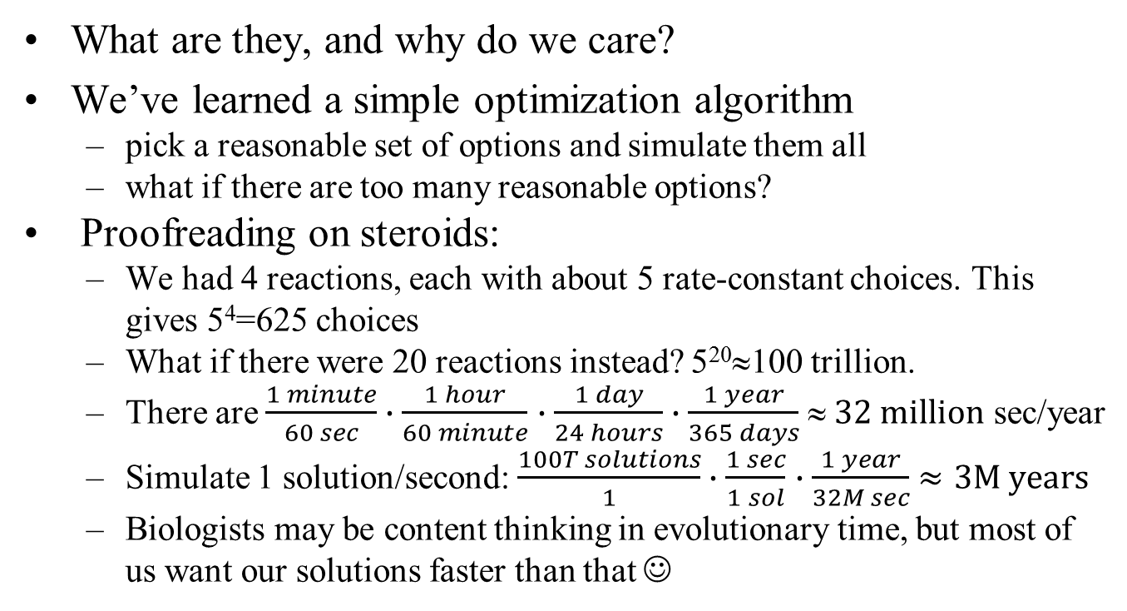
Genetic algorithms
What are they, and why do we care?
We’ve learned a simple optimization algorithm
pick a reasonable set of options and simulate them all
what if there are too many reasonable options?
Proofreading on steroids:
We had 4 reactions, each with about 5 rate-constant choices. This gives 5⁴=625 choices
What if there were 20 reactions instead? 5²⁰≈100 trillion.
There are $\frac{1 minute}{60 sec}∙\frac{1 hour}{60 minute}$ $∙\frac{1 day}{24 hours}∙\frac{1 year}{365 days}$ $ 32 million$ sec/year
Simulate 1 solution/second: $\frac{100T solutions}{1}∙\frac{1 sec}{1 sol}$ $∙\frac{1 year}{32M sec}$ $≈3M years$
Biologists may be content thinking in evolutionary time, but most of us want our solutions faster than that ☺

Slide 3
Another hard problem
How many choices do we have for controlling M.sexta in our homework?
5 legs + 4 muscles = 9 variables. But 10 time slots, so 9*10=90 total variables.
2 values for each, so 2^{90 ≈} 10²⁷.
$\frac{{10}^{27} solutions}{1}∙\frac{1 sec}{1 sol}$ $∙\frac{1 year}{32M sec}$ ≈31 million trillion years
Sorry, the homework is still due this semester ☹.

Slide 4
But nature solved it
Optimal control of limbs is a hard problem…
but we nonetheless do have M.sexta. Somehow nature has come up with a reasonable solution to this problem.
How has nature solved the problem?
Evolution. Don’t just try every solution, but use mutations, sex and survival of the fittest.
Can we leverage that?
Reverse engineer a real M.sexta under a microscope?
Sorry, reverse engineering that many neurons is impractical
Despite what the Human Brain Project hoped
Can we put in lots of electrodes & monitor neurons in real time?
Not easy, but possible
There will be very different neural patterns in different situations
And we may want to control a soft robot who doesn’t have M.sexta’s body

Slide 5
Robot reproduction?
Interesting idea: Could we just build soft robots that reproduce, and wait a few million years for them to evolve?
Cool idea? Crazy? And who has a few million years to wait, anyway?
Next idea: build soft robots that reproduce like rabbits, and wait a few hundred thousand years?
Soft robots that reproduce like E.coli, and wait a few months for them to evolve?
That reproduce 10 times/second, and wait an hour for them to evolve?
Models can reproduce that fast!
We don’t actually have to implement real robot reproduction, we just simulate it. Much easier
Computers are fast: we can simulate a million years in just a few hours
Computers can simulate evolution way faster than even E.coli can evolve
Does this really work?
In fact, quite often, yes.

Slide 6
Genetic algorithms: overview
Instead of a population of actual M.sexta, we will have a population of virtual (i.e., simulated) M.sexta.
each individual is a M.sexta with some unique strategy. I.e., a solution to our problem
each individual has “genes” – some way to represent a solution. For M.sexta, the genes may be our 90 variables
each individual is different (just like nature)
Pairs of solutions meet, fall in love and have children
children have a mix of both parents’ genetic material
Solutions can mutate also; one parent → one child
The fittest from each generation survive to the next
Solutions can live forever (if a parent is really fast, but has only slow children, the parent can survive into the next generation itself)

Slide 7
Example
M #1
Dist=500
M #2
Dist=400
M #3
Dist=350
Generation #1
M #4
Dist=550
M #5
Dist=300
M #6
Dist=450
Two children, 1 mutation
M #4
Dist=550
M #1
Dist=500
M #6
Dist=450
Generation #2
No concept of male vs. female solution
Parents can survive into the next generation
We’ve shown the most fit always surviving; you may want to allow some unfit solutions to survive also

Slide 8
Step #1: define the genes
Design our own set of genes
Doesn’t have to have any kind of biological reality
Doesn’t have to play crazy-complicated tricks like many real genes do
Usually it’s sexual reproduction with haploid genes (!)
Main rules: preserve our own sanity (we’ll have to code it!), and KISS
For the homework, a simple set of genes
90 genes
Each gene has one leg or muscle control for one time slot

Slide 9
Data representation
legs
muscles
0 | 1 | 1 | 1 | 1
1 | 0 | 1 | 1 | 1
1 | 1 | 0 | 1 | 1
1 | 1 | 1 | 0 | 1
1 | 1 | 1 | 1 | 0
0 | 1 | 1 | 1 | 1
1 | 0 | 1 | 1 | 1
1 | 1 | 0 | 1 | 1
1 | 1 | 1 | 0 | 1
1 | 1 | 1 | 1 | 0
100 | 0 | 0 | 0
0 | 100 | 0 | 0
0 | 0 | 100 | 0
0 | 0 | 0 | 100
0 | 0 | 0 | 0
100 | 0 | 0 | 0
0 | 100 | 0 | 0
0 | 0 | 100 | 0
0 | 0 | 0 | 100
0 | 0 | 0 | 0
10x5 array for legs
10x4 array for muscles
Represent Manduca with two arrays
Legs: each element is 1 for fixed, 0 for floating
Muscles: either 100 (Newtons) or 0

Slide 10
Step #2: define mating
Design our own robot reproductive rules
They define how two parents combine to make 1 child
Again, doesn’t really have to match how real animals mate
Some research claims that three parents works better than two!
Maybe just, for each of the 10 time segments genes, randomly take legs+muscles from one of the two parents.

Slide 11
Example mating
legs
muscles
legs
muscles
0 | 1 | 1 | 1 | 1
1 | 1 | 1 | 1 | 0
1 | 1 | 1 | 0 | 1
1 | 1 | 0 | 1 | 1
1 | 0 | 1 | 1 | 1
0 | 1 | 1 | 1 | 1
1 | 1 | 1 | 1 | 0
1 | 1 | 1 | 0 | 1
1 | 1 | 0 | 1 | 1
1 | 0 | 1 | 1 | 1
0 | 1 | 1 | 1 | 1
0 | 0 | 0 | 100
0 | 0 | 100 | 0
0 | 100 | 0 | 0
100 | 0 | 0 | 0
0 | 0 | 0 | 0
0 | 0 | 0 | 100
0 | 0 | 100 | 0
0 | 100 | 0 | 0
100 | 0 | 0 | 0
0 | 0 | 0 | 0
0 | 1 | 1 | 1 | 1
0 | 1 | 1 | 1 | 1
1 | 0 | 1 | 1 | 1
1 | 0 | 1 | 1 | 1
1 | 1 | 0 | 1 | 1
1 | 1 | 0 | 1 | 1
1 | 1 | 1 | 0 | 1
1 | 1 | 1 | 0 | 1
1 | 1 | 1 | 1 | 0
1 | 1 | 1 | 1 | 0
100 | 0 | 0 | 0
100 | 0 | 0 | 0
0 | 100 | 0 | 0
0 | 100 | 0 | 0
0 | 0 | 100 | 0
0 | 0 | 100 | 0
0 | 0 | 0 | 100
0 | 0 | 0 | 100
0 | 0 | 0 | 0
0 | 0 | 0 | 0
100 | 0 | 0 | 0
1 | 1 | 1 | 0 | 1
1 | 1 | 0 | 1 | 1
0 | 0 | 100 | 0
1 | 100 | 0 | 0
1 | 0 | 1 | 1 | 1
1 | 1 | 0 | 1 | 1
1 | 1 | 0 | 0 | 1
0 | 100 | 0 | 0
0 | 0 | 100 | 00
100 | 0 | 0
+
1 | 1 | 1 | 0 | 1
1 | 1 | 0 | 1 | 1
0 | 0 | 100 | 0
1 | 100 | 0 | 0
1 | 1 | 1 | 1 | 0
1 | 1 | 1 | 1 | 0
0 | 0 | 0 | 0
0 | 0 | 0 | 0
Each entire row comes from the corresponding row in one of the two parents
=

Slide 12
Define mating
Should we pick which parent to get genetic material from on a fine-grained level or coarse-grained?
Depends on what makes sense for your problem
Pulling very little pieces of DNA from parents may generate solutions that don’t make much sense
Pulling only large pieces may not introduce enough diversity

Slide 13
Reproduction in real organisms
Does our reproduction scheme seem similar to real life?
Not one bit. Real organisms tend to be sexual/diploid or asexual/haploid. We are sexual/haploid!
Organisms can reproduce sexually or asexually
Asexual: one parent → one child (mitosis, clone)
Sexual: two parents → one child (meiosis)

Slide 14
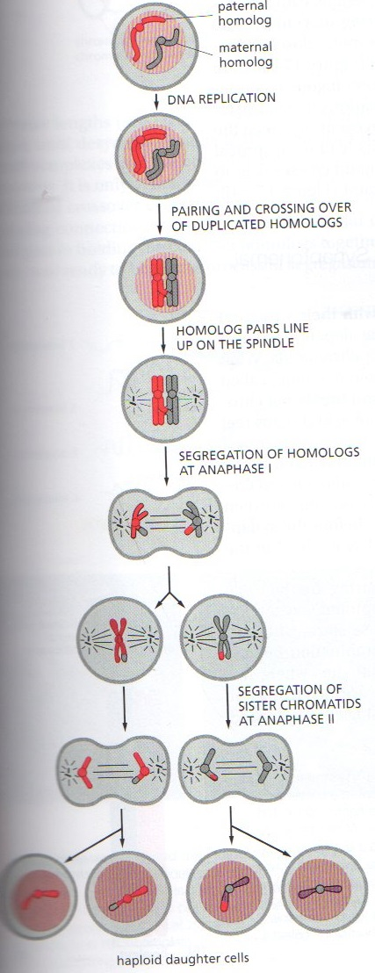
Meiosis
Sexual reproduction takes one chromosome from each parent (via meiosis), joins them via (e.g.,) dominant and recessive traits
GA does none of that. Why not implement what nature does?
Drawing credit: Molecular biology of the cell, Alberts, 6th ed

Slide 15
Why are GA “unnatural”?
Advantages of sexual reproduction & diploid chromosomes:
Diploid: genes that are counterproductive can remain in a population (as long as they are recessive); provides diversity in case the environment changes
It’s hard to see how we can implement sexual reproduction without diploid chromosomes (otherwise how would the gametes know which genes to put in which order?)
Why not implement this in GA?
Coding dominance is a lot of work, and arguably not needed
Our environment never changes (we have no Ice Age to drive sudden change)
We can arbitrarily decide that some unfit individuals will live
We can keep individuals for many generations if desired
Mutations can produce diversity, and are easy to implement

Slide 16
Step 3: define mutations
One parent mutates to produce one child.
Well, bacteria can do this
Decide what you want a mutation to be
Flip a few bits? How many?
Pros and cons of flipping lots of bits vs. a few?
Big mutations may help you quickly reach a reasonable solution in just a few generations (i.e., get a lot of diversity quickly)
Little mutations may be better when your population is already pretty good, and you want to fine-tune some of the solutions

Slide 17
Example mutation
parent
child
legs
muscles
legs
muscles
0 | 1 | 1 | 1 | 1
0 | 1 | 1 | 1 | 1
1 | 0 | 1 | 1 | 1
1 | 0 | 1 | 1 | 1
1 | 1 | 0 | 1 | 1
1 | 1 | 0 | 1 | 1
1 | 1 | 1 | 0 | 1
1 | 1 | 1 | 0 | 1
1 | 1 | 1 | 1 | 0
1 | 1 | 1 | 1 | 0
100 | 0 | 0 | 0
100 | 0 | 0 | 0
0 | 100 | 0 | 0
0 | 100 | 0 | 0
0 | 0 | 100 | 0
0 | 0 | 100 | 0
0 | 0 | 0 | 100
0 | 0 | 0 | 100
0 | 0 | 0 | 0
0 | 0 | 0 | 0
0 | 1 | 1 | 1 | 1
0 | 1 | 1 | 1 | 1
1 | 0 | 1 | 1 | 1
1 | 0 | 1 | 1 | 1
1 | 1 | 0 | 1 | 1
1 | 1 | 0 | 1 | 1
1 | 1 | 1 | 0 | 1
1 | 1 | 1 | 0 | 1
1 | 1 | 1 | 1 | 0
1 | 1 | 1 | 1 | 0
100 | 0 | 0 | 0
100 | 0 | 0 | 0
0 | 100 | 0 | 0
0 | 100 | 0 | 0
0 | 0 | 100 | 0
0 | 0 | 100 | 0
0 | 0 | 0 | 100
0 | 0 | 0 | 100
0 | 0 | 0 | 0
0 | 0 | 0 | 0
0
100
→
100
Copy the parent exactly
Mutate some number of bits
Perhaps replicate entire rows or row groups

Slide 18
Step 4: simulate evolution
Simulate one generation:
take n_{mating} pairs of parents and create new children
take n_{mutate} individual parents and create new children
evaluate the fitness of all new children
keep the fittest individuals (be they parents or children)
Do this over and over and over…
That’s about it!

Slide 19
Pros and cons
Pros of genetic algorithms:
Easy for biologists to understand ☺
Often works well. As an engineer, I would say “surprisingly well,” but perhaps the biologists are not surprised.
Cons of genetic algorithms:
It doesn’t always work well.
When not?
E.g., for the equivalent of eyes; a structure that has no workable near neighbors, where you either have it or you don’t.
HW #5 will show us how well it works.
Like actual evolution, it’s random. When we write our software, we will use random numbers to pick the mutation & crossover. So we might get lucky, or unlucky.
Randomness makes our code harder to debug.
There are numerous other classes of algorithms, by the way, that can be far faster or more optimal, but usually rely on some clever insights or more math.

Slide 20
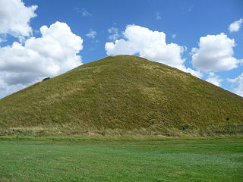
Nice easy hill to climb
People talk about “fitness landscapes.” Here’s an easy one.
No matter where you are, if you keep going uphill you’ll get to the top
if you have enough children, probably one will be a bit fitter than you
enough generations, you’ll reach the top

Slide 21
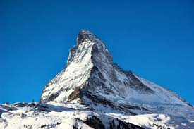
The Matterhorn
Yes, it’s one big hill.
But if you're standing on a knife edge, almost every direction is down
It means you have to take very small steps unless you’re heading in the right direction.

Slide 22
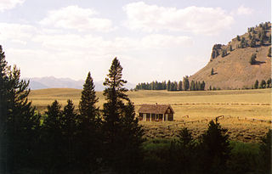
One hill surrounded by a vast plain
Lots of small steps will get you no extra fitness
You must (somehow) get to the hill, by a 1 in a million random chance
The equivalent of evolving an eye

Slide 23
Climbing in a mountain range.
You can climb to the top of a hill and not realize there’s a higher mountain nearby.
Mathematicians call this a local optimum
GA can often find a biologically optimal solution because the real system did indeed evolve

Slide 24
HW
run my GA and watch it evolve
discuss the HW
Go over “elif” (from if/then foils 13-15)

