Slide 1
EE 194/Bio 196: Modeling,simulating and optimizing biological systems
Spring 2018
Tufts University
Instructor: Joel Grodstein
joel.grodstein@tufts.edu
Lecture 6: bacterial chemotaxis

Slide 2
Bacterial chemotaxis
What is it?
“Chemo” ⇒ chemicals
“taxis” ⇒ motion towards
There is also phototaxis, electrotaxis, etc.
Why do we care?
May be used for cancer treatments
More practice using classes and objects
Lead-in to bioelectricity
Goal seeking without a soul
Bacteria have no brain, but can exhibit “intelligence”
Bacteria implement memory
One programming assignment; more practice with classes

Slide 3
Bacteria are smart
Well, not as smart as people
They can still solve some hard problems.
if there’s food somewhere, they’ll find it.
maybe grad students can learn something from bacteria ☺
Bacteria can swim really well
They try to swim towards a food source
This is hard!
They don’t have eyes, to see where the food is from far away
swimming in molasses is not easy to do

Slide 4
Human sound-taxis
Humans can locate sounds
Two ears, one on each side of the head
Which ear hears a sound first?
Could E.coli do something similar?
Sugar molecules diffuse
https://www.youtube.com/watch?v=oDgNBkxDoPM

Slide 5
E.coli proposal
the world (ECF)
E.coli, with left & right sugar sensors
Will this work? Can E.coli swim towards whichever “nose” senses higher [sugar]?
No.
E.coli are tiny (1μ long), and can detect a gradient of 1 molecule per μ
Their “left” side is really close to their “right” side.
[sugar]_{left} ≈ [sugar]_{right} .

Slide 6
People have only one nose
And we can tell where in a room perfume is
Even blindfolded
How do we do it?
Sniff once.
Walk a step
Stronger? Yes, keep walking. No, pick a new direction.
Go to step #2
Could E.coli use this strategy?
Yes. And they (mostly) do.

Slide 7
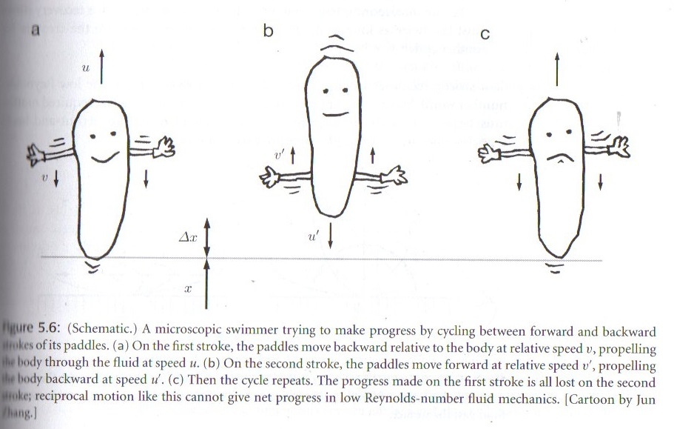
Swimming in molasses
How might E.coli swim?
Flapping doesn’t work (see below)
Can a front crawl work?
Could a breaststroke work?
E.coli does none of the above
No, you can’t get out of the water
Cilia work this way, but not in most bacteria
From “Biological Physics,” Philip Nelson

Slide 8
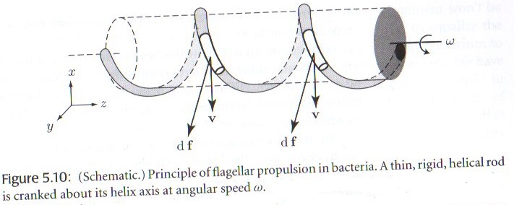
In fact, E.coli use a helical screw (like a propeller)
Cranked by a rotary motor
As usual, powered by ATP
And, yes, it’s somewhat jerky (but it still works) ☺
From “Biological Physics,” Philip Nelson

Slide 9
Steering
An E.coli has several flagella
each powered by a small motor.
each can turn clockwise or counterclockwise
If they all turn clockwise E.coli runs (i.e., swims “straight”)
If one of them suddenly turns counterclockwise, then the E.coli starts to spin randomly, called tumbling.

Slide 10
Chemotaxis proposal
have a memory
sample [sugar] and store it
pick a random direction and run
while (True):
sample [sugar]
if (it decreased relative to memory):
tumble
memory = sample
swim a bit
Show the animation
Do the E.coli in the animation seem to have a goal and be trying to achieve it?
Yes, but…
E.coli has no brain.
The central mechanism of chemotaxis is only half a dozen chemical reactions
How can a few reactions be smart? Don’t you need a brain to be smart?
our human brain is arguably just a bunch of chemical reactions, too
admittedly, about 100 billion neurons worth!

Slide 11
Chemotaxis proposal
have a memory
sample [sugar] and store it
pick a random direction
while (True):
swim a bit
sample [sugar]
if it decreased (relative to memory):
tumble
memory = sample
What do you think? Will it work?
How many details of the biochemistry are there?
Easy to understand or hard?
This is a high-level model
Yes. We saw the movie
None!
Easy and intuitive!

Slide 12
Top-down vs. bottom-up
Kinetic proofreading
bottom-up emergent model
started with lots of low-level detail; tried different parameters until a miracle emerged
if it does, you know where to look in the lab.
High-level model
start with a high-level, minimal-detail model
can it explain observed data? If not, on to the next idea
if so, then try to add more detail (& confirm w/lab work)
the good part: we get lots of intuition. The bad part: our high-level model might not be implementable
all models are wrong, but some are still useful

Slide 13
What next?
We have a high-level model. So what?
Bacterial chemotaxis is quite well studied & (at least in E.coli) well understood. In fact, our high-level model is not quite exact.
Potential final project: learn more about the biology and code a more detailed E.coli. Then you can decide if the intuitive high-level model helped you understand the details.

Slide 14
Chemotaxis and cancer
Synchronized cycles of bacterial lysis for in-vivo delivery, Nature 2016 (MIT group)
Salmonella typhimurium seem to naturally hunt down tumors. Take advantage of this
Initially simulated (predicted salmonella would work better than E.coli); later work done on mice with colorectal tumors grafted onto them
Add the following software to S. typhimurium
express a messenger protein AHL
if ([AHL] > quorum_threshold):
express haemolysin E (toxic to many tumor cells) self destruct
Nobody quite knows why (hypoxic?)
This is called quorum sensing
How do you cure your salmonella infection?
Could be antibiotics
You can engineer your salmonella to be dependent on a chemical that you provide
Not all of them die; a few survive, grow until a new quorum, and the cycle repeats indefinitely

Slide 15
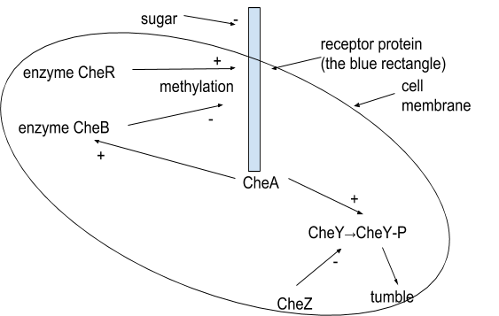
Details
Fast action path:
Methylated receptor binds to sugar → deactivates CheA
Activated CheA phosphorylates CheY, which enables tumbling
Slow adaptation path
Activated CheA phosphorylates CheB
This decreases methylation
Eventually returns [CheA*] to normal level; ditto for tumble freq
Where is the memory?
% of receptors that are methylated

Slide 16
Takeaways
Memory is really useful to have
And bacteria do have memory
We’ll see that memory is indispensable for morphogenesis also
It only takes a few reactions to build “goal-seeking” behavior
if they’re the right ones ☺
the same may be true for morphogenesis
Chemotaxis could be a tool for drug delivery
Now, on to bioelectricity

Slide 17
for next time
Talk about bounds on tumble interval. Too long, and random hits from other molecules change your run direction. Too short, and you don’t outrun diffusion.
That’s why you need perfect adaptation. Really, it’s a form of prop+integral control.

