Slide 1
EE 194 Advanced VLSI
Spring 2018
Tufts University
Instructor: Joel Grodstein
joel.grodstein@tufts.edu
Lecture 2: Moore's Law, Scaling and power

Slide 2
Technology scaling
Everyone has heard of Moore’s Law. It’s probably been mentioned in most newspapers at some point. But what does it really mean?
Every generation (1-2 years) all dimensions scale by 0.7
7²=0.5, so devices/unit area doubles
Consequences:
1000x performance increase from 1990-2010
Changed our lives
Why is Moore’s Law true?
It's less of a natural law, and more of a prediction of human progress.
Actually making this happen has had huge consequences
The definition of a "generation" is getting longer!
Let's examine the consequences of scaling dimensions

Slide 3
What do wires look like
Chips have multiple layers of metal
Typically, each successive layer runs perpendicular to the layers above, below
That was beyond my artistic skills
W
H
L
C_{lat}
C_{area}

Slide 4
Wire capacitance
Does anyone remember the formula for capacitance?
C_{area} ≈ εLW/H_{inter-layer}
Ignores fringing cap, etc.
C_{new}= ε(L_{new})(W_{new})/(H_{inter-layer,new})= ε(.7L)(.7W)/(.7H_{inter-layer}) = .7C
Intuitive explanation of what capacitance is?
a capacitor doesn’t like you to change the voltage across it. A big cap means that it takes a lot of charge flowing in to raise the voltage
W
H
L
C_{lat}
H_{interlayer}
C_{area}

Slide 5
What was supposed to happen
The master plan
Capacitances keep getting smaller.
A scaled transistor still effectively drove as hard
So delays keep getting faster.
The plan worked fine from about 1985-2005
The golden age of computing: everything kept getter better and better all the time ☺
And then it didn’t
wire R, physics and money got in the way
we’ve still not quite figured out what to do about it

Slide 6
Wire resistance
Does anyone remember the formula for resistance?
R = ρL/(WH), where ρ=1.7x10-8 Ω⋅m for copper
Ignores inductive effects (return resistance, skin effect), …
R_{new} = ρL_{new}/(W_{new}H_{new})= ρ(.7L)/((.7W)(.7H)) = R/.7
So if a wire just shrinks evenly, its resistance gets higher each generation! Very bad.
W
H
L
C_{lat}
C_{area}

Slide 7
Wire resistance
Physical analogy: a pipe of water. It’s hard to get water through a skinny pipe.
even if it’s short
W
H
L
C_{lat}
C_{area}

Slide 8
RC scaling
Wire delay ∝ RC (roughly)
(RC)_{new}=R_{new}C_{new} = (?R)(?C)
So wire RC delay is constant (assuming we’ve shrunk all dimensions equally)
R_{total}=R_{device}+R_{wire}
Wire delay didn’t shrink, and that eventually slowed delay scaling
How does the value of V_{dd} affect the RC delay?
RC delay is independent of voltage: raising or lowering supply voltage makes no difference
=(R/.7)(.7C)=RC
V
t

Slide 9
RC scaling
What about the time to cross a fixed distance (e.g., to cross the die with one long wire)
R = ρL/(WH)
Capacitance ≈ εLW/H_{inter-layer}
Now L remains constant, rather than shrinking (W, H shrink)
Compute it yourselves:
R_{new} = ρL_{new}/(W_{new}H_{new})= ρ(L)/((.7W)(.7H)) = R/.7²
C_{new}= ε(L_{new})(W_{new})/(H_{inter-layer,new})= ε(L)(.7W)/(.7H_{inter-layer}) = C
(RC)_{new} = R_{new}C_{new} = (R/.7²)(C) = 2RC
The RC delay to cross a fixed distance doubles each generation. Sounds bad?
In practice, nobody does this (see our HW1).

Slide 10
Transistor scaling
This is not a course in device physics; we will (must) gloss over almost everything ☹.
Suffice it to say that:
Scaling transistors is very hard. The physics is becoming black magic (and very expensive). Intel Fab 42 (7nm) = $5B equipment cost.
1.2nm gate-oxide thickness is only about 5 atoms thick, resulting in gate leakage.
Device threshold voltages must get smaller to scale speed, but this results in more sub-threshold leakage (kT/q is constant).
Transistors somehow continue to shrink.
Device currents do continue to increase, which (along with less capacitance) keeps delays decreasing… but not much

Slide 11
Power
Now for the fun part.
What are the units of power and energy (from 1st-semester physics)?
Energy is an amount of work (Joules)
Power is energy per unit time (a derivative, J/sec or Watts)
Why we care
A battery holds a fixed amount of energy. After we expend that much energy, it’s dead.
If a chip uses 5W of power, then how much heat does it generate?
5W. A chip does no mechanical work, so all power is converted to heat.
High power means your chip can double as a toaster ☹.

Slide 12
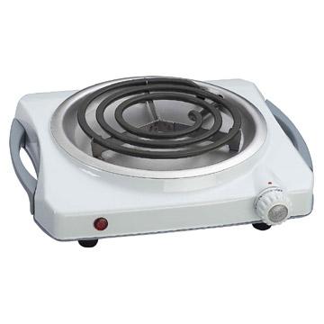
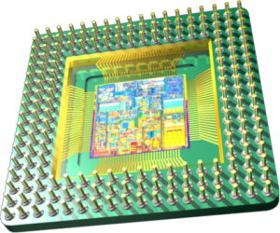
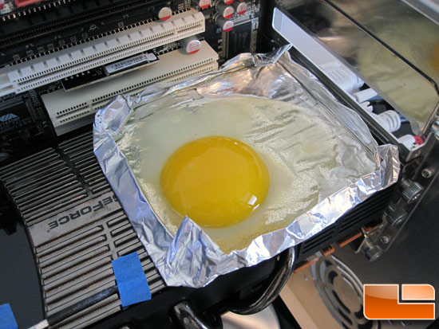
A Microprocessor as a HotPlate
= ?

Slide 13
Circuit-level power, take 1
V_{OUT}
V_{IN}
C
What is this circuit?
Simple CMOS inverter
You all remember this from EE103, right?
When the input falls, the output ???
rises

Slide 14
Circuit-level power, take 1
V_{OUT}
V_{IN}
C
When the output rises, energy is expended. Where does it go?
Energy stored in the electric field of a capacitor = .5CV²
Energy dissipated as heat via resistance = .5CV² (extra-credit problem derives this)
If there were no resistance, how much heat would be created?
None! Ideal capacitors do not generate heat

Slide 15
Dynamic power
A capacitor stores and releases electric charge. This creates an electric field, which stores energy. A capacitor does not create heat.
But the charge on a capacitor gets there through wires and transistors, which have resistance. Any time charge flows through resistance, that process creates heat.
Intuitively, think of any mechanical object that moves against friction. It gets hot. The more friction and the faster the movement, the hotter it gets.
The power supply charges & discharges capacitance through transistors and wires, which burn power & emit heat.

Slide 16
Dynamic power
Then energy stored in the capacitor is .5CV². Miraculously, this is also the heat generated by the resistance.
The actual resistance of the transistors and wires is irrelevant!
Not always a general law, but works pretty well for our case.
See the extra-credit problem for more detail.
If energy to switch one node is .5CV², then power=$\frac{energy}{switch}∙\frac{switches}{sec}$ =.5CV²f
Which energy are people talking about when they say .5CV²f?
The energy dissipated as heat through the resistor
The capacitive energy will get turned into heat when we discharge

Slide 17
Worst-case power scaling
From about 1980-2005, performance kept increasing
people kept V fairly high, since higher V → higher freq
frequency scaled superlinearly
Assumptions for capacitance:
If die area stayed the same… C_{total} gets linearly bigger each generation (W_{total}, L_{total} remain constant, H shrinks)
In fact, die area keeps increasing (more xtor → more performance)
Plus, leakage kept getting worse
fell slowly
not looking good!
CV²f
much bigger

Slide 18
The Power Problem
In about 2005, the industry started getting very serious about power. How did they do it? Necessity was the mother of invention.

Slide 19
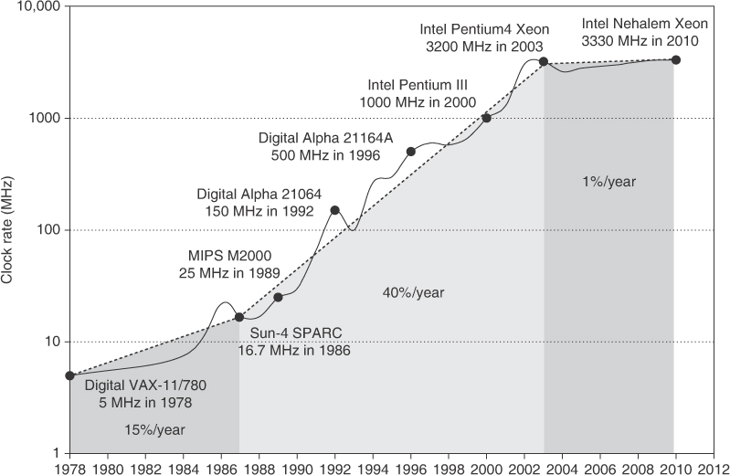
Why power stopped increasing
Because frequency stopped increasing!
They avoided having chips double as nuclear reactors by no longer increasing frequency (and other tricks, too)

Slide 20
Power scaling since 2005
Frequency has not gotten much higher
Future topic: DFVS, adapting freq to demand
Voltage scaled down as fast as it could
But kT/q is a fundamental limit
Die areas have gotten larger over time, .5CV²f hasn’t. Reasons why (architectural or circuits)?
As noted, f has stayed pretty constant
Extra die area has been use for low-power caches, with little switching
Or for integrating system logic, with low f.
Dark silicon is the logical extension of this
GPUs are an exception
Coming soon: clock gating keeps C_{effective} << C_{total}

Slide 21
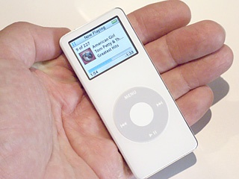
Cooling an iPod nano ...
iPod relies on passive transfer of heat from case to the air.
Why? Users don’t want
fans in their pocket ...
To stay “cool to the touch”
via passive cooling,
power budget of 5 W.
If iPod nano used 5W all the time, its battery would last 15 minutes

Slide 22
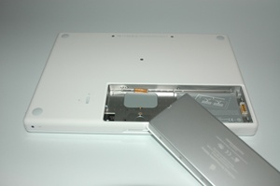
Battery: Set by size and weight limits ...
Battery rating: 55 W-hour.
At 2.3 GHz, Intel Core Duo CPU consumes 31 W running a heavy load - under 2 hours battery life! And, just for CPU!
46x more energy than iPod nano battery. And iPod lets you listen to music for 14 hours!
Almost full 1 inch depth. Width and height set by available space, weight.
At 1 GHz, CPU consumes
13 Watts. “Energy saver” option uses this mode ...

Slide 23
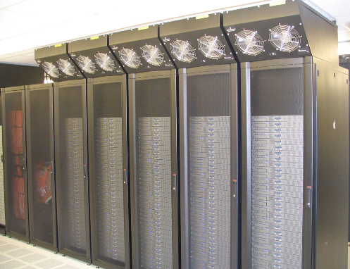
Servers: Total Cost of Ownership (TCO)
Machine rooms are expensive. Removing heat dictates how many servers to put in a machine room.
Electric bill adds up! Powering the servers + powering the air conditioners is a big part of TCO.
Should we care about power for big servers?
Reliability: running computers hot makes them fail more often.

Slide 24
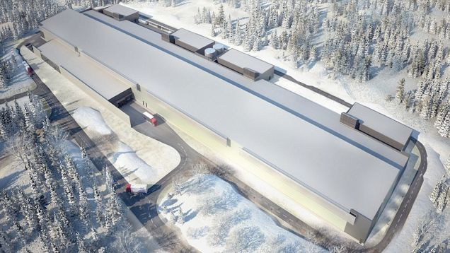
Facebook server farm: Sweden
a

Slide 25
Advertising campaign for Utah

Slide 26
Power is a problem
Scaling is making power a bigger and bigger problem
Let’s look at it in more detail – and look at how to minimize it.

Slide 27
Static Power Dissipation
V_{in}
I_{SC}
C
Short-Circuit Current:
Direct Current Path between VDD and GND when both NMOS and PMOS transistors are conducting
caused by finite-slope input signals and by subthreshold leakage
anyone remember what that means?

Slide 28
Static Power Dissipation
V_{in}
I_{SC}
C
Assume V_{dd}=1V, V_{t}=.4V
If .4V<V_{in}<.6V, then both N and P devices will be on
Lower V_{dd} to .7V
What voltage range will incur I_{SC}?
Subthreshold leakage means that both devices conduct somewhat for (e.g., for the N) V_{in}<V_{Tn}.
Lowering V_{dd} definitely reduces I_{SC}.
V_{in} >.4 and <.3
So, does not occur. But…

Slide 29
Effect of slew rate on I_{SC}
V_{in}
I_{SC}
V
C
t
V_{in} can be either the solid black (fast slew rate) or dotted black (slow) line; V_{out} is blue.
Which V_{in} will lose more energy from I_{SC}?
slower slew rate will spend more time in the I_{SC} region
same currents, but over more time → more energy

Slide 30
Range of reasonable gate sizes
Assume that the right-side inv has a fixed size
What are the pros and cons (speed and power) of having the left-side inv be much smaller, about the same, or much larger?
Bigger means faster. But there are diminishing returns. And bigger area means more capacitance and more power
Smaller means less power. But it also means slower. And slower means more I_{SC} through the right-side inverter

Slide 31
How far can you lower V_{dd}?
Lowering V_{dd} will lower CV² quadratically, and also lower I_{SC}. How low can you go?
As V_{dd} approaches V_{T}, gate delay gets much larger (not just linearly)
What if V_{dd} gets even lower than V_{T}? Can any devices turn on?
Nominally not, but subthreshold conduction still works
Inverters can still function
Very low power, but extremely slow
Can we lower V_{T}?
Not really; we become susceptible to exterior fixed-magnitude noise
kT/q is constant, and we get hit by random thermal noise

Slide 32
Static Power Dissipation
V_{in}
C
Gate leakage
Gate leakage is a quantum tunneling phenomenon
The gate oxide is an insulator; classical physics says no current can flow through it
When gate-oxide thickness is small enough, quantum tunneling can occur
electron’s momentum & position cannot both be known precisely; if you know it is not moving fast enough to surmount the energy barrier, then you don’t know which side of the oxide it’s on

Slide 33
In-class group exercise
Why would each of these tricks reduce static power?
Use fewer & smaller-width transistors
Less transistors leaking; and I=V/R, so more R means less I_{sc} each
Lower supply voltage
reduces subthreshold leakage and thus I_{SC}
Keep signal slew rates fast
Less time when both transistors are on, so reduces I_{sc} duration
Increase V_{T}
reduces subthreshold leakage (but hurts speed)
Why might physical designers use high-V_{T} devices, but then change to low-V_{T} on critical paths?
To expend leakage power only where it will do the most good
Switch to high-k dielectric
reduces gate leakage (but increases gate capacitance)

Slide 34
Reducing dynamic power
Next up: how can we reduce dynamic power?

Slide 35
Activity factor
We said that:
energy to switch one node is .5CV²
power=$\frac{energy}{switch}∙\frac{switches}{sec}$ =.5CV²f
In more detail:
power=$\frac{energy}{switch}∙\frac{switches}{cycle}∙\frac{cycles}{sec}$ = (.5CV²)∙AF∙f
AF is the activity factor
potentially different for every node
says (on average) how many switches to expect per cycle
C_{eff} ≡ AF ∙ C
combines AF and C into one number: so power= .5C_{eff}V²f
this assumed that switches/sec=f; i.e., every node switches once every cycle

Slide 36
Activity-factor examples
Consider a counter that increments every cycle
What is the activity factor for…
Its low-order bit (bit #0)?
Bit #1?
The clock?
V_{dd}?
If bits #0 and #1 have C=20ff, C_{clock}=500ff and V_{dd} has C=10000ff, which has the most dynamic power?
1
.5
2
0
The clock overwhelms any other single node (and is often comparable to all other nodes combined)

Slide 37
Lowering Dynamic Power
Reducing V_{dd} has a quadratic effect
Also increases gate delay ~linearly (until V_{dd}→V_{T})
If we lower voltage and freq, power reduces cubically.
Keep It Simple, Stupid
architectural complexity → size → long wires, big capacitances → power.
Reduce switching activity
Clock Gating idle units or stalled pipe stages
Reduces AF and thus C_{effective}.

Slide 38
Clock gating
Perhaps the most common technique for reducing power.
It is powerful.
Consider the cone of logic driving a node (i.e., the transitive fanin all the way back to registers).
If all of the registers are clocked by the same clock, and it’s gated, then the entire cone is quiescent.
Turn off as many clocks as you can!
Leave on the ones that are doing real work ☺
Examples to draw:
E-stage adder and multiplier: clock them together?
Two bits of the same datapath: clock them together?

Slide 39
Limits to clock gating
Flops that are changing must clock ☺
Physical-design limits on granularity
It’s physically painful to make many low-fanout clocks.
So we usually have a reasonably small number of fairly high-fanout clocks
We can only gate off the clock when everything it drives is guaranteed to be inactive.
Turning off an entire pipe stage, or an entire unit, is a Really Good Thing

Slide 40
Di/dt noise
Circuits 101: ΔV = L di/dt
L = inductance (dominated by how big your package is)
di/dt = how fast total supply current changes
When current changes rapidly, you get voltage spikes
Any physical intuition for why that is?
An inductor will not let the current through it change instantly.
When you try to do so, it induces a voltage to create a counteracting current.
voltage
current
time

Slide 41
Di/dt noise
Circuits 101: ΔV = L di/dt
So if
we are doing lots of computation, and
we suddenly run out of data and stop, then…
… our voltage rises (and, e.g., perhaps puncture gate oxide)
And if
we are waiting for data and so not doing much, and
the data arrives and we quickly do computation, then…
… our voltage drops (and, e.g., latches lose state).
But didn’t we just say to turn off clocks aggressively?
Yes, but not too aggressively ☺
And don’t turn them all on at once!
Big servers often have micro-architectural hooks to control this
Consequences:
Limits how aggressively we can turn off circuits to conserve power
It’s one limit on how low we can make V_{dd} (i.e., we have to be sure the supply voltage stays a lot bigger than the di/dt noise!).

Slide 42
Summary of reducing power
We went over many ways to reduce power:
Keep supply voltage as low as feasible (within performance limits)
Keep V_{t} high (except for critical paths)
Keep frequency as low as possible
Keep gate delays “reasonable”
Sleep units whenever possible
Turn off clocks to reduce dynamic power (but watch out for di/dt)
Remember: architectural complexity → size → long wires, big capacitances → power (Keep It Simple, Stupid)

Slide 43
The future
Everyone has predicted the end of Moore’s Law for 15 years already.
It hasn’t stopped yet, but it definitely has slowed down.
Manufacturing costs have risen.
Any “Law” predicting exponential growth clearly cannot keep going forever!
And Moore’s Law violates Murphy’s Law ☺.
Living with the end of Moore’s Law (power) will be a recurring theme for the rest of the course

Slide 44
Coming up later…
EE194/Advanced Architecture focuses on architectural power savings.
Our next topic will be static-timing analysis and speed binning
lots of connections with minimizing power and setting V_{dd}
Then comes clocking
we’ll cover conditional clocks in a lot of detail
Another unit on DFVS
all about saving power by lowering V and F
We may also discuss dark silicon
We may discuss timed digital logic
Perhaps the most power-efficient form of digital logic

Slide 45
In-class exercises
If we double the thickness of the oxide between metal layers, how does that affect R and C of wires? Can you think of any disadvantage to doing this?
A particular circuit has a total of 10 pF of capacitance, and runs at 2 GHz at .9V with an activity factor of .2. Compute P_{dyn}. If the static power is 1mW, compute the total power. If the computation requires 2000 cycles, how much heat will be generated?

