Slide 1
EN1 Electricity inside of you
Fall 2022
Tufts University
Instructor: Joel Grodstein
joel.grodstein@tufts.edu
Moving averages

Slide 2
Big picture of the course
What is bioelectricity?
Neurons and working with the nervous system
Cardiac bioelectricity
Worms

Slide 3
Today’s problem
How to clean up noisy signals
Without having a baby/bathwater problem!

Slide 4
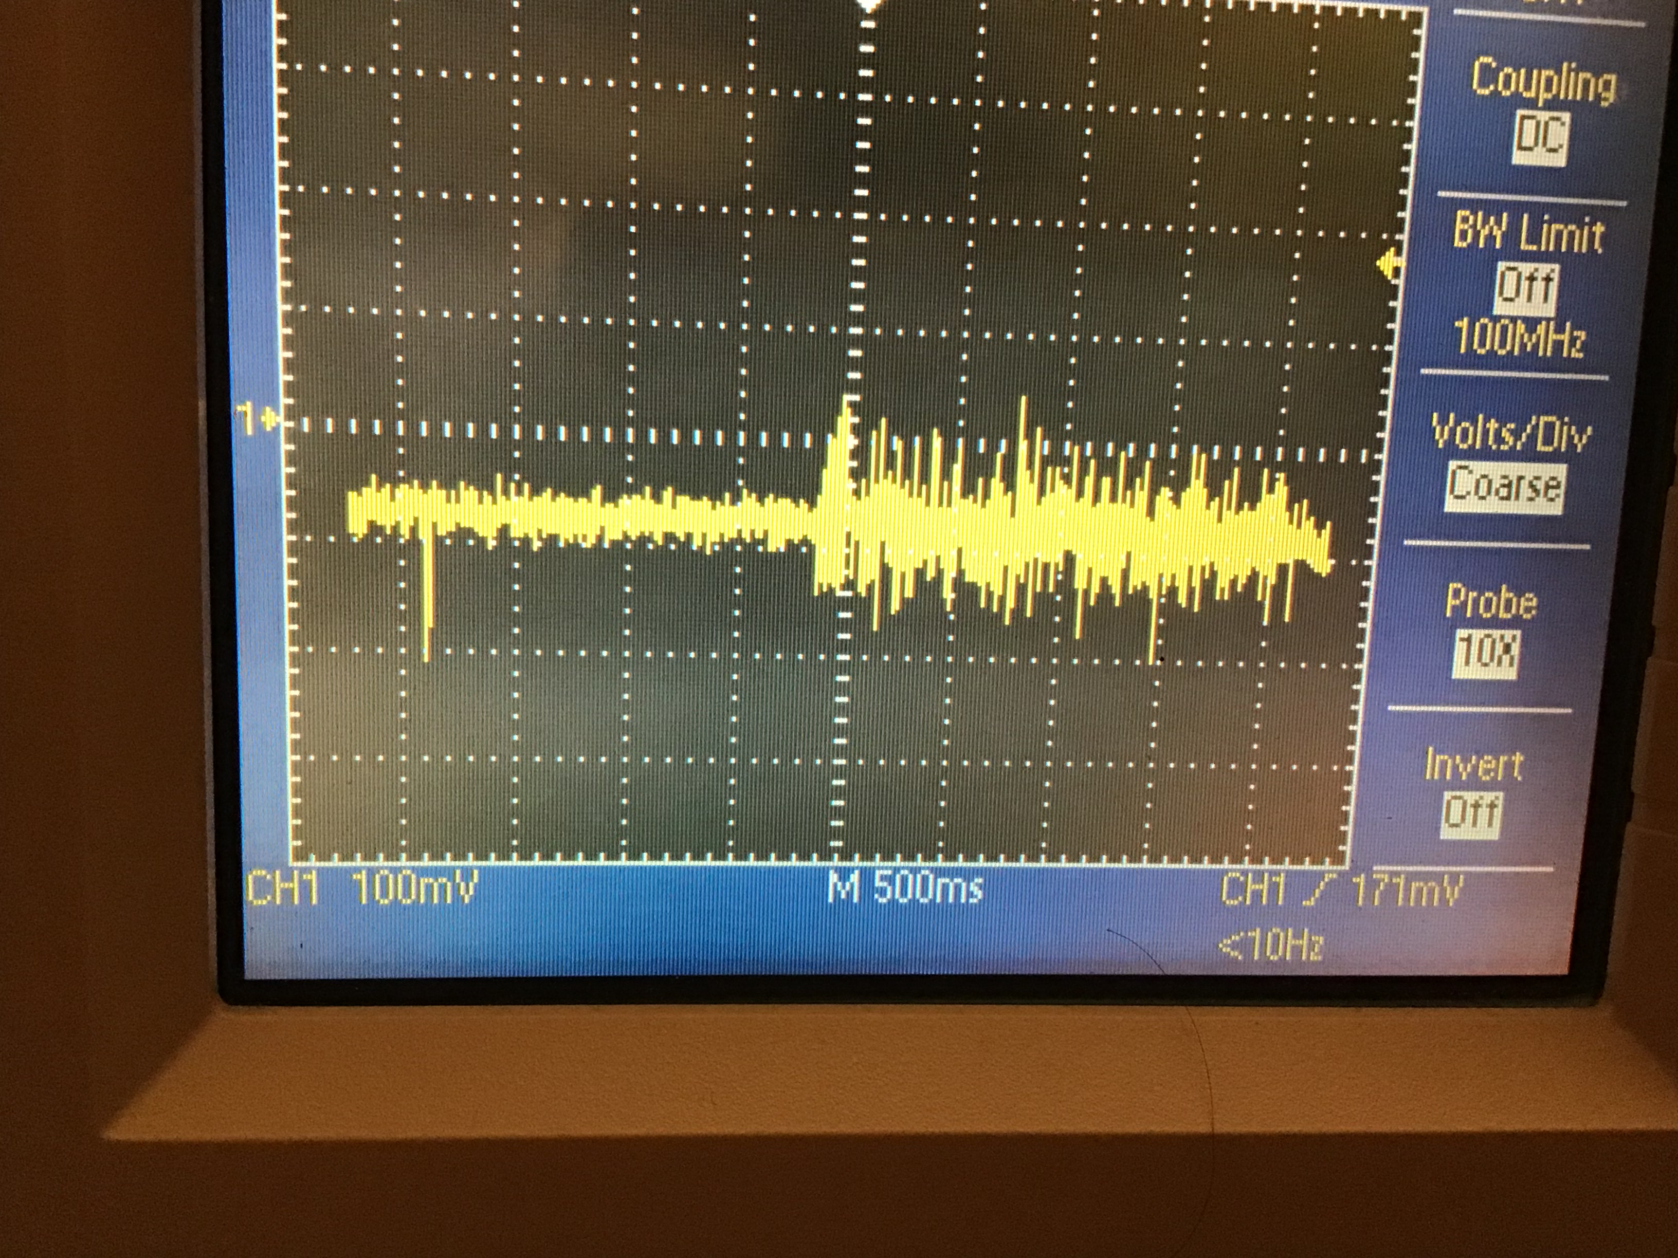
Filtering
Left side: sEMG with muscle quiet
Right side: muscle clenched
What do we want to get rid of and why?
Fancy word: “get rid of it” ⇒ filter it away
How can we get rid of the noise (but not throw away the baby)?
Notes:
Why do we want to get rid of it? it is distorting our muscle-force measurements when the muscle is on, and making it harder to discriminate between on vs. off.
Getting rid of it is hard… we could just subtract about 40mV from the muscle-on signal, but the interaction is probably more complicated than that.
The picture is Dropbox\preamp_pictures\5_3_2021\ad623_sEMG4.jpg.

Slide 5
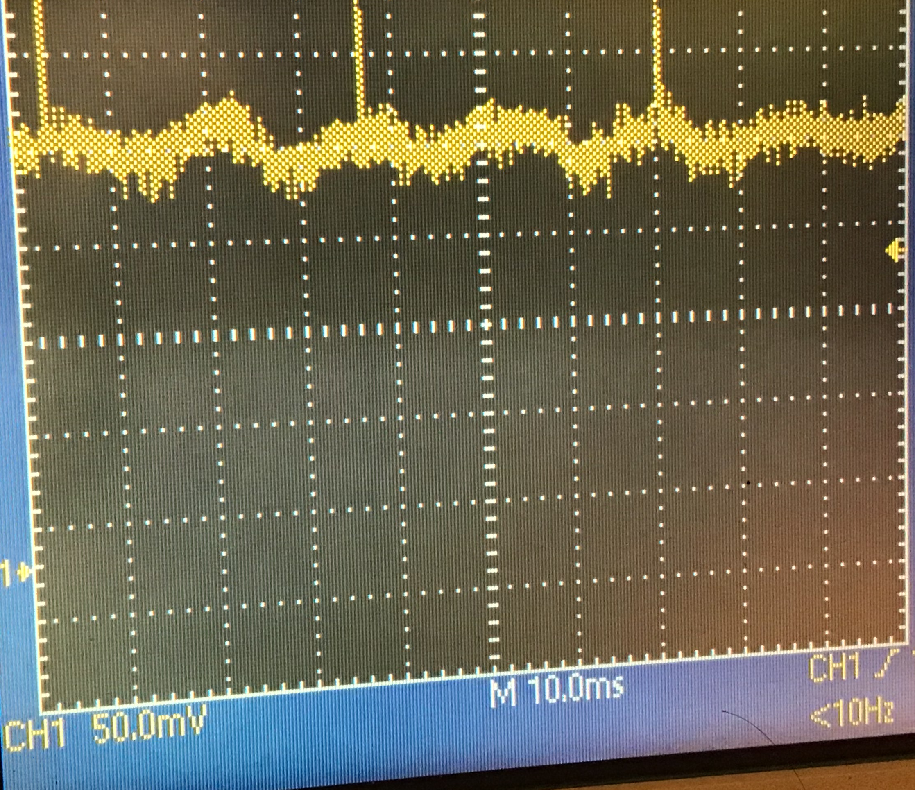
Filtering
This picture is zoomed in from last slide
What frequency is the noise?
Where is it from?
With knowledge comes power – we can now get rid of the noise
Notes:
The picture is Dropbox\preamp_pictures\5_3_2021\ad623_sEMG10.jpg.
The main signal is 60 Hz, but there’s clearly a much-higher-frequency noise on top of that also. Maybe 500 Hz?

Slide 6
Idea #1: moving average
Start with a sampled sine wave that’s our noise signal
Do a moving average of the last 4 signals
Last “4” samples are [1]
Moving average = 1
Notes:
Why isn’t our first red dot at t=0? Probably it should be, but that would have (with a constant sampling interval) made all of the dots at t=0, making this a trivial example ☹.
Yes, I really should redraw this to shift the sine wave left and make it 1 at t=0.
And a real sample signal would have more than two samples/cycle… but that would make the example more complex.

Slide 7
Idea #1: moving average
Start with a sampled sine wave that’s our noise signal
Do a moving average of the last 4 signals
Last “4” samples are [1,-1]
Moving average = 0

Slide 8
Idea #1: moving average
Start with a sampled sine wave that’s our noise signal
Do a moving average of the last 4 signals
Last “4” samples are [1,-1,1]
Moving avg = 1/3

Slide 9
Idea #1: moving average
Start with a sampled sine wave that’s our noise signal
Do a moving average of the last 4 signals
Last “4” samples are [1,-1,1,-1]
Moving avg = 0

Slide 10
Idea #1: moving average
Start with a sampled sine wave that’s our noise signal
Do a moving average of the last 4 signals
Last “4” samples are [-1,1,-1,1]
Moving avg = 0

Slide 11
Idea #1: moving average
Start with a sampled sine wave that’s our noise signal
Do a moving average of the last 4 signals
Last “4” samples are [1,-1,1,-1]
Moving avg = 0
All subsequent averages will be 0

Slide 12
Moving-average intuition
If you sample points from multiple cycles, they’ll all mostly average out
Wider filter → sample from more cycles → more averaging out
Signal oscillates faster → fixed-width filter gets more samples → more cancelation
High frequencies get attenuated ⇒ low-pass filter

Slide 13
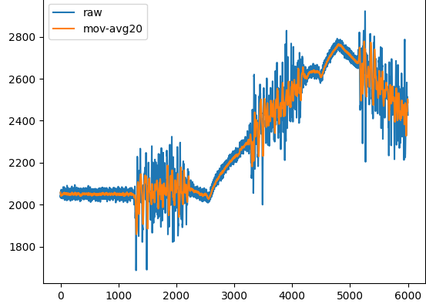
Idea #2: fixing baseline drift
Baseline drift can occur from slow movements (e.g., breathing)
Blue signal: raw data
Orange: 20-sample moving-average filter to remove 60-Hz noise
20 samples = 1/50 sec > 1 cycle
Notes:
The figure comes from frequency.xlsx, tab semg2_with_manual_drift. I then copied the numbers into a temporary file and plotted them.

Slide 14
Idea #2: fixing baseline drift
Leaving the drift in place would trick us into calling sample #4800 a very strong signal
But how do we get rid of it?
Notes:
The figure comes from frequency.xlsx, tab semg2_with_manual_drift. I then copied the numbers into a temporary file and plotted them.

Slide 15
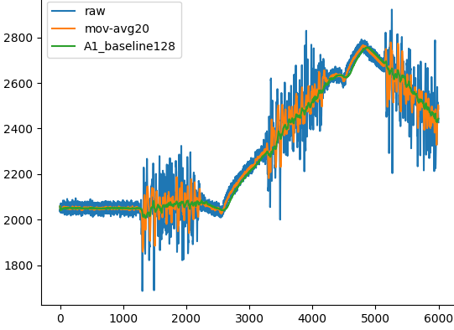
Another moving average – now over 128 cycles
baseline drift is a very slow change
now subtract off the baseline

Slide 16
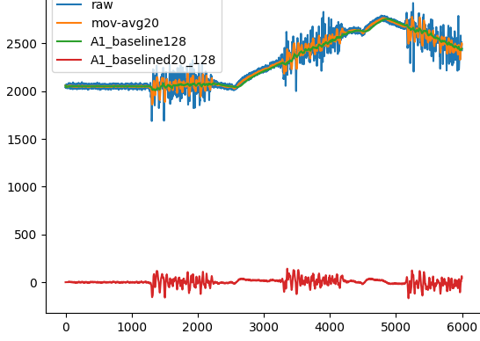
Red signal has baseline drift removed
Nearly noise-free
Centered at y=0

Slide 17
Lab 4 code Moving average

Slide 18
Moving average
1, 5, 2, 9, 3, 5, 1, 6
(1+5+2+9)/4=4.25

Slide 19
Moving average
1, 5, 2, 9, 3, 5, 1, 6
(5+2+9+3)/4=4.75

Slide 20
Moving average
1, 5, 2, 9, 3, 5, 1, 6
(2+9+3+5)/4=4.75

Slide 21
Moving average
1, 5, 2, 9, 3, 5, 1, 6
and so on… easy, right?
Some code:
for i in range(3,len(numbers)):
avg = (numbers[i]+numbers[i-1]+[i-2]+[i-3])/4
do something with avg
This isn’t good enough! Any reasons why?
needs a really big list
needs 4 adds/output term (what about a 128-wide sum?)
you need the entire list before you can start
Let’s fix these issues!
(9+3+5+1)/4=4.5

Slide 22
Clever observation #1
We really only need one subtract and one add per output
The data: 1, 5, 2, 9, 3, 5, 1, 6
1 + 5 + 2 + 9 original: 17
5 + 2 + 9 + 3 17 - 1 + 3 = 19
2 + 9 + 3 + 5 19 -5 + 5 = 19
9 + 3 + 5 + 1 19 – 2 + 1 = 18
Can do one subtract + one add per term even for a 128-wide filter!

Slide 23
Computer-science trick #2: circular buffer
For a four-wide moving average, how many numbers must we store?
The data: 1, 5, 2, 9, 3, 0, 1, 6
1
5
2
9
Original: 1 + 5 + 2 + 9 = 17 (must still divide by 4)

Slide 24
Computer-science trick #2: circular buffer
For a four-wide moving average, how many numbers must we store?
The data: 1, 5, 2, 9, 3, 0, 1, 6
1
5
2
9
3
0
1
6
Next term=3, and 17 – 1 + 3 = 19
Next term=0, and 19 – 5 + 0 = 14
Next term=1, and 14 – 2 + 1 = 13
Next term=6, and 12 – 9 + 6 = 10

Slide 25
Code from lab 6 (sEMG LEDs)
compute the current location in the first circular buffer
read the ADC
val = ch0_ADC.read()
f1_ptr = n_reads & f1_mask
ch0_f1_run_sum += (val - ch0_circ_buffer1[f1_ptr])
ch0_circ_buffer1[f1_ptr] = val
f1_out = ch0_f1_run_sum >> divide_f1
n_reads += 1
update the moving-average, do the divide
so the current location moves the next time around

Slide 26
Ditto for buffer #2 (the baseline)
same idea as the first filter
f2_ptr = n_reads & f2_mask
ch0_f2_run_sum += (val - ch0_circ_buffer[f2_ptr])
ch0_circ_buffer2[f2_ptr] = val
baseline = ch0_f2_run_sum >> divide_f2
baselined = f1_out - baseline
ch0_run_sumsqr += (baselined * baselined)
Fix any baseline drift
And work on our per-segment RMS
Notes:
Note we haven’t talked about per-segment RMS yet! It’s in the background notes for lab #4.

Slide 27
Per-segment RMS
Next problem
We still have a signal that swings up and down a lot

Slide 28
Per-segment RMS
We want it to look more like this
Our tricks: RMS, Schmidt trigger, segments

Slide 29
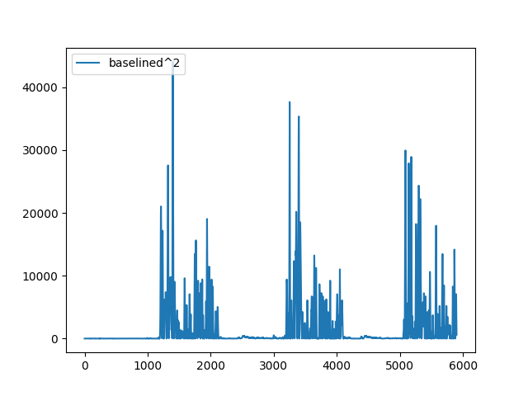
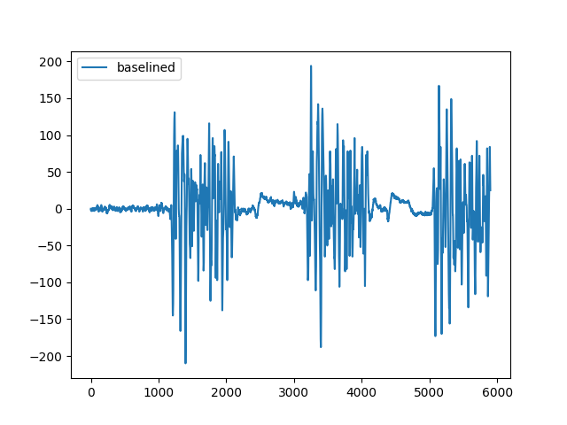
Square
First, remove negative numbers by squaring
negative numbers are gone ☺
but the numbers still bounce around, and are very big
Notes:
This signal is taken from \data\csv_files\semg2_with_drift (with the first 100 points removed). Somehow it doesn’t look quite like the last picture…

Slide 30
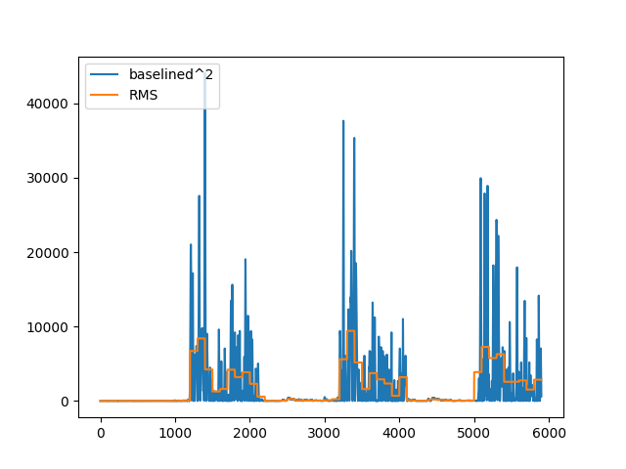
Segment average
Next, segmental averages
Typically, take square root to get numbers smaller
Root Mean Square
we won’t bother

Slide 31
Ditto for buffer #2 (the baseline)
same idea as the first filter
f2_ptr = n_reads & f2_mask
ch0_f2_run_sum += (val - ch0_circ_buffer[f2_ptr])
ch0_circ_buffer2[f2_ptr] = val
baseline = ch0_f2_run_sum >> divide_f2
baselined = f1_out - baseline
ch0_run_sumsqr += (baselined * baselined)
Fix any baseline drift
And work on our per-segment RMS

Slide 32
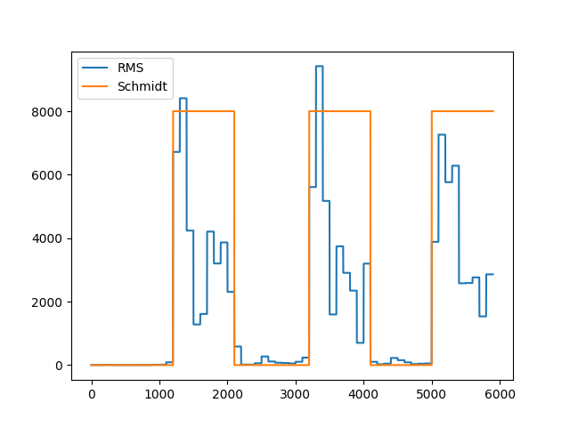
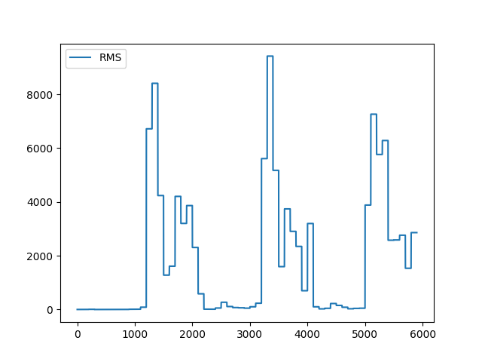
Schmidt trigger
Final issue: signal is still too bouncy
we’ll want to turn an LED just on vs. off
must draw a dividing line somewhere

Slide 33
End-of-segment computation
Every (e.g.,) 100th sample…
pos_in_current_segment += 1
if (pos_in_current_segment==f3):
ch0_On,changed=Schmidt(ch0_On,ch0_run_sumsqr,
ch0_Schmidt0,ch0_Schmidt1)
muscle_fun (ch0_On, changed)
pos_in_current_segment=0
ch0_run_sumsqr=0
n_reads += 1
if (n_reads>NSAMPLES):
timer.deinit()
Schmidt-trigger computation and call user function
Prep for next segment
When we’re all done, stop the timer

