Slide 1
EN1 Electricity inside of you
Fall 2022
Tufts University
Instructor: Joel Grodstein
joel.grodstein@tufts.edu
Day #1

Slide 2
What we (won’t) build
https://xkcd.com/730/
This is a second-time new class, about bioelectricity
We will not be building circuits like the comic (Darn!)

Slide 3
Agenda for today
What is bioelectricity and why do we care?
The past – impact in the last 50 years
The present and near future – the next 10 years
Basic research in body shape
Logistics of this course

Slide 4
What is bioelectricity?
Any suggestions for a definition?
What parts of your body do you think use it?
Brain?
Heart?
Anyplace else?
Notes:
Pretty much every cell in your body generates electricity. Other than your heart & nervous system, nobody really knows why!

Slide 5
Why might you care?
1980-2022
Computing goes from slide rule to cell phones
Pace of change is slowing down
Changes the world (not always for the better!)
Industry focus: neural network for better ads
2022-2040?
Biology + engineering = ?
Biology + electricity = ?
Already changing the world (not always for the better!)
Motto: successful engineering is interdisciplinary
The easy problems have mostly already been solved
We live in an interdisciplinary world
Notes:
Steve Jobs, John Sculley story – computing has changed the world
A computer has gone from fitting into a big room, to the palm of your hand, to being implanted next to your heart.
Bioengineering is arguably not always a societal good, either – think of the recent debate on modifying human embryonic DNA.
For interdisciplinary big problems, think climate change.

Slide 6
Joke
Doctor sees you for 10 minutes & fixes your pain, and charges $1000…
The pandemic has driven this home pretty well
Notes:
Doctor joke – how much were you willing to pay 10 minutes ago when you were in pain?

Slide 7
Agenda for today
What is bioelectricity and why do we care?
The past – impact in the last 50 years
The present and near future – the next 10 years
Basic research in body shape
Logistics of this course

Slide 8
Can you think of any successes?
Where has bioelectrical medicine succeeded so far?
Diagnosis tools?
Drugs that affect your bioelectrical system?
Implants that affect your bioelectrical system?
Notes:
diagnosis: ECG, EMG/NCS, brain scans, fMRI
Drugs: ion-channel blockers for cardiac issues; GJ blockers for general anaesthesia!
Implants? Pacemaker for sure, and PNS/SCS.

Slide 9
Agenda for today
What is bioelectricity and why do we care?
The past – impact in the last 50 years
The present and near future – the next 10 years
Basic research in body shape
Logistics of this course

Slide 10
Why now?
Real disruption “takes place on the edge of where one industry is colliding with another industry and [Jobs] said therefore you’ve got to zoom out”
John Sculley
Convergence between:
Biology: the controller of everything in our bodies; genomics + neurons = too much data to deal with
Electronics: miniature, wireless power
Big data: lots of bioelectrical & chemical signals
Notes:
Scully was talking about the convergence of entertainment and computing, which of course isn’t our focus.
The “miniature” is because neurons are really small and we’re only beginning to be able to read/write them.

Slide 11
Electroceuticals
Electroceuticals: miniature electronic devices, alter the signal flow in (at first) peripheral nerves
£500M investment by GlaxoSmithKline (the largest British drug maker). First products expected in mid-2020s
Galvani Bioelectronics (funded by Alphabet and GSK) offering $1M prize for the first implantable device that can record/block/stimulate neural signals stably for 60 days. You don’t offer a prize unless you have some expectation it will be claimed
Trial underway to control rheumatoid arthritis with vagus-nerve stimulation (https://www.scientificamerican.com/article/can-zapping-the-vagus-nerve-jump-start-immunity/ )
US FDA recalled nearly half a million pacemakers due to a vulnerability that could allow hackers to literally stop hearts beating (https://thehackernews.com/2017/08/pacemakers-hacking.html )
Notes:
The big deal with electroceuticals: they are specific rather than systemic.

Slide 12
More electroceuticals
Some videos
https://youtu.be/CHNzYbT7ufY – walking after spinal paralysis at EPFL, and https://www.epfl.ch/labs/courtine-lab/
https://www.youtube.com/watch?v=bh68vdQxftc – CEO of Cala Health
Some articles
https://www.independent.co.uk/life-style/health-and-families/features/electricity-new-medicine-nuroscience-brian-spinal-cord-a8614911.html
https://burnstrauma.biomedcentral.com/articles/10.1186/s41038-018-0123-2
Action Potential Venture Capital
Kendall Square VC firm, funded by GSK, specializes in electroceuticals
Imran Eba usually comes to EE123 for a guest lecture

Slide 13
Agenda for today
What is bioelectricity and why do we care?
The past – impact in the last 50 years
The present and near future – the next 10 years
Basic research in body shape
Logistics of this course

Slide 14
Morphogenesis
One of the black mysteries of biology
An egg and sperm unite to form one cell. That cell contains all of your DNA
Fast forward 9 months or so. You now have 37 T cells
Each has exactly the same DNA as the one starting cell
DNA is the software that tells a cell how to behave. How can they do different things?
Because every cell runs the same software, but with different inputs (in this case, chemical and electrical signals that are the SW outputs)
All of those 37T cells, each running the exact same software, have talked to each other and agreed on who does what! Which are eyes, feet, etc
Incredible feat of distributed computing. No idea how!

Slide 15
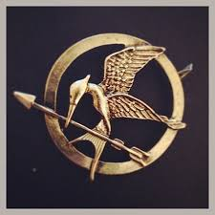
Morphogenesis in popular culture
mockingjay
We will not cover genetic engineering of mutant animals
(We will talk about some very weird nature)

Slide 16
Why do we care?
If we’re not trying to build the Hunger Games, why do we care about morphogenesis?
It’s a cool problem & a dark mystery
We want to turn a stem cell into a kidney (avoid a lifetime of immune suppressants)
Problem: nobody quite knows how
Works fine in an embryo
Throw a stem cell into an adult body ⇒ no
Punch line:
“37T cells have talked to each other and agreed…”
Growing evidence of electrical communication

Slide 17
Agenda for today
What is bioelectricity and why do we care?
The past – impact in the last 50 years
The present and near future – the next 10 years
Basic research in body shape
Logistics of this course

Slide 18
Where, when
Lab days
build lots of things
sEMG, ECG, preamps, A/D, PyBoard
some Python
Lecture days
just enough theory to do the labs
some biology, some medicine
just enough to understand applications of bioelectricity

Slide 19
Group work
Divide up into groups of 2-3 people
Each group does the labs together
only hand in one report
but everyone learns the material ☺
Reform groups 3-4 times during the semester
Minimize odds of getting stuck with “incompatible” people for a long time
Get to know more people
Final projects are also in groups
Pick your own people
Hopefully you know who you work with well by then

Slide 20
Grading
No tests, no final exam
About eight labs = 65%
Final project = 25%
Participation = 10%

Slide 21
Workload
Labs are meant to be self-contained
do the lab, talk to each other about questions while you’re there
write up questions after class
No homework
Final project prep will take thought and time
but should hopefully be fun and creative too ☺

Slide 22
Medical confidentiality
We’ll measure bodily signals
sEMG = signals from brain to muscles
ECG = heart beating
Recording your own signals is optional
It is confidential medical data
Turn in one data set per group (or turn in mine)
None of us are clinically qualified to diagnose from an EMG or ECG
Any abnormalities you see may well be artifacts of our cheap equipment. See a licensed doctor if you have concerns

Slide 23
Class web page
https://www.ece.tufts.edu/en/EIY
Syllabus, class calendar, all lecture slides
All labs, as well as the lab turn-in
Go over safety stuff

Slide 24
Polls
How much programming experience do people have?
How much biology?
Physics?
Building stuff?

Slide 25
This is not a programming course
There’s ES2, CS 11/15, ...
We’ll learn/use a minimal amount of Python
about 3 lectures worth
If you want more
most labs have a “bonus” section
there’s a free online text, lectures
Final projects range from 0 to lots of programming

Slide 26
Right now
Check your login
Questions?

Slide 27
Us
Coding
ES 2
CS 11, CS 15
Physics
PHY 11,12
PHY 25
EE/BME 123
Medical instrum
BME 100
EE 110

Slide 28
Embedded computing
What defines a computer?
Permanent memory to store lots of programs & data; (only) common thread is the computation
Some kind of keyboard & screen
Cost > $100; about 80M PCs sold in 2021 (+tablets, phones, …)
What defines an embedded-computation device?
One main purpose, & it’s not computation
Pacemaker, refrigerator, greeting card, car ABS, …
Perhaps no keyboard or screen
Cost = anything; 200M refrigerators, 200K pacemakers/year
Notes:
All sales numbers are for US only

Slide 29
Why do we care?
Most medical systems use embedded computing
Our PyBoard is, too
Tufts will offer a minor in embedded computing

Slide 30
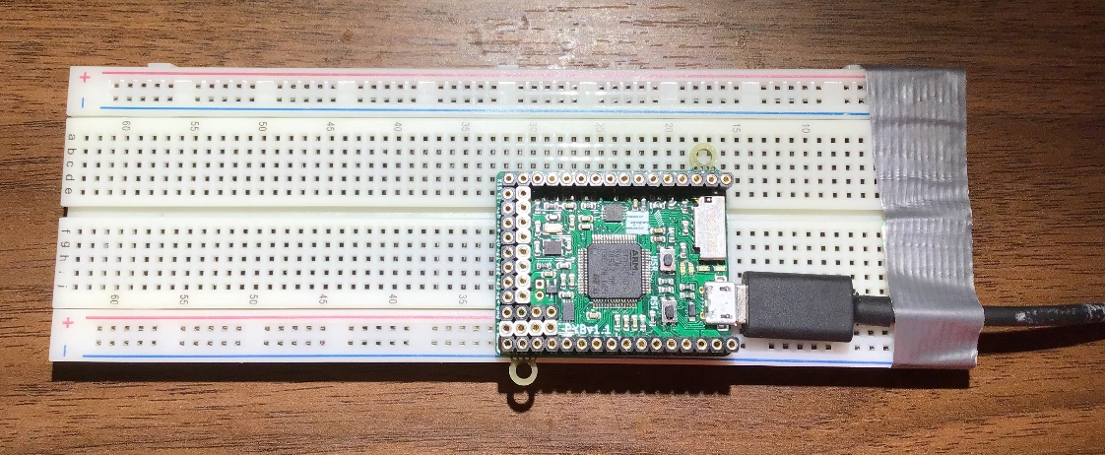
Our labs will program and use the PyBoard
No keyboard or screen!
So how do we use it?

Slide 31
Using a host IDE
PyBoard
USB
PC (host)
Write programs on the PC with an Integrated Development Environment (IDE)
Save the programs on PC hard drives
Download/run on PyBoard via USB
Program can flash LEDs, drive speaker, …
Program can send printout → IDE screen
Or – downloaded program can remain on PyBoard

Slide 32
Office hours
Listed on the course web page

Slide 33
Nolop reminder

