Slide 1
EN1 Electricity inside of you
Fall 2022
Tufts University
Instructor: Joel Grodstein
joel.grodstein@tufts.edu
4 – The frequency domain

Slide 2
Big picture of the course
What is bioelectricity?
Neurons and working with the nervous system
Cardiac bioelectricity
Worms

Slide 3
Today’s lecture
Working with signals in the frequency domain
What does that mean?
What problem(s) will it solve?

Slide 4
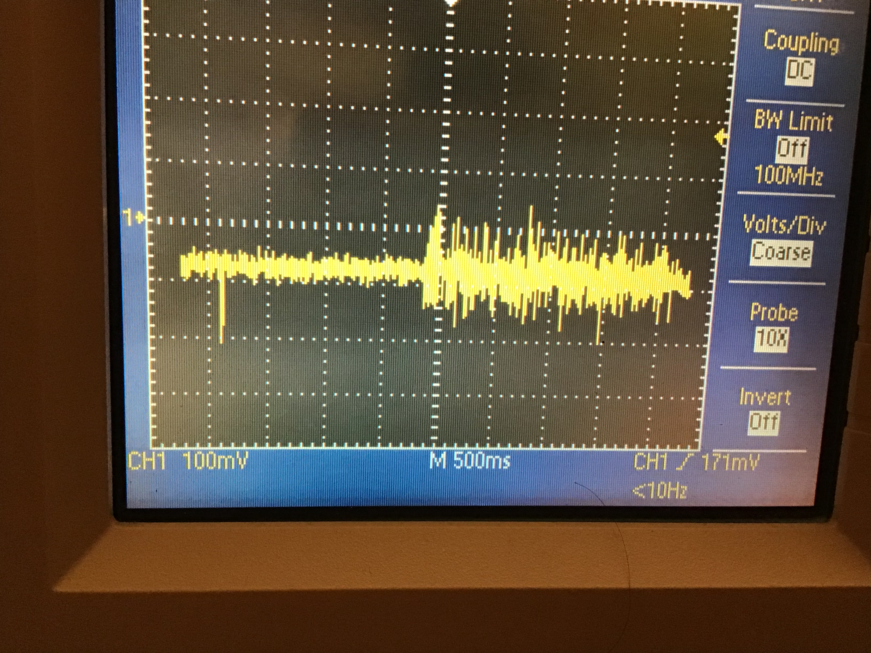
Filtering
Remember this?
Left side: sEMG with muscle quiet
Right side: muscle clenched
What do we want to get rid of and why?
Fancy word: “get rid of it” ⇒ filter it away
How can we get rid of the noise (but not throw away the baby)?
Notes:
Why do we want to get rid of it? it is distorting our muscle-force measurements when the muscle is on, and making it harder to discriminate between on vs. off.
Getting rid of it is hard… we could just subtract about 40mV from the muscle-on signal, but the interaction is probably more complicated than that.
The picture is Dropbox\preamp_pictures\5_3_2021\ad623_sEMG4.jpg.

Slide 5
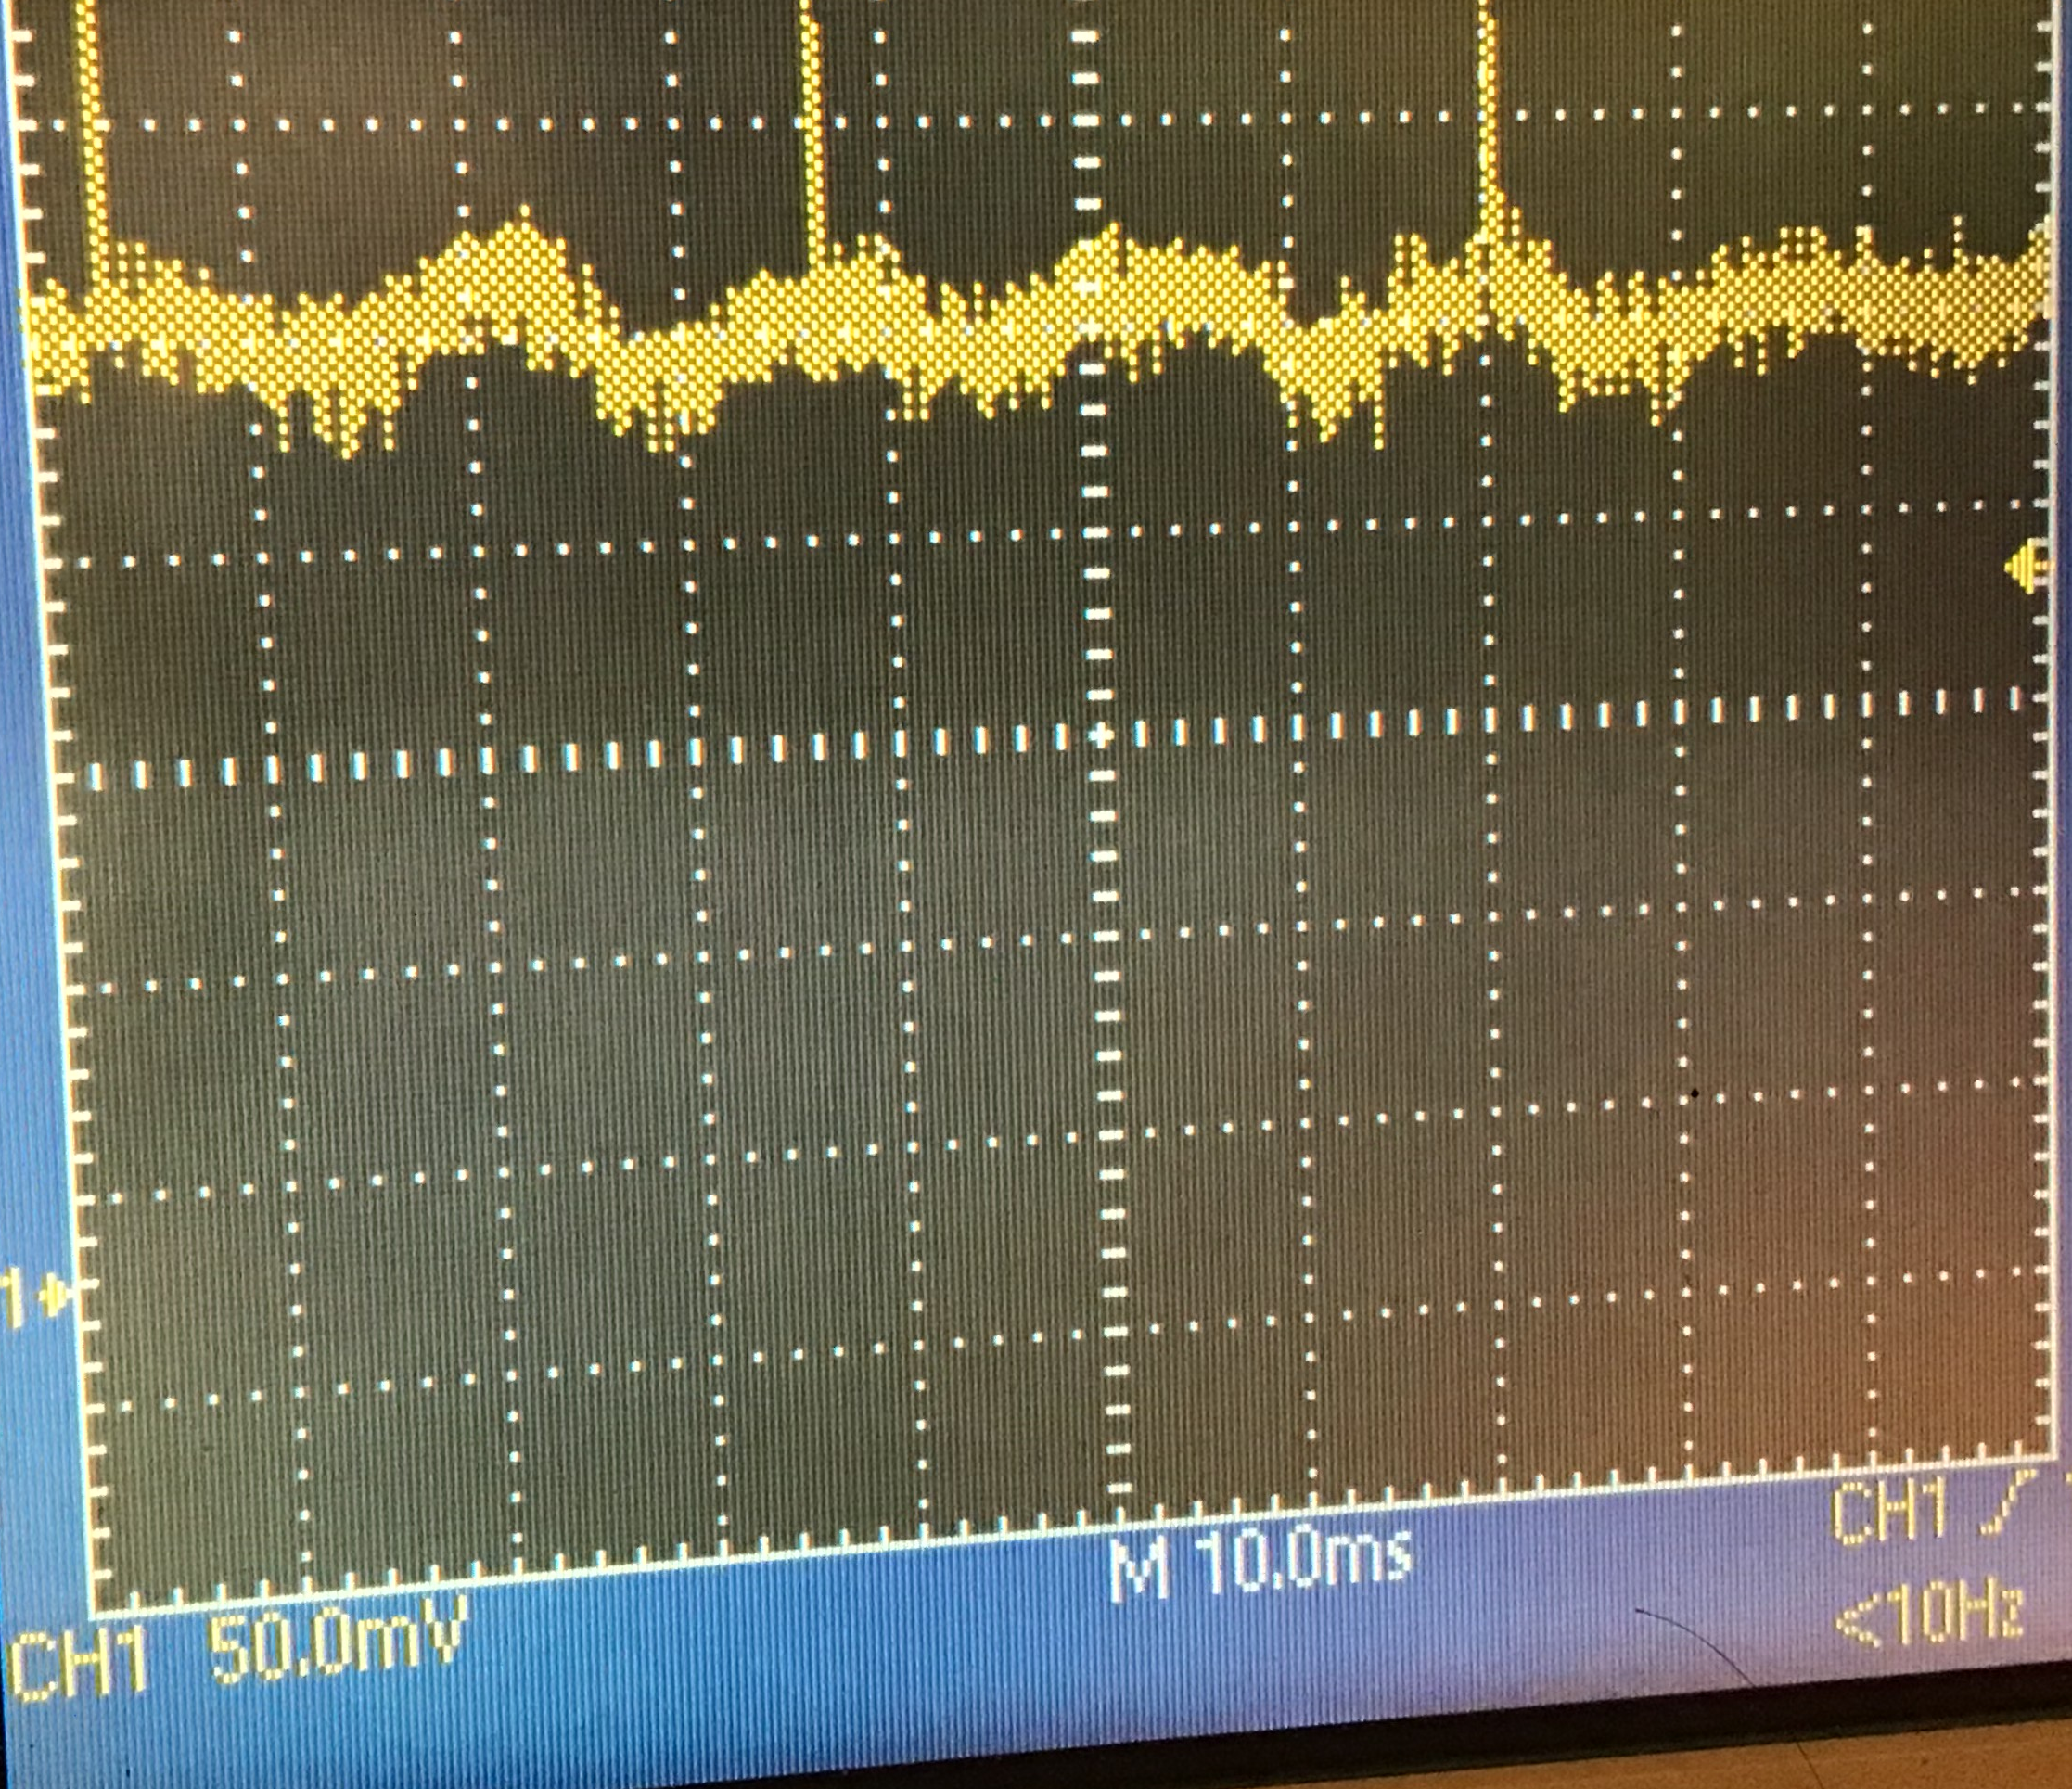
Filtering
We noted that the noise is 60 Hz
This picture is zoomed in from last slide
What frequency is the noise?
Where is it from?
With knowledge comes power – we can now get rid of the noise
Notes:
The picture is Dropbox\preamp_pictures\5_3_2021\ad623_sEMG10.jpg.
The main signal is 60 Hz, but there’s clearly a much-higher-frequency noise on top of that also. Maybe 500 Hz?

Slide 6
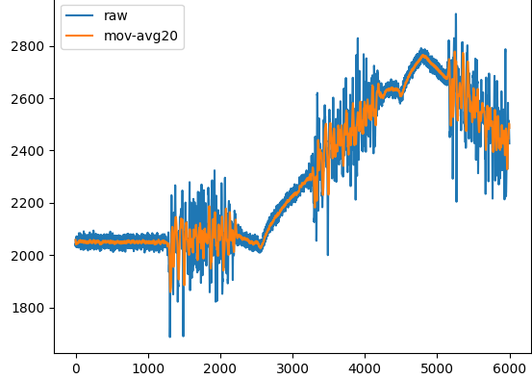
We reduced the noise with a moving-average filter
$\left(\frac{1 sec}{60 cycles}\right)\left(\frac{1000 samples}{sec}\right)$= $\left(\frac{16 samples}{cycle}\right)$
So average over ≥ 16 samples
Notes:
The figure comes from frequency.xlsx, tab semg2_with_manual_drift. I then copied the numbers into a temporary file and plotted them.

Slide 7
Noise is dramatically reduced ☺
Notes:
The figure comes from frequency.xlsx, tab semg2_with_manual_drift. I then copied the numbers into a temporary file and plotted them.

Slide 8
But so is the signal ☹
This is our lead-in to a quick overview of Fourier analysis
Just a quick overview!

Slide 9
Frequency domain
Have you ever seen a sound-mixing board?
break music into ≈20 frequency bands
adjust their volume independently
The key
any signal can be broken into the sum of sinusoids of different frequencies
maybe a counter-intuitive notion – but true!

Slide 10
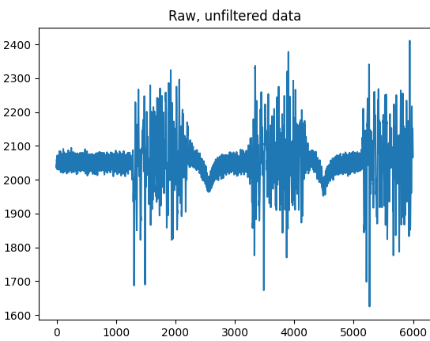
Another signal
Quite similar to the other, but without the big baseline drift
Notes:
Actually, it’s the same dropbox\en1_eiy\data\csv_files\semg2.csv. This time, though, without manually-added baseline drift.

Slide 11
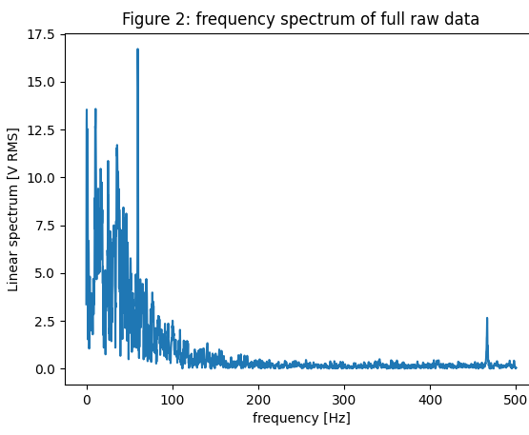
Frequency-domain version
Anything interesting?
Note the peak at 60Hz; the usual noise
Our moving-avg filter removed any oscillations at >60 Hz. Any problem?
it removes lots of signal too!
All of this content vanishes ☹

Slide 12
Sources of noise
Low frequency (<.5 Hz)
electrode contact noise
motion artifacts
baseline drifts
High frequency
>300Hz
random noise
lots of other muscles, neurons firing everywhere
Notes:
Contact noise = an imperfect electrode-to-skin contact. Changes when you sweat or move)
Motion artifact = electrical changes when you move (even with a good skin contact). E.g., from muscle activation
Baseline drift = static voltages building up, amplifier offsets changing
I have no idea what the 470 Hz spike is!

Slide 13
Typical frequency content
sEMG summary: freq range of 10–500 Hz, with most of the usable energy from 50–150 Hz.
ECG summary: various noise < 0.5 Hz; most of the signal is in 5-50 Hz. Most commercially ECG devices provide a passband up to 150 Hz, with a 60 Hz notch filter.
AD8232
preamp
.5-40 Hz filter
PyBoard
A2D converter
CPU (moving avg + stuff)
leads from your body
Notes:
The picture here is our system. Note the filter inside the AD8232. That’s why we don’t really see 60Hz noise in our pictures.
But it does kill lots of good signal.

Slide 14
More “why do we care”
Biomedical signals are noisy
we saw sEMG and ECG
X-rays, ultrasound, MRI, … are all noisy too
Noise can be 2D or 3D also !?!
again, X-rays etc. are all images
remember the fancy image-enhancement on CSI?
Camera images for self-driving cars are full of noise
robotic systems: sensor + control + actuator
visual noise from snow, fog, etc
lots of random sound, vibrations, …

Slide 15
Where next courses will go
EE 20, BME 3, ME 31: basic frequency-domain Fourier analysis
EE 21,22,23: lots more frequency-domain analysis (linear systems, poles/zeros, Laplace, …)
EE 125: Digital Signal Processing
We’ll stick with a simple moving-average filter in this course ☺
Notes:
We won’t do any sophisticated digital filtering for this course

Slide 16
BACKUP

Slide 17
What we’ll build
Our labs will just use moving-average filters!
Why?
More sophisticates filters are hard to do at 1kHz in MicroPython ☹
More on this shortly
Running average is good enough for us
lab questions will ask you to interpret your results accordingly
it turns out running average also has a frequency-domain interpretation

Slide 18
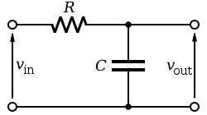
Analog filtering
“Classical” filters
built with resistors, capacitors, amplifiers
continuous-time signals
Pull up AD8232 data sheet to show the R & C in its Cardiac Monitor configuration (page 28)

Slide 19
Digital filtering
Majority case nowadays
Starts with sampling
Take snapshots every Δt seconds
Digitize the snapshots with an A-to-D converter

Slide 20
Digital filtering
D-to-A converter or other output
A-to-D converter
computer processing
Samples are processed digitally
Output can be converted back to an analog waveform, or used to drive stepper motors, other software, etc

