Slide 1
EE 123 Bioelectricity
Fall 2020
Tufts University
Instructor: Joel Grodstein
joel.grodstein@tufts.edu
Lecture 4c: worms

Slide 2
Big picture of the course
Where does bioelectricity come from?
Neurons and working with the nervous system
Cardiac bioelectricity
Worms
Bio backgrounder
Morphogenesis
Building a worm V_{mem} pattern

Slide 3
Review
Remember the morphogenesis problem?
37 trillion cells, same software but some are eyes, ears, toes, …
Our hypothesis: a V_{mem} pattern is the API that decides which cells become what
A machine compares current shape vs. the goal & decides what to do

Slide 4
Using the V_{mem} pattern
0
.2
Per-cell software:
if (0≤V_{mem} ≤ .2):
I_am_head=True
if (.4≤V_{mem} ≤ .6):
I_am_chest=True
Human embryo, 9-10 weeks
.5
.7
1
Some cells set I_am_head=True (whatever that means)
That triggers their DNA if-then code to build head proteins
Objection: something needs to deal with 3D
Could do per-region subdivision
Next up – how can we build this V_{mem} pattern?
Notes:
This slide sets the context for the rest of the unit.
The rest of the unit discusses how to build a Vmem pattern. This slide shows *why* we build it; i.e., what the pattern might mean & how the growing body might use the pattern.

Slide 5
Contents for this unit
Patterning a 5-cell worm – our first try
Morphagens + lots of feedback – our second try
GJ connectivity range –archipelagos, 2 heads and collapse
Wrapup

Slide 6
ΔV_{mem} + GJs
-40mV -20mV 0mV
-65mV
Cl⁻
K⁺
Na⁺
-60mV
+25mV
+20mV
IC
IC
Start with 5 cells
Two end cells have ion channels; set them to -65mV, +25mV
Connect them with GJs
What happens?
Current flows (just like cardiac cells)
What V_{mem} pattern results?
Intermediate voltages
The ends dip a bit
Thought question: will drift & diffusion eventually balance along the body? If so, could there be a voltage drop?

Slide 7
Why do the ends dip?
ICF
V_{mem}=-71mV
I_{Na}
I_{K}
Remember our cell model
.4
2.2
.4
60 40
$$V_{Na}^{N}$$
$$V_{K}^{N}$$
$$V_{Cl}^{N}$$
ECF
77mV
-89mV
-71mV
ICF
V_{mem}=-71mV
Thevenin equivalent circuit
Any collection of batteries, resistors, current sources → V + R
G_{eq}=G_{Na} ║ G_{K}║G_{Cl}
-71mV (V_{mem})
ECF
Notes:
Intuition for why this is reasonable: when Vmem = -71mV, there’s no net current across the membrane. This is true in QSS or SS. Note that since our Thevenin equivalent no longer distinguishes between ions, it can no longer say if each individual ion is balanced – and thus cannot say if we are in SS vs. QSS. But it’s simple!

Slide 8
Why do the ends dip?
-65mV
-60mV
+25mV
+20mV
IC
IC
-60mV
+20mV
G_{eq}
G_{eq}
-65mV
+25mV
ECF
Basic circuit theory predicts V_{mem} dip at the ends
Same theory will make other predictions later

Slide 9
Head or tail?
-65mV
+25mV
+25mV
-65mV
+25mV
IC
IC
Good so far; we have a V_{mem} pattern
How do the ends know which is which?
Why isn’t the head a tail?
Why aren’t both heads?
Why don’t we try to set front and back to random V_{mem}?

Slide 10
Head or tail?
-20mV
+15mV
-10mV
+5mV
-65mV
+20mV
IC
IC
Add positive feedback
Still no way to tell which is which
But cannot have two heads or two tails, at least ☺
if (V_{mem,me} > V_{mem,middle}):
increase my V_{mem}
else decrease
Notes:
The cool thing is that, with each cell’s software *independent* of each other, there are only two final outcomes!

Slide 11
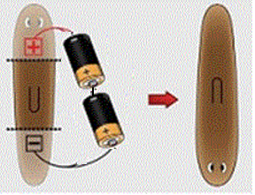
Explains batteries?
+10mV
-30mV
-60mV
+20mV
+20mV
-60mV
IC
IC
if (V_{mem,me} > V_{mem,middle}):
increase my V_{mem}
else decrease
Connect batteries → reverse voltage
Quickly regenerate the full ΔV_{mem}
Head and tail reverse!

Slide 12
Regeneration?
-40mV -20mV -10mV
-20mV -20mV -20mV
-60mV
+20mV
IC
IC
if (V_{mem,me} > V_{mem,middle}):
increase my V_{mem}
else decrease
Cut off the head and tail; keep the middle
Will the worm regenerate?
No ion channels in the remaining worm!
Positive feedback is gone
Charge all diffuses equally

Slide 13
Mini-quiz
Sum up how we built up our V_{mem} pattern in a few sentences
What are its problem(s)?

Slide 14
Contents for this unit
Patterning a 5-cell worm – our first try
Morphagens + lots of feedback – our second try
GJ connectivity range –archipelagos, 2 heads and collapse
Wrapup

Slide 15
What are we missing?
-40mV -20mV -10mV
-60mV
+20mV
IC
IC
if (V_{mem,me} > V_{mem,middle}):
increase my V_{mem}
else decrease
End cells can’t easily determine “V_{mem,middle}”
Long-distance transmission needs “repeater” stations
Neurons + myelin needed nodes of Ranvier
Same principle here

Slide 16
Morphagens
-60mV
+20mV
Equal [M] everywhere
drift
steady state
Start with a tube full of negative ions M
Diffusion: it all spreads out evenly
Add a voltage differential (-60 to +20 mV)
Drift: M all moves to the right
Diffusion: M goes back to the left
Eventually: steady state where diffusion and drift balance
the mystery ion
Notes:
“M” is because it’s a mystery ion – we haven’t actually found it

Slide 17
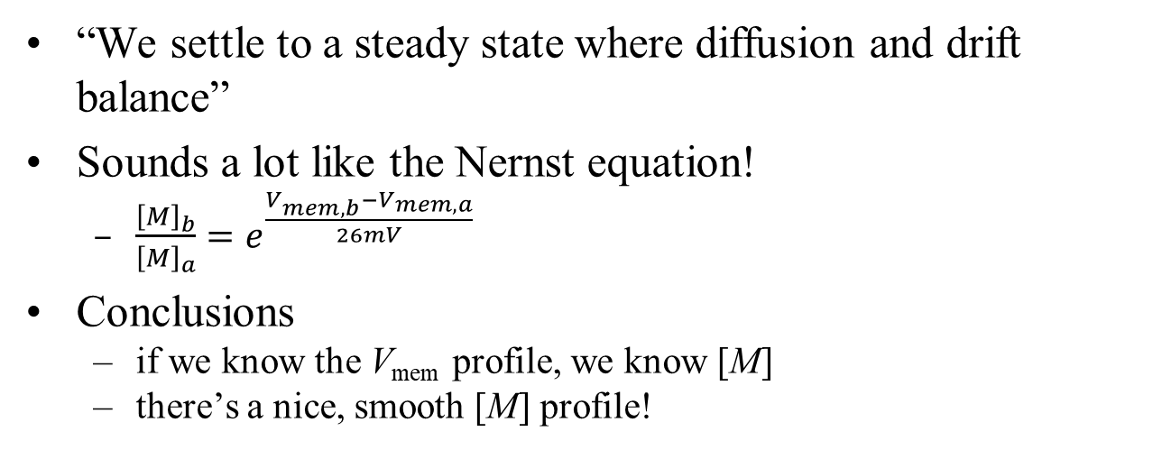
Nernst again
-60mV -40mV -20mV 0mV +20mV
[M]₀
$$\left[M\right]={\left[M\right]}_{0}e^{\frac{40mV}{26mV}}$$
$$\left[M\right]={\left[M\right]}_{0}e^{\frac{80mV}{26mV}}$$
“We settle to a steady state where diffusion and drift balance”
Sounds a lot like the Nernst equation!
$\frac{{\left[M\right]}_{b}}{{\left[M\right]}_{a}}=e^{\frac{V_{mem,b}−V_{mem,a}}{26mV}}$
Conclusions
if we know the V_{mem} profile, we know [M]
there’s a nice, smooth [M] profile!

Slide 18
So what?
-60mV -40mV -20mV 0mV +20mV
[M]₀
$$\left[M\right]={\left[M\right]}_{0}e^{\frac{80mV}{26mV}}$$
Old problem: cannot know V_{mem,middle}
There’s a fixed total amount of M, and it redistributes itself according to the global V_{mem} profile
Your own local [M] reflects the V_{mem} profile
And so we can use it for our positive feedback

Slide 19
Morphagen feedback
V_{mem,me} = f([M]_{me})
-25mV
+20mV
-40mV
-60mV
+10mV
-20mV
IC
IC
V_{mem}
[M]
[M]
Higher [M] → higher V_{mem}
Higher V_{mem} → attracts more M
Positive feedback!
No need to sense V_{mem,middle}

Slide 20
Remaining problems
-40mV -20mV 0mV
-60mV
+20mV
IC
IC
V_{mem}
V_{mem,me} = f([M]_{me})
[M]
Middle segment has no ion channels or feedback → cannot regrow
Long-distance transmission needs “repeater” stations

Slide 21
Remaining problems
-40mV -20mV 0mV
-60mV
+20mV
IC
IC
IC
IC
IC
V_{mem,me} = f([M]_{me})
Put this in every cell
Middle segment has no ion channels or feedback → cannot regrow
Long-distance transmission needs “repeater” stations
What happens?

Slide 22
All works fine?
-40mV -20mV 0mV
-60mV
+20mV
IC
IC
IC
IC
IC
+20mV
V_{mem}, [M]
V_{mem}
-60mV
[M]
Both V_{mem} and [M] gradually increase from tail to head
They will have somewhat different shapes, since f() is not linear
Global V_{mem} pattern determines [M] profile
Each cell is mostly locally consistent with V_{mem,me} = f([M]_{me})
Not fully; f() actually sets G_{Na}, G_{K} and not V_{mem}

Slide 23
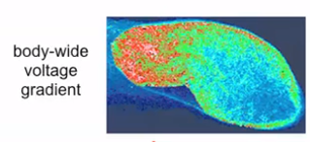
All works fine?
-40mV -20mV 0mV
-60mV
+20mV
IC
IC
IC
IC
IC
+20mV
V_{mem}, [M]
-60mV
From https://vimeo.com/184365295 , time 27:00

Slide 24
Mini-quiz
In a few sentences, what problem did our morphagen solve & how?
Ditto for adding multiple feedback points

Slide 25
Contents for this unit
Patterning a 5-cell worm – our first try
Morphagens + lots of feedback – our second try
GJ connectivity range –archipelagos, 2 heads and collapse
Wrapup

Slide 26
Islands?
-20mV -40mV -20mV
+20mV
+20mV
IC
IC
IC
IC
IC
+20mV
V_{mem}, [M]
-60mV
Each cell is mostly locally consistent with V_{mem,me} = f([M]_{me})!
Unfortunate by-product of local repeaters ☹
Does this explain a two-headed worm?
Why doesn’t this happen frequently?

Slide 27
Archipelago?
-60mV +20mV -60mV
+20mV
+20mV
IC
IC
IC
IC
IC
+20mV
V_{mem}, [M]
-60mV
Can this happen?
Seems plausible, but not present in nature
Any idea why not?

Slide 28
Islands
-65mV +25mV -65mV
+25mV
+25mV
+25mV -65 +25 - 65 +25mV
+20mV
R_{GJ} R_{GJ} R_{GJ} R_{GJ}
+25mV -65 +25 - 65 +25mV
ECF
What happens when R_{GJ}≈∞?
All cells are isolated from each other
Archipelago is quite possible

Slide 29
Short circuits
-20mV -20 -20 -20 -20mV
R_{GJ} R_{GJ} R_{GJ} R_{GJ}
+25mV -65 +25 - 65 +25mV
ECF
What happens when R_{GJ}→0?
Cells are short circuited
Worm cannot create a head or tail
There is an intermediate R_{GJ} where 2H is possible, but not archipelago

Slide 30
Mini-quiz
In a few sentences, what happens as we interconnect worm cells with more and more gap junctions?

Slide 31
Contents for this unit
Patterning a 5-cell worm – our first try
Morphagens + lots of feedback – our second try
GJ connectivity range –archipelagos, 2 heads and collapse
Wrapup

Slide 32
What comes next?
Build and analyze a simple worm (virtual-lab #4)
We will see correct formation, 2H and failure for various GJ densities

Slide 33
Why did we care, again?
Let’s remind ourselves what connection this has with our initial mysteries.
Hypothesis: morphogenesis is a layered system
A higher layer builds a V_{mem} pattern
A lower layer implements cell development accordingly
What we’ve just finished
Compares current body shape to desired body shape
Outputs instructions on what to do next

Slide 34
Summary
We’re about done with worms!
What have we learned?
Hopefully some interesting weird nature
Some long-range insight into regenerative medicine
If we set V_{mem} correctly, can we turn stem cell → kidney?

Slide 35
Backup

Slide 36
The Bitsey gating system
Bitsey lets you control any ion-channel conductance with any V_{mem} or [ion]
V_{mem} in a cell could control its G_{Na} and/or G_{K} (neuron)
[M] in the head can control the head’s G_{Na} and/or G_{K}
$G_{K}=G_{K}∗\frac{1}{1+{\left(\frac{\left[ion\right]}{k_{M}}\right)}^{N}}$
Known as an inverting Hill equation
[ion]=k_{M} ⇒ scale=½

Slide 37
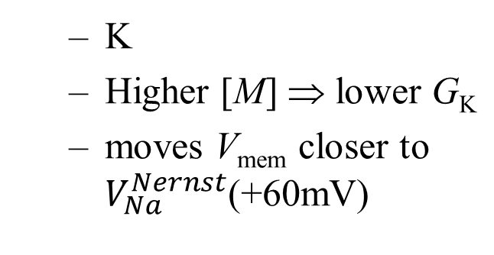
The Bitsey gating system
Remember: $V_{Na}^{Nernst}$≈+60mV, $V_{K}^{Nernst}$≈-80mV
If we want high [M] ⇒ high V_{mem} with a Hill inverter, which ion channel should [M] control?
K
Higher [M] ⇒ lower G_{K}
moves V_{mem} closer to $V_{Na}^{Nernst}$(+60mV)

Slide 38
if (I’m at an end of the worm)
if my [M] is bigger than average:
raise my V_{mem}
else:
lower my V_{mem}
if (I’m at an end of the worm)
G_{K} = Hill inverter ([M])
0V
M
M
M
1V
M
M
M
M
M
M
M
T K B S H
High V_{mem} ⇒ high [M] ⇒ low G_{K} ⇒ higher V_{mem}
Low V_{mem} ⇒ low [M] ⇒ high G_{K} ⇒ lower V_{mem}

Slide 39

Hill buffer
BACKUP
Bitsey also provides a Hill buffer
Any idea what we might use it for?
Control G_{Na}
But why bother controlling both of them?
$$\frac{{\left(\frac{\left[ion\right]}{k_{M}}\right)}^{N}}{1+{\left(\frac{\left[ion\right]}{k_{M}}\right)}^{N}}$$
[ion]=k_{M} ⇒ scale=½

Slide 40
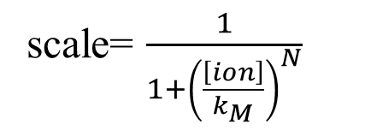
What about N>1?
As N gets larger, is k_{M} still the scale=½ point?
[ion]=k_{M} ⇒ scale=½ still
higher gain near [ion]=k_{M}
But why is gain useful?
scale= $\frac{1}{1+{\left(\frac{\left[ion\right]}{k_{M}}\right)}^{N}}$

Slide 41
if (I’m at an end of the worm)
G_{K} = Hill inverter ([M])
.6V
.2V
.8V
.5V
M
M
M
M
M
M
M
M
M
M
S S S S S
K B S S H
Consider the following sequence
Head-to-tail voltage difference increases by ΔV₀
Nernst equation: the ratio [M]_{head}/ [M]_{tail} increases by some ΔM₁
Ion-channel gating: resulting head-to-tail voltage difference ΔV₂
If ΔV₂ > ΔV₁ then we have positive feedback, and the disturbance grows

Slide 42
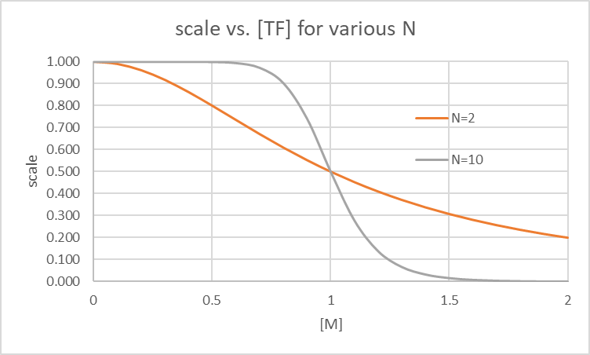
scale=.8
G_{K}=.8*1.7e-17
≈ 1.4e-17
scale=.2
G_{K}=.34e-17
.8
.9
1
1.1
1.2
Initial [M]
Look at the N=10 case
We build a substantial head-to-tail ΔV quite quickly

Slide 43
scale=.8
G_{K}=.8*1.7e-17
≈ 1.4e-17
scale=.6
G_{K}≈ 1e-17
scale=.45
G_{K}≈.8e-17
scale=.2
G_{K}=.34e-17
.8
.9
1
1.1
1.2
Initial [M]
But what if N=2?
We do not build ΔV as well
Less gain to amplify a small Δ[M]

Slide 44
0
.5
1
1.5
2
Assume this is the final [M] for a full-grown worm
[M]_{average} = 1
Now try to regrow a slice from the belly
knees

Slide 45
.2
.3
.4
.5
.6
Initial [M]
Ouch!
Now almost nothing happens
Any ideas on how to make a knee regrow well?
Look at the N=10 case

Slide 46
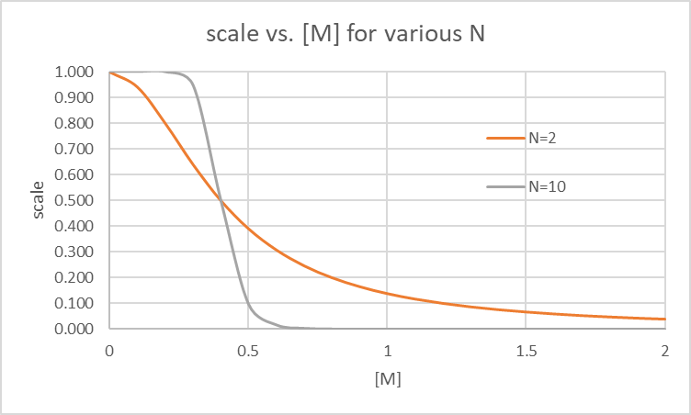
.2
.3
.4
.5
.6
Initial [M]
Set k_{M}=.4
Sure, but…
now the belly and head slices won’t work ☹
Conclusion: try to make N=2 work (or even N=1)
those have some gain everywhere
Look at the N=10 case

Slide 47
scale=.8
G_{K}=.8*1.7e-17
≈ 1.4e-17
scale=.2
G_{K}=.34e-17
.8
.9
1
1.1
1.2
Initial [M]
Next look at GJ_scale

Slide 48
scale=.8
G_{K}=.8*1.7e-17
≈ 1.4e-17
scale=.2
G_{K}=.34e-17
.8
.9
1
1.1
1.2
Initial [M]
GJ_scale gets bigger:
GJ resistances get lower
head and tail short out
V_{mem,head} and V_{mem,tail} both collapse to middle
ICF
ICF
G_{tail}
G_{head}
ECF
V_{cell}
ECF
V_{cell}

Slide 49
scale=.8
G_{K}=.8*1.7e-17
≈ 1.4e-17
scale=.2
G_{K}=.34e-17
.8
.9
1
1.1
1.2
Initial [M]
G_{GJ0}
G_{GJ1}
G_{GJ2}
G_{cell0}
G_{cell1}
G_{cell2}
G_{cell3}
V_{cell0}
V_{cell1}
V_{cell2}
V_{cell3}
ECF

Slide 50
Where does M come from?
0
.5
1
1.5
2
Take a small tail slice
2 cells regrow to 5
total [M] stays constant
[M] will keep shrinking as the worm divides and regrows ☹
Actually M is constantly being produced and decaying
0
.05
.1
.15
.2

Slide 51
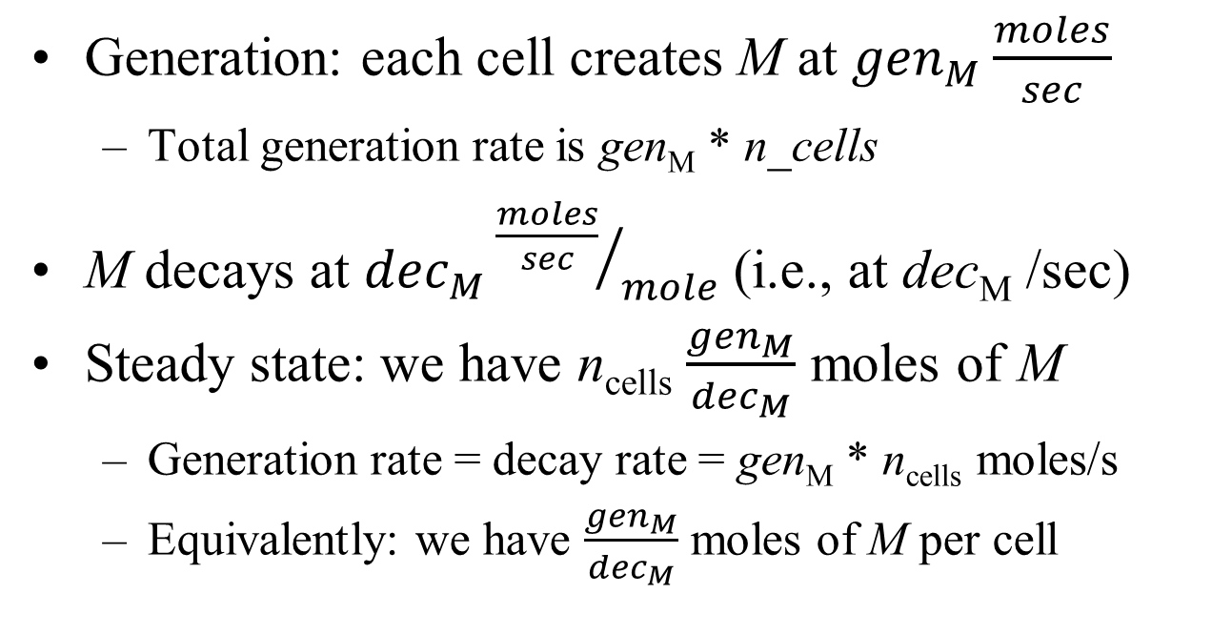
Generation and decay
Generation: each cell creates M at ${gen}_{M}\frac{moles}{sec}$
Total generation rate is gen_{M} * n_cells
M decays at ${dec}_{M}{\frac{moles}{sec}}/{mole}$ (i.e., at dec_{M} /sec)
Steady state: we have n_{cells} $\frac{{gen}_{M}}{{dec}_{M}}$ moles of M
Generation rate = decay rate = gen_{M} * n_{cells} moles/s
Equivalently: we have $\frac{{gen}_{M}}{{dec}_{M}}$ moles of M per cell

Slide 52
What to vary
Our inverter parameters: k_{M} and N
GJ_scale, number of cells
G_{K}, G_{Na}, G_{Cl}
GJ_diff and valence for M

