Slide 1
Dragonfly Topology for networks
Presented by：Long Bao

Slide 2
Netwrok
Notes:
Cellular network

Slide 3
Topology

Slide 4
Topology
B
A
Notes:
Long latency
Expensive

Slide 5
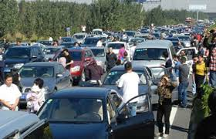
Topology
B
A3
A2
A1
Notes:
Long latency
Expensive

Slide 6
Topology
B
A
Perfect?
Notes:
Neighbor needs two step
Impossible for the central computer

Slide 7
Topology
Bandwidth
Latency
Cost
Scalability

Slide 8
Outlet
Dragonfly Topology Description
Dragonfly Topology Routing
Cost analysis
Conclusion

Slide 9
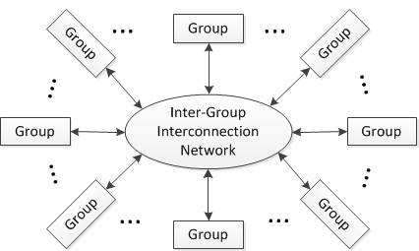
Dragonfly Topology Description
Hierarchical Network
Router, Group and System
Figure 1. High-level block diagram of a dragonfly topology

Slide 10
Dragonfly Topology Description
(a, p, h) network
K=p+a+h-1
K’=a(p+h)
K’>>K
N=ap(ah+1)

Slide 11
Dragonfly Topology Description
A simple example—(4,2,2) Network

Slide 12
Dragonfly Topology Description
Topology Variations

Slide 13
Dragonfly Topology Routing
Existing routing algorithm
Minimal (Min)
Valiant (Max)
Universal Globally-Adaptive Load-balanced (UGAL)
UGAL-L
UGAL-G

Slide 14
Dragonfly Topology Routing
Minimal and Valiant method

Slide 15
Dragonfly Topology Routing
UGAL
Problems
Limited throughput

Slide 16
Dragonfly Topology Routing
UGAL
Problems
High intermediate latency

Slide 17
Cost analysis
(15+15)/(15+15+15+15)=50%
16/(16+15+15+15)=25%

Slide 18
Conclusion
Less diameter
Low cost
Small latency
Future Work
Routing Strategy Research
High-radix topology

