Slide 1
SISD—Single Instruction Single Data
Xin Meng
Tufts University
School of Engineering

Slide 2
SISD—Single Instruction Single Data
According to the number of concurrent instruction (or control) and data streams available in the architecture[1]
Flynn's taxonomy
SISD
MISD
SIMD
MIMD
SPMD
MPMD
(Single Instruction, Single Data)
(Multiple Instruction, Single Data)
(Single Instruction, Multiple Data)
(Single Instruction, Multiple Data)
(Single Program, Multiple Data)
(Multiple Program, Multiple Data)
 | Single Instruction | Multiple Instruction | Single Program | Multiple Program
Single Data | SISD | MISD
Multiple Data | SIMD | MIMD | SPMD | MPMD
Tufts University
School of Engineering

Slide 3
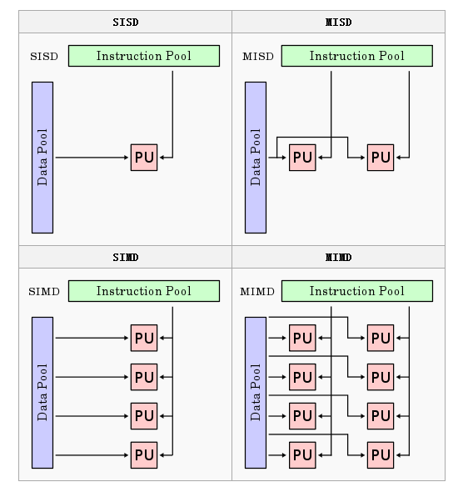
SISD—Single Instruction Single Data
SISD
A sequential computer which exploits no parallelism in either the instruction or data streams.
Single control unit (CU) fetches single Instruction Stream (IS) from memory. The CU then generates appropriate control signals to direct single processing element (PE) to operate on single Data Stream (DS)
Examples of SISD architecture are the traditional uniprocessor machines like a PC (currently manufactured PCs have multiple processors) or old mainframes
Tufts University
School of Engineering

Slide 4
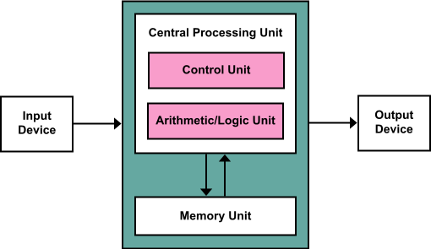
SISD—Single Instruction Single Data
Von Neumann architecture / Princeton architecture
a design architecture for an electronic digital computer:
a processing unit : arithmetic logic unit and processor registers a control unit : an instruction register and program counter,
a memory: to store both data and instructions[2]
This architecture has evolved to be any stored-program computer in which an instruction fetch and a data operation cannot occur at the same time because they share a common bus. This is referred to as the Von Neumann bottleneck[3] and often limits the performance of the system[4]
Tufts University
School of Engineering

Slide 5
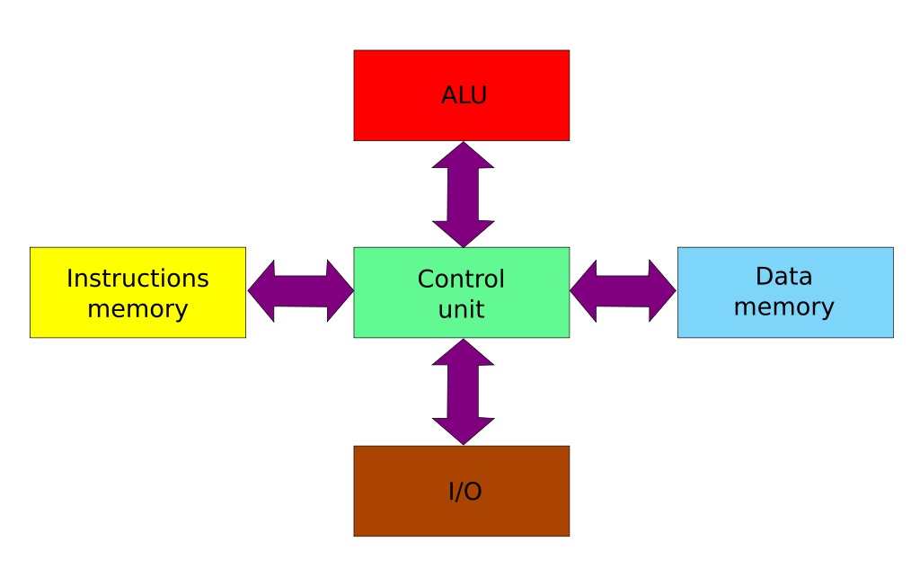
SISD—Single Instruction Single Data
Harvard architecture
Today, most processors implement such separate signal pathways for performance reasons but actually implement a modified Harvard architecture, so they can support tasks such as loading a program from disk storage as data and then executing it.
a computer architecture with physically separate storage and signal pathways for instructions and data. (This term stores instructions on punched tape and data in electro-mechanical counters)
Tufts University
School of Engineering

Slide 6
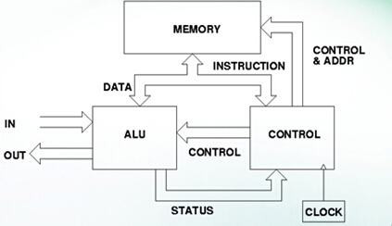
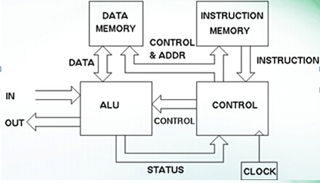
SISD—Single Instruction Single Data
Compare between Von Neumann architectures and Harvard architectures:
Von Neumann architecture:
the CPU can be either reading an instruction or reading/writing data from/to the memory. Both cannot occur at the same time since the instructions and data use the same bus system.
Harvard architecture:
the CPU can both read an instruction and perform a data memory access at the same time, even without a cache.
Also, a Harvard architecture machine has distinct code and data address spaces.(instruction address zero is not the same as data address zero.)
A Harvard architecture computer can thus be faster for a given circuit complexity because instruction fetches and data access do not contend for a single memory pathway.
Tufts University
School of Engineering

Slide 7
SISD—Single Instruction Single Data
Applications/Improvement of the SISD architecture
The bare SISD core[5]
Look-ahead pipelined computer system[6]
Tightly coupled hybrid SIMD/SISD system
Tufts University
School of Engineering

Slide 8
SISD—Single Instruction Single Data
Conclusion
SISD ( a term referring to a computer architecture in which a single processor, a uniprocessor, executes a single instruction stream, to operate on data stored in a single memory)
Von Neumann architecture
Harvard Architecture
Compare between the two types
Tufts University
School of Engineering

Slide 9
SISD—Single Instruction Single Data
References:
[1] Flynn, M. J. Some Computer Organizations and Their Effectiveness. IEEE, Transactions on Computers. C–21 (9): 948–960
[2] von Neumann, John (1945), First Draft of a Report on the EDVAC
[3] C. Gordon Bell; R. Cady; H. McFarland; J. O'Laughlin; R. Noonan; W. Wulf (1970), A New Architecture for Mini-Computers—The DEC PDP-11, Spring Joint Computer Conference: 657–675.
[4] Markgraf, Joey D. The Von Neumann bottleneck
[5] R.E. Gonzalez; Xtensa: A Configurable and Extensible Processor, IEEE Micro, vol. 20, no. 2, pp. 60-70, Mar. 2000 Microprocessor Soft-Core, IEEE, 1-4244-0622-6/06, 2006
[6] Mehmet Celenk, Pipelined Dynamic SISD System Organization, IEEE, 0094-2898/91/0000/0128, 1991
Tufts University
School of Engineering

