Slide 1
Anti Counterfeiting Technologies
EE126 Computer Engineering
Clifford C Youn

Slide 2
What’s Counterfeiting?
Forged, copied or imitated without the perpetrator having the right to do with the purpose of deceiving or defrauding
Potential negative ramifications of counterfeit parts with altered serial numbers being sourced and distributed in the supplier networks
Damage from Counterfeiting
About 5-7% of total world trade - $600 billion¹⁾
Poor product quality, deterioration of the brand, concern for consumer safety, decrease in company’s revenue
1) IAAC (International Anti Counterfeiting Coalition), 2012

Slide 3
Anti Counterfeit Technologies
Basic Goal - Should be easily applied but difficult to imitate
Difficult to duplicate or forge
Easily identifiable visually without the need of special equipment
Hard to re-label or reuse
Easily noticeable when tampered with
Types of Anti Counterfeit Technologies
Authentication Verification
Tracking & Tracing

Slide 4
Anti Counterfeiting Technologies
 | Authentication Verification |  | Tracking and Tracing
Technology | Overt | Covert | Machine-Readable
Define | Visible to the eye | Not visible to the eye Require special equipment for visualization | Need tool/equipment for identification
Examples | Holograms Optically variable devices Color-shifting inks/films Security thread Fluorescent inks | Security inks/coatings (reactive/UV/IR/thermochromic inks) Hidden printed messages Digital watermarks Taggants (biological/chemical/microscopic) | RFID (Radio Frequency Identification) EPC (Electronic Product Code) Barcodes Laser marking Optically stored marks

Slide 5
Anti Counterfeiting Technologies
 | Authentication Verification |  | Tracking and Tracing
Technology | Overt | Covert | Machine-Readable
Advantage | User verification Improved security | Low implementation costs Easy upgrading/addition Flexible implementation | Convenient bulk tag reading Quick response time Traceability and anti counterfeiting protection integrated into a single label
Disadvantage | User training Potential imitation and reuse Possible false assurance Proper disposal procedure | Potential imitation Costly for additional security options | Different RFID standards (US vs EU vs others) Security (cloning attacks) problem Overhead costs

Slide 6
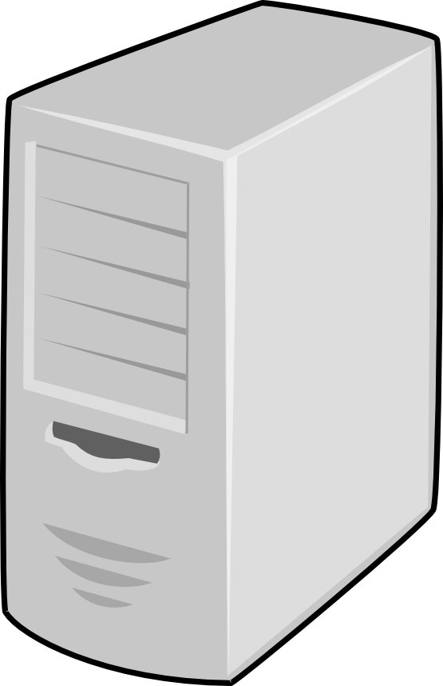
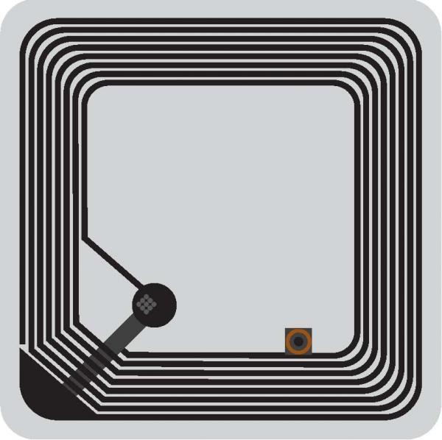
RFID System – How it works
Main System
Reader
Antenna
RFID Tag
Readers send certain frequency RF signals by antennas, then RFID tags generate induced currents and are activated when they reach the workplace of antennas
Tags send their own codes information out through built-in antennas
Antennas receive the carrier signals sent by tags and sent to the readers, then readers demodulate and decode the signals and send to the background of the main system
Main system judges whether the tags/products are genuine or not

Slide 7
Why RFID?
“Authentication Verification” & “Tracking and Tracing” at the same time
Advantage of RFID over Barcode
No line of sight necessary – can be read through wood, plastic, cardboard, other materials except metal
No minimum size requirements
Works in harsh and dirty environments – e.g. outdoors, around chemicals, moisture and high temperatures
Reads hundreds of labels at a time
Enables highly automated processes
Offers on-chip data storage
Tags reprogrammable on-the-fly
Notes:
Use overt/covert technologies on top of RFID label
Track and trace using RFID system

Slide 8
RFID – Challenges (STRIDE model)
Types | Description
Spoofing | Cloning of RFID tags by copying the information of one tag to another or unauthorized inventory scanning
Tampering w/ data | Delete/modify/add/reorder data in RFID
Replay attacks | Unwanted extension of operation range by adding “ghost” between a reader and a tag
Repudiation | No evidence to prove that user has actually performed a certain action - denial of receiving certain pallet/case/item
Information disclosure (sniffing) | Read w/o the knowledge of tag bearer and leaking information to unauthorized users
Denial of Service (DoS) | Can’t function properly to provide normal services – kill tags, erase tag setting, shield tags from being read, signal jamming
Elevation of Privilege | Adversary gains higher privileges than the authorized level
Proper tag authentication is an essential keystone for guaranteeing genuine identification → require tags to have cryptographic capabilities (e.g. public, private key systems)

Slide 9
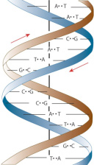
DNA Marking Scheme
Additional anti counterfeiting technology based on DNA
Uncopyable: cannot be reproduced or simulated
Incorporated into the chip production process: ablation, sandblasting, blacktopping, refurbishing will distort or remove DNA marks

Slide 10
Thank you!

