Slide 1
Self-Destructing Circuits
EE126
Bryan Zhang
12.1.2014

Slide 2
Background
Circuits purposefully designed to destruct after a certain period
Physically disappears
Also known as “transient electronics”
Materials of circuit must be selected according to specific environments
i.e. Silicon’s properties suited for aqueous decomposition

Slide 3
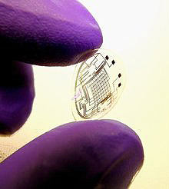
Importance
Medical applications
Transient Sensors, implants
Environmental Impact
Bio-degradable, vanishing sensors
Military utility
Surveillance equipment
Precious technology
Consumer electronics
Notes:
Image source: http://www.technologyreview.com/sites/default/files/legacy/contact_lens_x220.jpg

Slide 4
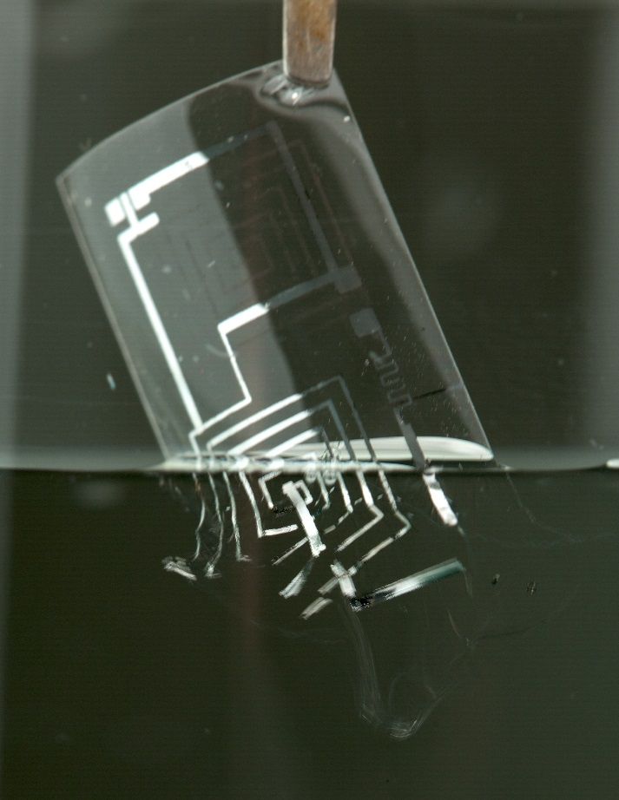
Methods
Silk protein encapsulation (Tufts, U. Illinois, others)
Sturdy
Biodegradable
Ultra-thin sheets of silicon + magnesium/magnesium oxide conductors and dielectrics
Water-soluble
Zinc oxide is alternative to silicon
Insulating polymer films (Iowa State University)
Biodegradable
Man-made
Notes:
Image: http://images.sciencedaily.com/2014/10/141009153809-large.jpg

Slide 5
Current Issue: Timing the Destruction
Big obstacle: achieving desired degradation time
Different materials have various degradation speeds
Silicon, nitride, and zinc oxide are two main choices due to hydrolysis
Conductors:
Low resistivities, stability, current existence in technologies
Magnesium for electrodes (hydrolysis, biocompatibility)
Zinc, Iron, Tungsten as alternatives
Alloys are being researched for their mechanical properties
Aluminum can slow degradation rate
Iron hydroxides also decompose more slowly than elemental iron

Slide 6
Timing the Destruction (continued)
An alternative approach is to use biomaterials for encapsulation
As opposed to metals
Polyvinyl alcohol based (PVA)
Combined with gelatin to slow degradation, sucrose to accelerate

Slide 7
Future Developments
Program the circuit or device to destruct
Opposed to controlled degradation over time
Have non-aqueous self-destruction

Slide 8
Conclusions
Nascent technology with large potential impact
Next step for electrical development
Sound investment to remain at the forefront of BME/EE research

Slide 9
References
AVS: Science & Technology of Materials, Interfaces, and Processing. (2014, October 9). Dissolvable silicon circuits and sensors. ScienceDaily. Retrieved November 29, 2014 from www.sciencedaily.com/releases/2014/10/141009153809.htm
Hwang, S., Song, J., Huang, X., Cheng, H., Kang, S., Kim, B., ... Rogers, J. (2014). High Performance Biodegradable/Transient Electronics on Biodegradable Polymers. Advanced Materials, 26(23), 3905-3911. Retrieved December 1, 2014.
Kang, S.-K., Hwang, S.-W., Cheng, H., Yu, S., Kim, B. H., Kim, J.-H., Huang, Y. and Rogers, J. A. (2014), Dissolution Behaviors and Applications of Silicon Oxides and Nitrides in Transient Electronics. Advanced Functional Materials, 24: 4427–4434. doi: 10.1002/adfm.201304293
Rogers, J. (2014, July). Inorganic Substrates and Encapsulation Layers for Transient Electronics. Retrieved November 29, 2014 from www.engineeringvillagecom.
Thurler, K. (2012, September 27). Smooth as Silk "Transient Electronics" Dissolve in Body or Environment. Retrieved November 29, 2014, from http://now.tufts.edu/news-releases/smooth-silk-transient-electronics
Yin, L., Cheng, H., Mao, S., Haasch, R., Liu, Y., Xie, X., Hwang, S.-W., Jain, H., Kang, S.-K., Su, Y., Li, R., Huang, Y. and Rogers, J. A. (2014), Dissolvable Metals for Transient Electronics. Advanced Functional Materials, 24: 645–658. doi: 10.1002/adfm.201301847

